Slide 1
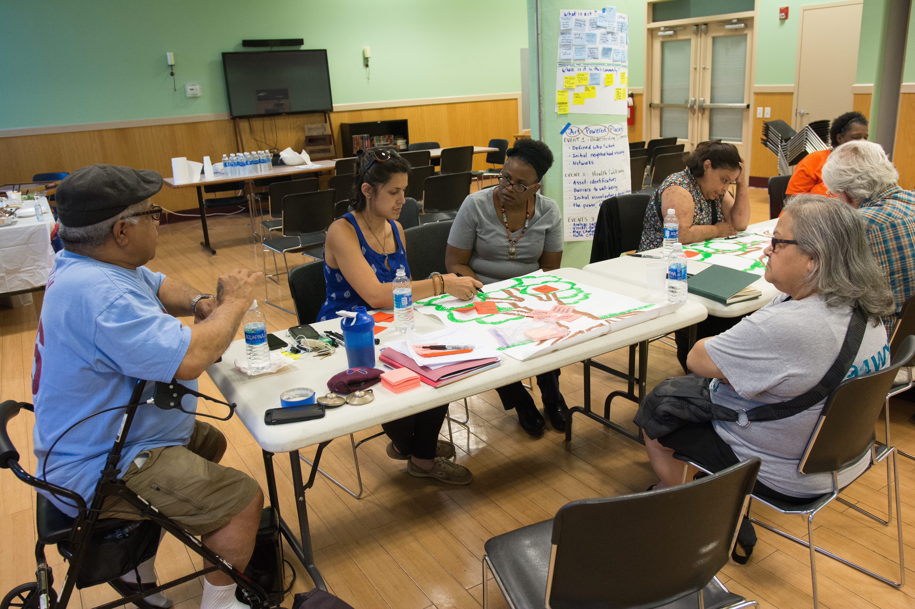
If you build it…will they come?
Community Engagement begins with a Conversation
Lisa Jo Epstein, Just Act with
Mark Harrell, SWCDC
Stasia Monteiro, HACE
De’Wayne Drummond, Mantua Civic Association &
Mt. Vernon Manor CDC

Slide 2
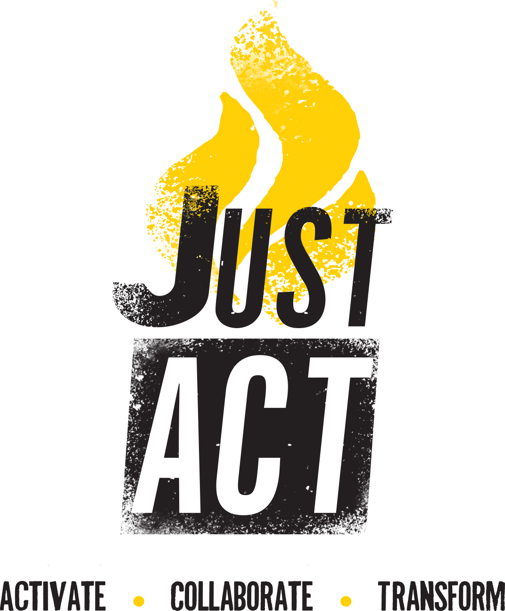
How does the conversation start?
With an invitation.
Connect cross-sector partners
with similar desires

Slide 3
Just Act is an arts-based catalyst for healing, change & activism to build a just world.
We develop & refresh the capacity of individuals & organizations to stand up for justice with
renewed compassion,
greater knowledge & energy to collaborate creatively, and
with emboldened courage to face struggles and opportunities in our lives and communities.

Slide 4
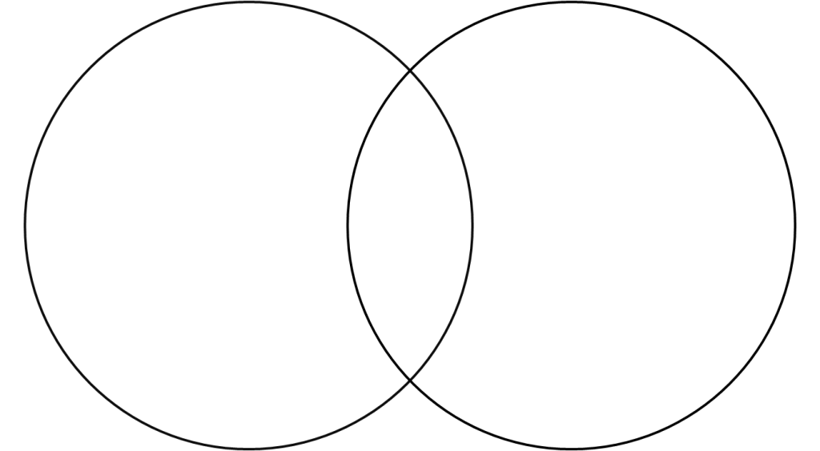

ABCD
Arts-based Community
Development:
Asset-based Community
Development
"Arts-centered activity that contributes to the sustained advancement of human dignity,
health and/or productivity within a community."
—William Cleveland,
Founder,
Center for the Study of Art & Community
“Building on the skills of local residents, the power of local associations, and the supportive functions of local institutions, asset-based community development draws upon existing community strengths to build stronger, more sustainable communities for the future.”
—The ABCD Institute, John McKnight & John Kretzmann, Founders

Slide 5
Arts and Asset-based Community Engagement:
Putting the human heart into the toolkit of planning & place-keeping
Cultural Asset Mapping
Corridor Planning
Community Development
Notes:
.

Slide 6

This is equity:
“Just and fair inclusion into a society in which all can participate, prosper, and reach their full potential. Unlocking the promise of the nation by unleashing the promise in us all.”
--The Equity Manifesto,
EVERYONE is INVITED

Slide 7
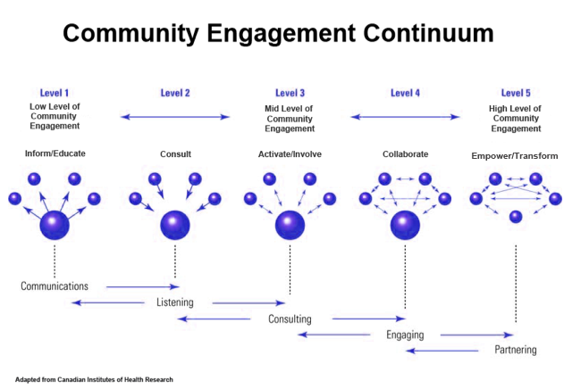

Slide 8
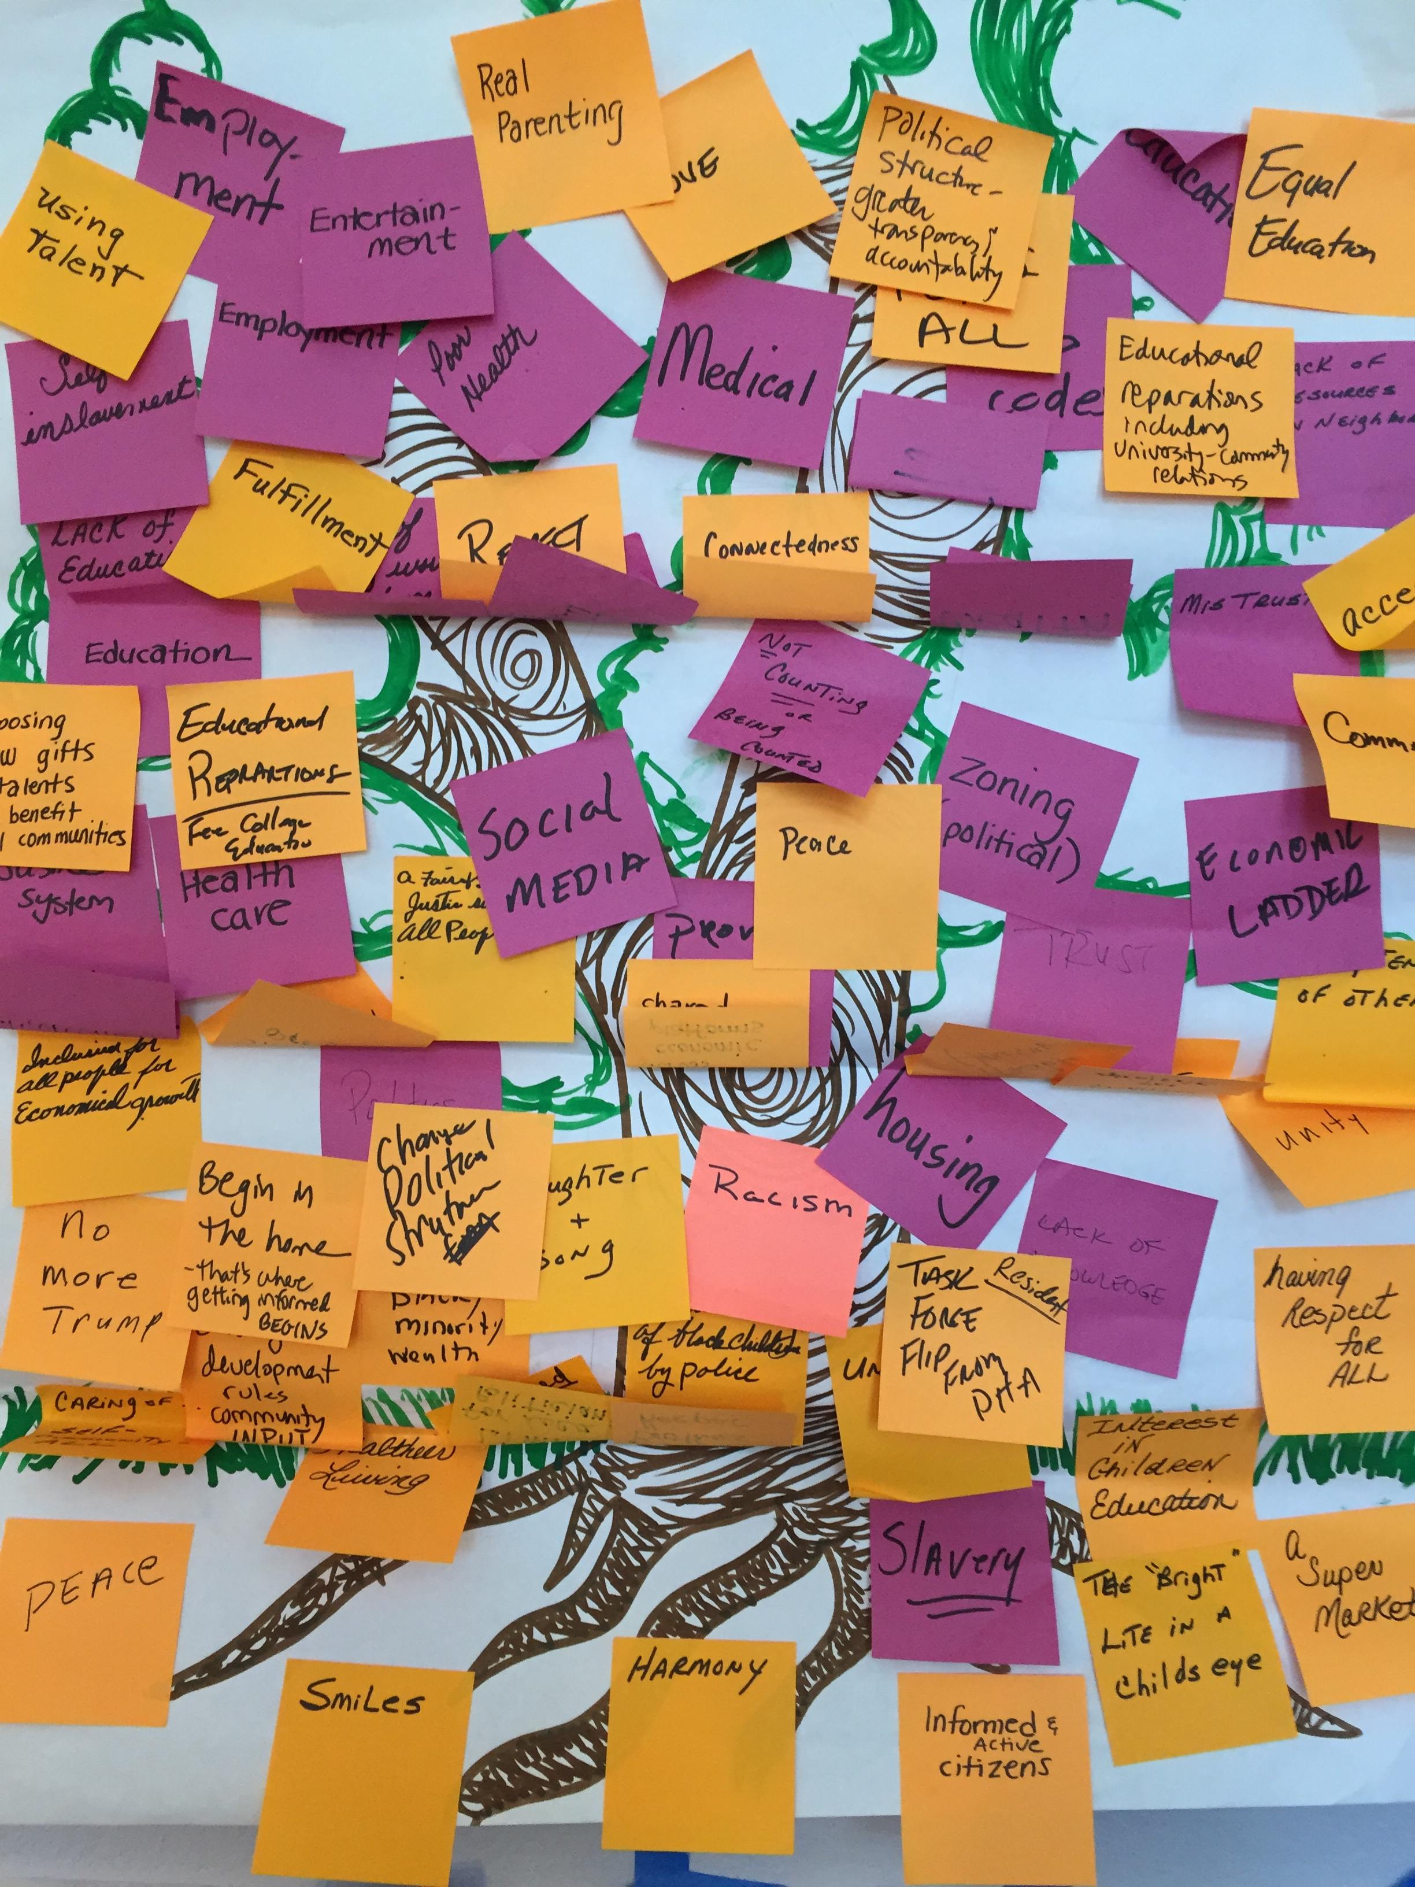
Cross-Sector Community Partnerships
Identify and challenge social injustice
Engage neighborhood residents as partners & core creators of the change process
Arts and theatre-based strategies promote health & well-being of individuals, groups & communities

Slide 9
Creative Placemaking Immersion Project
NEA
National Alliance of Community Economic Development Associations (NACEDA)
NACEDA
Philadelphia Association of Community Development Corporations (PACDC)
PACDC
APM (Asociacion Puertorriquenos en Marcha, Inc.)
Americans for the Arts
Just Act with MaryBeth Semerod, Participatory Evaluation
Brewerytown/Sharswood
HACE
Mt. Vernon
Southwest CDC

Slide 10
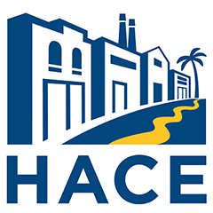




DHCD’s Neighborhood Advisory Committees (NACs) to lead and engage residents low and moderate-income neighborhoods in activities that support the City’s core objectives
Promoting neighborhood sustainability through programs addressing homelessness prevention, energy conservation education, housing preservation, neighborhood safety, and health and wellness
Utilizing referral services for available housing counseling, workforce development and economic opportunities
Cultivating youth mentoring and civic engagement
Ensuring resident participation in City planning and development initiatives

Slide 11
“The challenge for every community is not so much to have vision of what it wants to become, or a plan, or specific timetables. The real challenge is to discover and create the means for engaging citizens that brings new possibility into being. To state it more precisely, what gives power to communal possibility is the imagination and authorship of citizens led through a process of engagement…This is what creates a structure of belonging. This is more critical than the vision and the plan.”
--Peter Block
Community: The Structure of Belonging

Slide 12
What are the goals of an Art Powered Places
conversation?
Utilize theatre & arts-based strategies to…
Increase knowledge and awareness
  local community needs and assets
  barriers related to community health and well-being
Facilitate relationship building and cross-sector collaboration
  support and strengthen local communities

Slide 13
Evaluation Design
Intersection of Art and Social Issues
Imagine
Art
Community Members
Community
Development Groups
Define
Art
Community
Design
Collaborative Creative Placemaking Project

Slide 15
Ways to build the conversation…

Slide 16
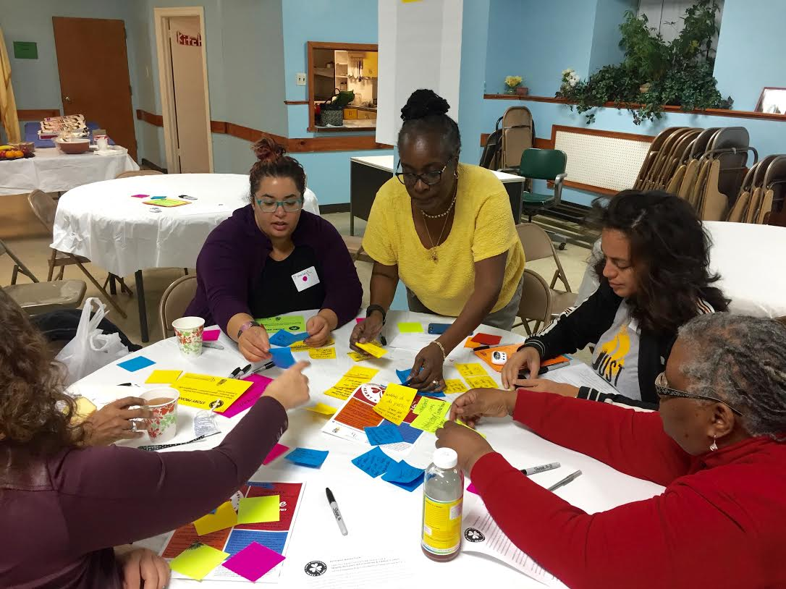
Just Act
activates a local community's assets and hopes by
collaborating with diverse groups and creatively facilitating communication amongst them
to collectively generate transformative solutions.
The result is the creation of public spaces that promote people's health, well-being, and supporting leadership capacity that aligns with their core values.

Slide 17
Activate

Slide 18
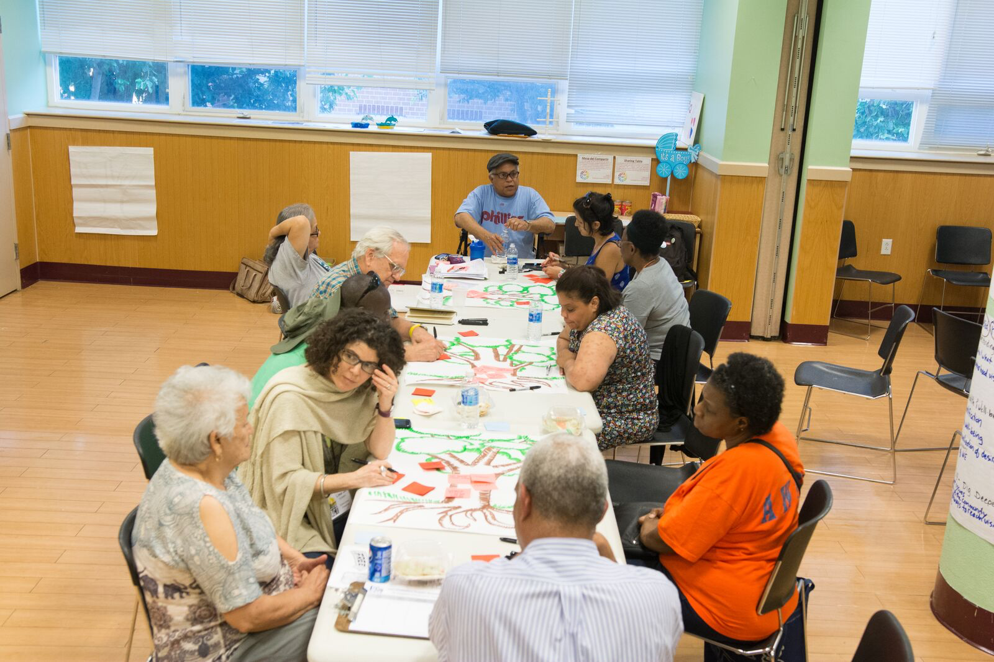
The conversation happens at whose table? who is there?
Planning for Equitable Community Development

Slide 19
Am I Invited?
(and how)

Slide 20
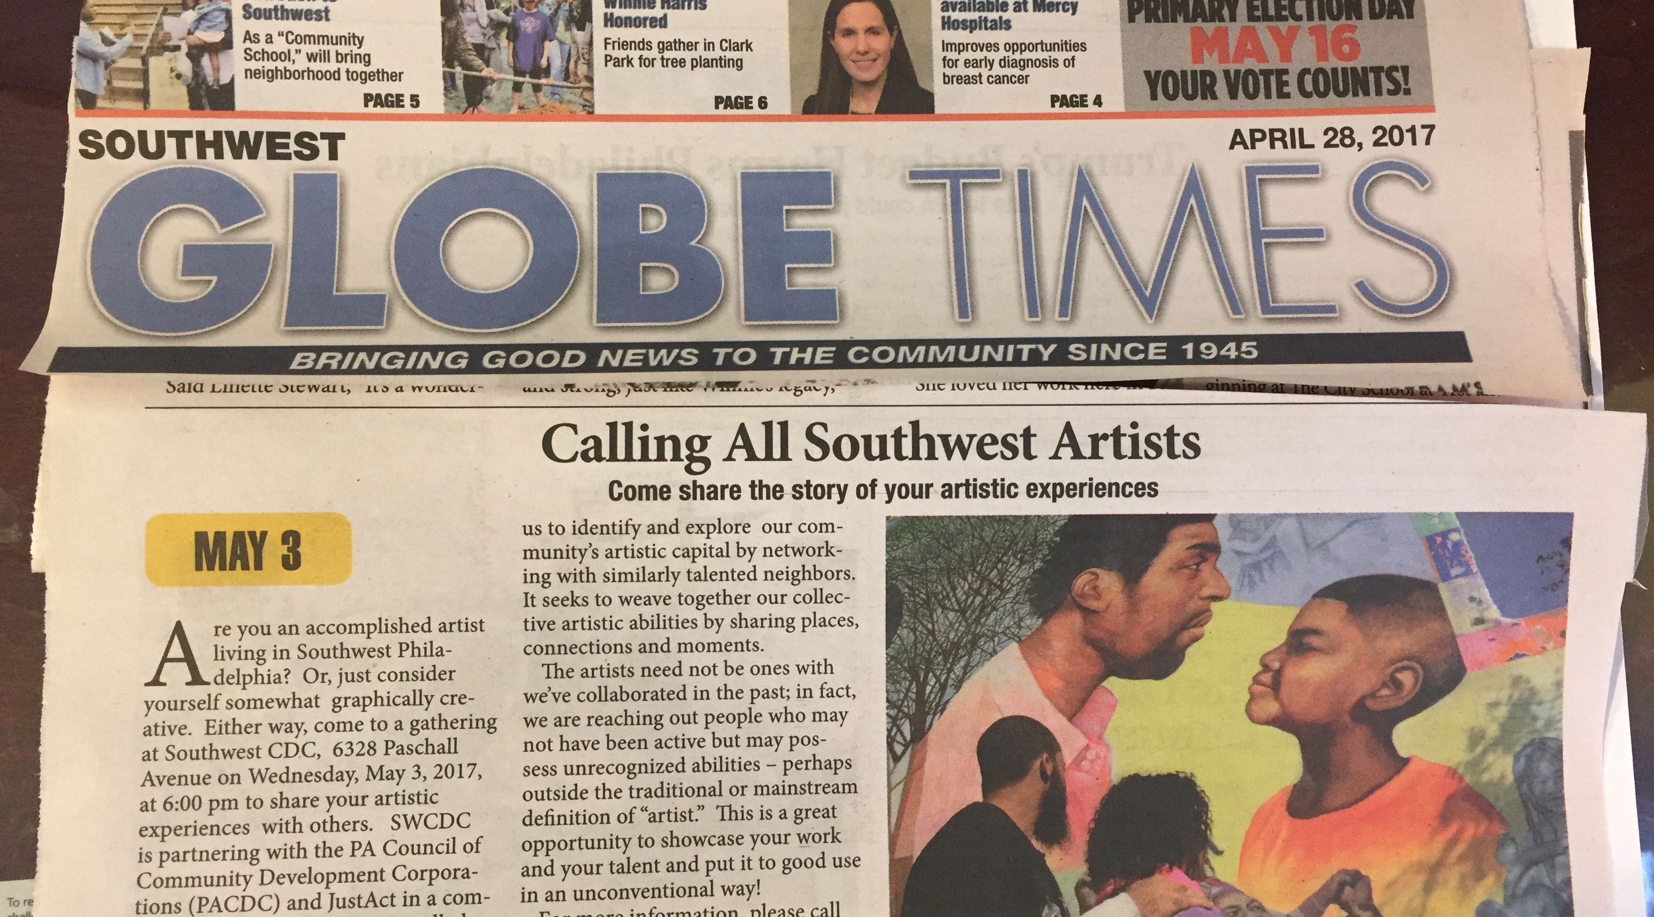
Invite neighbors to be part of the conversation

Slide 21
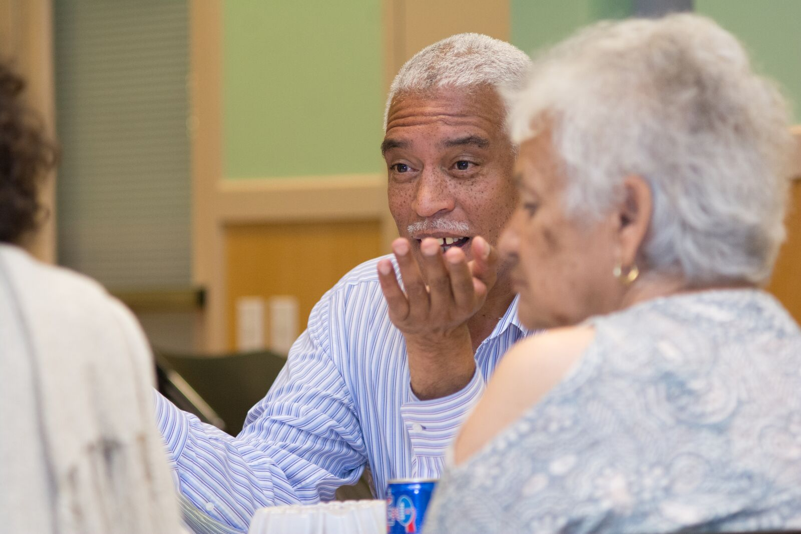
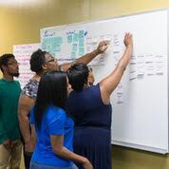
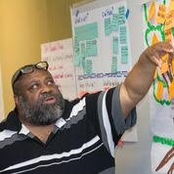
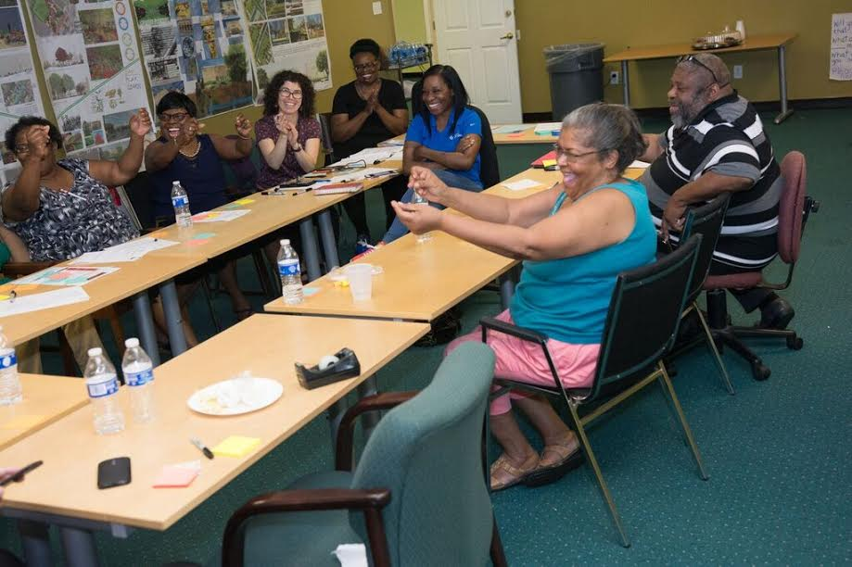
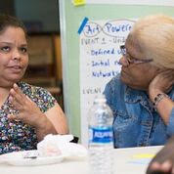
“Our ability to grow together may be fundamentally rooted in our ability to know together.”
--Chris Benner, Manuel Pastor, Equity, Growth and Community

Slide 22
“The challenge for every community is not so much to have vision of what it wants to become, or a plan, or specific timetables. The real challenge is to discover and create the means for engaging citizens that brings new possibility into being. To state it more precisely, what gives power to communal possibility is the imagination and authorship of citizens led through a process of engagement.”
--Peter Block
Community: The Structure of Belonging (2008)

Slide 23
Collaborate

Slide 24
Process of Placemaking (Change)
Knowledge
Awareness of Neighborhood Roles/Issues/Assets/
Awareness of Role that Art plays
Collaboration for Change
Identify partners/projects/plans
Value of Arts
Community vision for revitalization and change
APP Curriculum Modules
Orientation
Module 1
Module 2
Module 3
Module 4

Slide 25
Start with good questions &
generous listening…anew

Slide 26


“It’s about community and getting them together. Working together as a group, trying to get everyone to get along is about all of us. If we don’t do it, then it won’t happen. It’s a WE thing.”
–Ms. Joyce, Art-Powered Places, Brewerytown/Sharswood

Slide 27
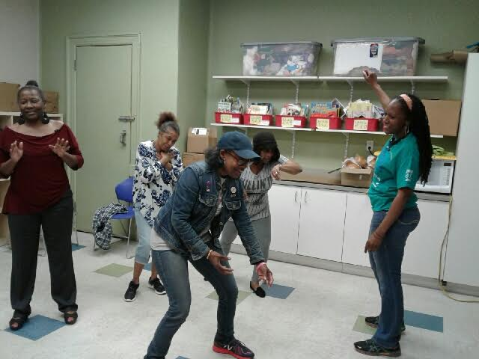
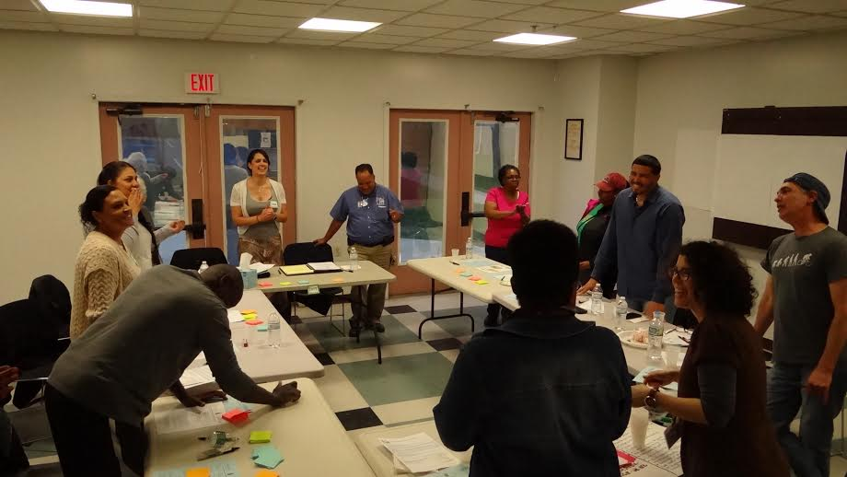
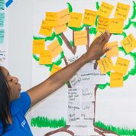
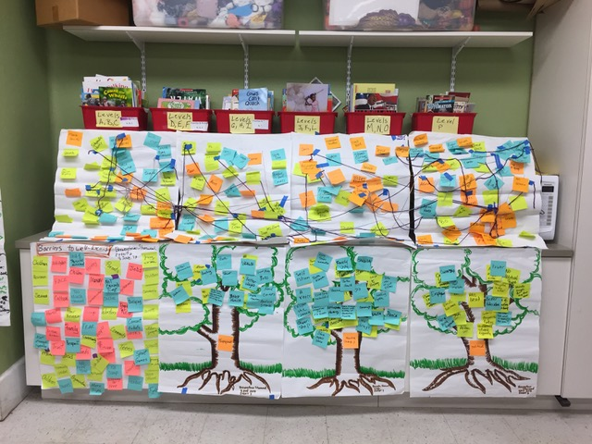
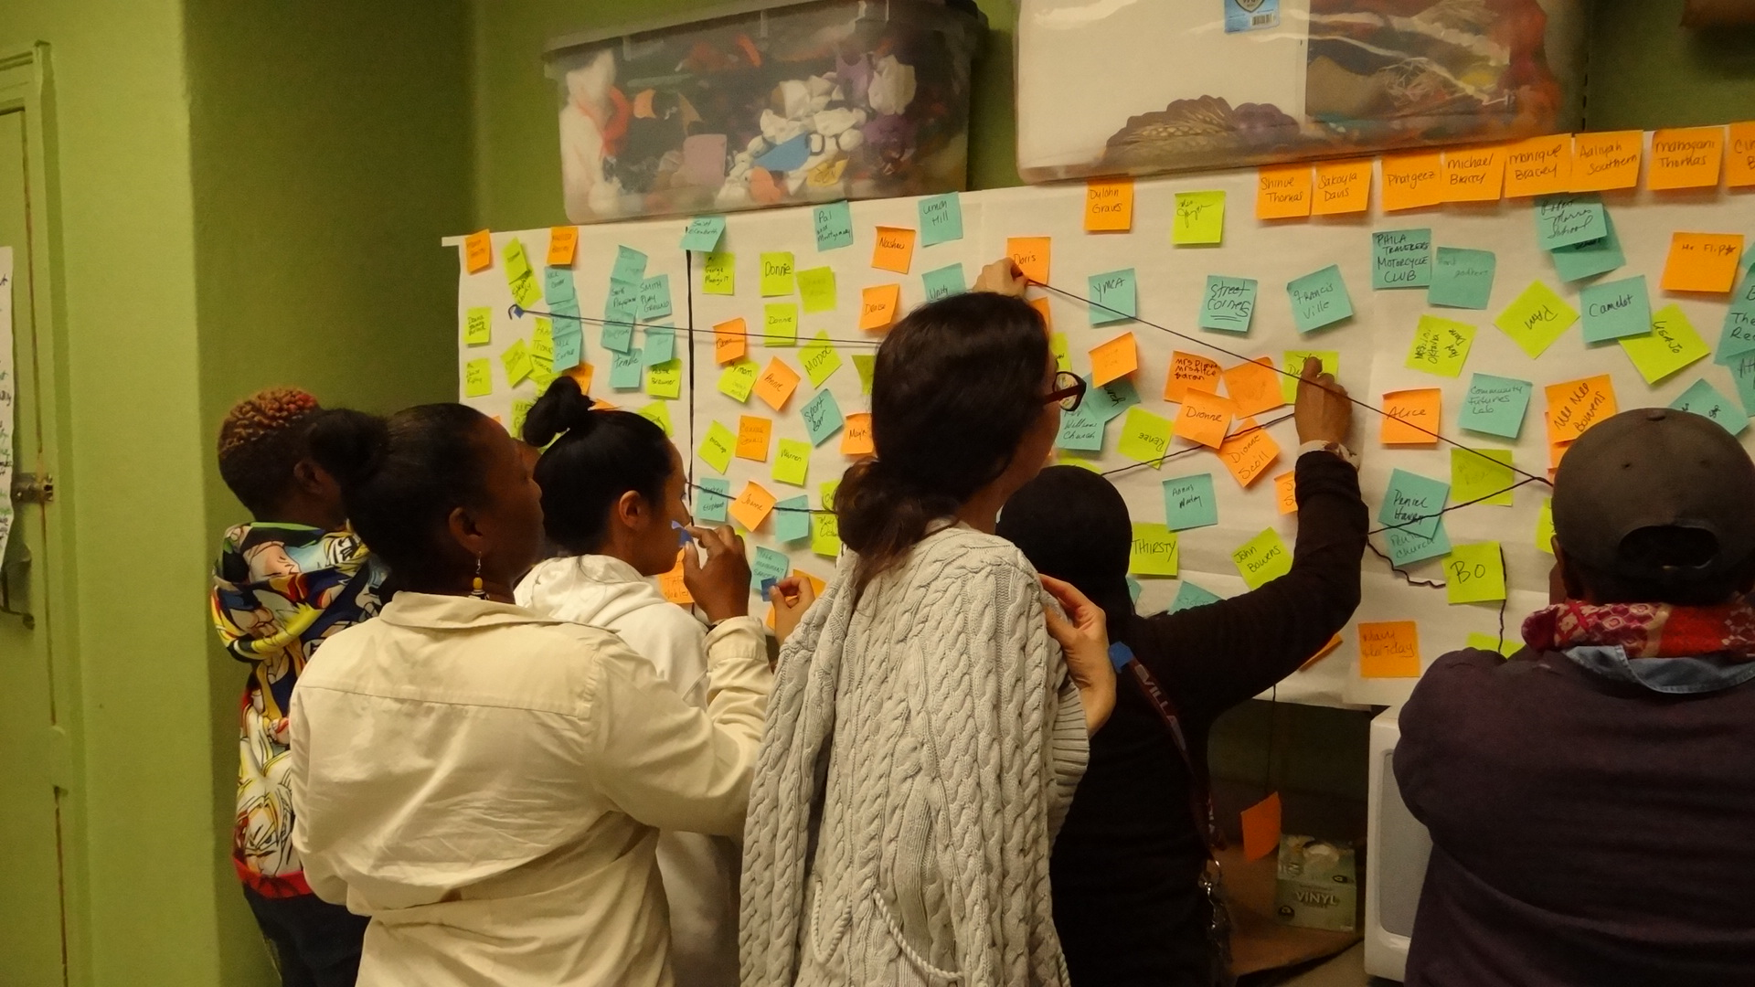
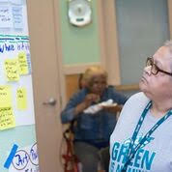
What does an Art Powered Places conversation look & feel like?
· CAT (Community Action Team)
· SET (Story Engagement Team)
· Community Connector Network Map
· Aural Soundscapes
· Word Plants
· Theater of the Oppressed and Image Theater
· Story Circles and Story Interviews
· Problem Trees
· Giftbacks

Slide 28
Sense of Place
People
Individual
Group
Process
Affect
Place
Natural
Built
Cognition
Behavior
Place Attachment
Place Identity
Place Dependence
Place
Attachment

Slide 29
Module 1: Define the path/partners
Knowledge/Awareness of roles
Neighborhood Advisory Committee
Commitment to the community (neighborhood)
Neighborhood Advisory Committee
Neighborhood Advisory Committee
“villagers take back the village”
Neighborhood models caring – helps new families
Specific concern related to neighborhood (identified via role as NAC leaders/members)
Vision for change- “Believe/hope change can happen
Sense of pride in where we live shared by all.
Rebuild community to what it was.
What brought you here?
What is your one wish for the neighborhood?
How are you connected to each other?
METHODS
  Community Cultural Network Analysis Tool
  Story Circles
  Soundscapes

Slide 30
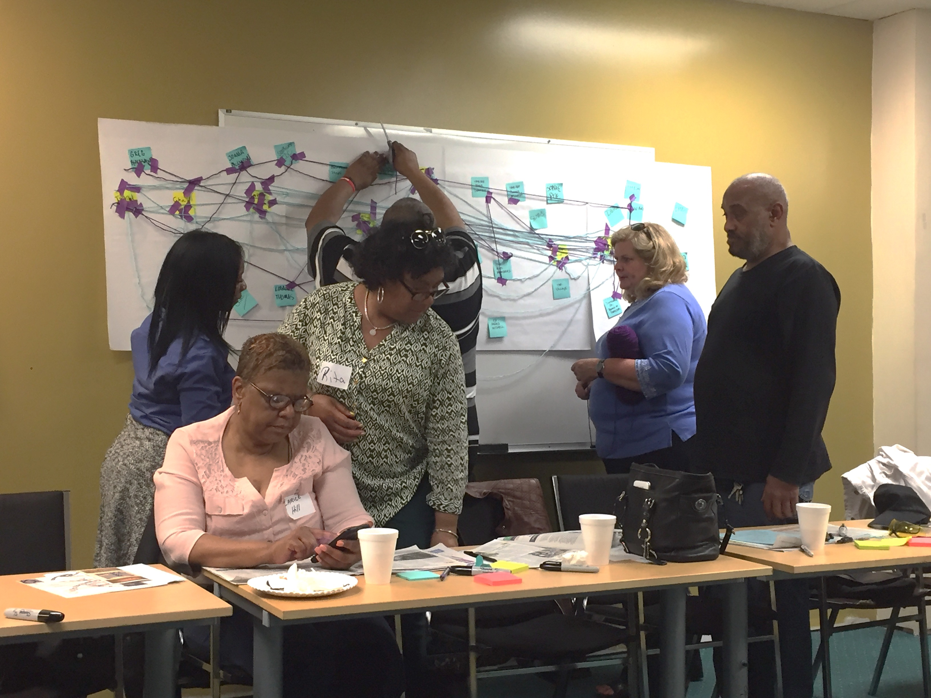
Community & Cultural Network Mapping
Identify community & cultural networks, & connectors to invite
Link together; see how info flows. Ask: who is missing? Why How to reach them?
Converse: ways their contributions could support NAC & APP
Formal & Informal alike
  Community Connectors: People Pulse
  Artists: creators, culture-bearers, food ways, etc.
  Networks: Associations, Organizations, Institutions, Groups, Faith-based, blocks, key Events/Gatherings, etc.

Slide 31
Story Circles
Reflect
Listen
Share
Process
Trust
Art of conversation
Listen with generosity
Commitment to equity: we are all co-creators
Shared responsibility
Cross talk to process stories
Remove power struggles
“Trust the circle to bring the story to you”
--John O’Neal

Slide 32
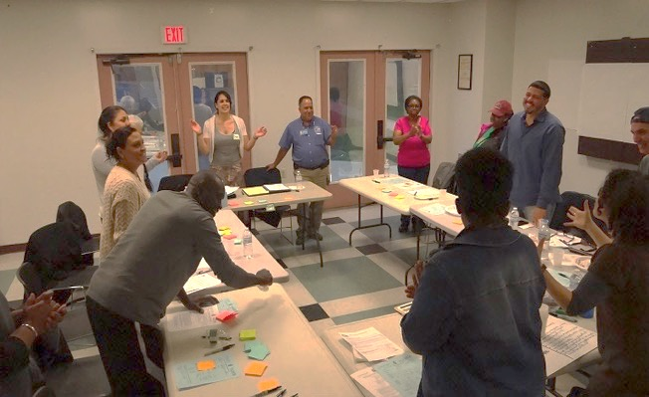
“There is much to say about the merit of a community process, as processing is one of the most basic ways that we can come to deeply understand our world… The space we’ve created in the Art Powered Places process with Just Act has allowed people to reveal their earnest observations of the neighborhood and its people and has given us more deeply relevant knowledge of the challenges we face as we work to grow wellness in our communities.”
--Stasia Monteiro,
NAC Coordinator HACE
Residents at HACE create a “soundscape of change” during an Art Powered Places session

Slide 33
Module 2: Create context for identifying assets/needs/barriers
Knowledge/Awareness of networks for relationships building
What supports your health and well-being as an individual?
What supports the health and well-being of my community?
What are the barriers to community health and well-being?
Who is affected by these barriers?
Neighborhood Advisory Committee
Open spaces to connect with each other
Neighborhood Advisory Committee
Neighborhood Advisory Committee
Barriers defined- residents are forgotten & feel invisible
Access to education-children & families
Clean, safe and beautiful neighborhoods
Institutions that are open and aware of diverse needs
Hope for positive change
Art and Natural Beauty of Neighborhood –needs to be preserved

Slide 34
Image Theatre: Another form of conversation about barriers & visions

Slide 35
Module 3: Identifying the agents of change: New partners and perspectives
Collaboration
Neighborhood Advisory Committee
Neighborhood Advisory Committee
Neighborhood Advisory Committee
Willingness to listen
Sense of hopelessness
Distance/disconnect between community members and those in power
Lack of togetherness
Walk in my shoes approach
Share our strengths in new ways across generations
Step up and help generations from repeating painful patterns
Develop deeper shared understanding of needs/issues/solutions
Change mindset- safety & health/well-being
How do the barriers/problems serve to shape a vision for the future?
What are the stepping stones necessary to achieve this vision?
What steps can we take collectively to address these barriers/achieve goals?

Slide 36
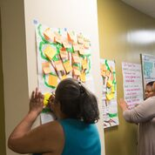
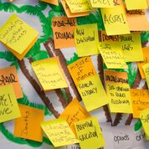
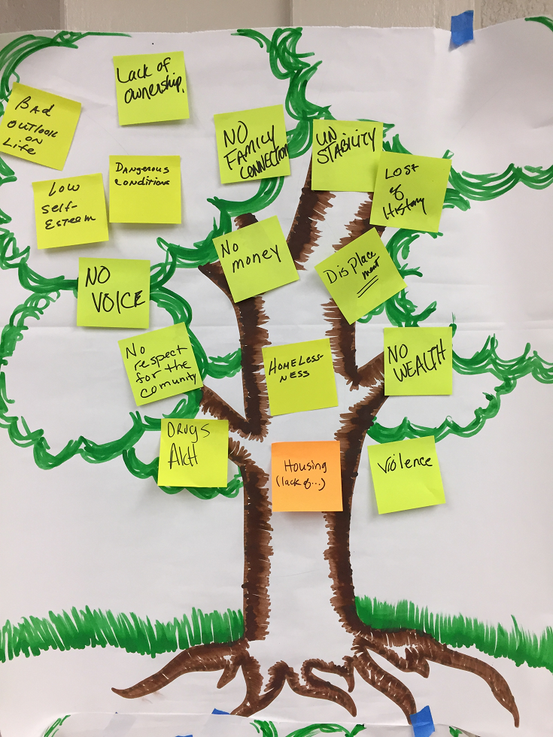
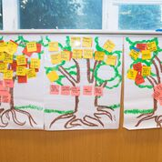
Vision Trees
Trunk – Problems/Barriers
Branches– Effects
Blooms– “Visions of Future”
Stepping Stones- “to Change”
Notes:
·

Slide 37
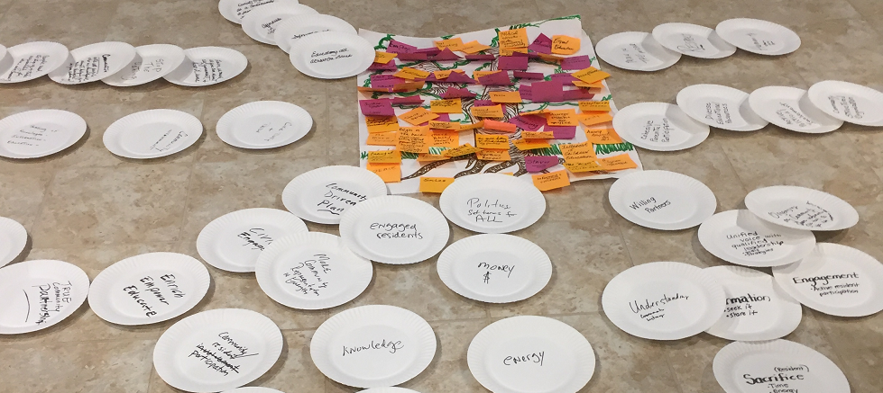
Stepping Stones
Sessions 3 and 4
What would health and well-being look like?
What are pathways to change?
https://drive.google.com/file/d/1p2dGlSp8uL0FX11Jr17tIpV5RWfq6_is/view?ts=5ac7809b

Slide 38
Transform

Slide 39
Module 4: Building a framework and pathway for change
Arts focused planning for community revitalization
Unpacking the ideas emerging in the vision trees to implement changes
Creating a creative placemaking pathway
  Ideas
  Action Steps
  Resources
  Partnerships
Neighborhood Advisory Committee
Community reflects everyone
Neighborhood Advisory Committee
Neighborhood Advisory Committee
Creative options for youth and elders to share
We need to share our vision- people on corners do not know they are standing on hallowed ground.
Grow pride and confidence in self and neighborhood
Expand environmental literacy
Events for expression of creativity
Create space for supporting families in learning about their child’s passions & how to support them in growing their talents
Informational and interactive events- social centers

Slide 40
In conversation with community members about Art Powered Places
“Changing the approach to community organizing and planning contributed to changing the group’s mindset.” –Aisha, SWCDC
“People need to feel empowered to make changes and feel like they have a voice. In the past, people had courage, but not the tools to make change. Now I feel this group has both.”
Charito, HACE

Slide 41
Community Engagement
Shift in thinking
Community members recognize skills, resources, talents and assets not just needs, problems & deficiencies
Shift in policies and practice
Opens new doors to new voices, new groups to participate in decision making
Capacity building
Supports community revitalization- sustainable, localized, and motivates new partnerships for change

Slide 42
Art-Powered Places Themes
Knowledge
“this process has made me think I can do it”
“gave us strong knowledge of what the community needs”
“power of we”
Engagement
“This process was helpful because it helped us to visualize ideas;
it’s an example of bringing the community together that’s not just talking.”
Capacity Building
“People need to feel empowered to make changes and feel like they have a voice.”
“Where am I in this picture?”

Slide 43
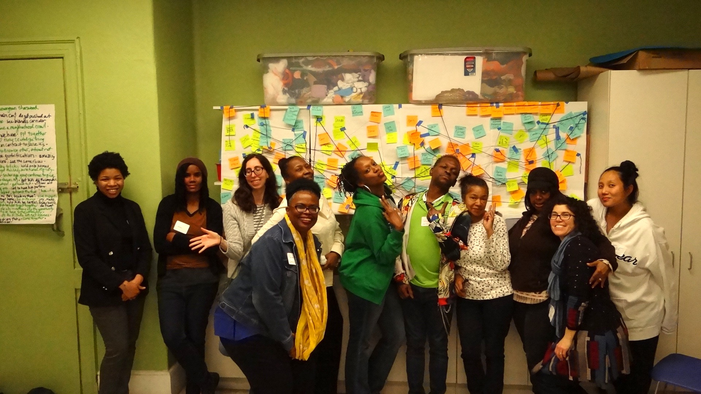
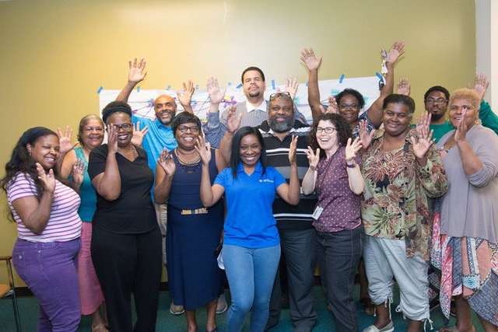
Art-Powered Places
Community Engagement (local level)
Mobilizing arts and culture and strategic partners
To impact the quality of life (livability)
To raise the visibility of arts and culture so that many more people are participating.
Creating coalitions to support community improvements
Notes:
Aisha: Changing the approach to community organizing and planning contributed to changing the group’s mindset.”

Slide 44
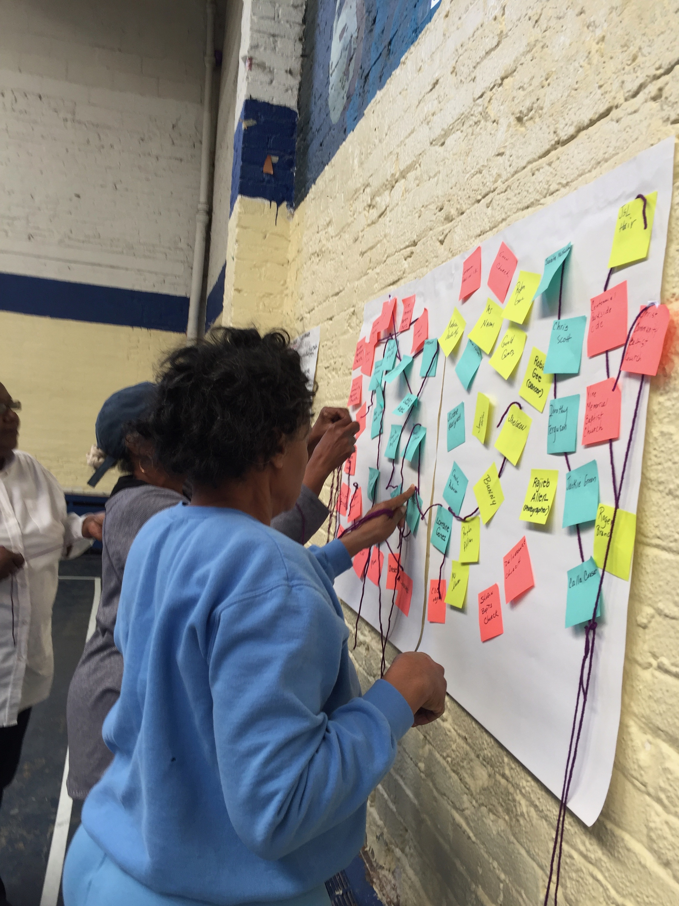
Have a conversation with us!
info@justact.org
https://www.facebook.com/
justact.today/
215.290.9784

