Slide 1
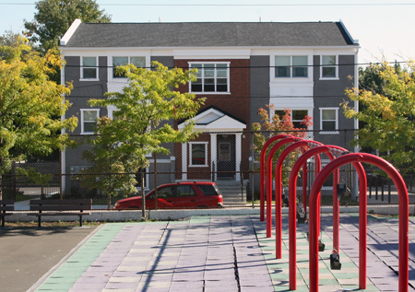

Adopting a Preservation Strategy for Philadelphia’s Affordable Rental Housing
Carolyn Placke
Program Officer | Housing & Health
LISC
Philadelphia Association of CDCs
Forward Equitable Development Conference
June 26, 2019

Slide 2
Who We Are
With residents and partners, LISC
forges resilient and inclusive communities of opportunity across America–great places to live, work, visit, do business and raise families.

Slide 3


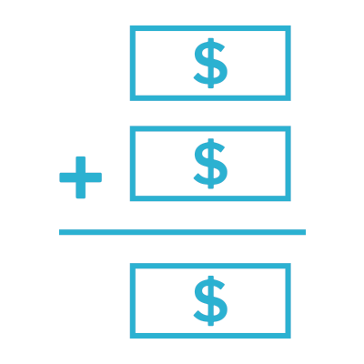
Our Model
LISC is an investor, capacity builder, convener and innovator.
Pool public and private dollars
Work with local partners
Support people and places
We raise funds from philanthropies, corporations and financial firms, federal, state and local governments and through the capital markets.
We also generate income from consulting, and lending services.
Through a network of local offices and community-based partners across the country, we provide grants, loans, equity and technical assistance.
We also lead advocacy efforts on local, regional and national policy.
By investing in housing, businesses, jobs, schools, public spaces, safety, youth, health centers, grocery stores and more, we catalyze opportunities in communities nationwide.

Slide 4
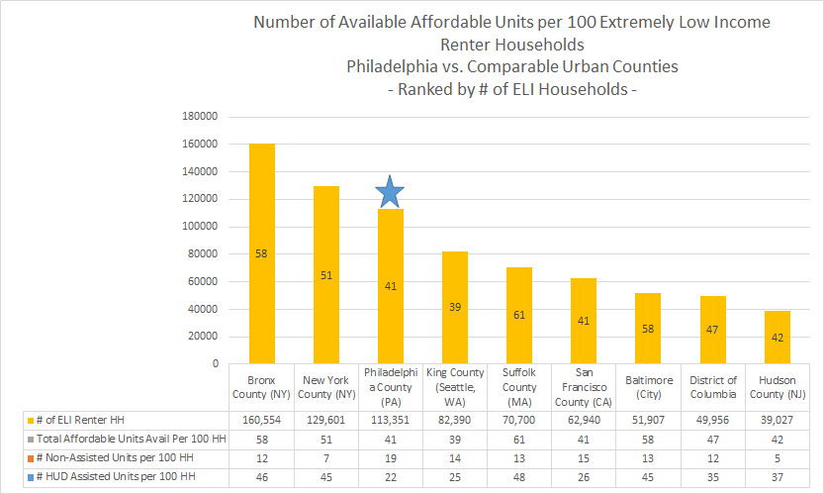
Philadelphia’s Housing Affordability Gap
Philadelphia County ranks among the largest urban counties serving renters earning at or below 30% AMI.
Income inequality affects communities of color disproportionately.
Source: Urban Institute – Mapping America’s Rental Housing Crisis

Slide 5
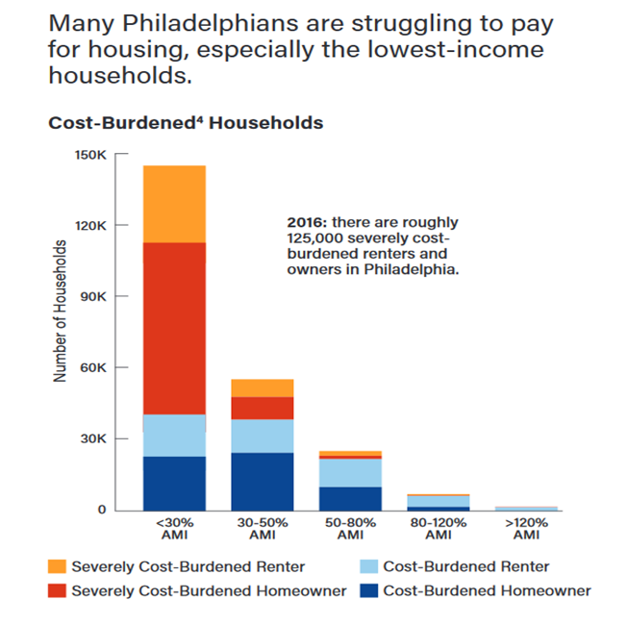
Housing Cost Burden
In Philadelphia, the Fair Market Rent (FMR) for a two-bedroom apartment is $1,266. In order to afford this level of rent and utilities — without paying more than 30% of income on housing — a household must earn $4,220 monthly, $50,640 annually, or $24.35 per hour.
Source: City of Philadelphia, Housing for Equity: An Action Plan for Philadelphia

Slide 6
Factors Contributing to the Demand for Affordable Housing
Definitions:
Publicly Assisted Affordable Rental Housing uses federal subsidies to support construction and ensure affordable rents for seniors, the disabled, and lower-and moderate-income households
At Risk Properties are ones that may be lost due to age and deterioration physical condition, the end of affordability period or expiration of subsidy. Properties located in stronger markets and/or owned by for-profit owners present higher risk.
Naturally Occurring Affordable Housing operates without federal subsidy and is affordable to lower-and moderate-income households.
Renter Burden
Lower- Incomes & Poverty
Demand for New Affordable Housing Units
&
Demand for New Resources to Preserve Affordability
Loss Of Affordable Units

Slide 7

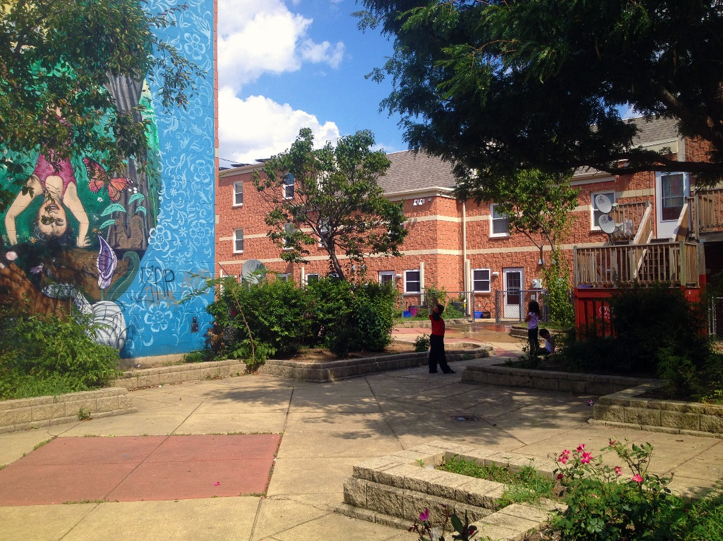
Philadelphia’s Publicly Assisted Affordable Rental Housing Challenge
According to the City of Philadelphia, 14,500 publicly assisted units are between 15 and 30 years old, or are nearing the end of the rental assistance contract.
These units may need some form of financing or re-syndication to replace obsolete systems, energy efficiency upgrades, or to renovate apartments. Other owners may face renewing or opting-out of the rental assistance program.
Source: City of Philadelphia: Foundation for the Future: Developing Philadelphia's Housing Action Plan

Slide 8
Affordable Rental Housing Preservation
Working Committee - By Sector
Private
Capozzi Real Estate
Citizens Bank
Diamond & Associates
Elon Development Group
Homeowner’s Association of Philadelphia (HAPCO)
City & State
City of Philadelphia - Housing Advisory Board
City of Philadelphia - Housing Trust Fund Board
City of Philadelphia – Dept. of Planning & Development
Pennsylvania Housing Finance Agency
Philadelphia Housing Authority
Non-Profit
Asociación Puertorriqueños en Marcha (APM)
Community Legal Services
Disabled in Action, Inc.
HACE
Liberty Resources
LISC
Mission First Housing Group
Philadelphia Association of CDC’s
Regional Housing Legal Services
The Reinvestment Fund
ULI Philadelphia (ULI)
Notes:
Values
Consensus approach to decision-making and direction
Cross-Sector/Cross-Discipline engagement
Commitment to developing Preservation Strategy
Process:
6 months: 5 Working Committee Meetings from May to October 2017
Engaged Research Partner on National Best Practices
Regular Meetings with City’s Planning & Development to discuss progress & benchmarks
Outcomes:
Reviewed 130 best practice interventions
Applied Evaluation Criteria: Timeframe, Applicability to Phila., Evidence of Success

Slide 9
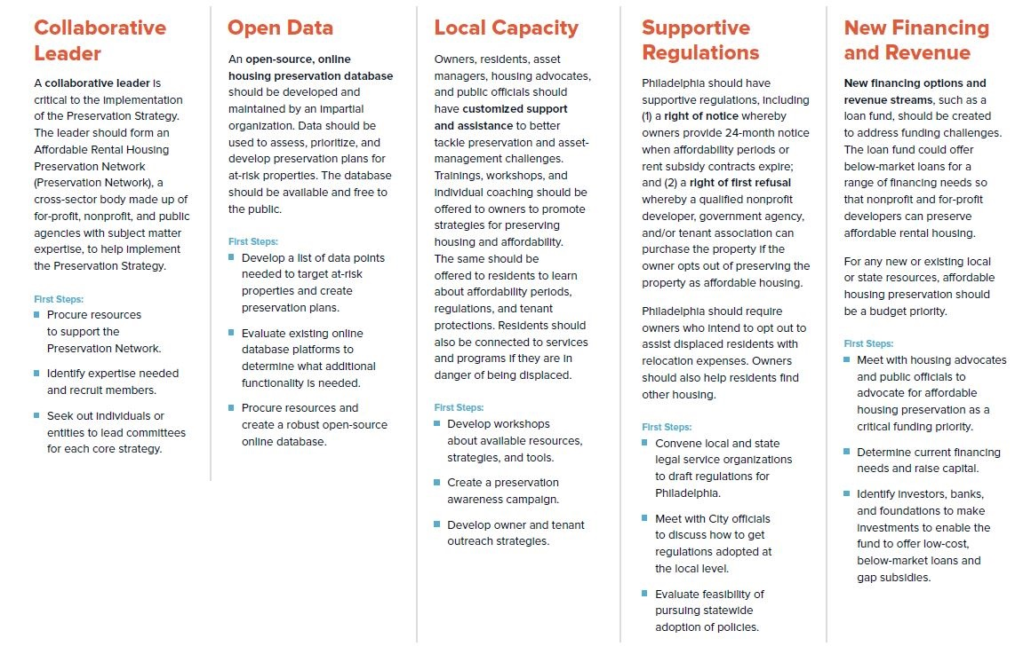
Preservation Strategy –
At A Glance

Slide 10
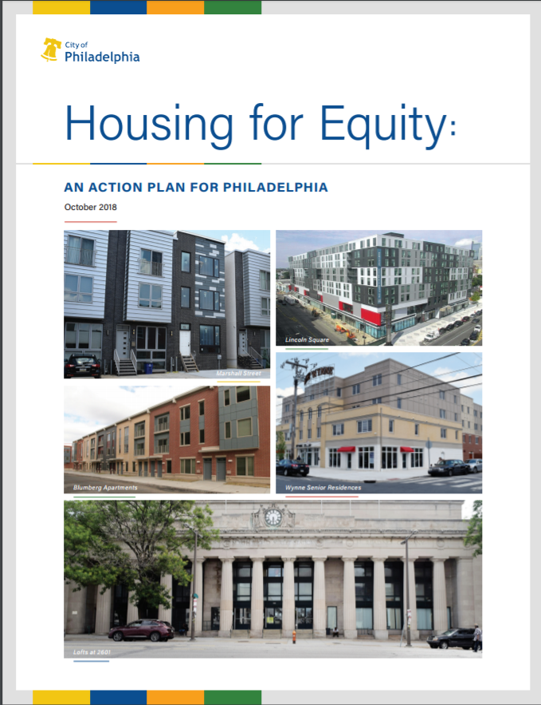
Affordable Rental Housing Preservation Working Committee Accomplishments & Moving Forward
  Affordable Rental Housing Preservation Strategies & Interventions
    included in City of Philadelphia’s first Housing Action Plan,
  Housing for Equity: An Action Plan for Philadelphia (October 2018)
  Open Data (At-Risk Properties):
    Researched City and National Housing Preservation Databases to identify more than 300 at-risk properties.
    Developed methodology for prioritizing and targeting those properties that are most at-risk.
  Regulations:
    Researching Right of First Refusal and Right of First Purchase Laws
  Capacity Building:
    Developed a framework to build owner capacity for preserving at-risk properties:
      Predevelopment financing and grants to support preservation plans for 480+ units in 6 neighborhoods across the city.
      Asset Management Training for property owners

Slide 11
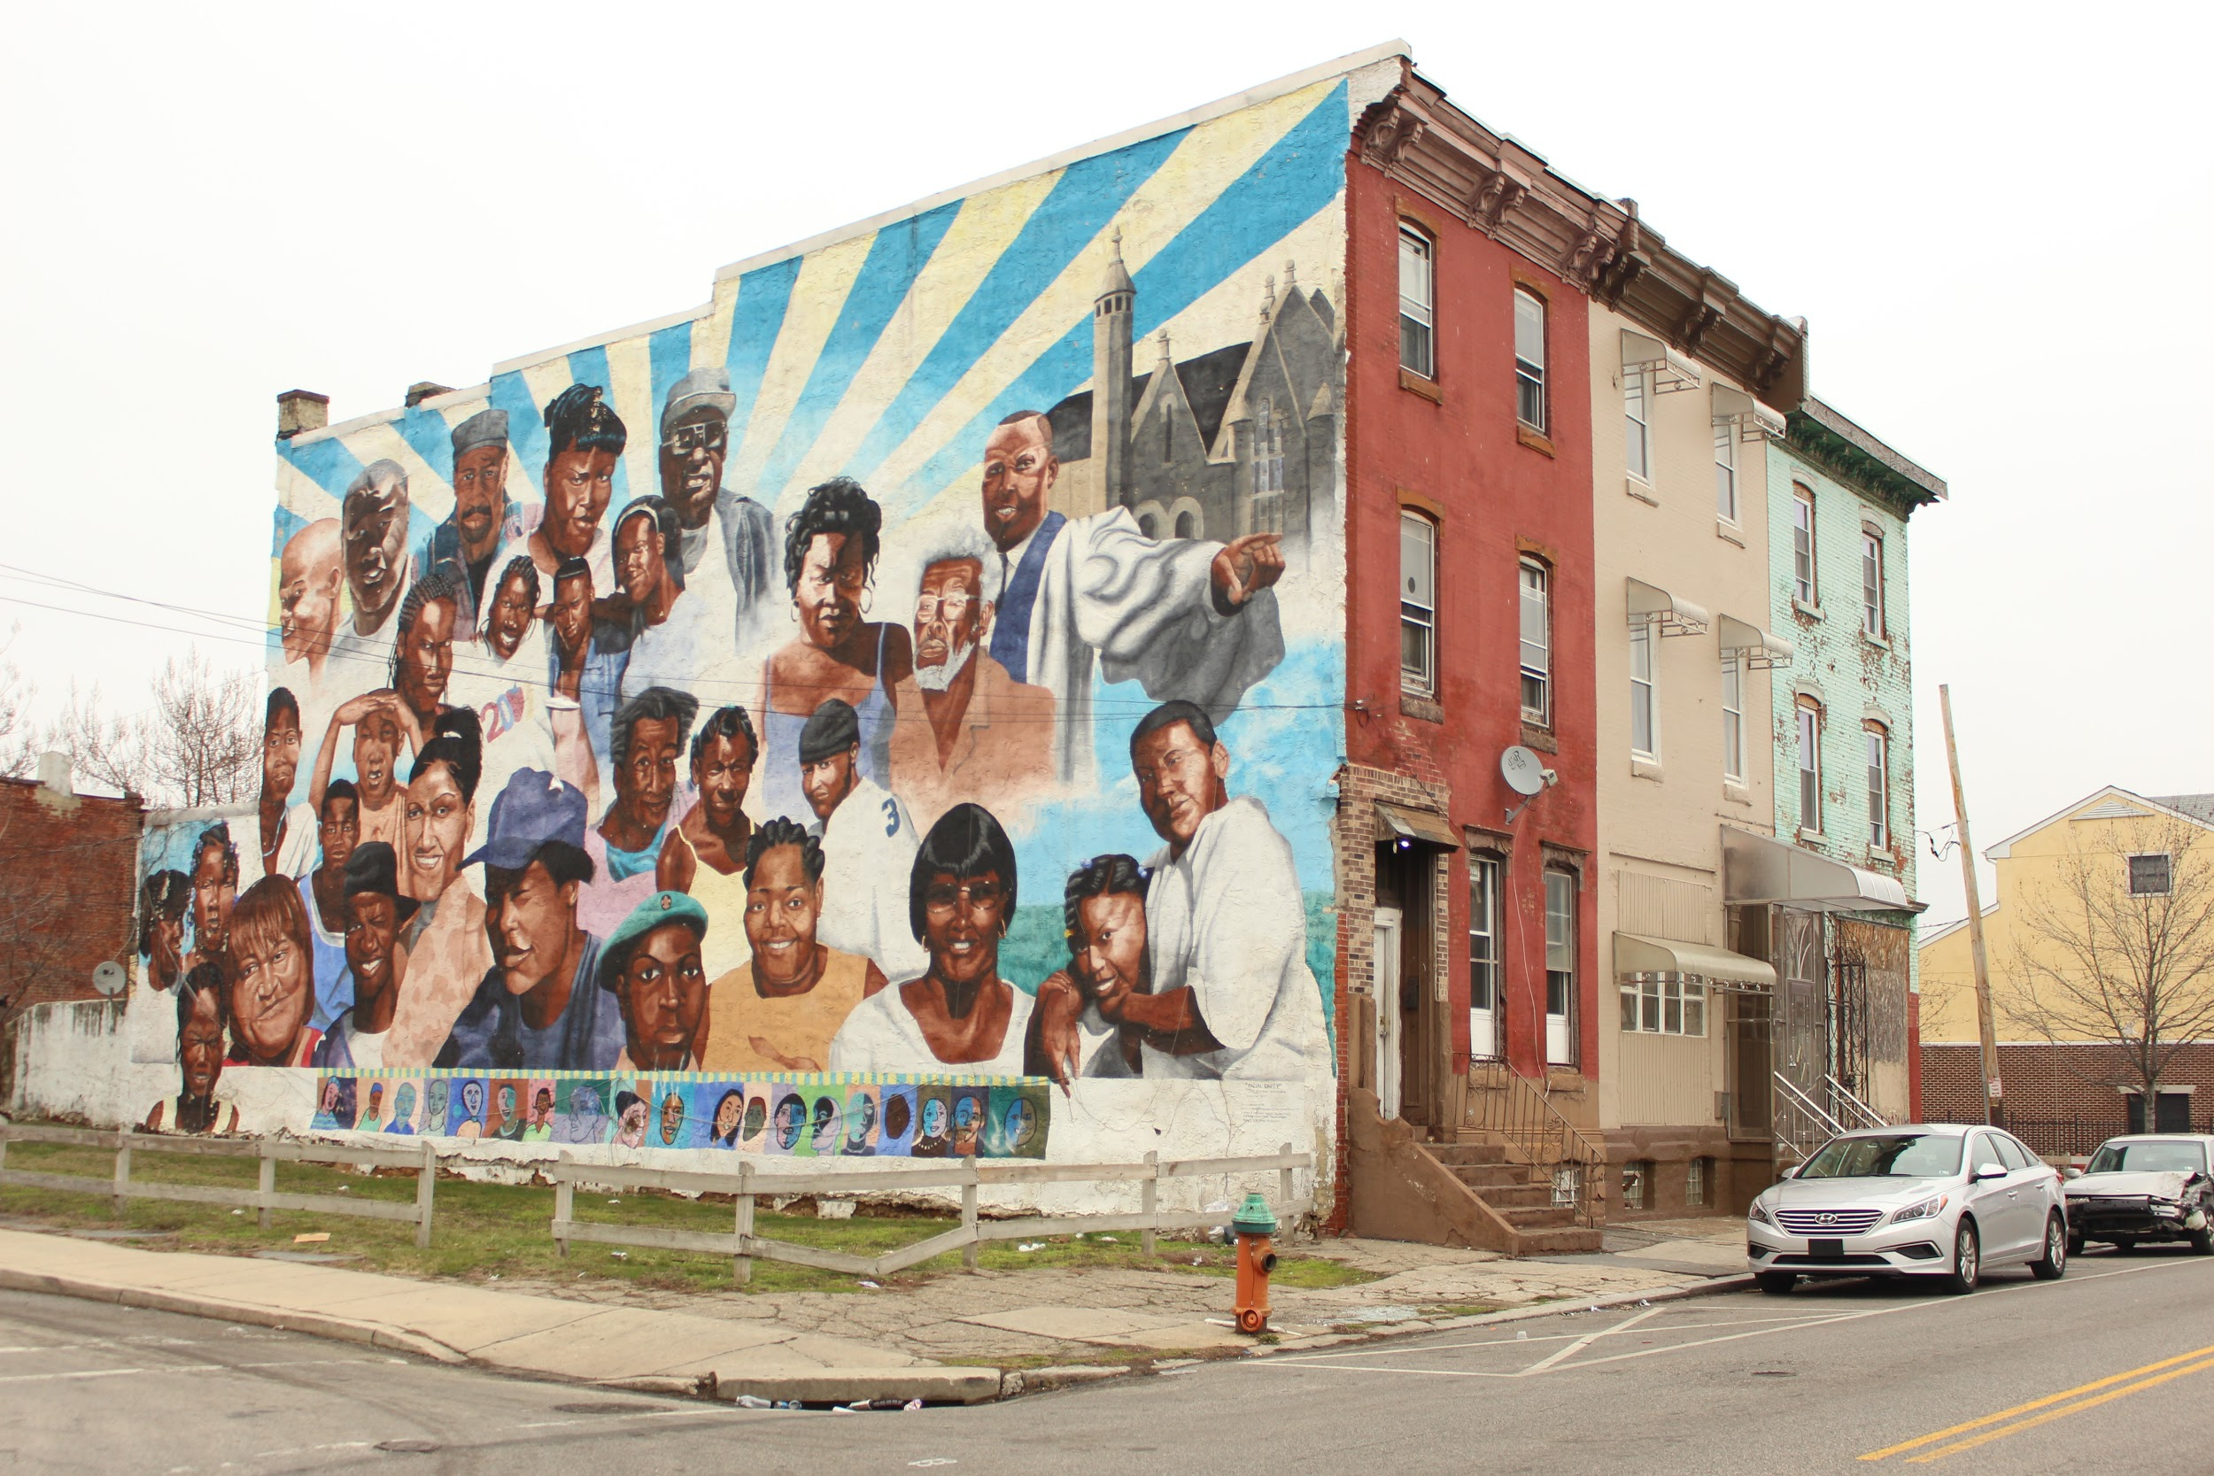

Preservation of Affordable Housing
Rachel Garland
Attorney, Housing Unit
Community Legal Services
PACDC Conference
June 2019

Slide 12
About Community Legal Services
Represents over 12,000 clients annually.
9 Practice Areas: housing, homeownership, utilities, employment, language access, public benefits, aging & disabilities, family advocacy
CLS attorneys and other staff provide a full range of legal services, from individual representation to administrative advocacy to class action litigation, as well as community education and social work.

Slide 13
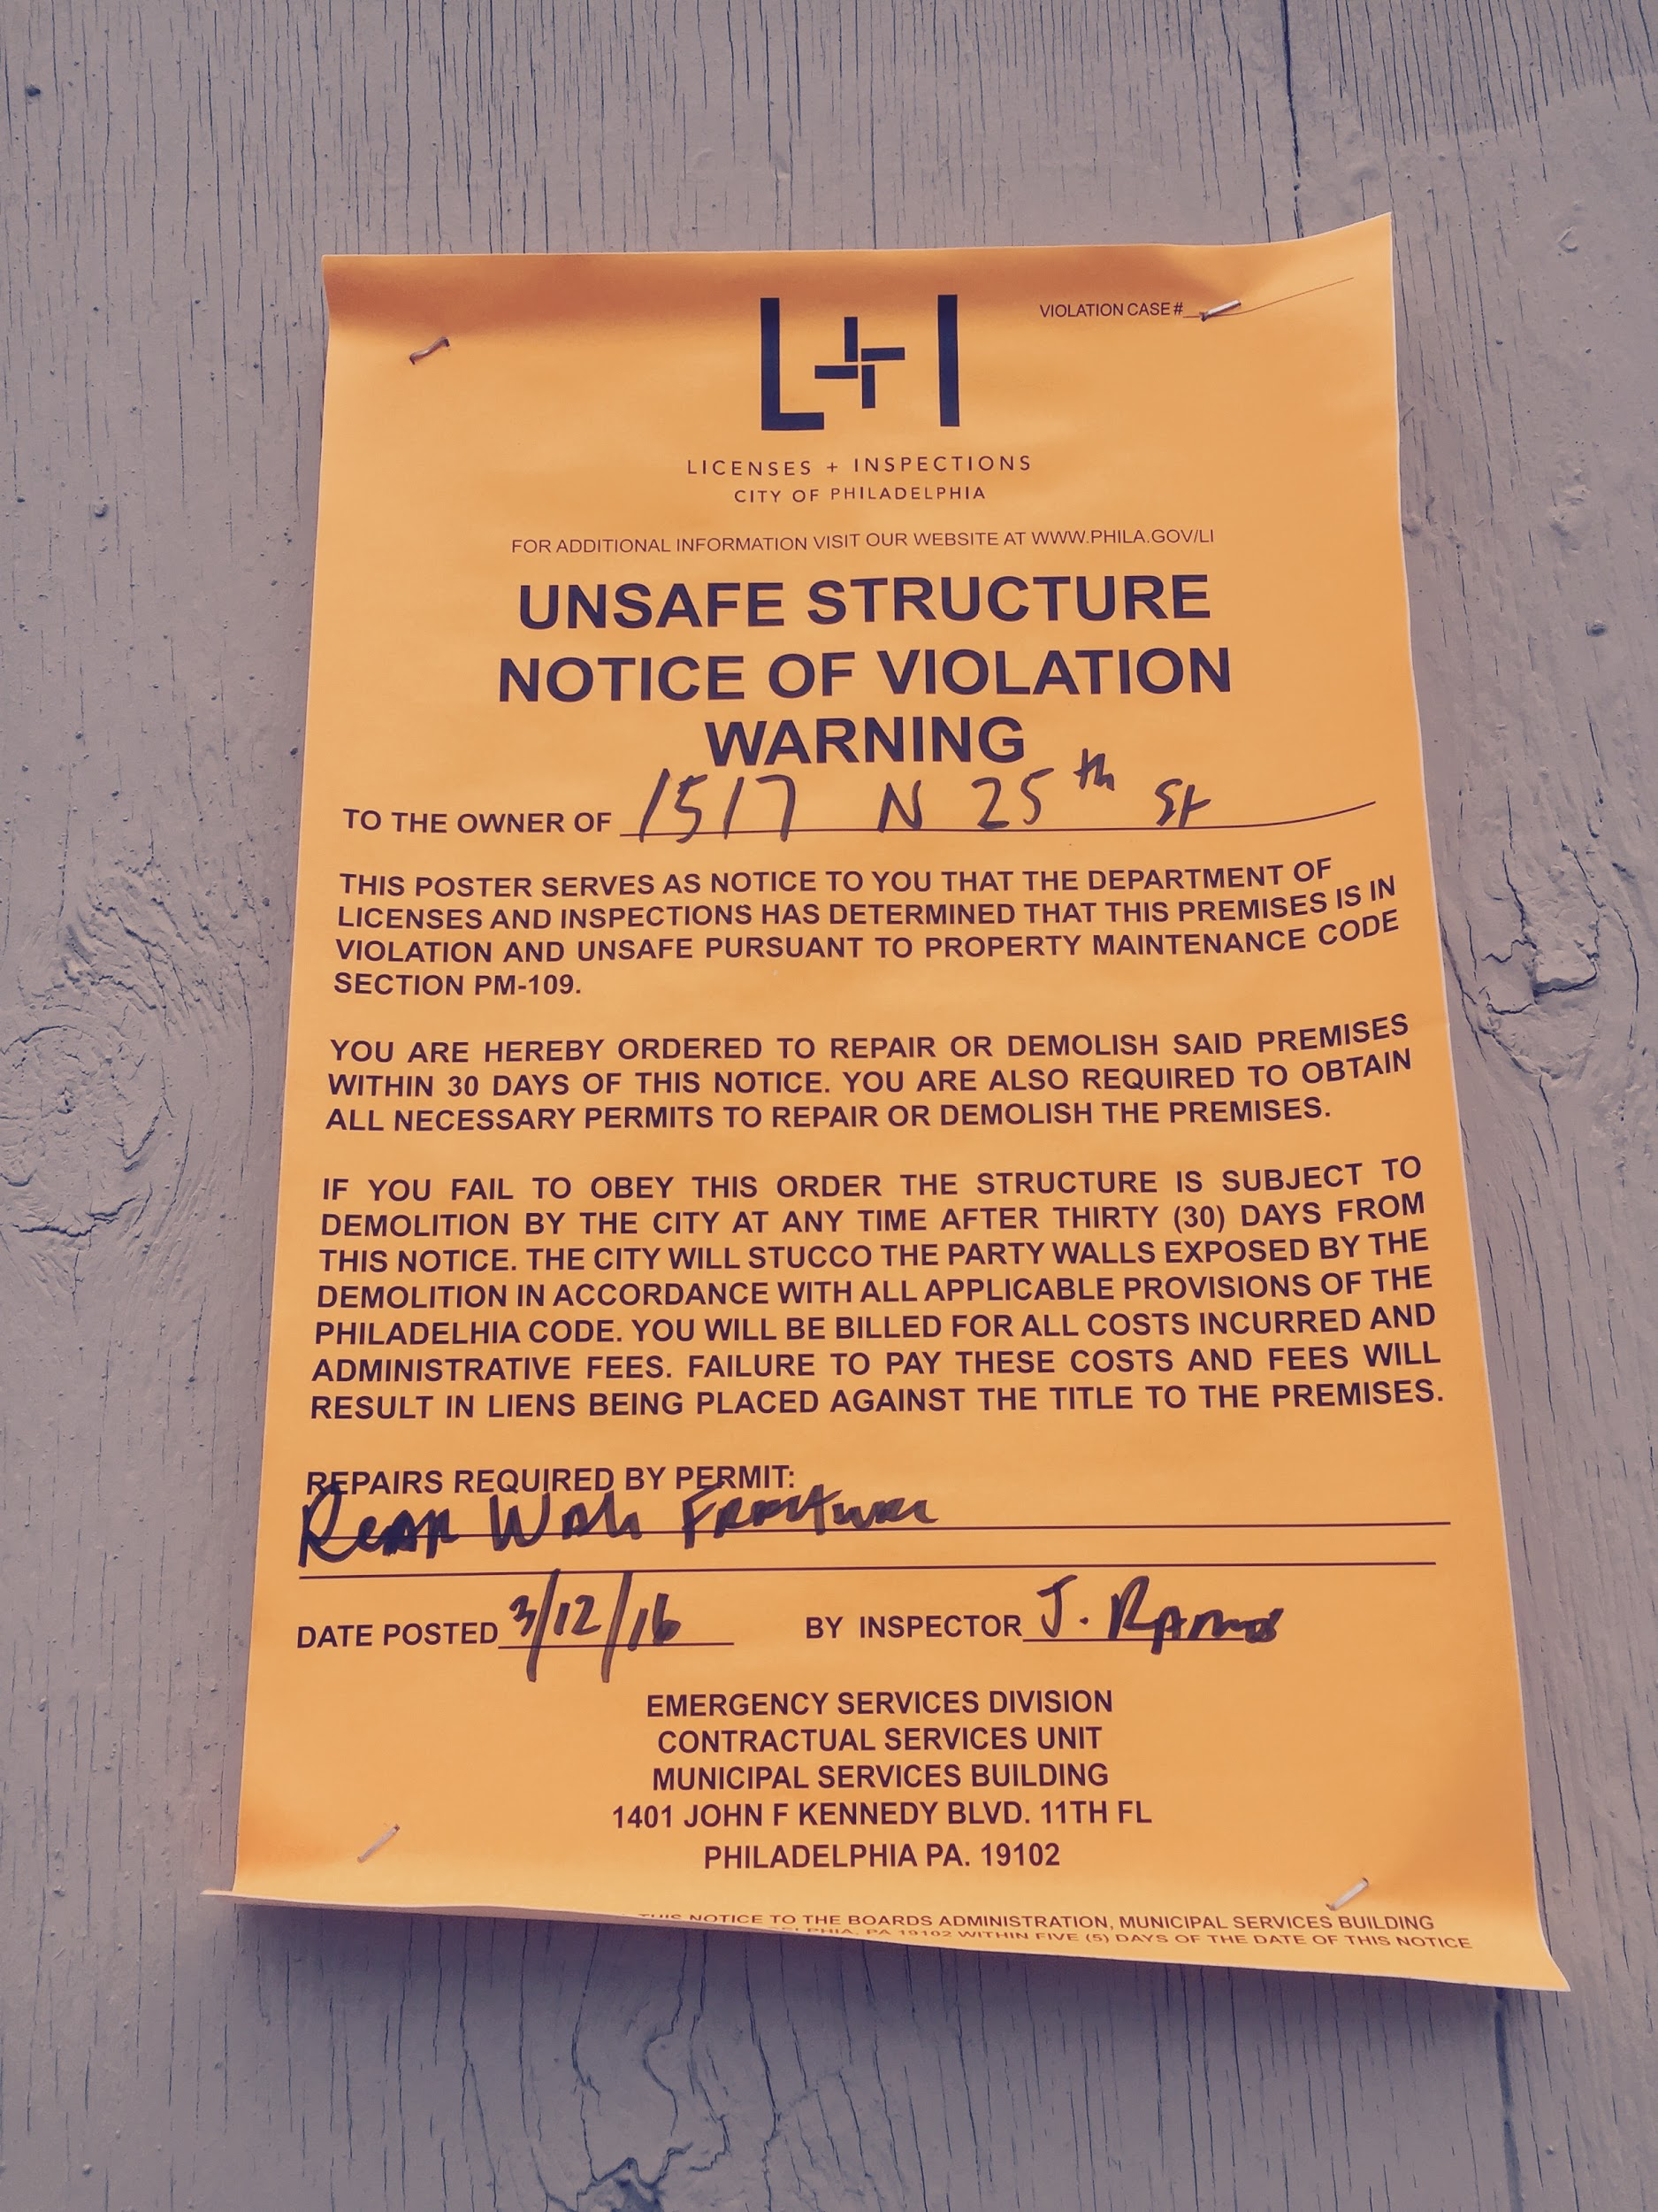
Eviction Outcomes
Eviction is a leading cause of homelessness and housing instability in Philadelphia. Philadelphia’s eviction rate is four times higher than the foreclosure rate, impacting nearly 1 in 14 Philly renters.
Tens of thousands of Philadelphians live in substandard housing and face above-average rates of childhood lead poisoning as well as asthma-triggering mold and vermin infestations.

Slide 14
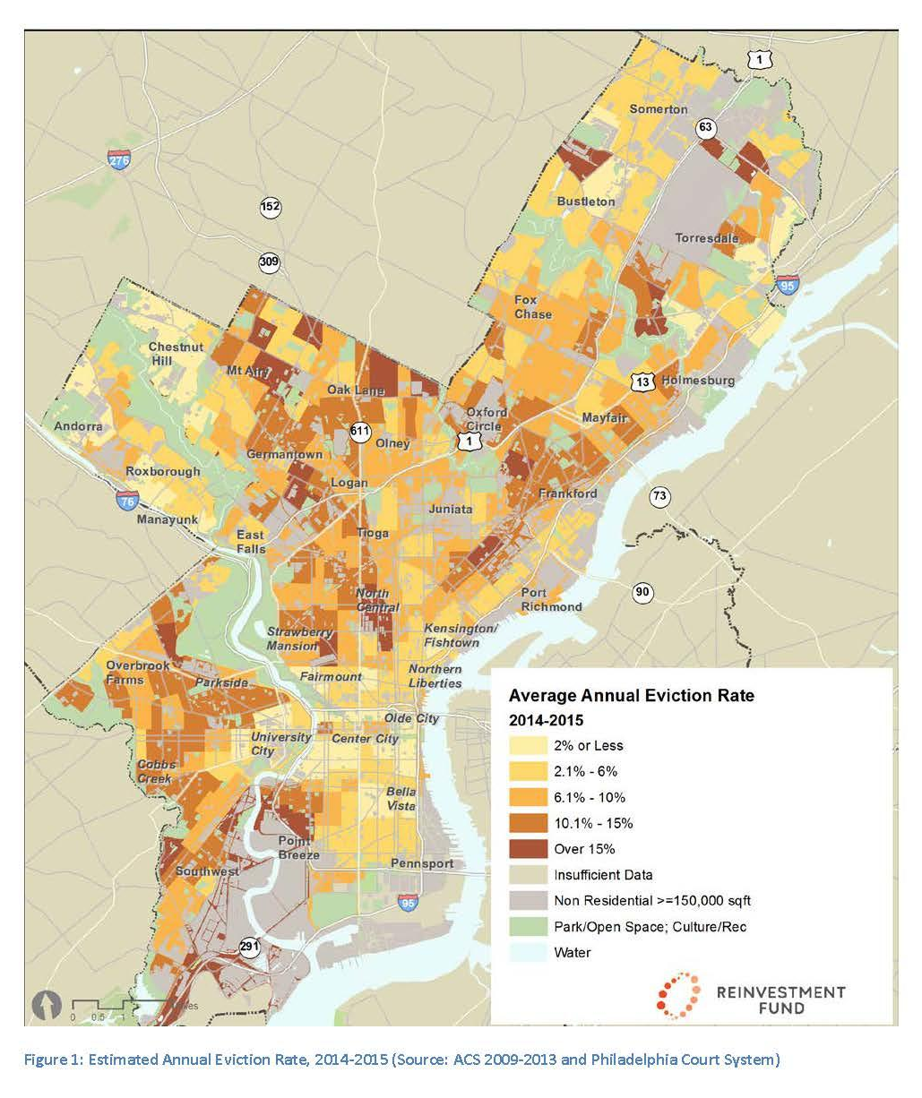
Single mothers and their children, seniors, people of color and people living with disabilities are most impacted by eviction.
Evictions propel families into a downward spiral of poverty; it’s commonplace for residents with eviction histories to be denied future housing and for heads of household to lose stable employment.
Evictions hurt children’s academic achievement and school attendance.
Eviction negatively impacts physical and mental health by fracturing continuity of care and management of chronic health issues.

Slide 15
Housing Discrimination is Pervasive
⅔ of Landlords in Philadelphia refuse subsidized housing vouchers. (Urban Institute)
70% of 22,000 annual eviction filings in Philadelphia are against Black women. (ACLU, Reinvestment Fund)
A high percentage of the City’s poor, Black and Hispanic populations live in racially concentrated poverty in North Central Philadelphia. (Pew, DHCD)
9,000+ units of affordable housing are at risk of loss in the next 20 years. This loss of housing has a distinct racial impact, where 63% of project-based housing residents are African-Americans, and where African-Americans are disproportionately more likely to carry severe housing cost burdens in the city. (Justice Lab, CLS)

Slide 16
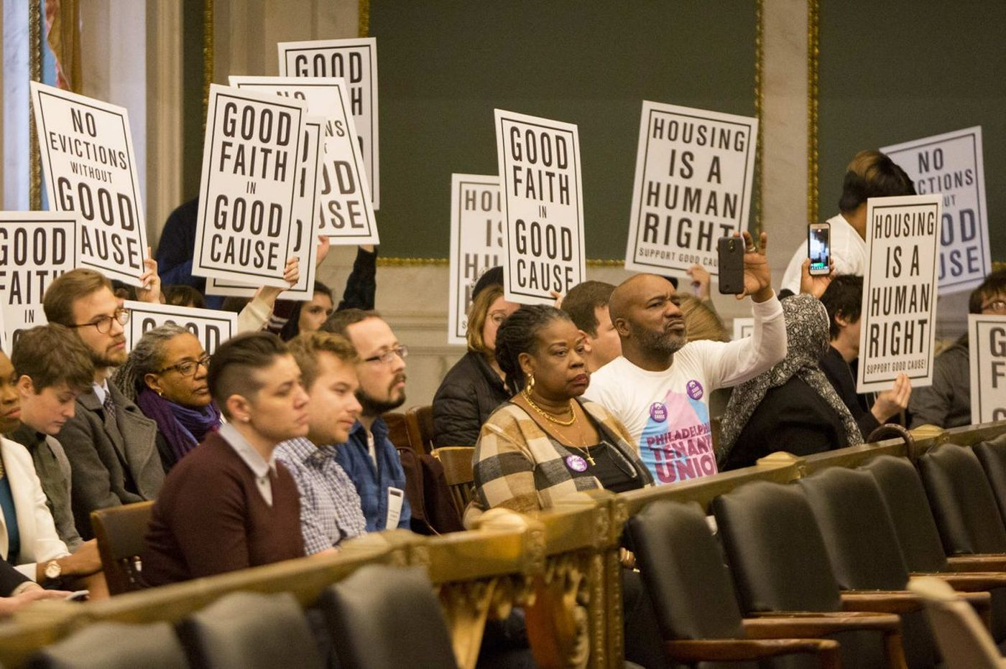
CLS Works Towards Housing Solutions
Just Cause Eviction Law passed December 2018
Strengthen Source of Income Discrimination Protections
Record Sealing for Eviction Judgments
Right to an Attorney for Low-Income Tenants
Increased Affordable Housing Options

Slide 17

Mass Evictions in Philadelphia
Definition: When a property owner attempts to evict, either legally or illegally, the entire population of a building, often for purposes of selling the property, renovations and/or increasing the rent. Also concerning is when a property loses its subsidy contract due to failure to renew or mishandling leading to termination.
Recent Examples:
Washington Square East (2009)
Brith Sholom (2010)
Elders Place I & II (2012)
PennWynn (May 2017)
Admiral & Dorsett Court (April 2018)
Greater Germantown Housing Development
Arvilla (June 2018)

Slide 18
Steps Forward
Commission “Danger of the Opt Out” Report
Identify properties at risk
Active member of the Affordable Rental Housing Preservation Working Committee. Co-leader of the Regulations sub-committee, which is researching Right of First Refusal and Right of First Purchase laws in other cities and states
Hold visioning sessions with tenants at risk of displacement
Form partnership between CLS & Regional Housing Legal Services to work with tenants at risk of displacement to form tenant co-ops, pathways to homeownership and community land trusts

Slide 19
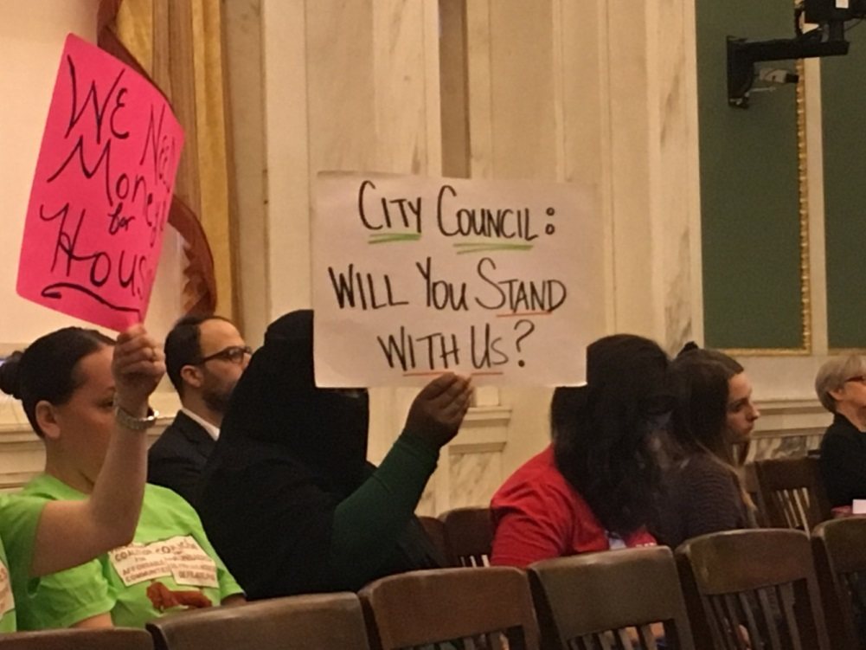
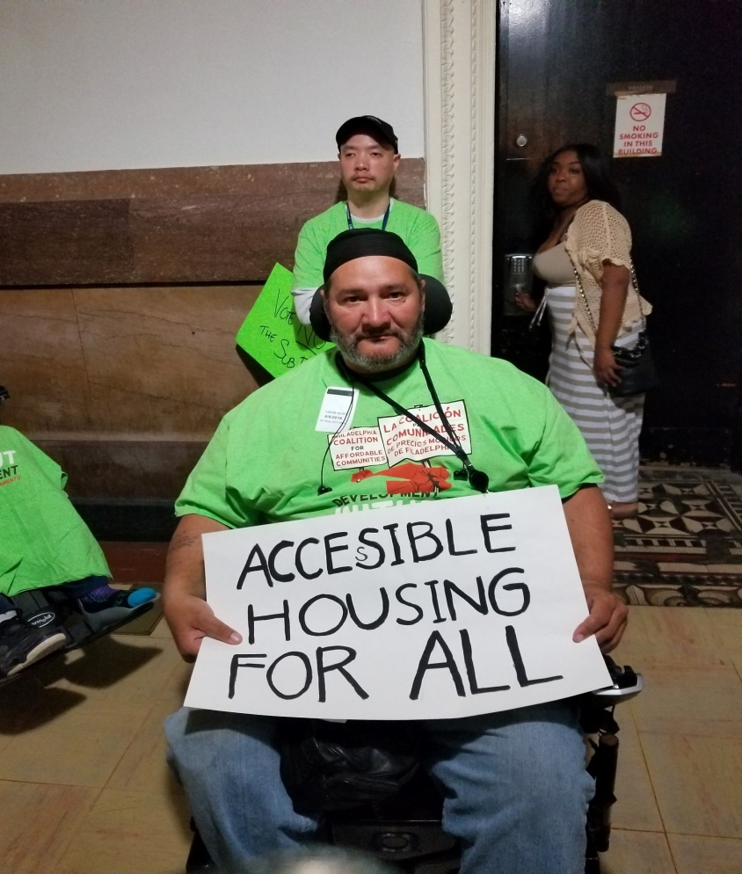
Adopting a preservation strategy for Philadelphia’s Affordable rental Housing:
The role of organizing to preserve and protect rental housing

Slide 20
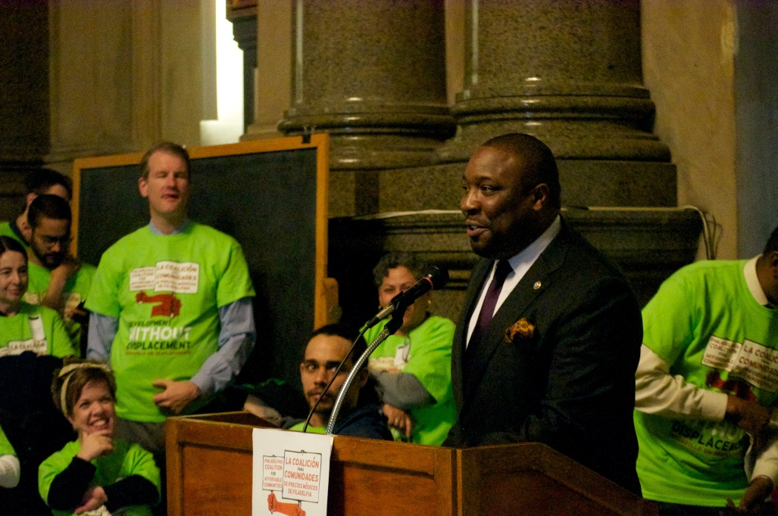
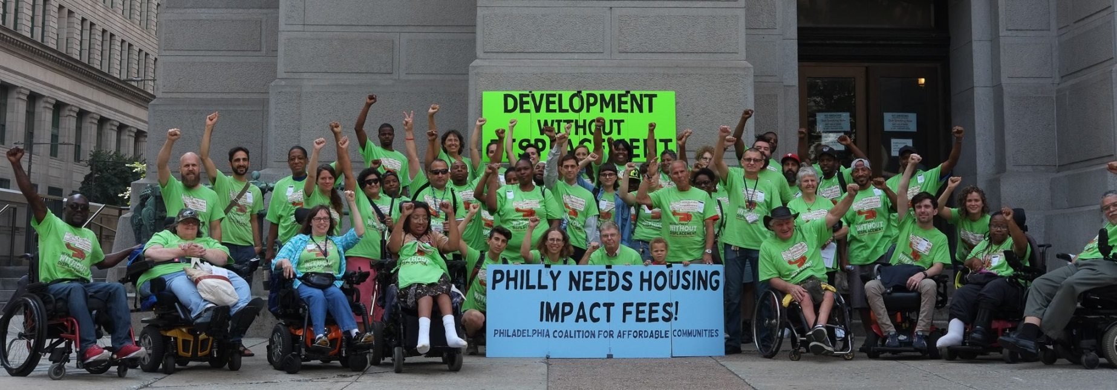
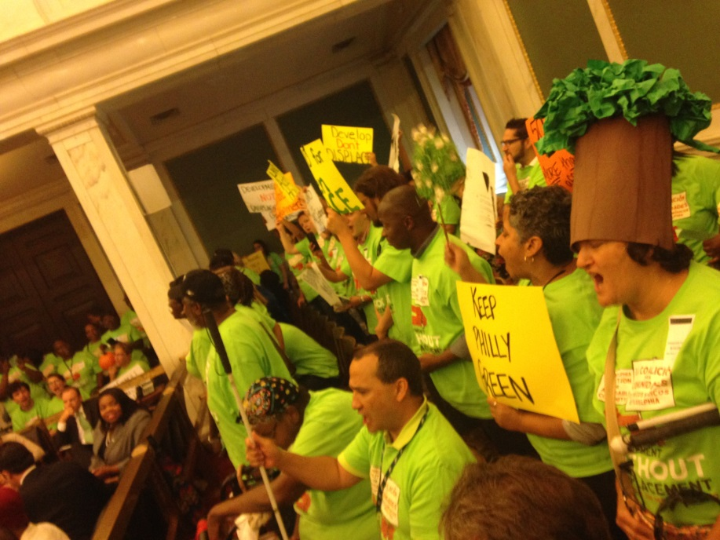
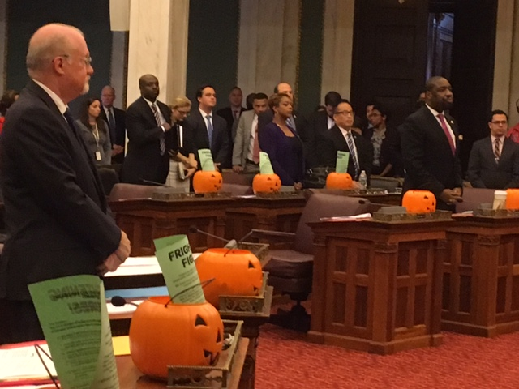
ORGANIZING TO WIN:
How we build our power to influence decision-makers

Slide 21
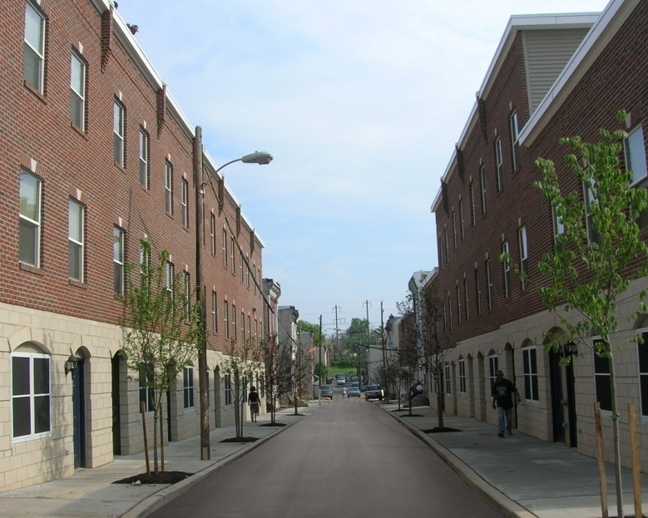
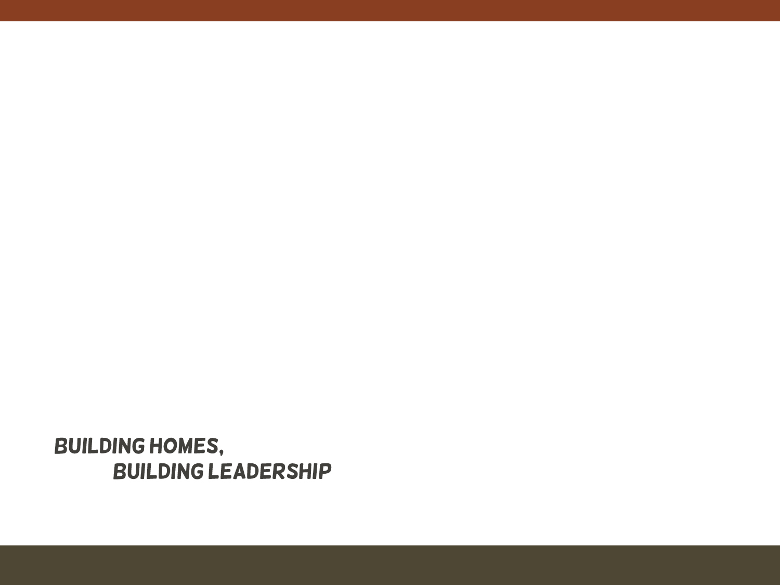
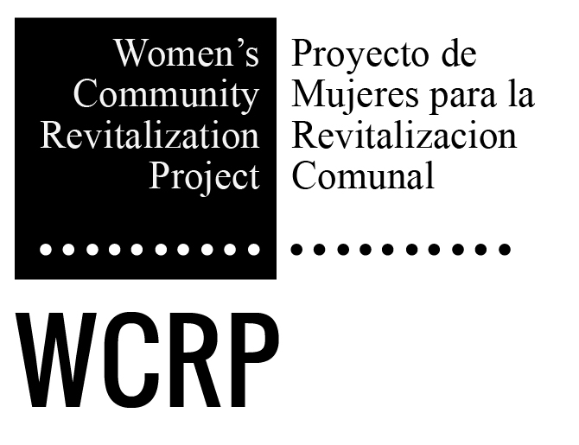
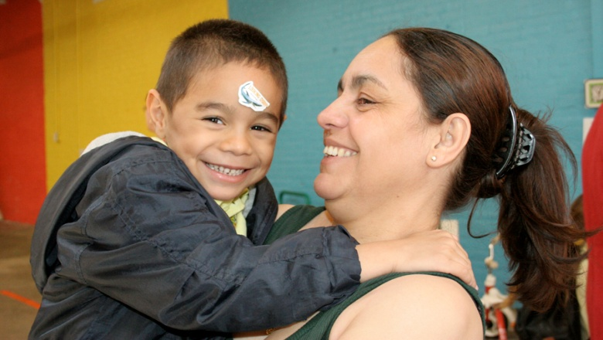
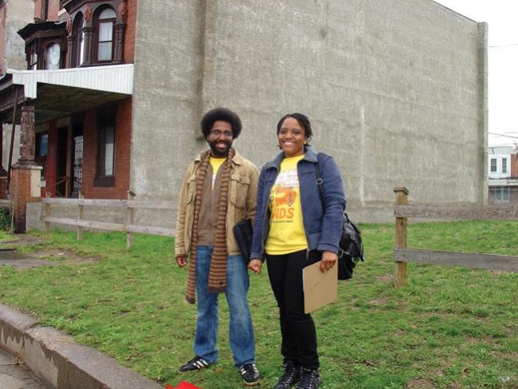
Notes:
Slide 2- Nora WCRP was founded almost 30 years ago, on the belief that community development and in our case that means building buildings (affordable homes) is important, but we know that it’s equally important to build the leadership of all of us who are part of this work—for us that leadership development often grows out of our community organizing and our efforts or campaigns to fight for fair policies and resource decisions.
WCRP identifies issues to work on by listening to folks in our community. All of us who live, study, or work in an area, know what’s going on there. We’ve come to see that it’s important to voice the stories that describe the issues that we see around us. But our insights become even more powerful when we can say-- this is what’s going on for me and here is the data which proves that it’s true for many others.
In addition to telling our stories in conjunction with the data-- I believe we also have some responsibility to identify solutions. Sometimes those solutions are neighborhood solutions, but often other communities are experiencing the same issues and that’s when we need to work city-wide and bring together many groups to build our voice and our power.
Mindy and Interface Studio have been our research partners in both the Campaign to Take Back Vacant Land and in the Development Without Displacement Campaign. They’ve helped us by answering research questions and helped us formulate some of our solutions.

Slide 22
Steps in a Organizing Campaign
Identify the Problem
Affordable rental housing is disappearing in Philadelphia
Build People Power
Find other organizations who share the same concerns and bring them together in
coalition.
Research Solutions
Identify policies that could solve the problem. Collect data and document stories/
experiences. What power do we need to build/what power do we already have
to influence decision-makers?
Develop Demands
Based on research and our analysis of our power– develop concrete demands of
policy-makers.
Take Action
Identify actions (a.k.a tactics) that will put pressure on decision-makers to act.
Win
Often a compromise from our original demand, we push to win policy that is fair,
transparent, accountable, and gives us what we need and deserve.
Celebrate Big wins or small wins, it’s important to celebrate. When we fight, we win!

Slide 23
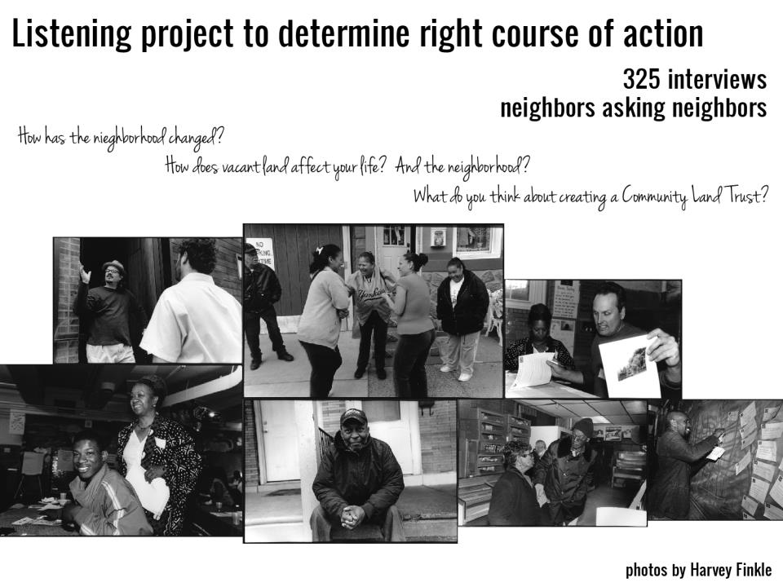

Slide 24
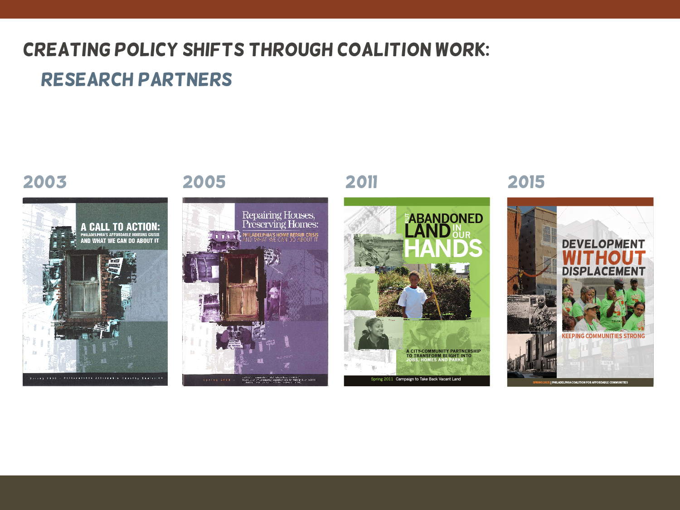
Notes:
Slide 3 – Nora
Each of these documents include data along with personal stories of people who were experiencing issues like
the need for affordable housing,
the need for resources for home repairs to keep up our homes,
the problems of crime and loss of value in our homes because of vacant blighted land and now
the problem of needing to leave our neighborhood because of rising rents and property taxes.

Slide 25
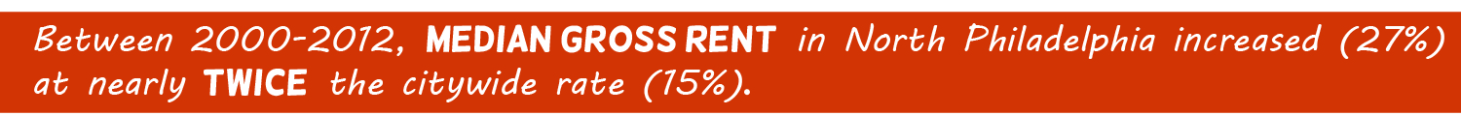
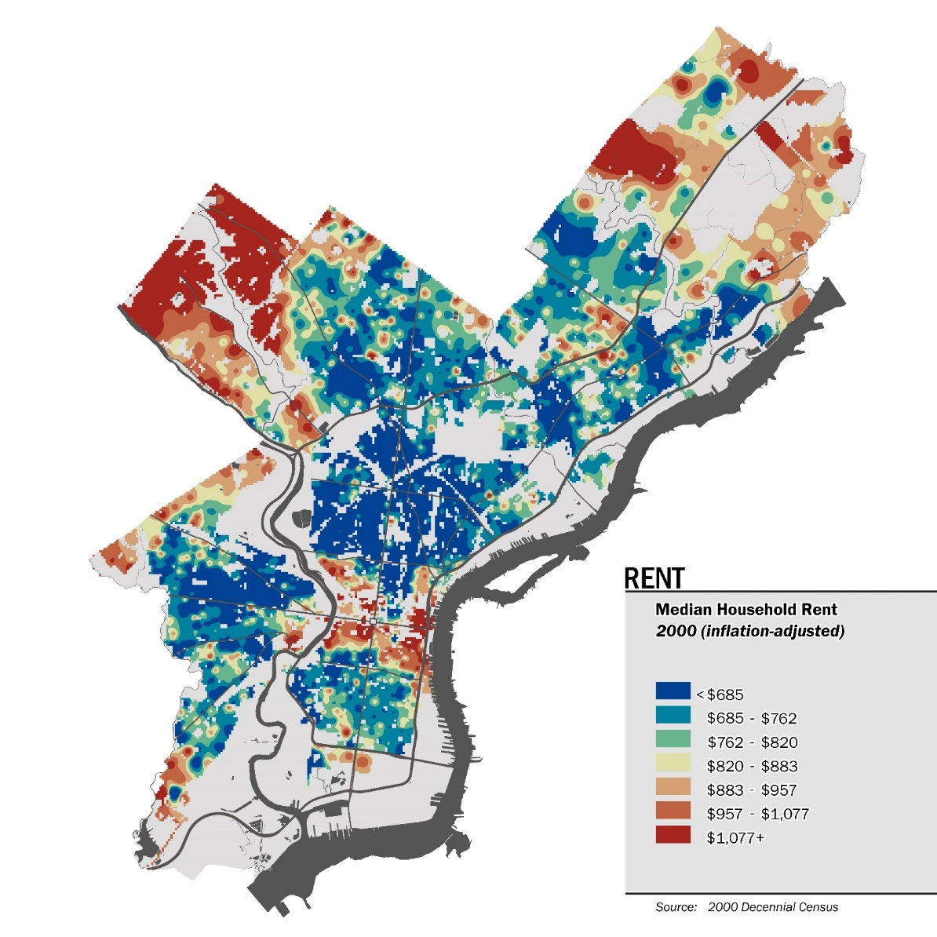
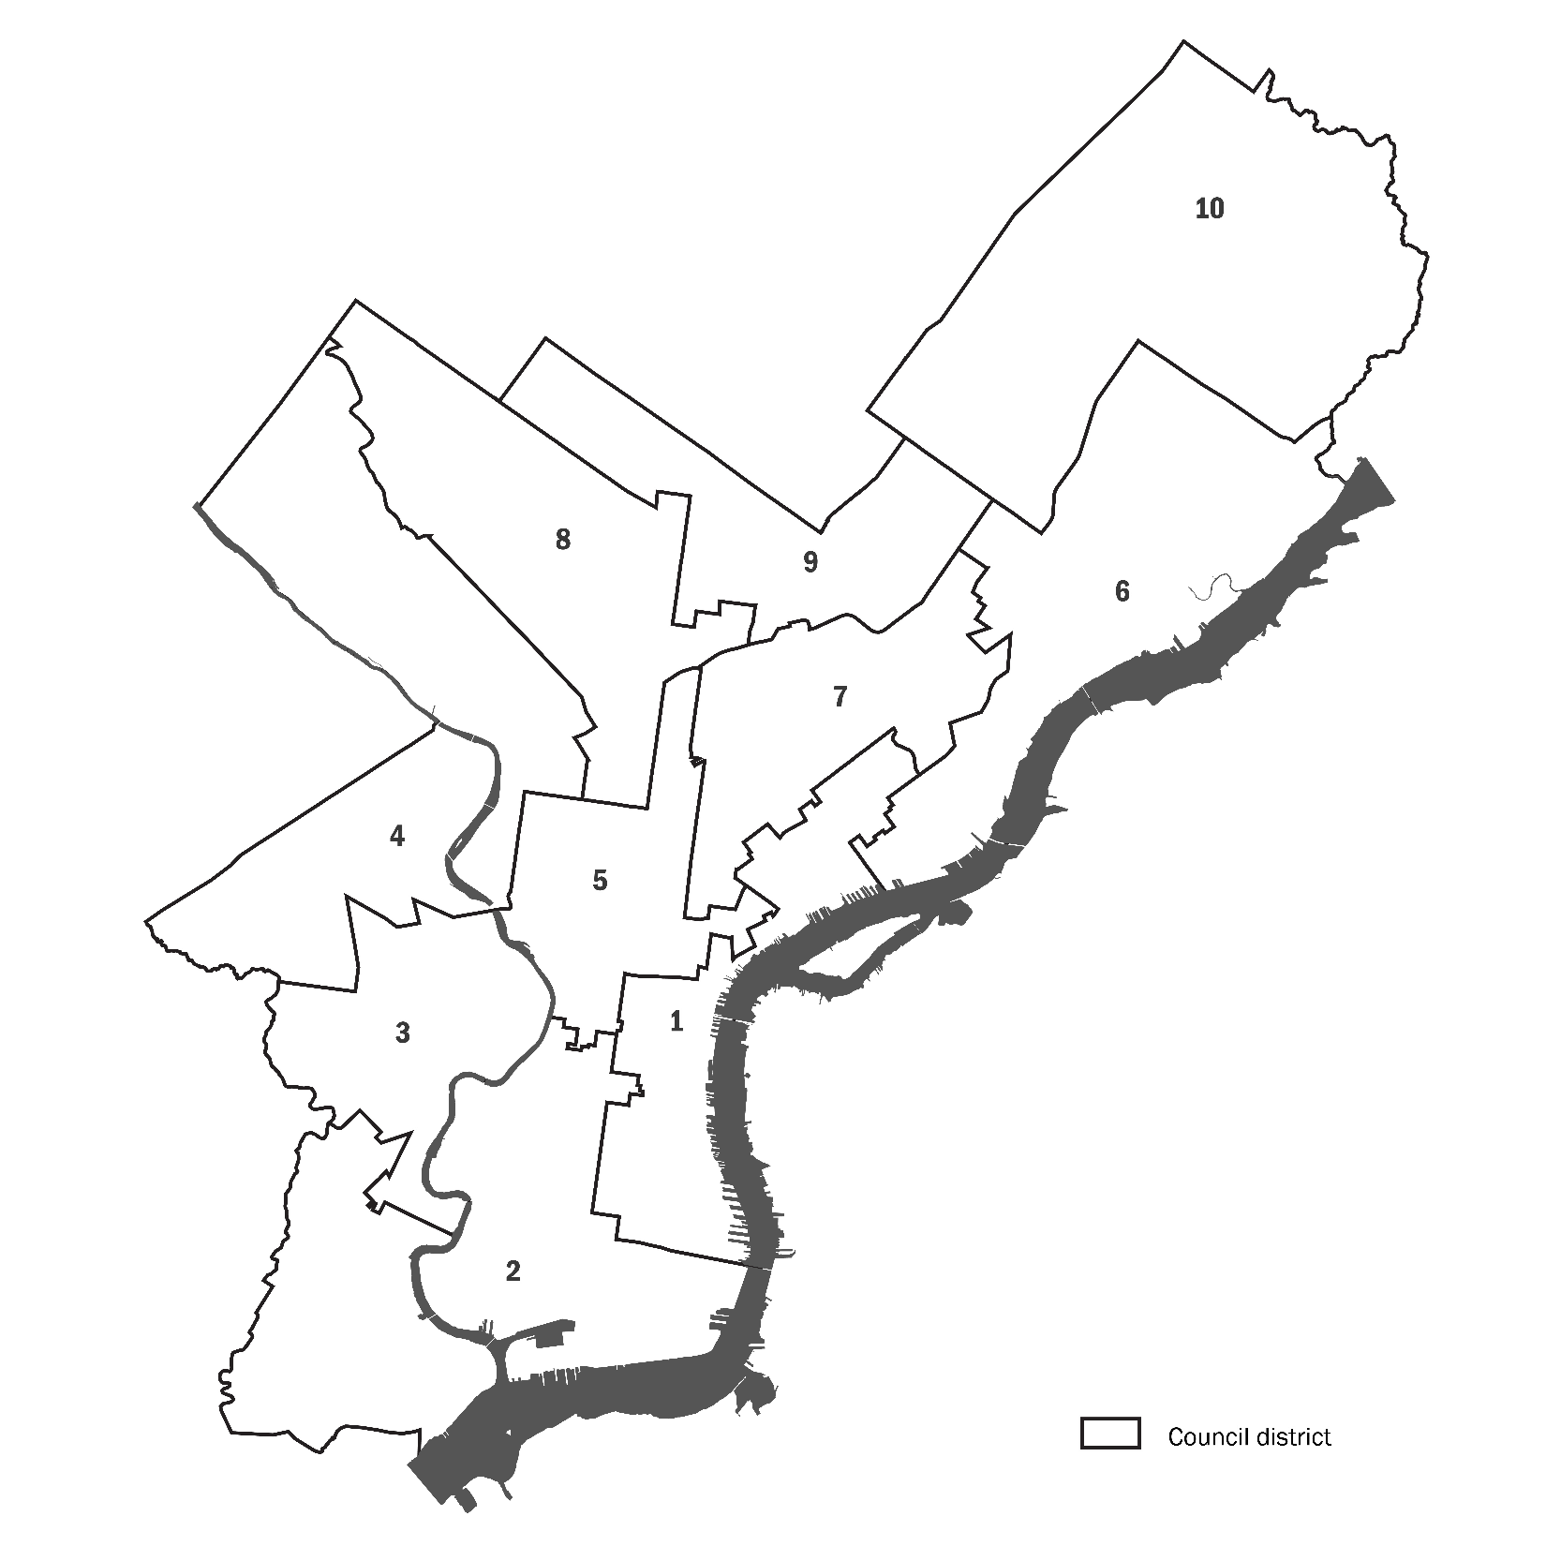
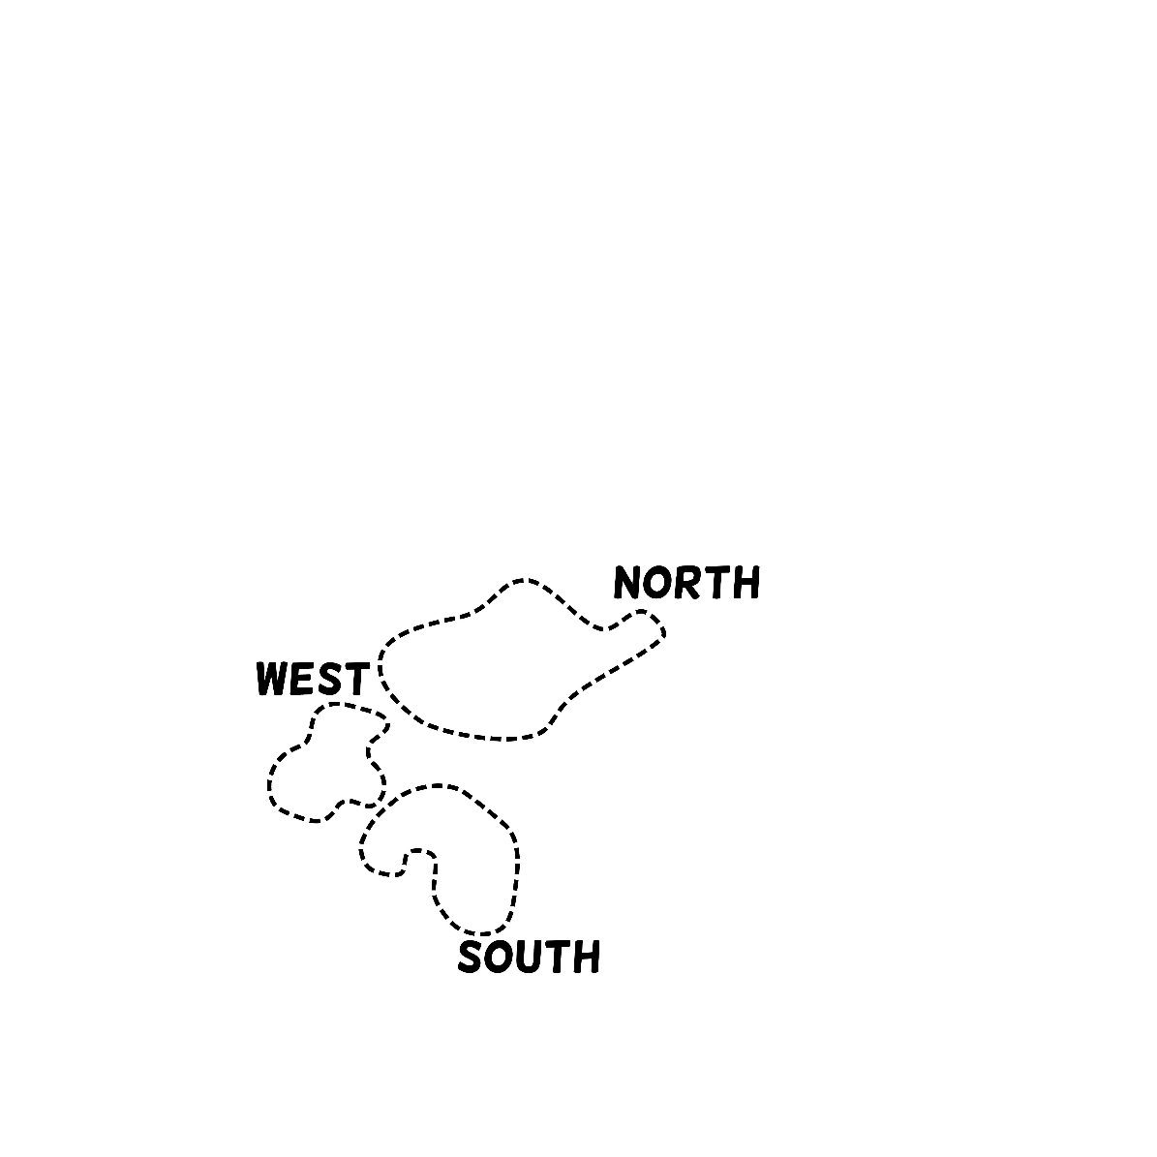
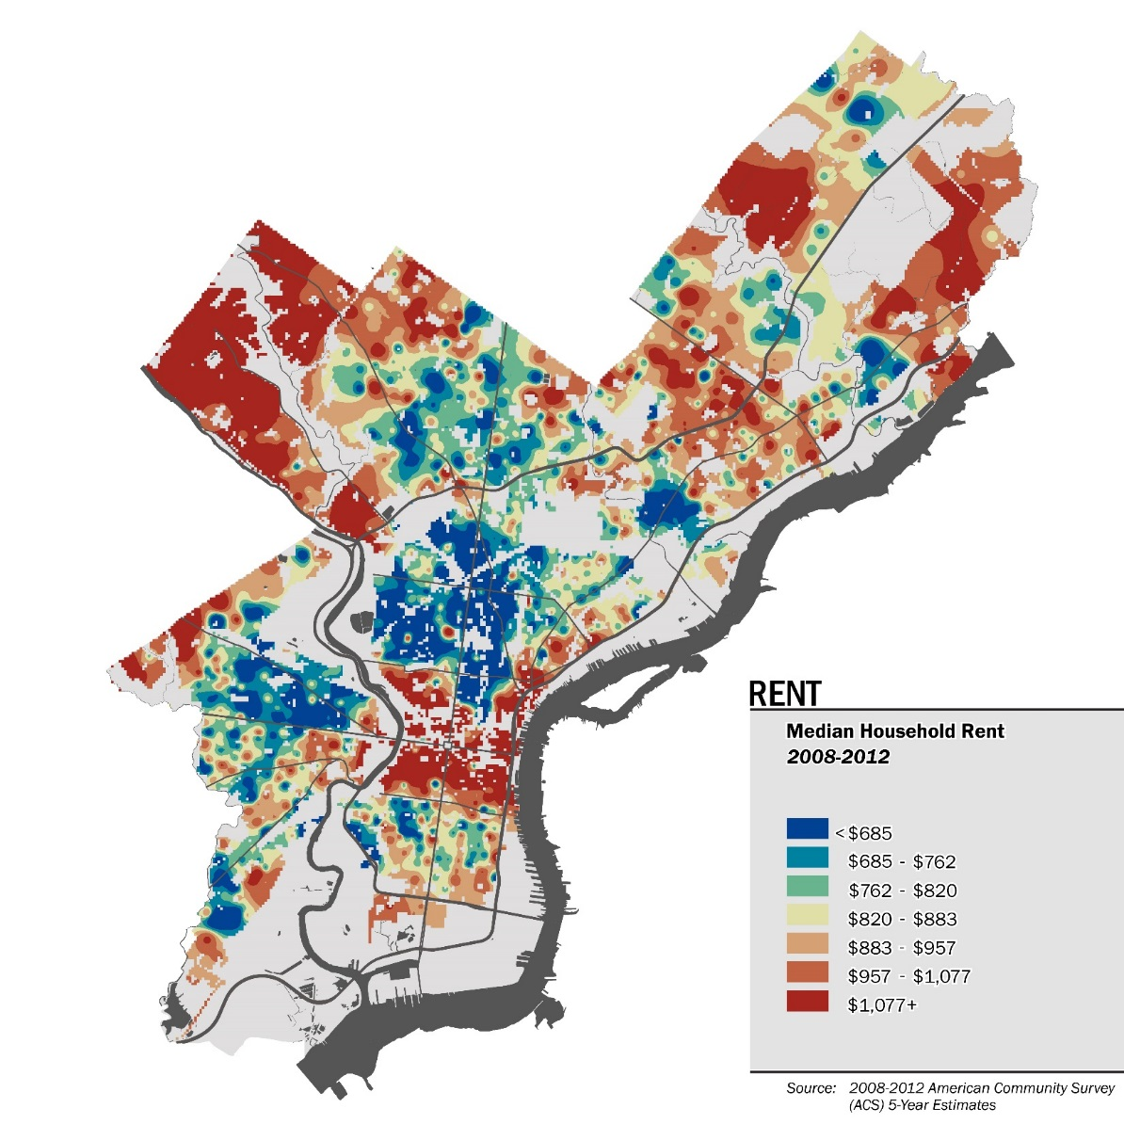

Notes:
MINDY 1 of the data indicators we looked at was CHANGE IN HOUSING COSTS.
These maps show Median Gross Rent in 2000 and 2012, adjusted to 2012 dollars. You can use our bubbles as a reference to see where the spread of red/warm colors indicates rents on the rise. Between 2000-2012, median gross rent in North Philly increased 27% at nearly twice the citywide rate of 15%.

Slide 26
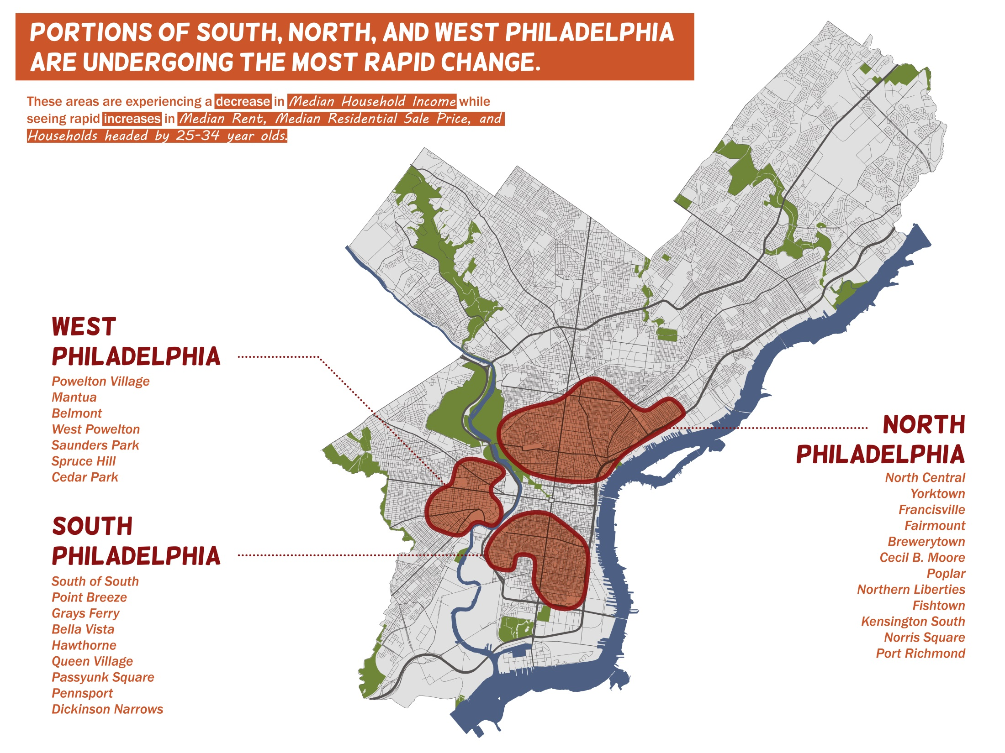

Slide 27
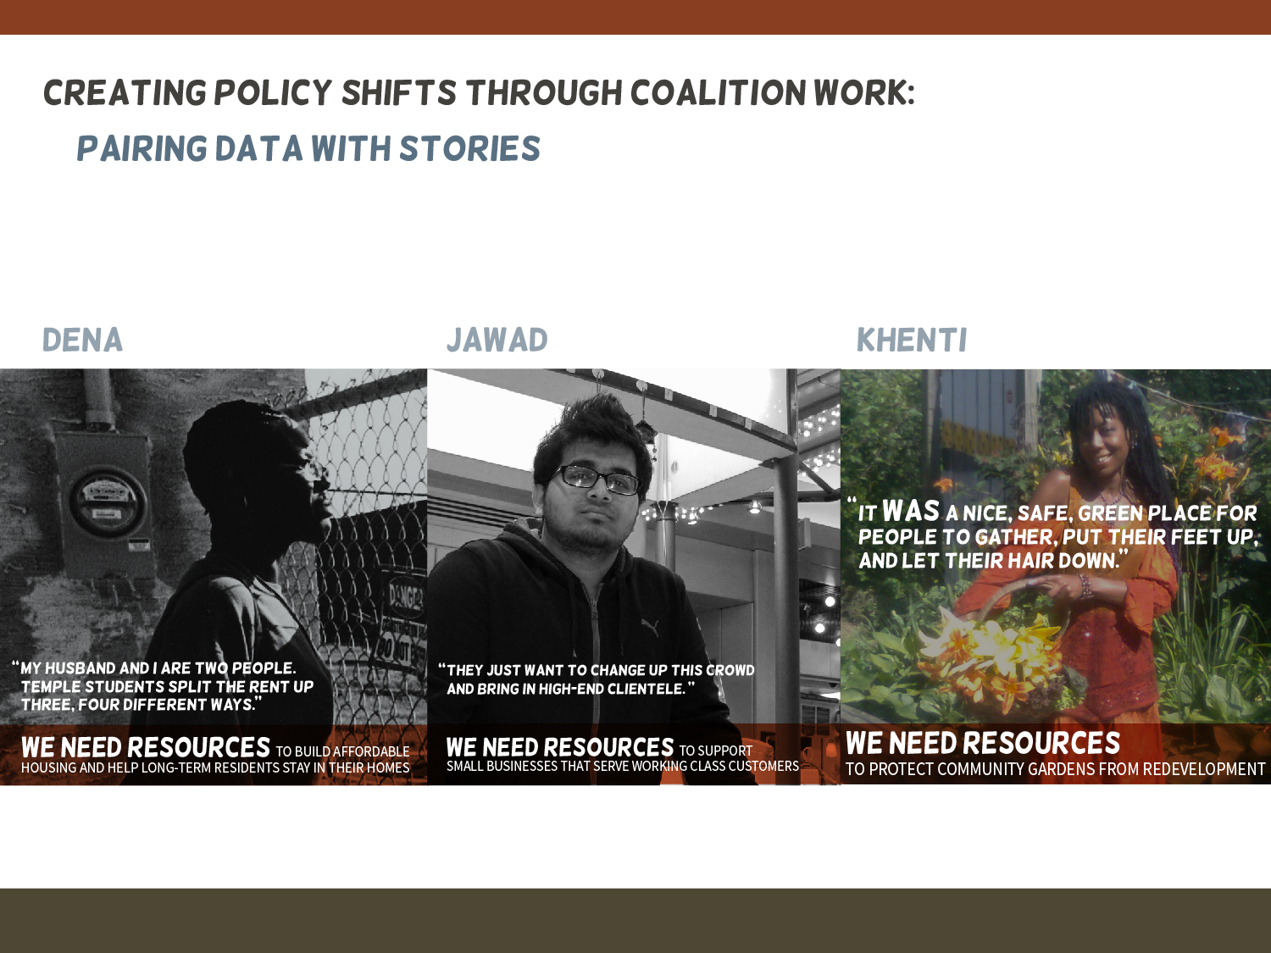

Slide 28
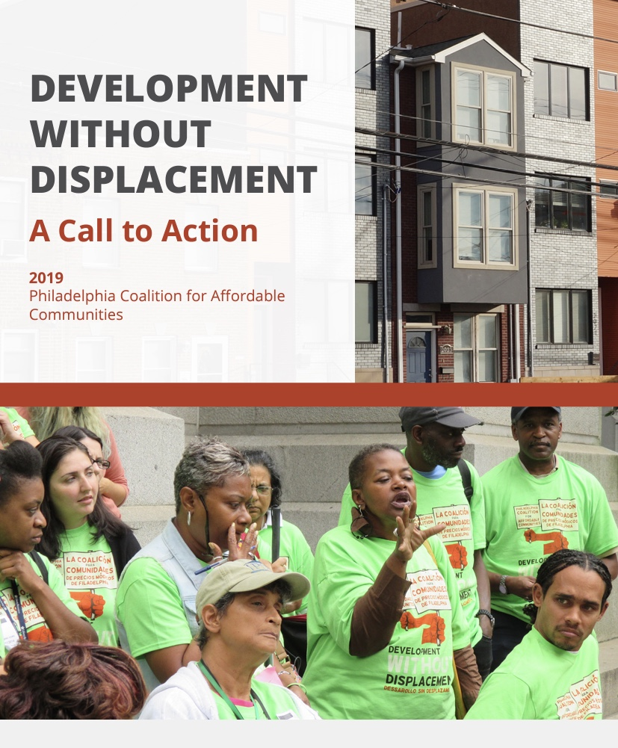

Slide 29
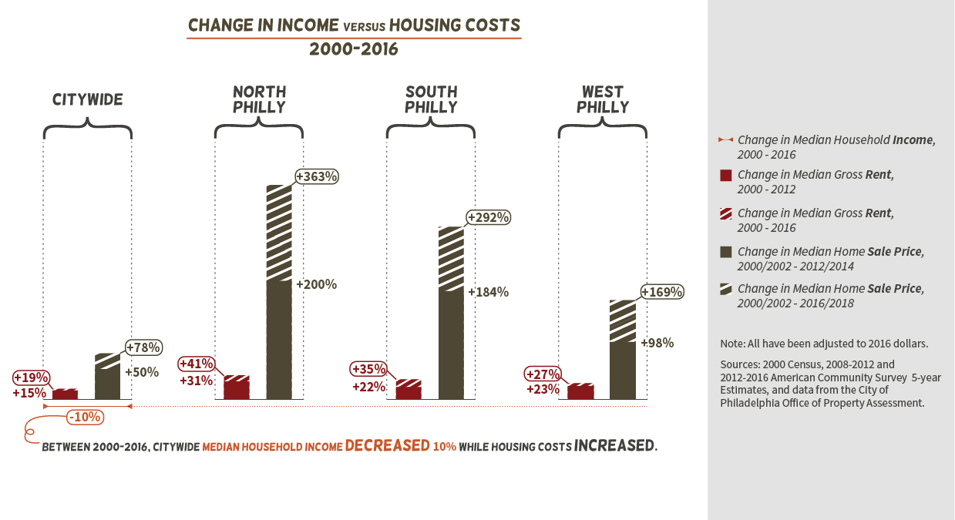

Slide 30
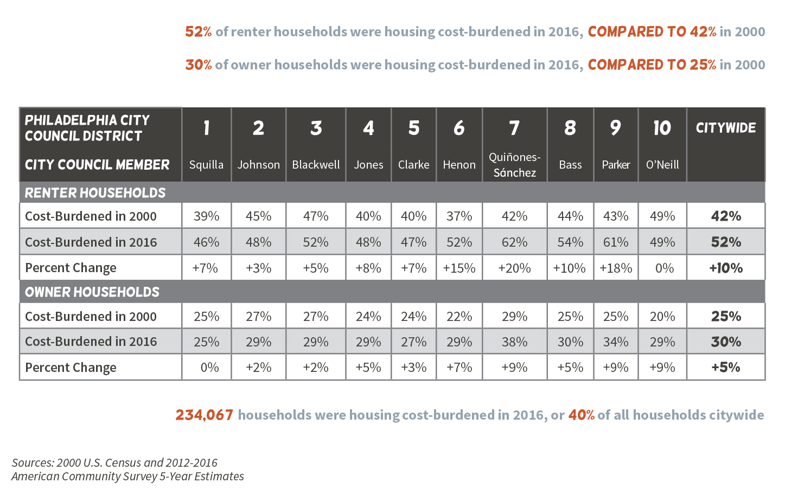

Slide 31
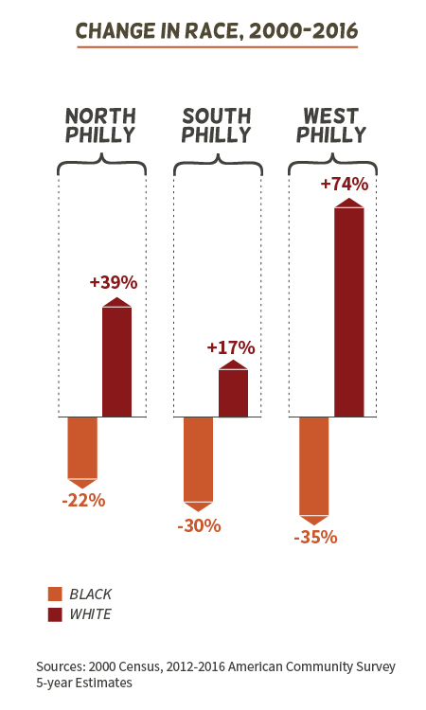

Slide 32
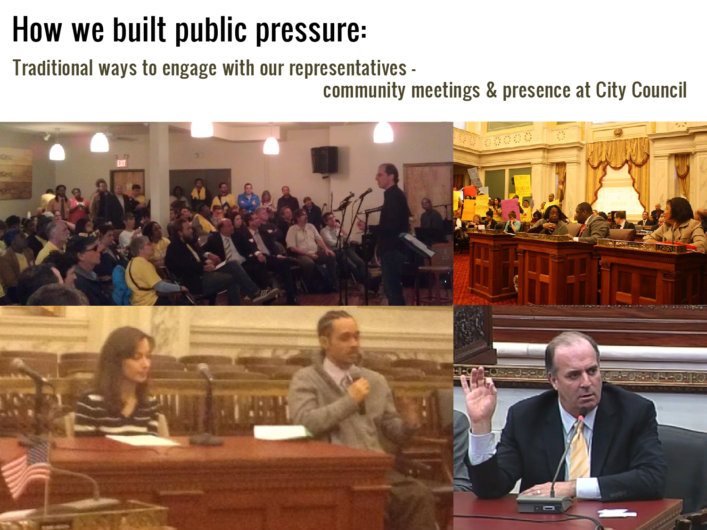

Slide 33
PCAC 10.19.2016 Brainstorm on Affordable Rental Housing Preservation
We asked PCAC members to brainstorm talking points to support the preservation of existing affordable rental housing. Their responses are collected below.
Losing affordable rental homes will lead to more homelessness which is a more expensive problem to tackle.
Losing affordable rental homes will segregate the city more.
Losing affordable rental homes and a lack of stable housing will lead to poor performance in school for kids.
Families will be torn apart if DHS removes children because their parents don’t have heat or housing.
Losing affordable rental housing will increase poverty.
Losing affordable rental housing will also lose economic and racial diversity in our neighborhoods.
Losing affordable rental housing means residents lose the stability that comes from housing they can afford.
The cost of renovating / preserving affordable housing is less than providing homelessness services, incarceration or welfare.
Where will people go?
We should show the effects losing affordable rental housing would have on each district in the city.
Losing affordable rental housing would disrupt the social fabric of our communities.
Losing affordable rental housing would increase gentrification as well as increase the number of small, minority owned businesses that close down or are pushed out of a neighborhood. I would hate to see Lee’s Deli in West Philly become a Starbuck’s.
Losing affordable rental housing would increase the instance of families doubling and tripling up in housing, causing a strain on everyone involved.
Stable housing has a strong / positive link to life outcomes in terms of good health, well-being and social development.
If we stabilize our neighborhoods we can stabilize our schools.
We should focus on number of people, not just number of units.
Have people write letters sharing their stories about their need for affordable housing or how access to affordable housing has changed their lives.
Talk about the current length of wait lists and how this will increase is we lose existing affordable rental housing.
Losing affordable rental housing will incur huge costs for the city due to the number of social service agencies that get involved when someone becomes homeless.

Slide 34
Philadelphia Coalition for Affordable Communities
WE MUST TAKE THIS OPPORTUNITY TO PRESERVE PHILADELPHIA’S INVESTMENT IN AFFORDABLE RENTAL HOUSING
The Problem:
We are in danger of losing more affordable rental housing than we are creating every year unless we act now to preserve existing housing affordability.
Without additional resources, apartments and townhomes in gentrifying neighborhoods, where the need for affordable housing is greatest, will be especially vulnerable.
These aren’t just “units” to the people that live in them. They are homes that offer stability and a critical foundation to keep their families strong.
With 1 out of every 2 renters in Philadelphia paying more than they can afford on rent, we can’t move backwards by losing homes we’ve already spent time, energy and in many cases taxpayers’ money developing.

Slide 35
The Solution:
Ensure that a substantial amount of City resources support affordable rental housing preservation.
New legislation introduced by Councilwoman Parker and passed in the spring of 2016, increased Philadelphia’s realty transfer tax. Council President Clarke and Councilwoman Parker have stated that the intention of this increase is to re-pay a proposed $100 million bond for affordable housing preservation.
BUT the current proposal only addresses the need for homeownership preservation, not the critical need for rental preservation.
We need to make sure that legislation passed to spend these new resources includes $40,000,000 to support affordable rental developments that will otherwise disappear.
With this money we can build on and preserve the investments we’ve already made to guarantee that low-income Philadelphia renters have a place to call home.

Slide 36
Affordable Rental Housing Preservation City Councilmember Call-In Script
Use this version if you live, work or worship in the district you are calling
Thank you for joining our efforts to educate City Councilmembers about the importance of preserving affordable rental housing in Philadelphia. We are in danger of losing over 1,000 affordable units in the next three years. We are asking City Council to use $40 million from legislation currently moving through Council to make sure we keep the affordable rental units we already have.
Hello, my name is ______________________ and I (live/work/worship) in the ___________ District. I’m part of the Philadelphia Coalition for Affordable Communities and I am calling today to talk to Councilmember____________________ to see if they will support our proposal to preserve affordable rental housing in Philadelphia. Are they available?
If No
We dropped off some information yesterday about the danger we face of losing over 1,000 affordable rental units in the next 3 years and I wanted to make sure they got it.
Can you let the Council member know I called and that we hope they will meet with us to talk about our proposal to use $40 million dollars from the Affordable Housing Preservation Bond to preserve affordable rental housing? Someone from the coalition will call soon to set up a meeting. Thank you.
If Yes
Hello Councilmember______________. My name is ______________. I (live)/(work)/(worship) in your district and I’m with the Philadelphia Coalition for Affordable Communities.
I am calling you to make sure you got the information we dropped off yesterday about the danger we face of losing over 1,000 affordable rental units in the next 3 years.
We hope you will meet with us soon to talk about our proposal to use $40 million dollars from the Affordable Housing Preservation Bond to preserve affordable rental housing in Philadelphia. Someone from the coalition will call you soon to set up a meeting. Thank you.

Slide 38
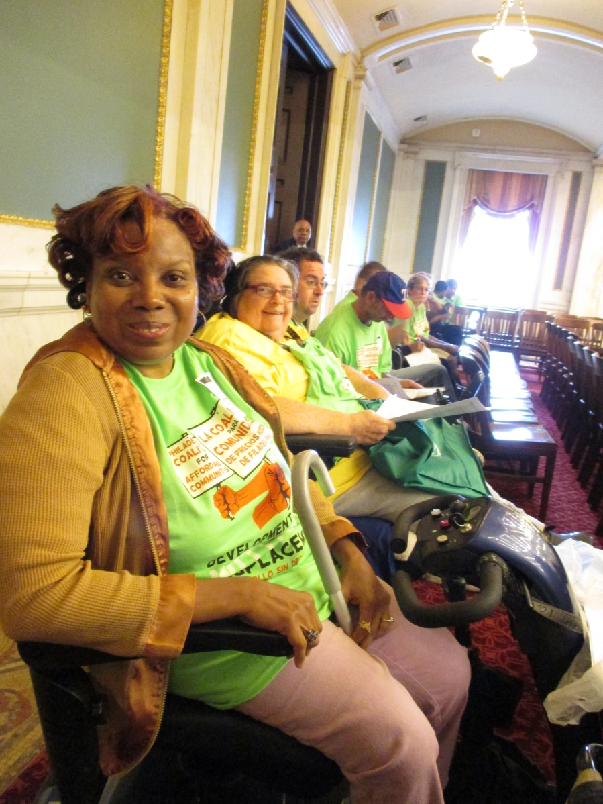
The Philadelphia Coalition For Affordable
Communities
JOIN US! Contact Christi Clark
cclark@wcrpphila.org
215 627 5550 ext 218

Slide 39
Thank You
Carolyn Placke – LISC
cplacke@lisc.org
Rachel Garland – Community Legal Services
RGarland@clsphila.org
Nora Lichtash - Women’s Community Revitalization Project
nlichtash@wcrpphila.org
Christi Clark – Philadelphia Coalition for Affordable Communities cclark@wcrpphila.org

