Slide 1
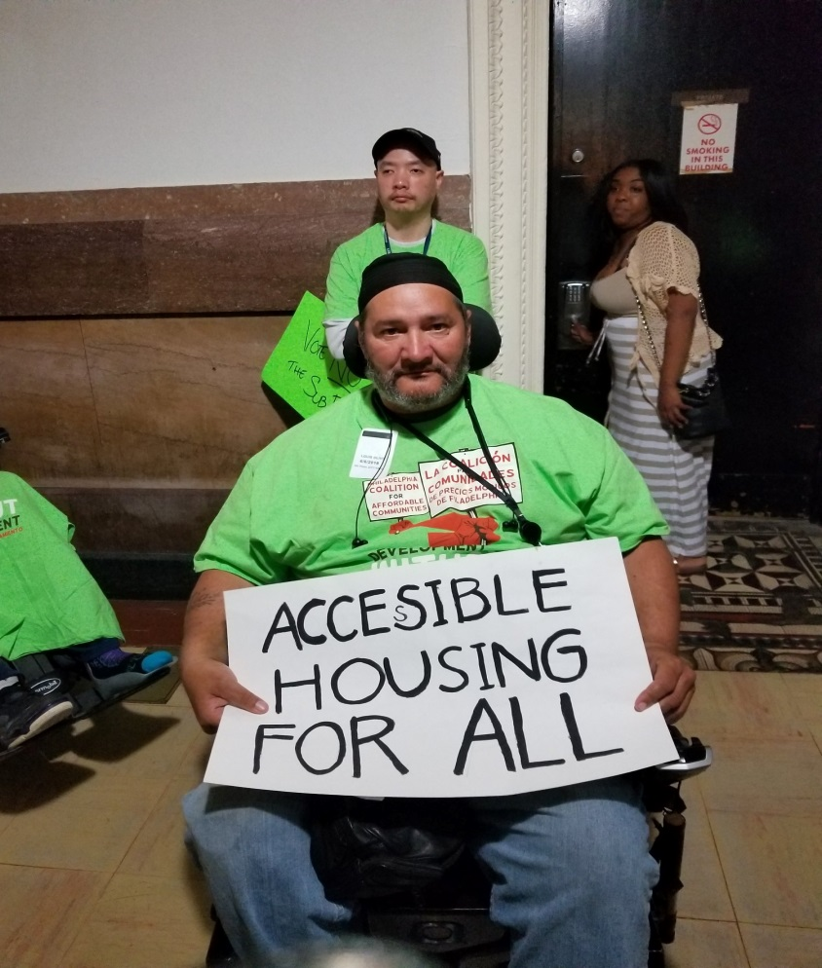
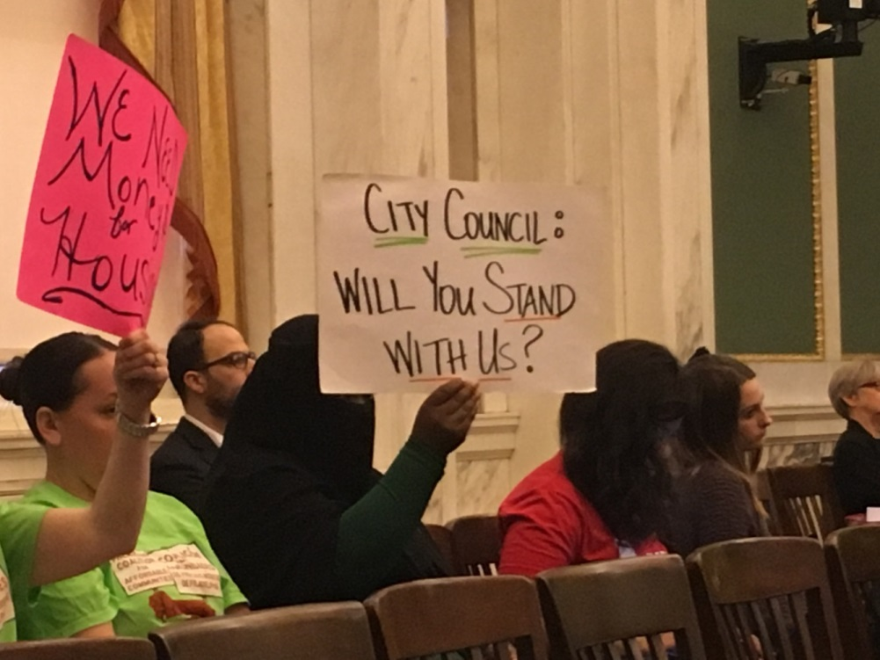
building our clout through community organizing

Slide 2
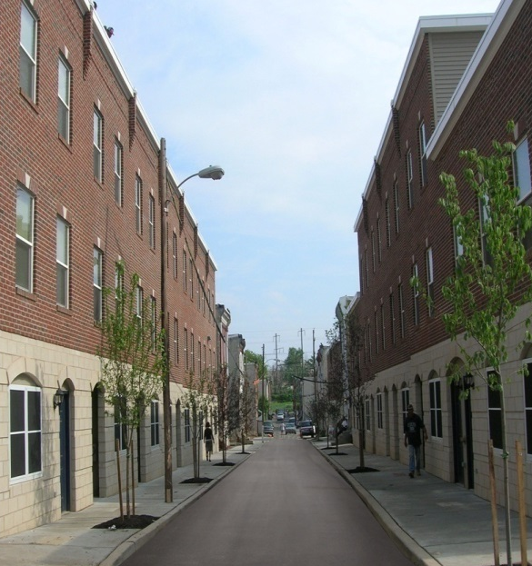
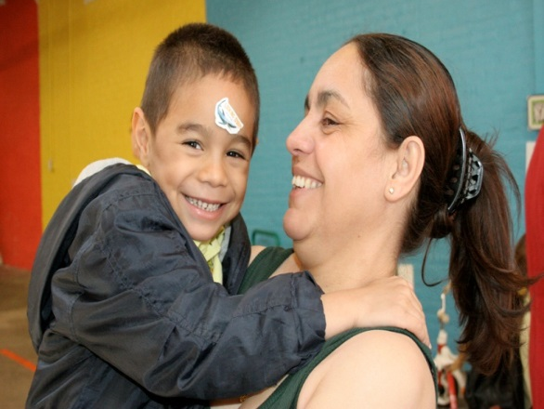
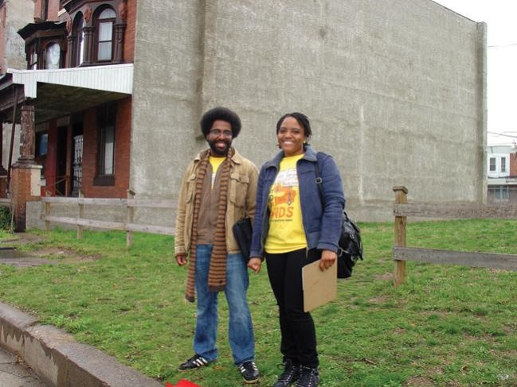

Slide 3
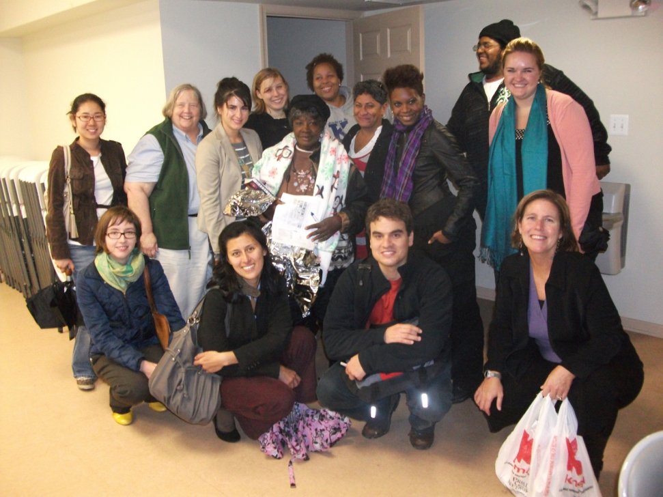
Involving Community Members on Committees and Our Board

Slide 4
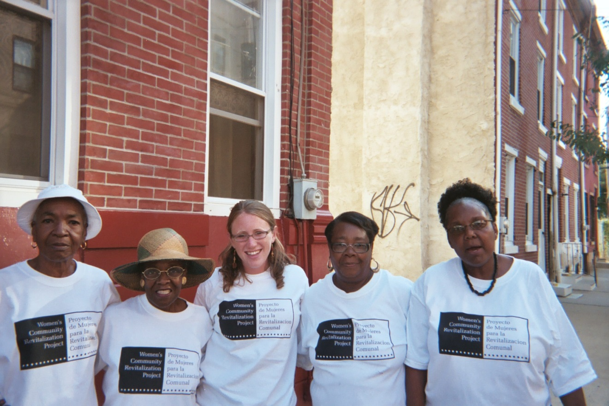
Doing Outreach in the Neighborhood

Slide 6
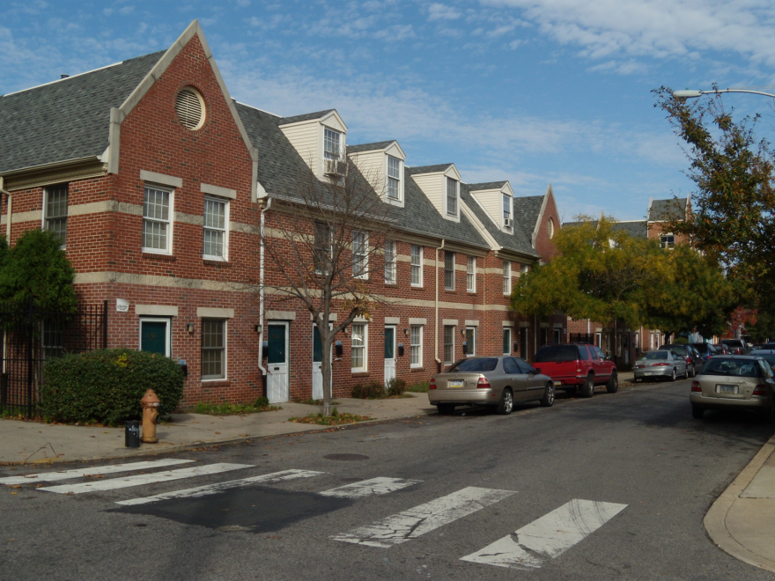
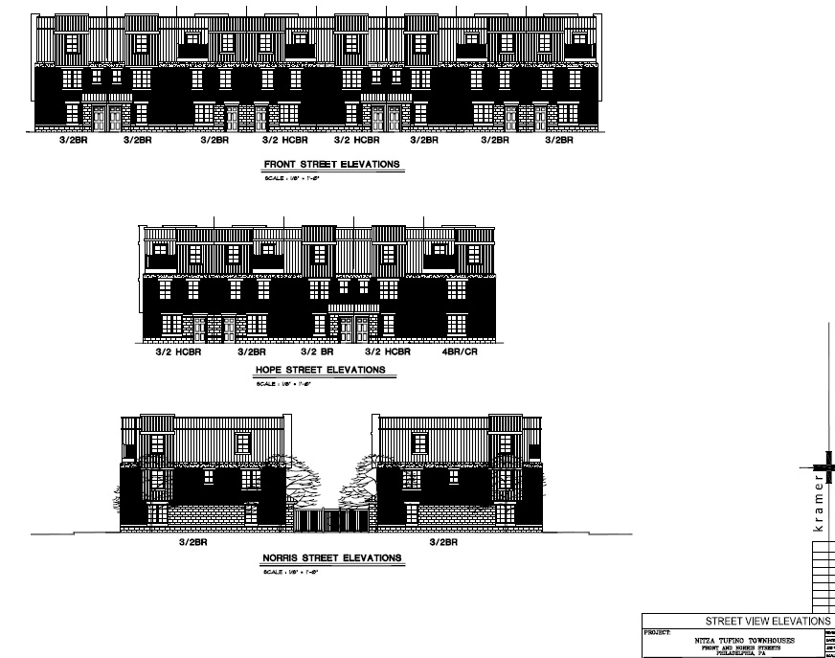
Not in My Back Yard & Zoning Challenges

Slide 7
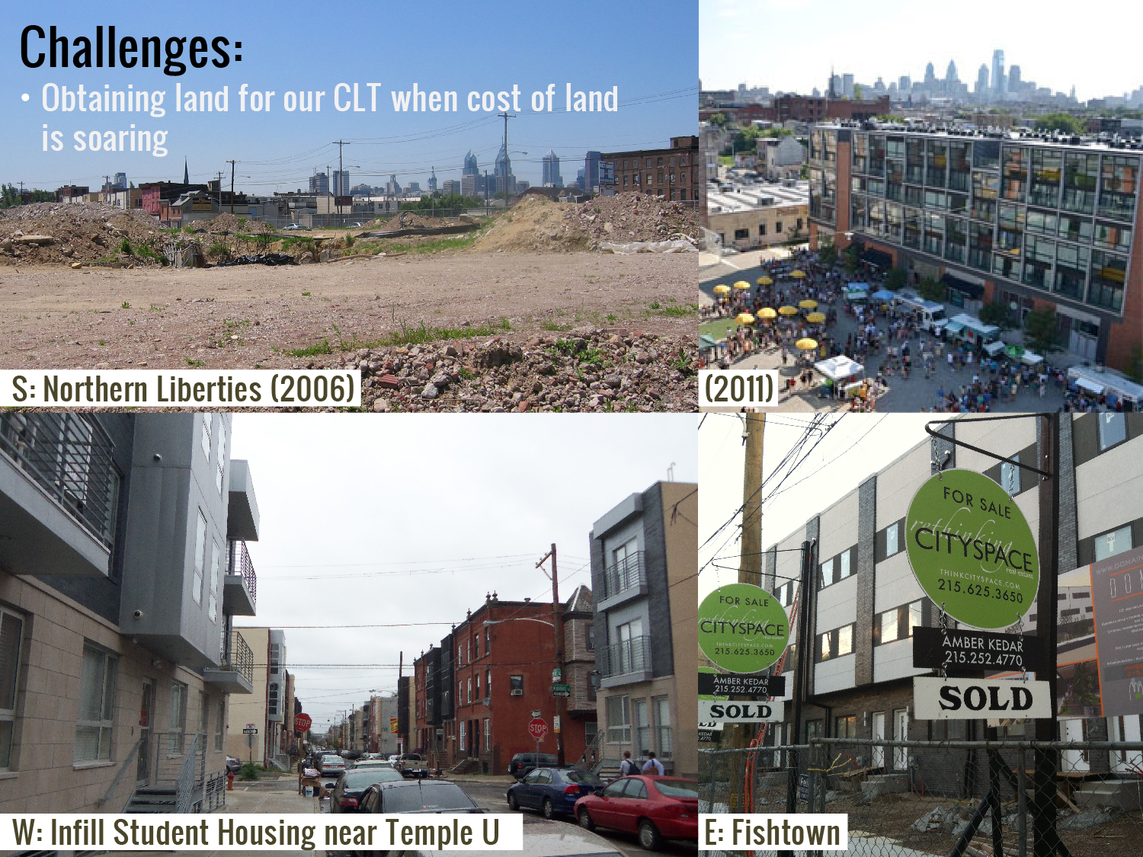
Obtaining Land When the Costs are Soaring

Slide 9
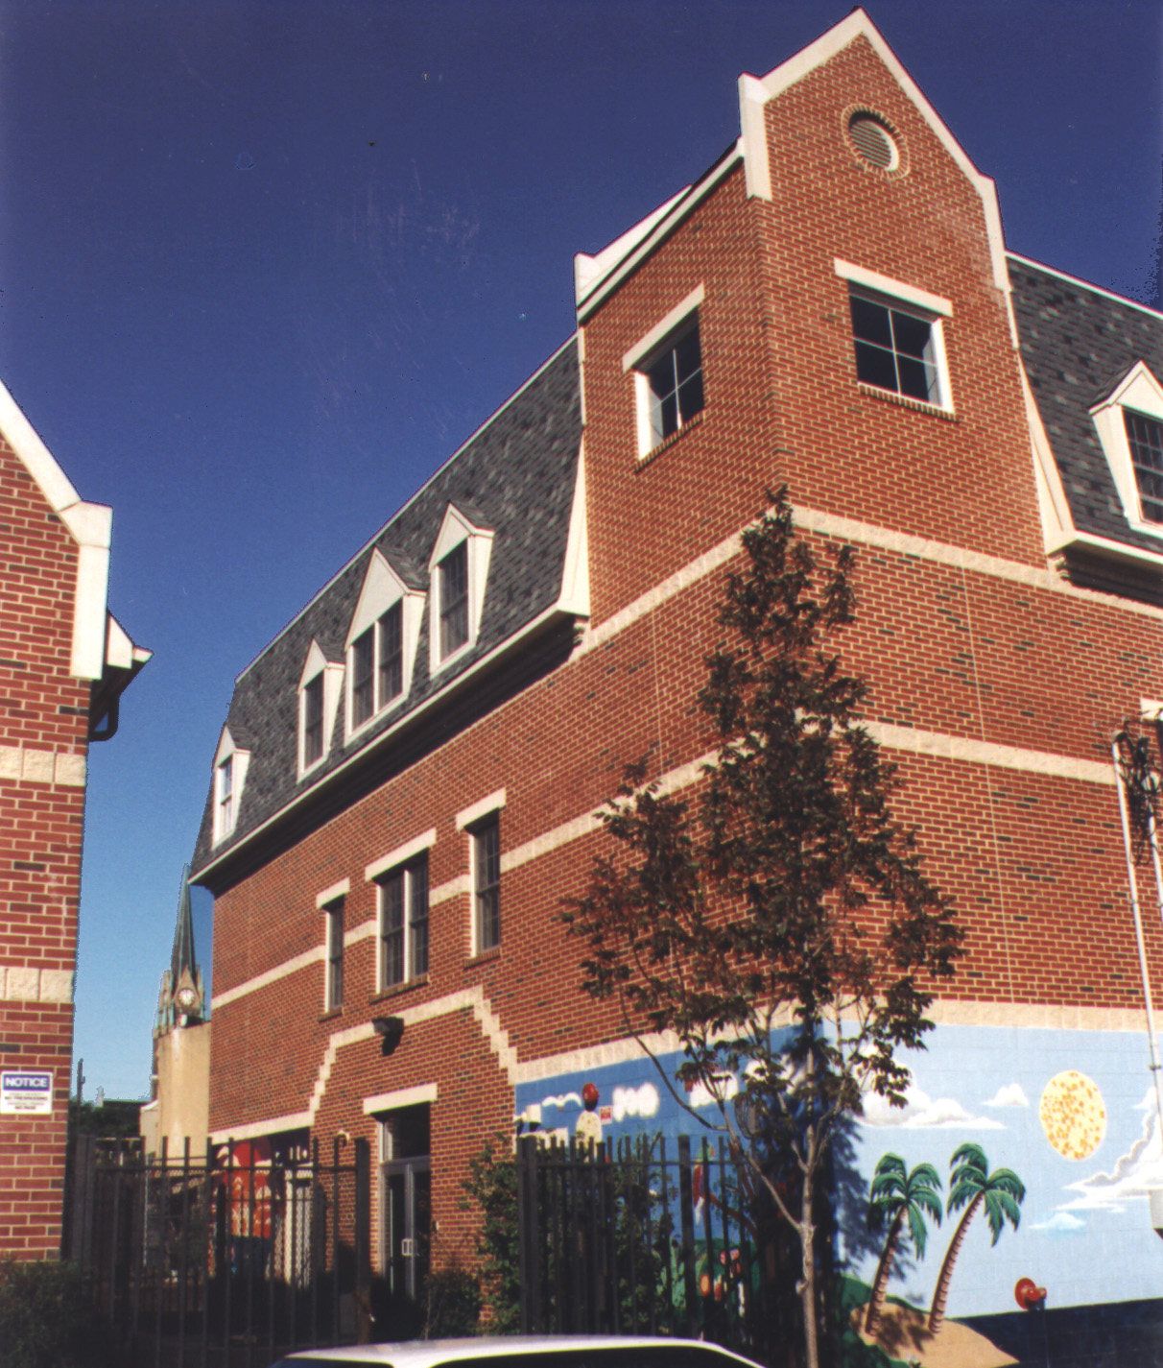
Villanueva Child Development Center
r

Slide 10
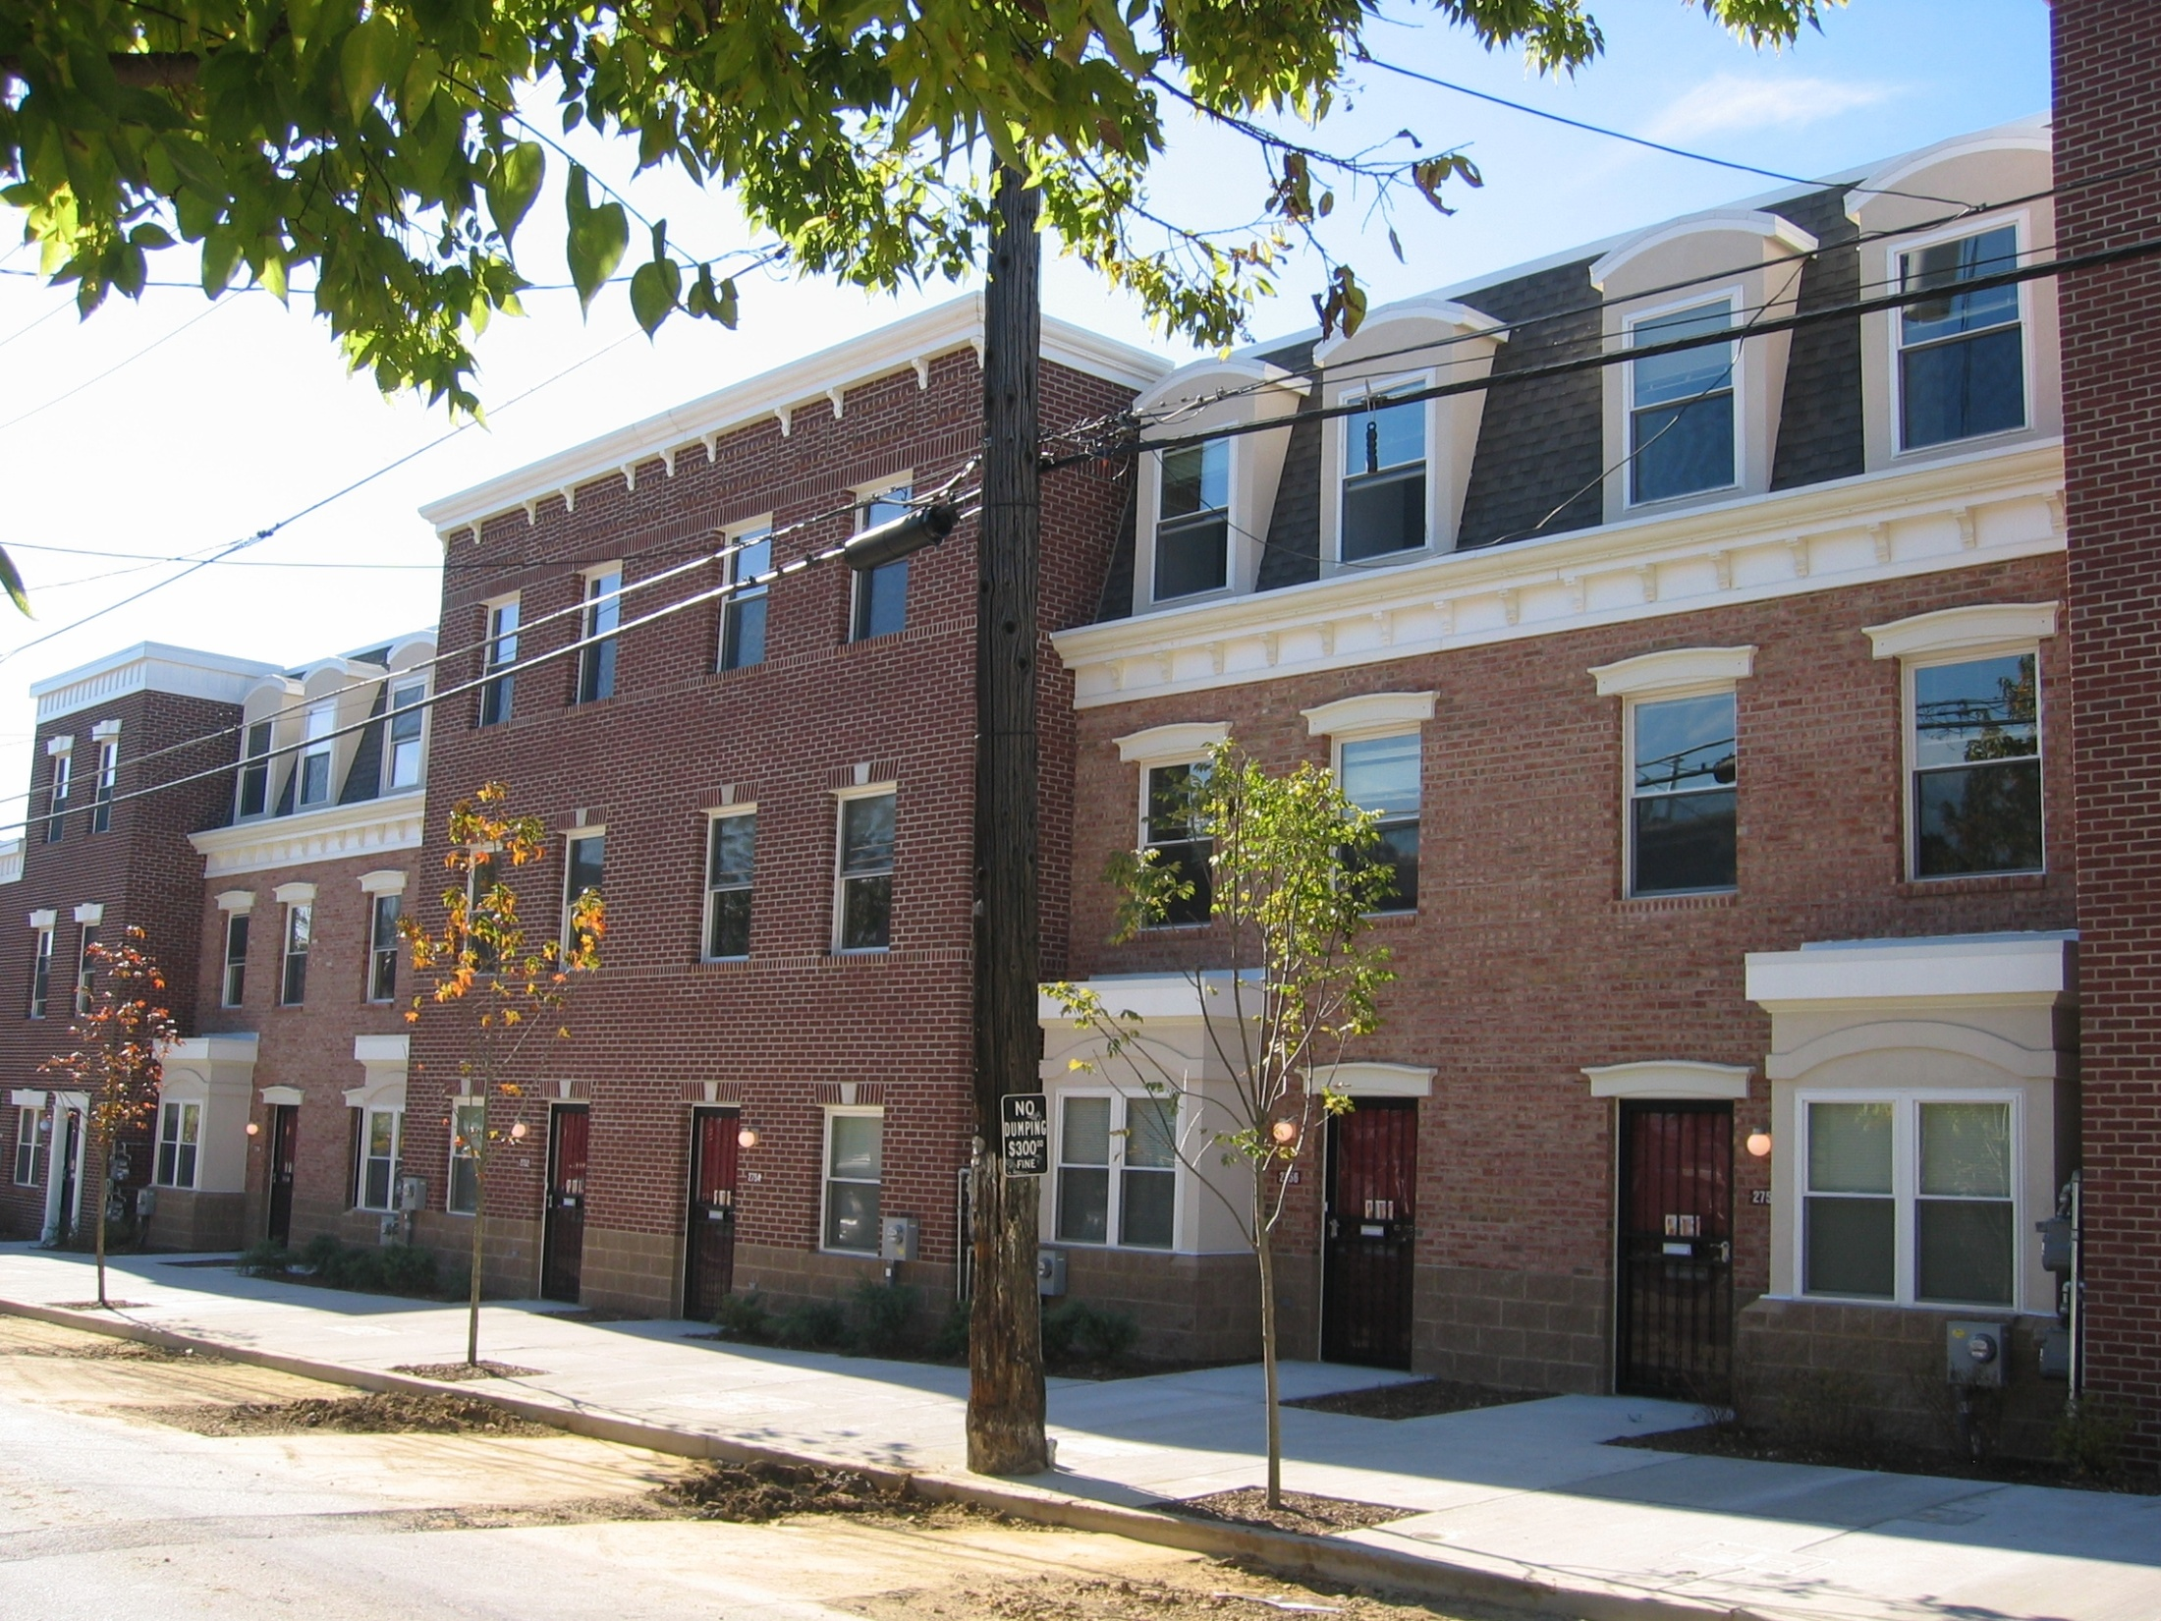
Iris Nydia Brown Townhouses Somerset & Mascher St.
AFTER

Slide 11
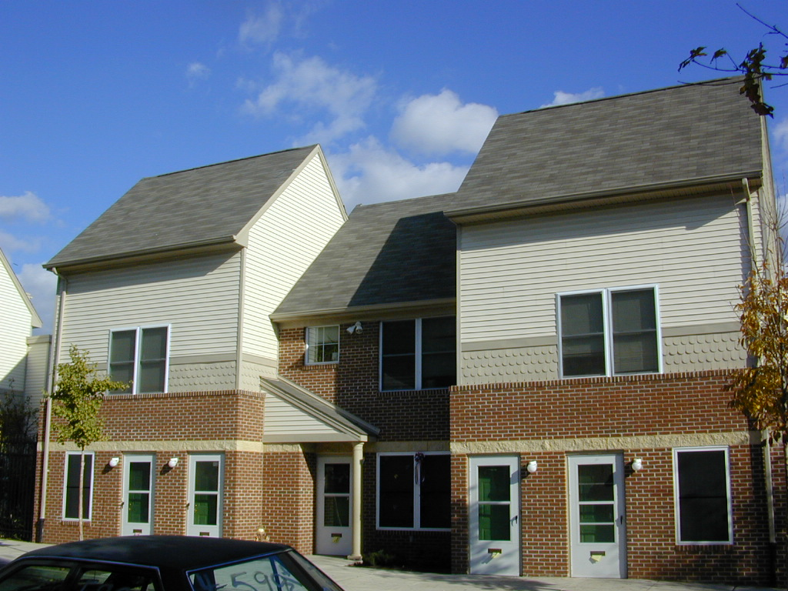

Slide 12
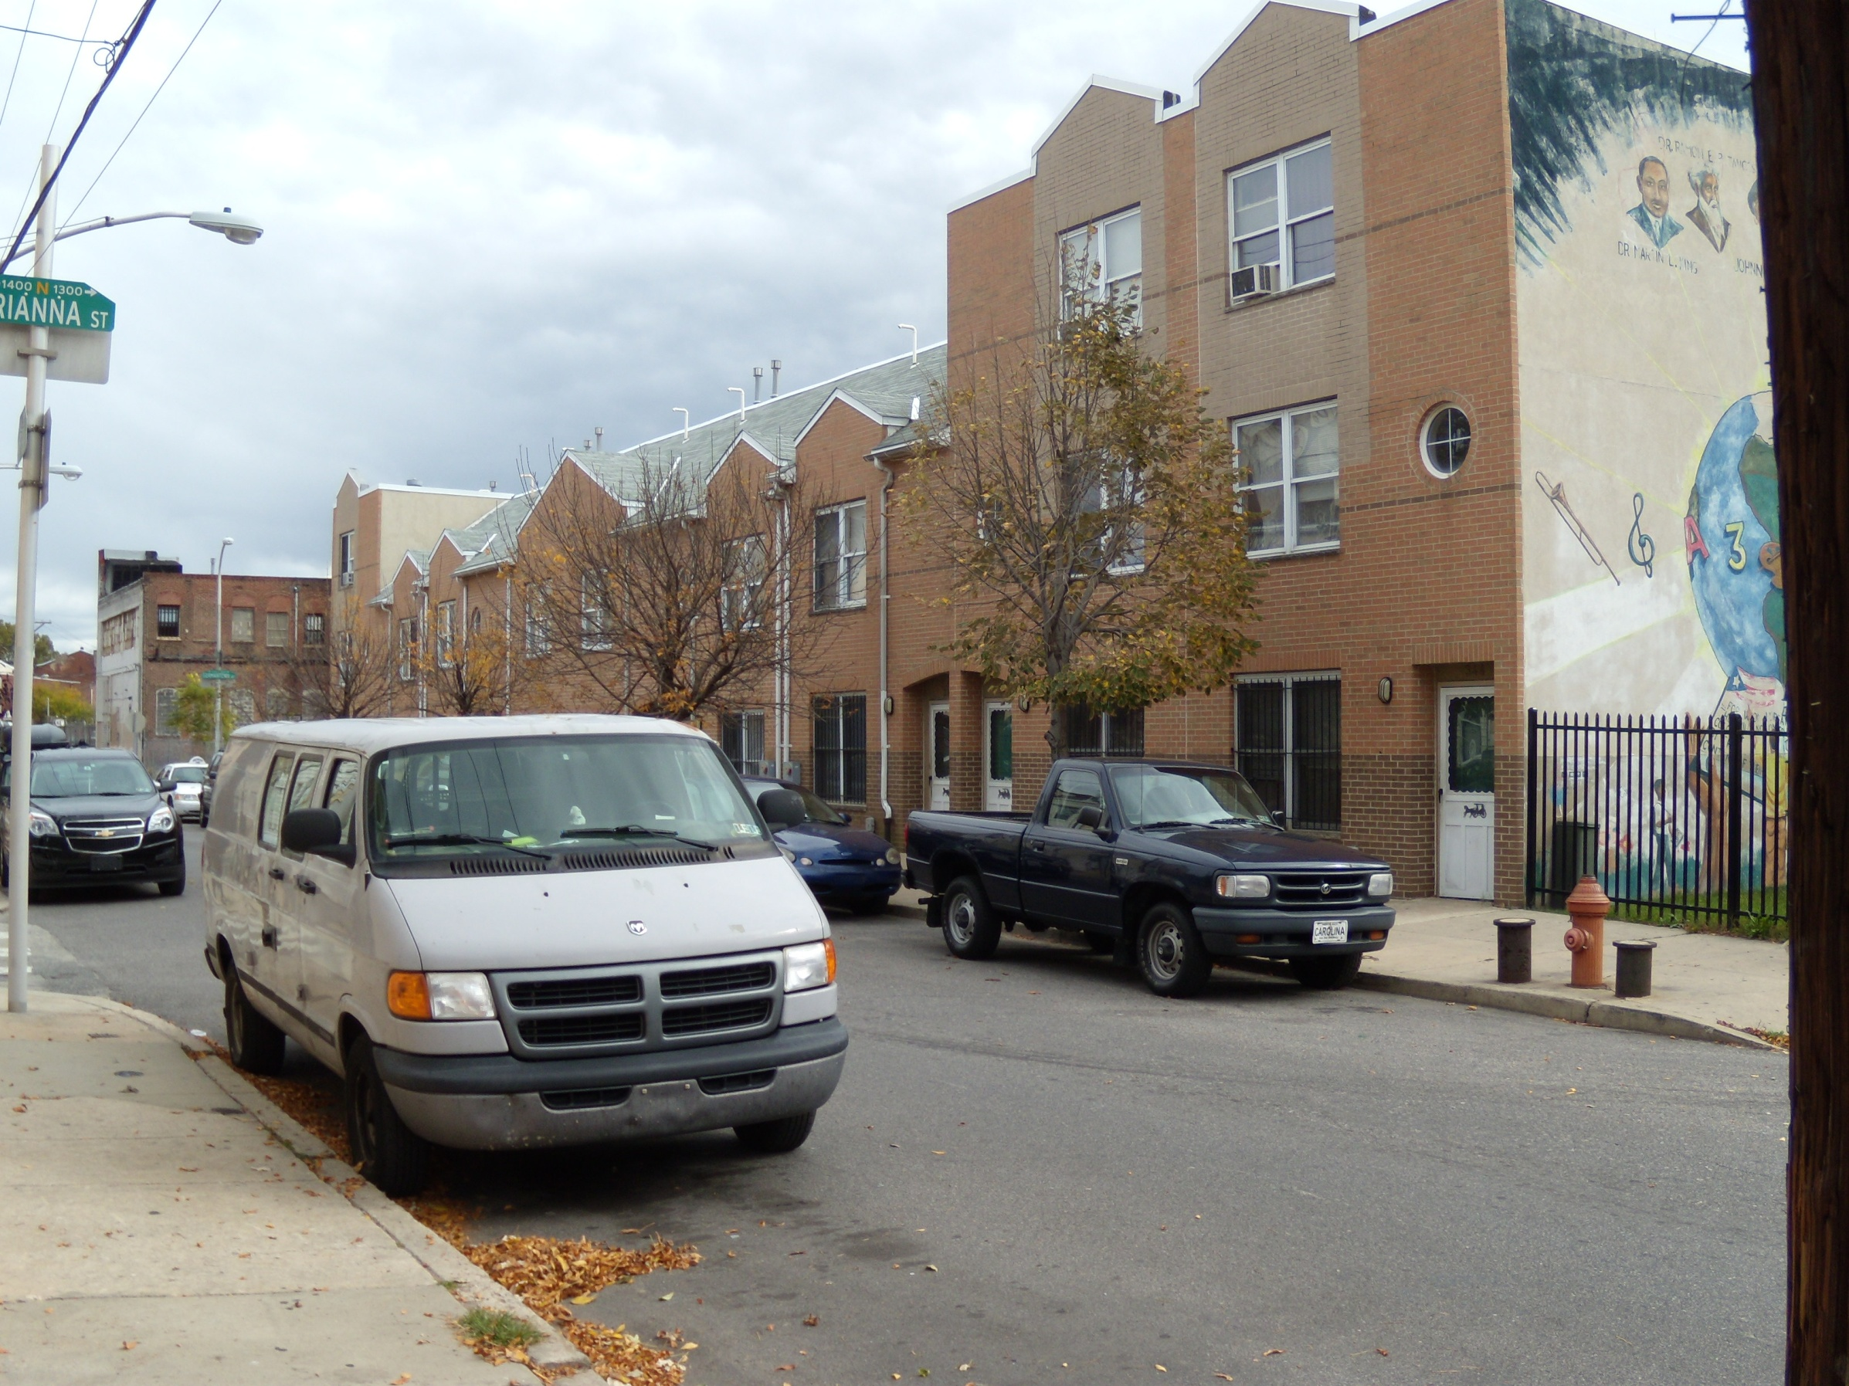
Johnnie Tillmon Townhouses 4th and Master

Slide 13
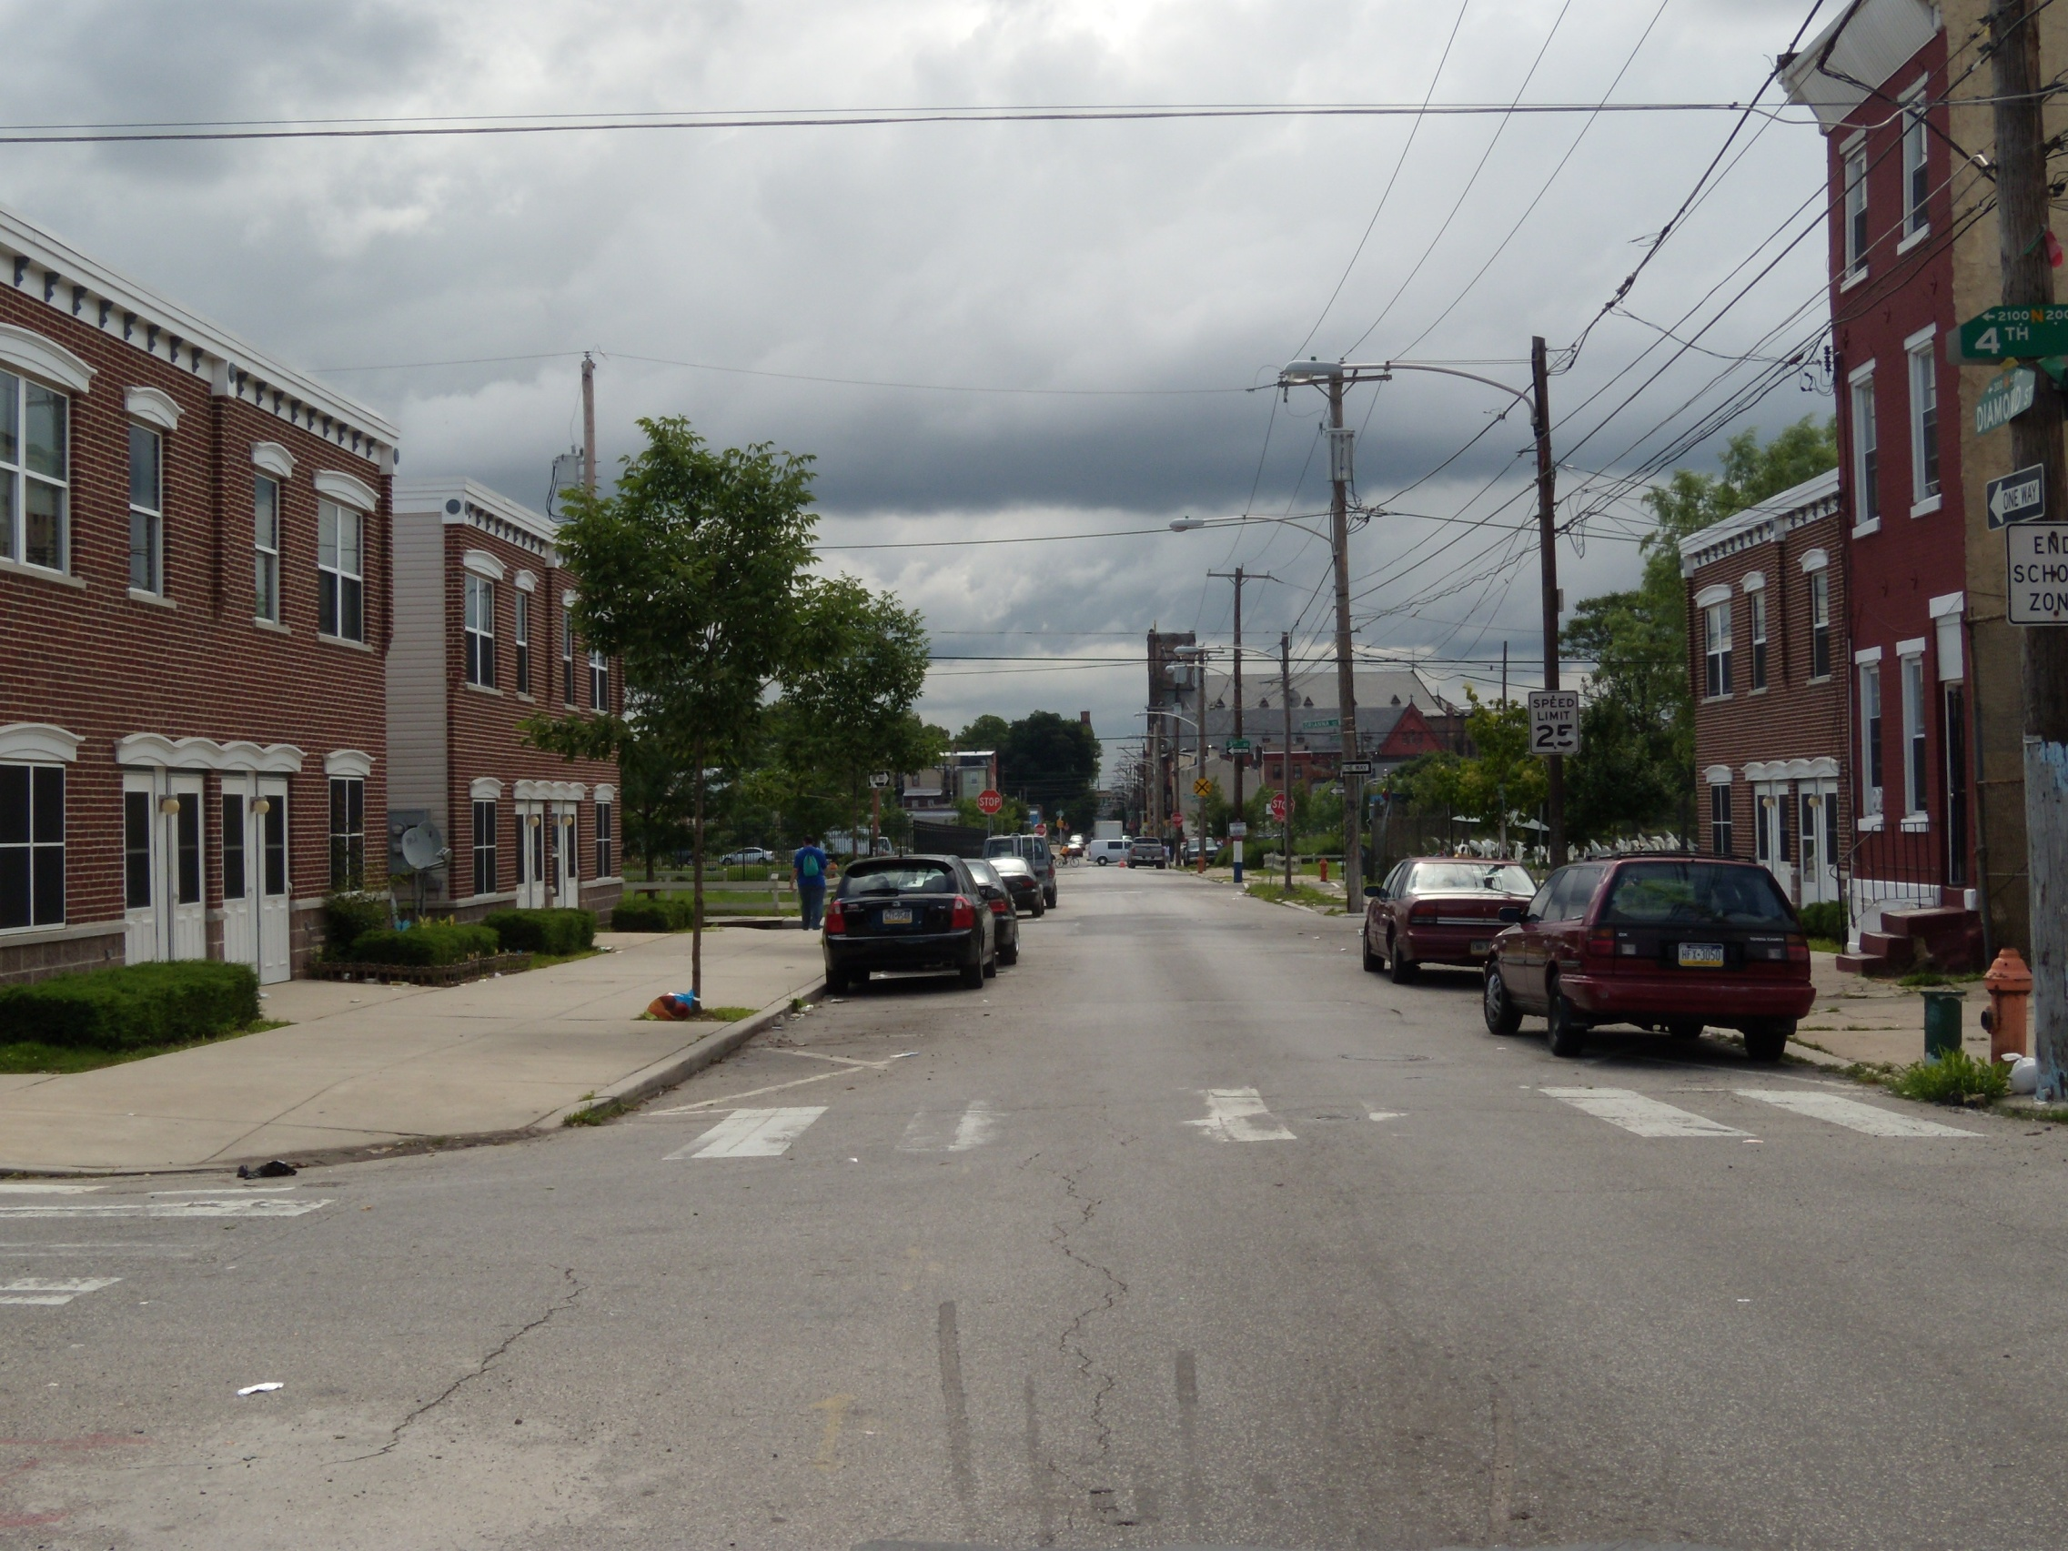
Karen Donnally Townhouses 4th and Diamond

Slide 14
Evelyn Sanders Townhouses 9th and Indiana

Slide 19
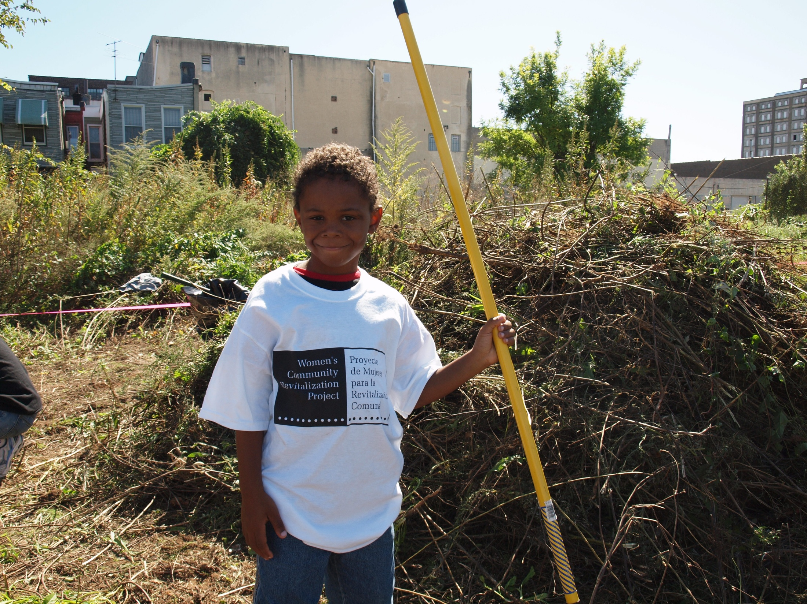

Slide 20
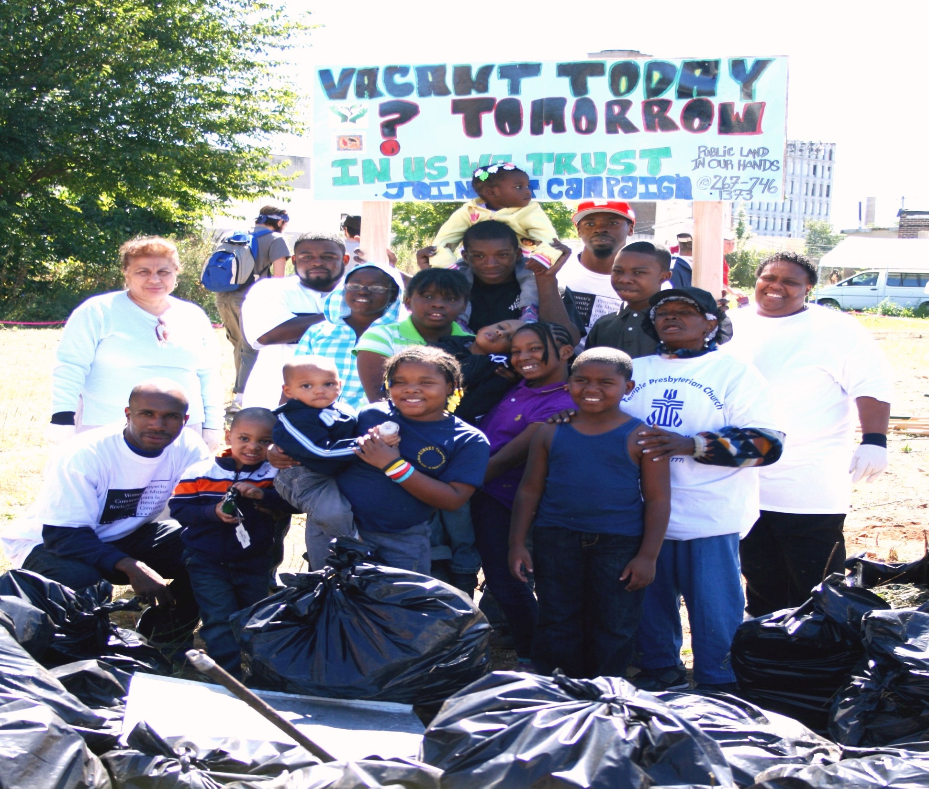

Slide 22
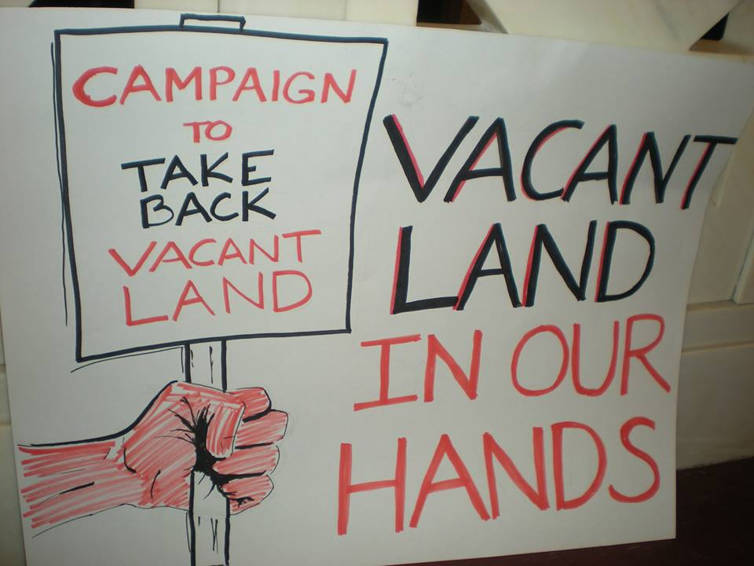

Slide 23
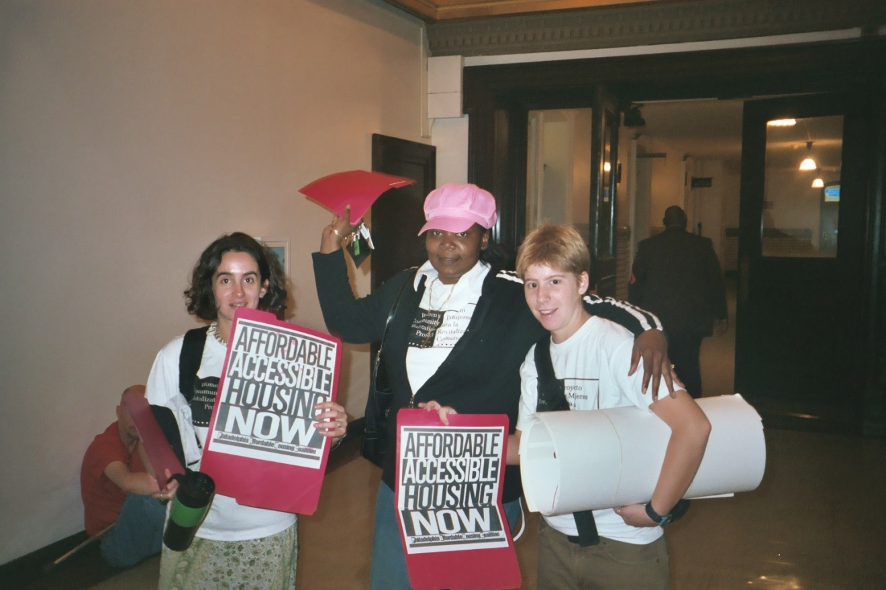

Slide 24
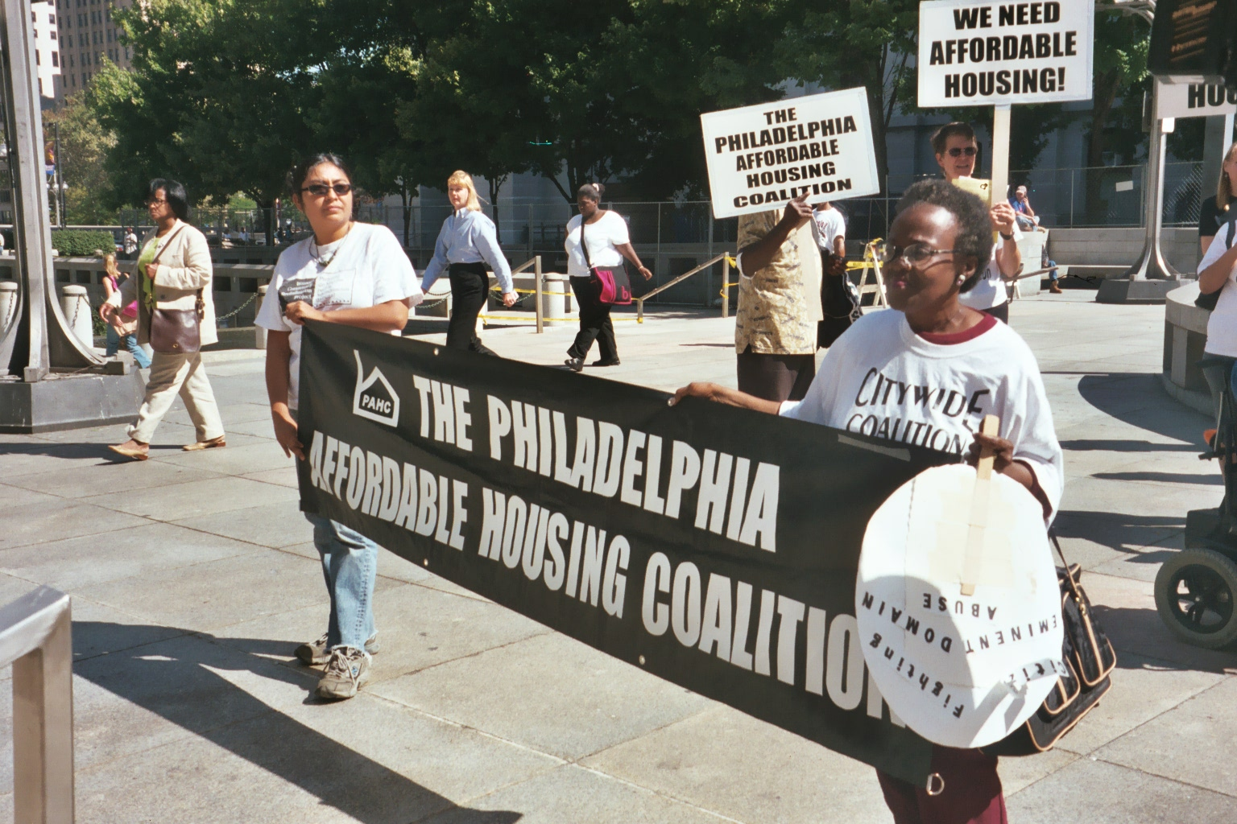

Slide 25
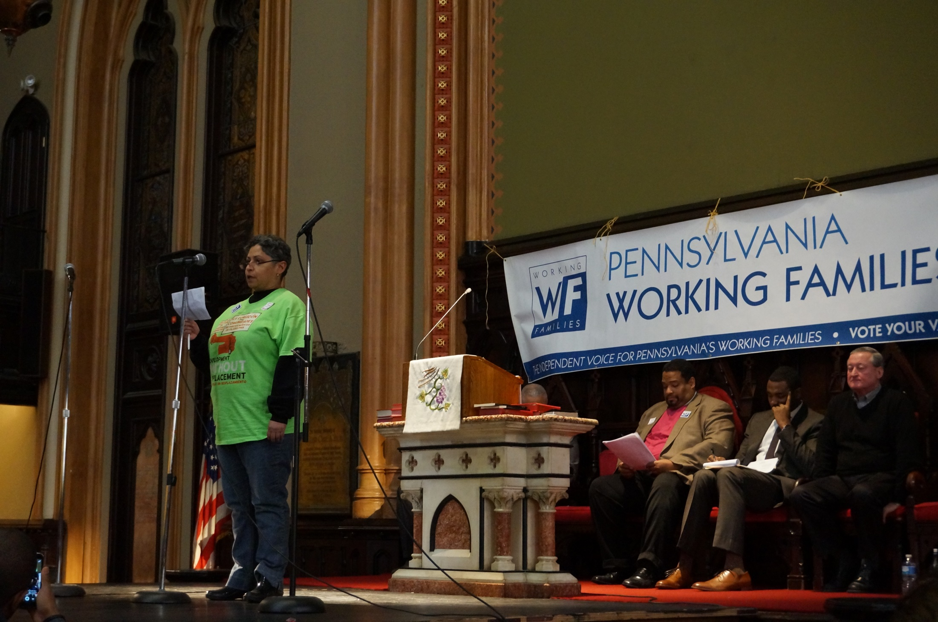

Slide 26
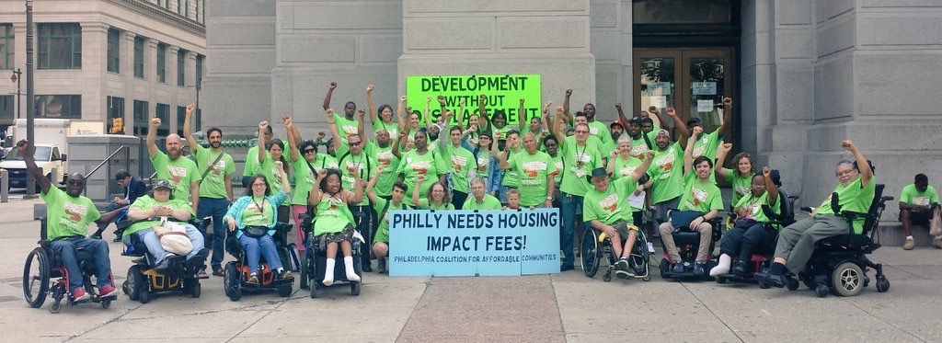

Slide 27
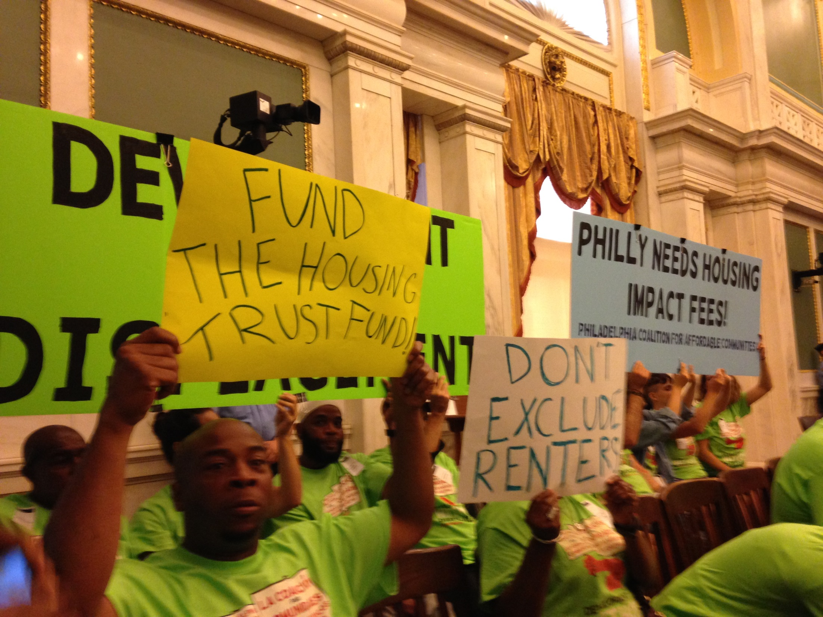

Slide 28
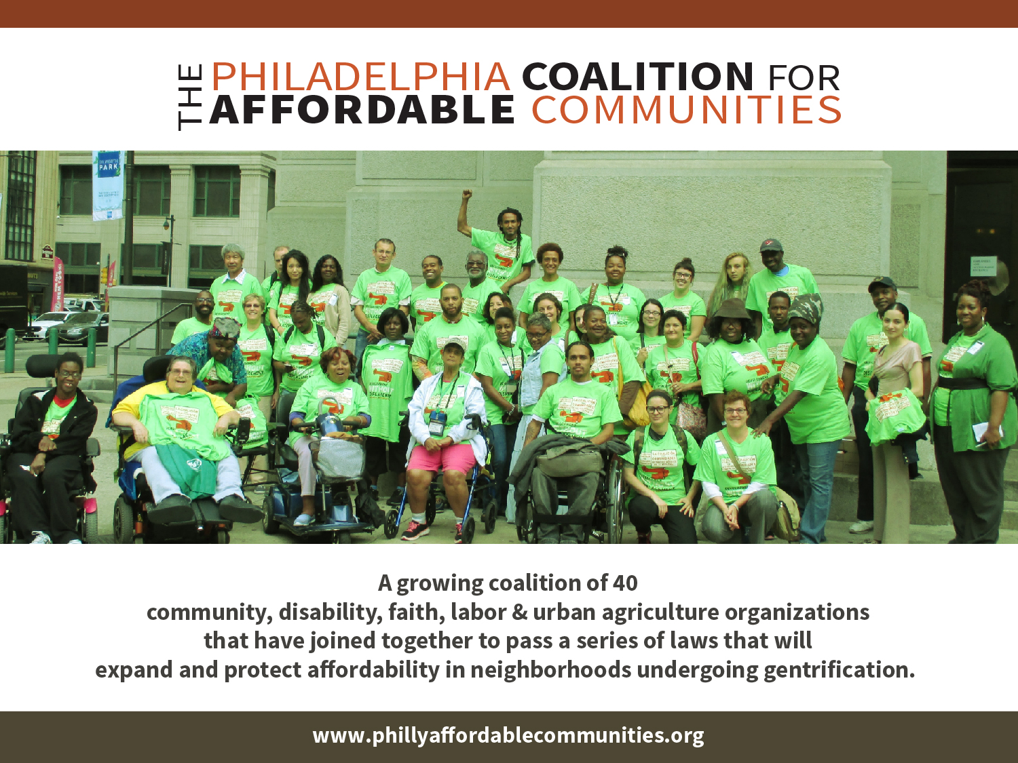
60
Notes:
NORA - introducing PCAC

Slide 30
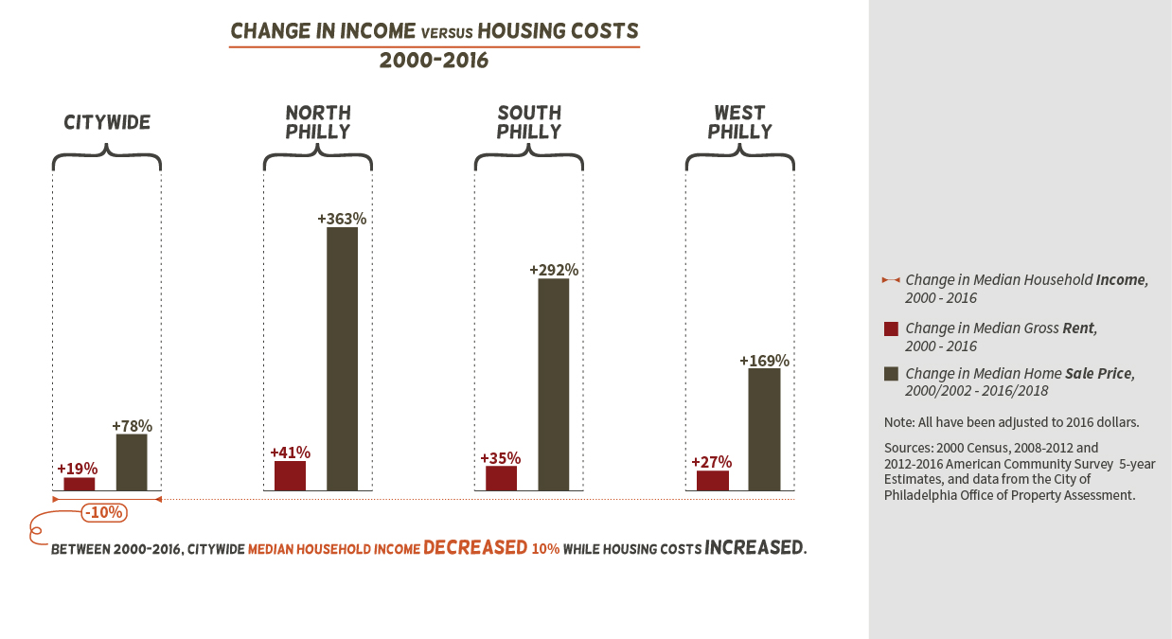

Slide 31
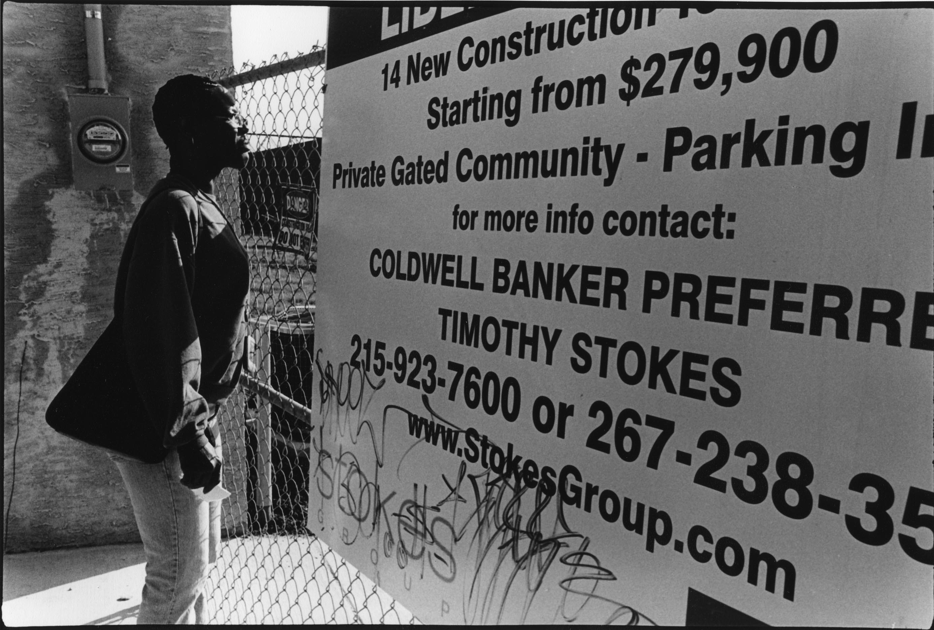

Slide 32
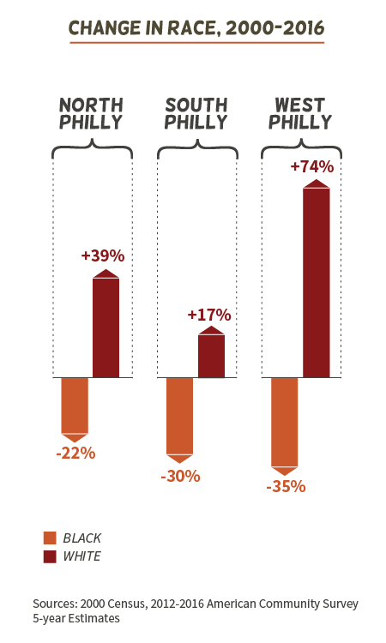

Slide 33
We invite you to work with the Philadelphia Coalition for Affordable Communities To ensure that our elected officials prioritize community needs
To pass legislation that would provide new dedicated sources of funding for the production and preservation of housing that is affordable and accessible
Ensure that half of all money in the housing trust fund goes to households making 30% or less of median income
Put $35 million annually from expiring tax abatements or another source into the housing trust fund
Ensure the land bank works in a fair, transparent and accountable way that gives us land for community needs
Publicly held and tax delinquent property from all council districts goes into the land bank
50% of the land from each district is given for nominal fee to groups for community benefit: affordable housing, economic development or food production
Land bank is not required to pay the city back for real estate and other municipal liens except for taxes imposed by the school district

Slide 34
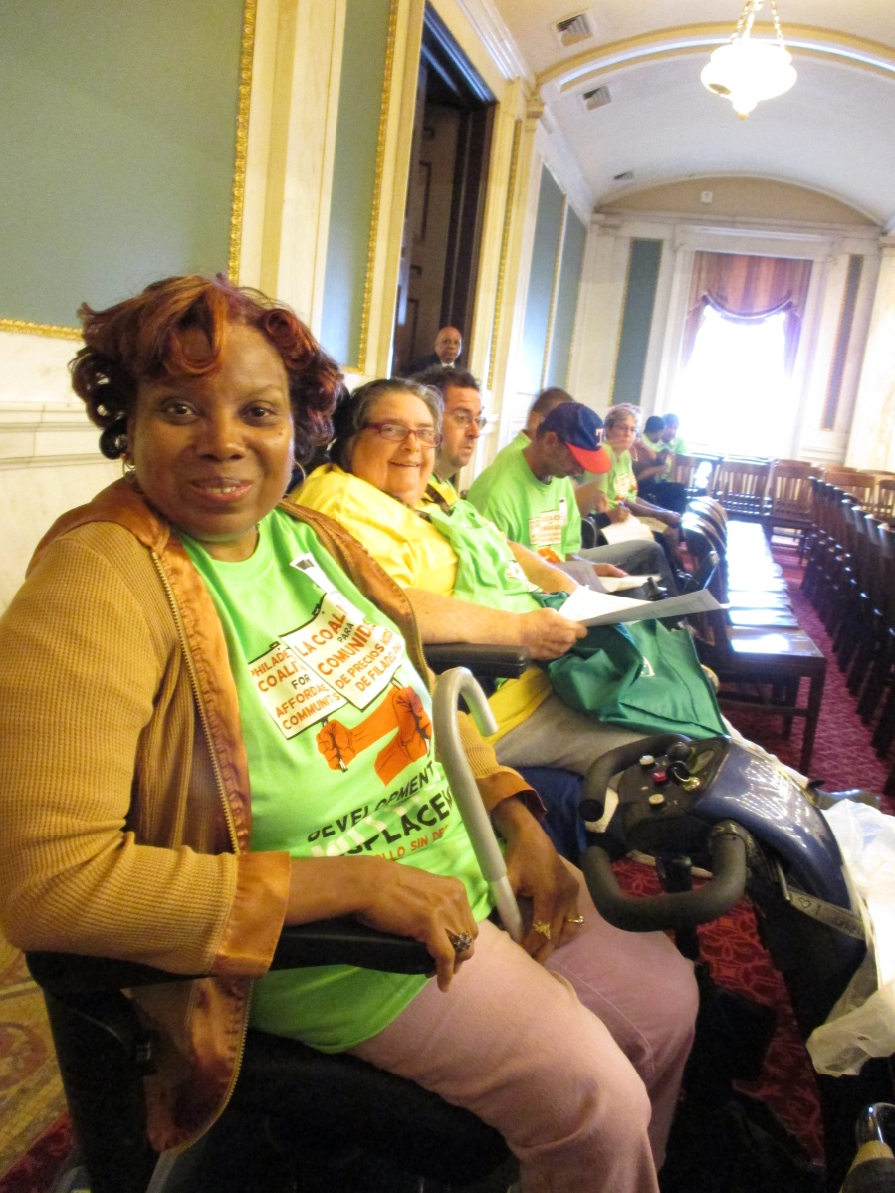
The Philadelphia Coalition For Affordable
Communities
JOIN US! Contact Christi Clark
cclark@wcrpphila.org
215 627 5550 ext 218

