Slide 1
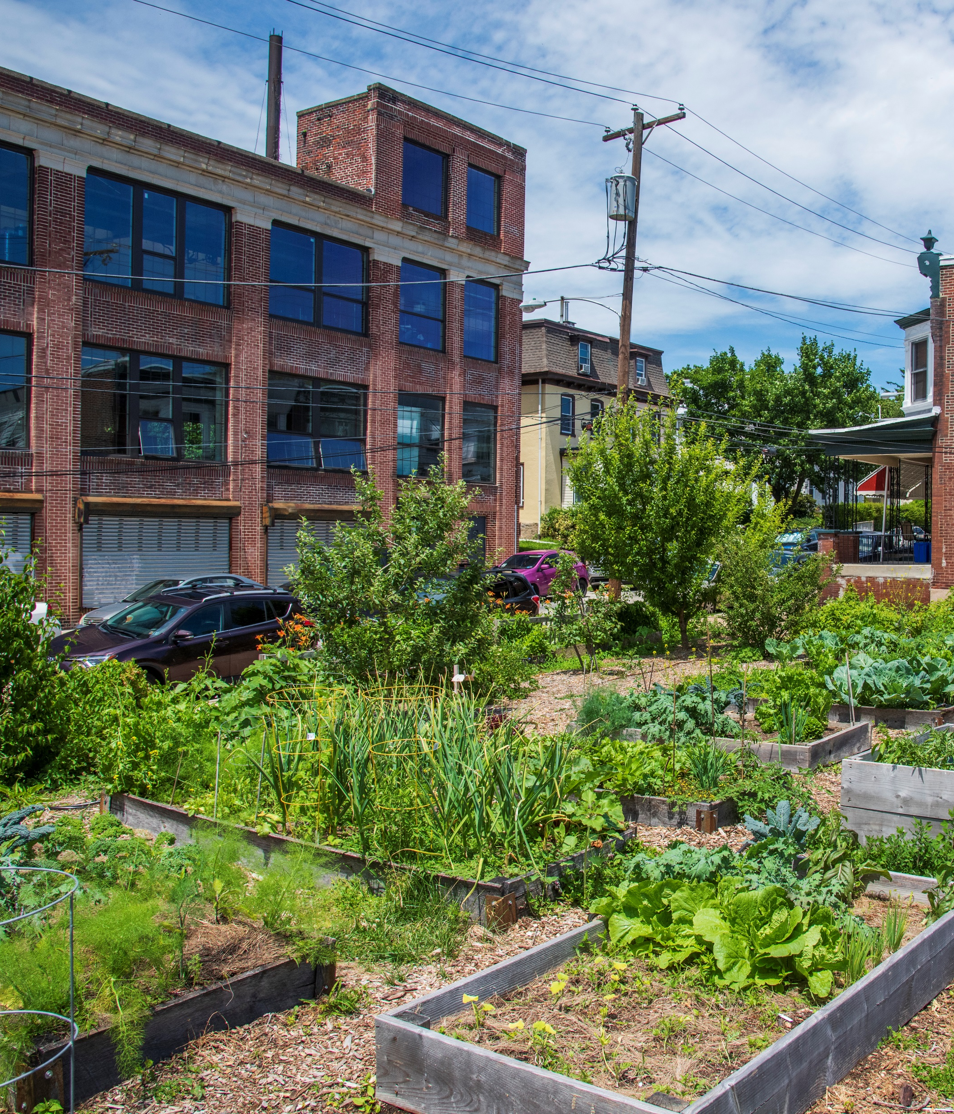
Protecting Land for Community Gardens
2019 PACDC Equitable Development Conference
Marlana Moore, Neighborhood Gardens Trust
Ebony Griffin, Public Interest Law Center
Myra Smith, Amber Street Community Garden
Victor Young, Five Loaves Two Fish Community Garden
Julius Rivera, Collins Smith Barrick Playgarden

Slide 2
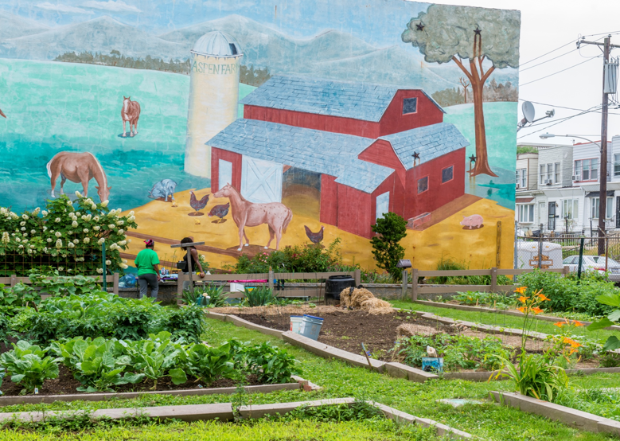
Community Gardens in Philadelphia
Food Producing
Aspen Farms, 49th & Aspen
Sitting Garden/Open Space
Tulip St Community Garden, Kensington

Slide 3
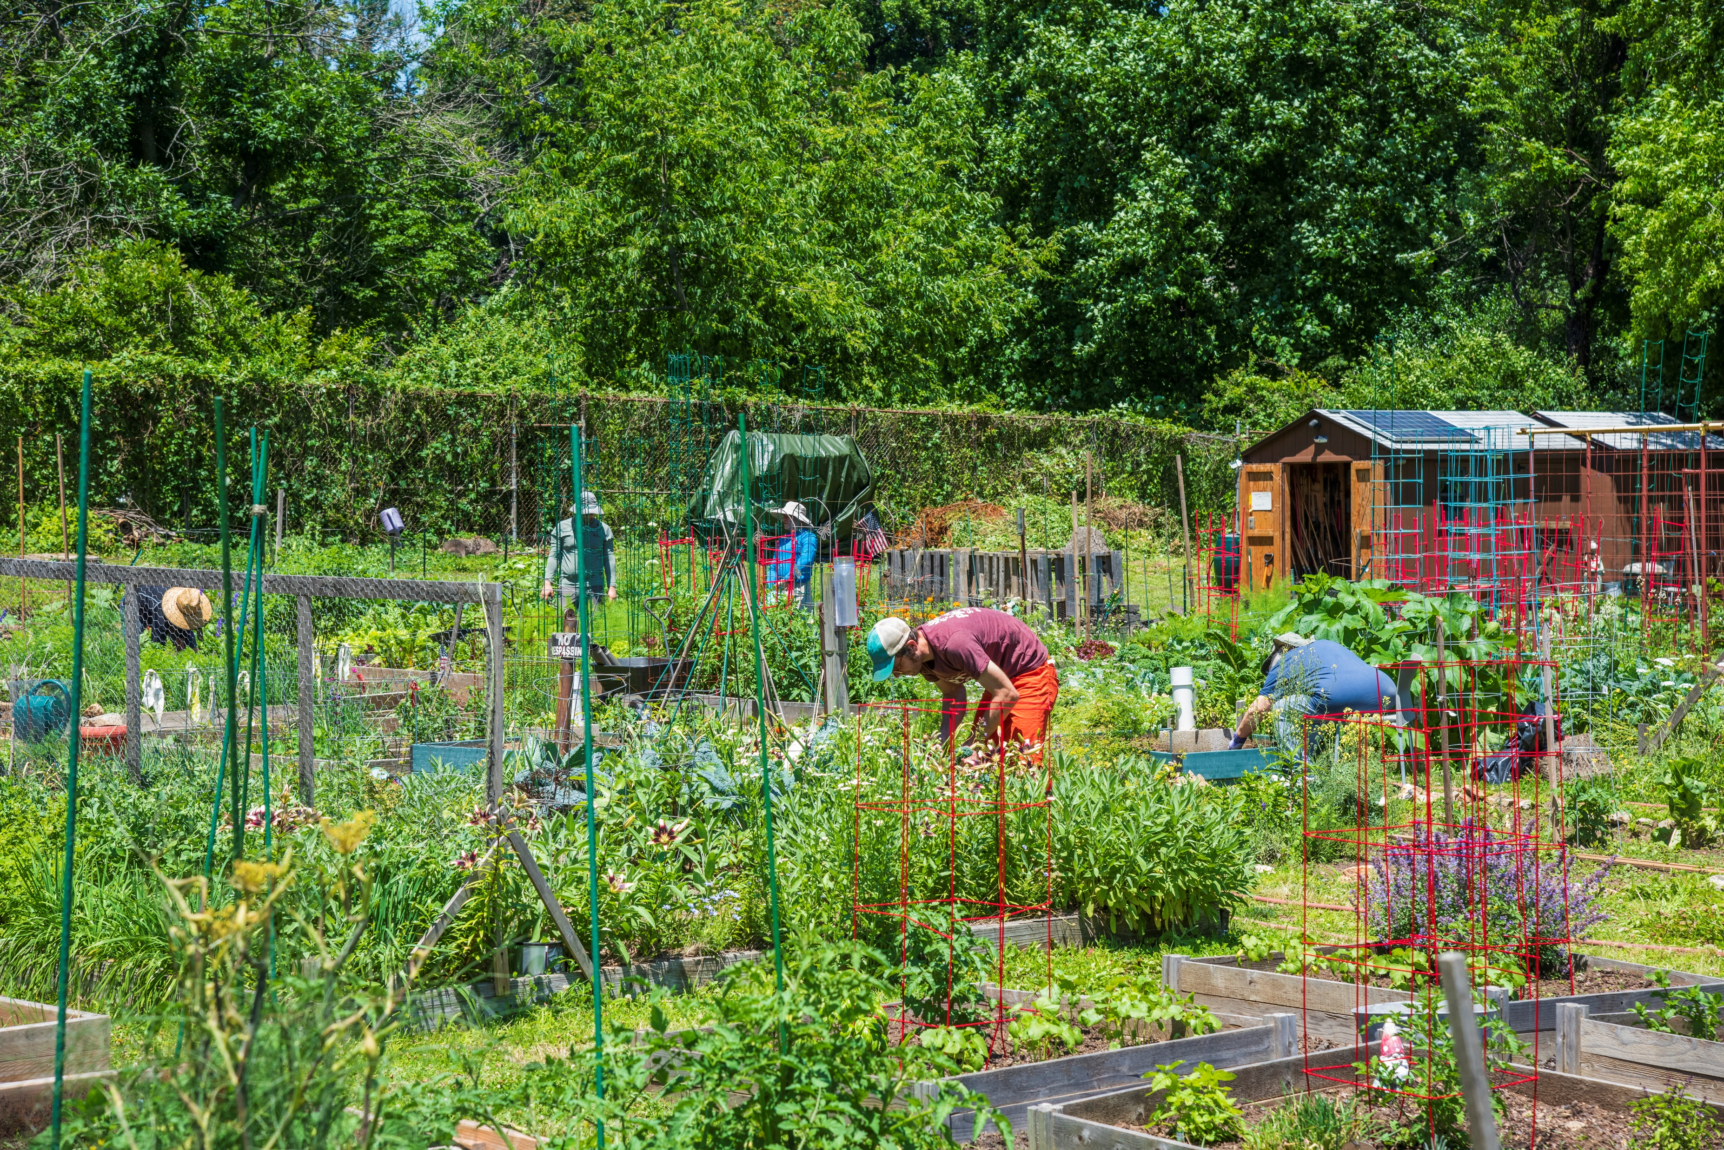
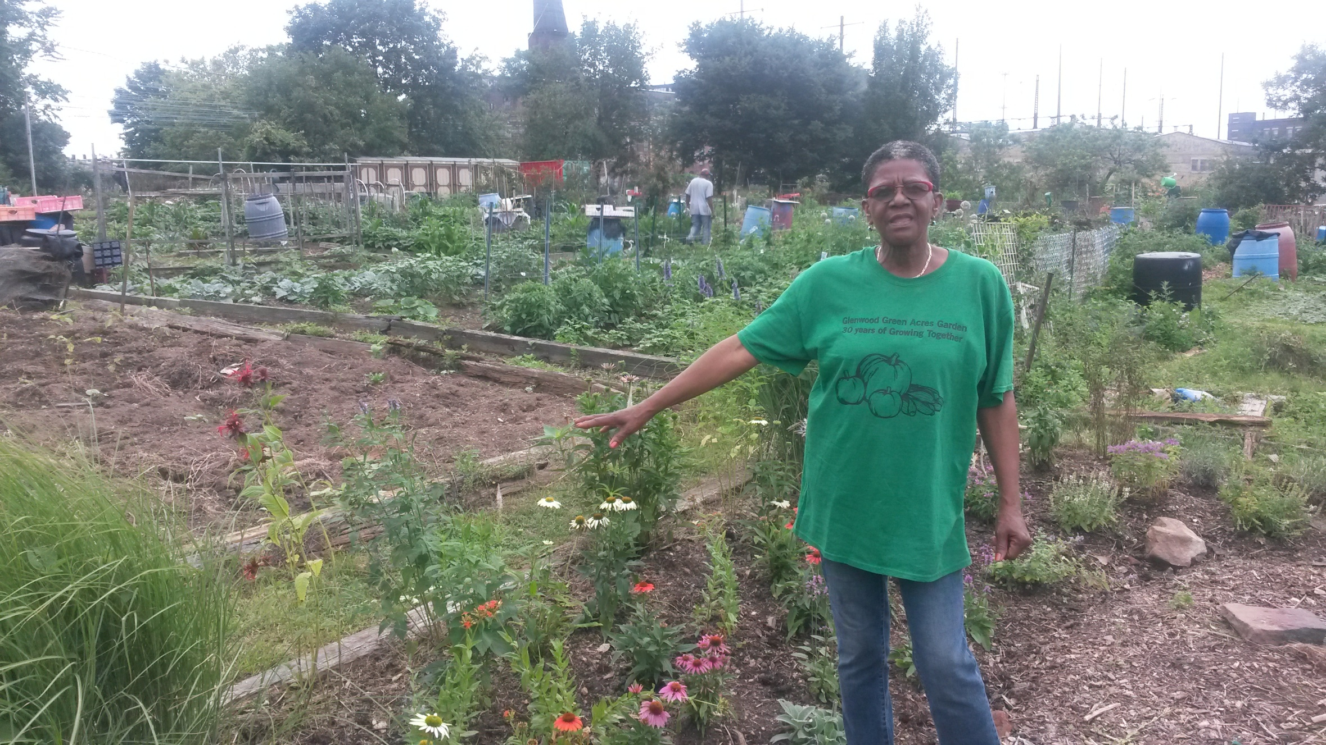
About Neighborhood Gardens Trust
NGT acquires and preserves community gardens and shared open spaces in order to enhance the quality of life in Philadelphia neighborhoods.
Glenwood Green Acres, North Philadelphia
Old Tennis Court Farm, Germantown

Slide 4
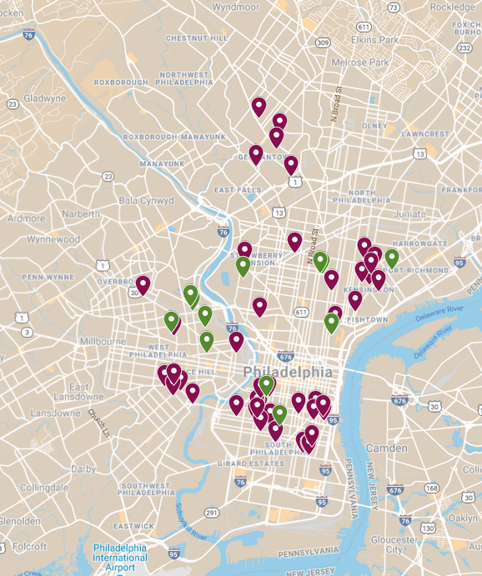
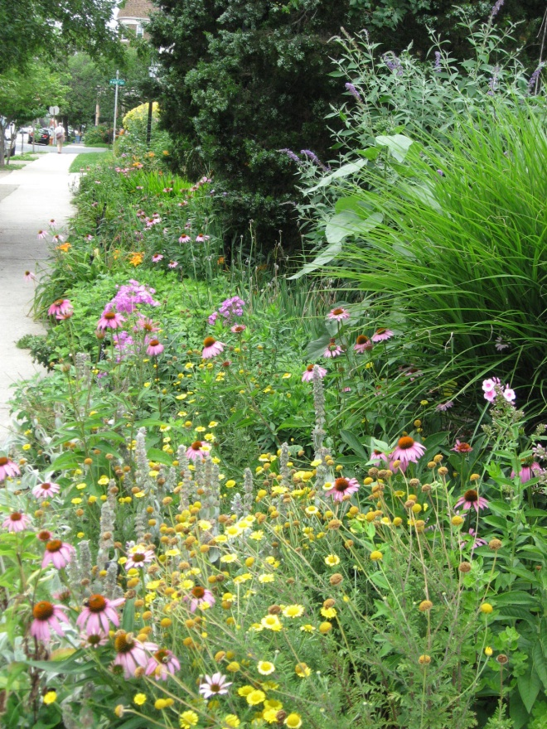
NGT Gardens
Protected 46 gardens to date
Aim to protect 70 by 2022
Preserved Garden
Acquisition Garden

Slide 5
Who owns vacant land?
Public Agencies
Department of Public Property
Philadelphia Redevelopment Authority
Land Bank
Private Owners
Tax Delinquent
Speculators/ Developers
Tax Delinquent Property
Tax Foreclosure
Land Bank

Slide 6
Map of Economically Viable New Construction Opportunities in Philadelphia Stepwise Analytics

Slide 7
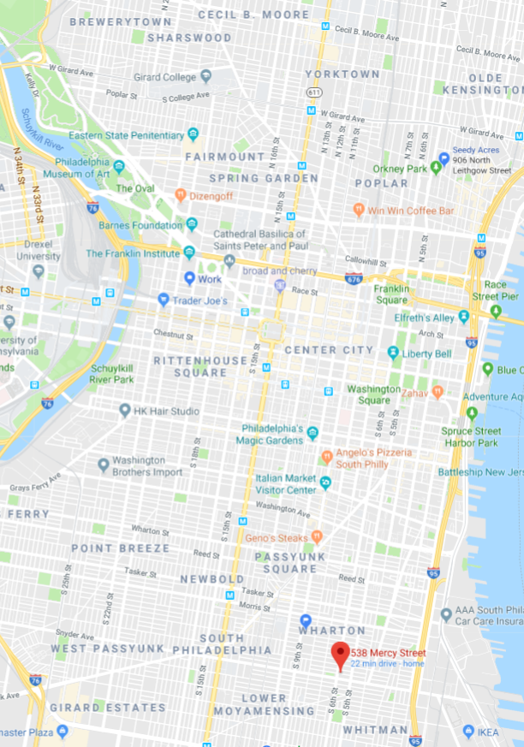
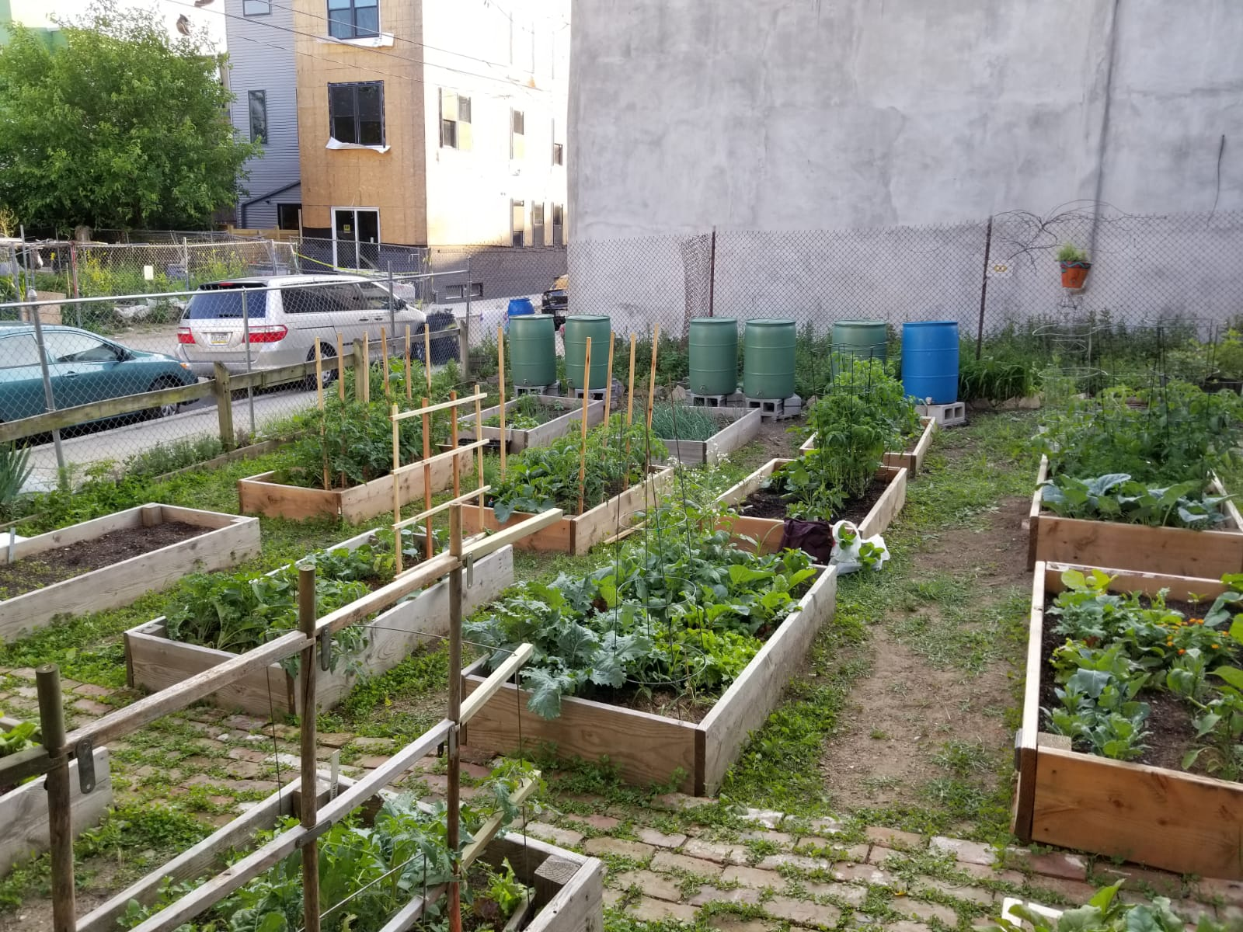
Growing Home Community Garden & Mercy Emily Edible Park
500-block Mercy St
Near 5th & Snyder

Slide 8
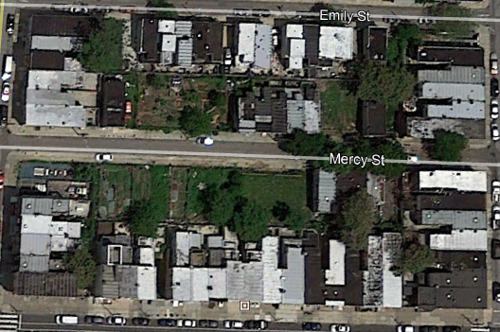
May 2016
MEEP
GH

Slide 9
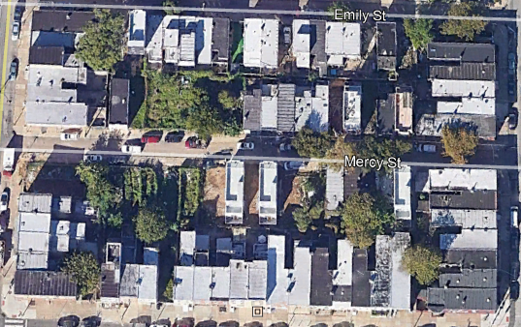
June 2017 – One year later… neighborhood change happens quickly

Slide 10
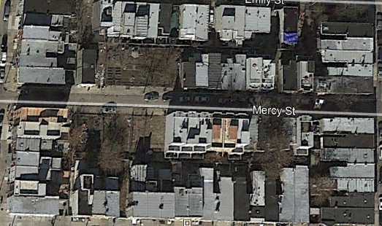
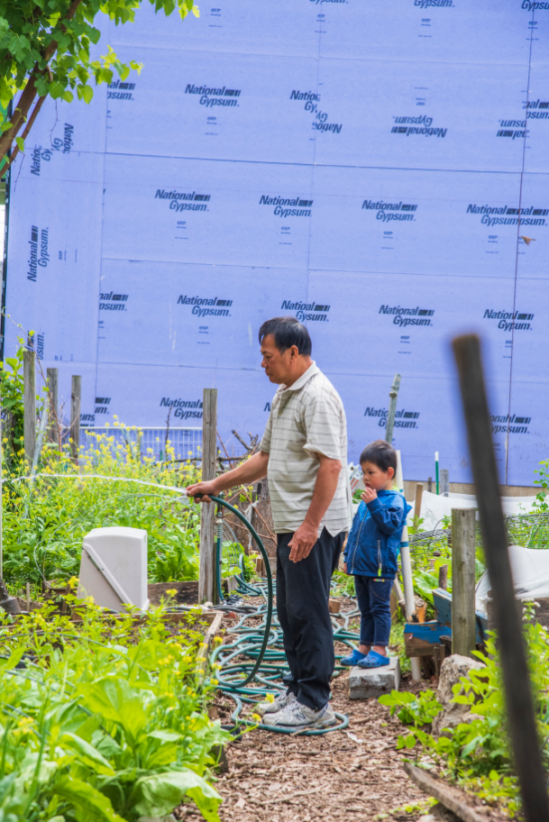
February 2019 – Gardening in the shadow of development

Slide 11
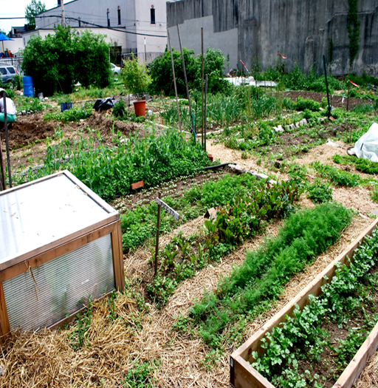
PROTECTING THREATENED COMMUNITY GARDENS
June 26, 2019
Public Interest Law Center: Ebony Griffin

Slide 12
LEGAL DISCLAIMER
The information that follows is not legal advice
It is a summary of the current law in this jurisdiction on selected topics
Legal claims are very fact-specific
Always contact an attorney when faced with legal questions

Slide 13
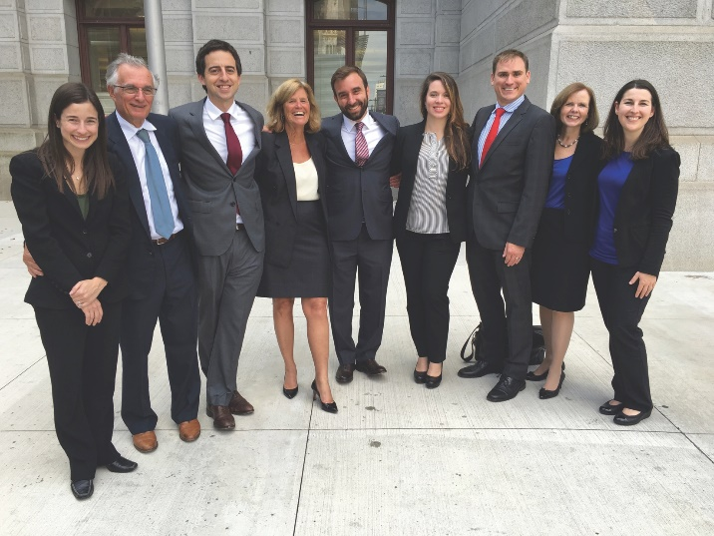
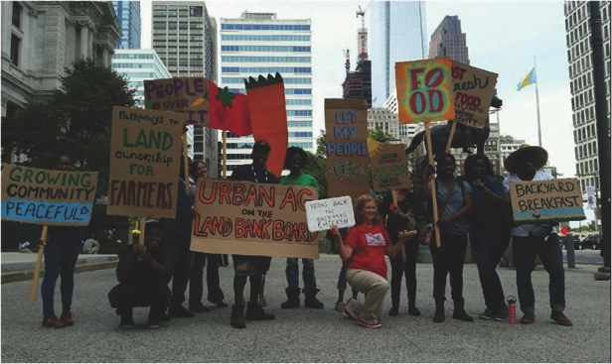
ABOUT THE LAW CENTER
MISSION
The Public Interest Law Center uses high-impact legal strategies to advance the civil, social, and economic rights of communities in the Philadelphia region facing discrimination, inequality, and poverty. We use litigation, community education, advocacy, and organizing to secure their access to fundamental resources and services.

Slide 14
OUR PRACTICE AREAS
HEALTHCARE
PUBLIC EDUCATION
ENVIRONMENTAL
JUSTICE
HOUSING
EMPLOYMENT
VOTING

Slide 15
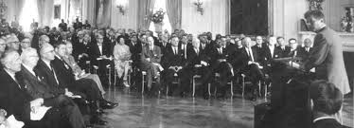
OUR HISTORY
Founded in 1969 as an affiliate of the Lawyers’ Committee for Civil Rights Under Law in response to President Kennedy’s call for lawyers to engage in the civil rights movement, the Public Interest Law Center has achieved such landmark reforms as establishing the right of all children with disabilities to receive a public school education, developing the first ever Community Right-to-Know ordinance that granted citizens access to information on pollution in their neighborhoods, forcing the Commonwealth of Pennsylvania to adopt an emissions inspection program, and successfully challenging PA’s 2011 gerrymandered congressional map and securing its replacement with a fair, non-partisan map.
Notes:
Landmark reforms include:
establishing the right of all children with disabilities to receive a public education
developing the first ever Community Right-to-Know ordinance that granted citizens access to information on pollution in their neighborhoods
Successful legal challenge to Pennsylvania’s 2011 gerrymandered congressional map

Slide 16
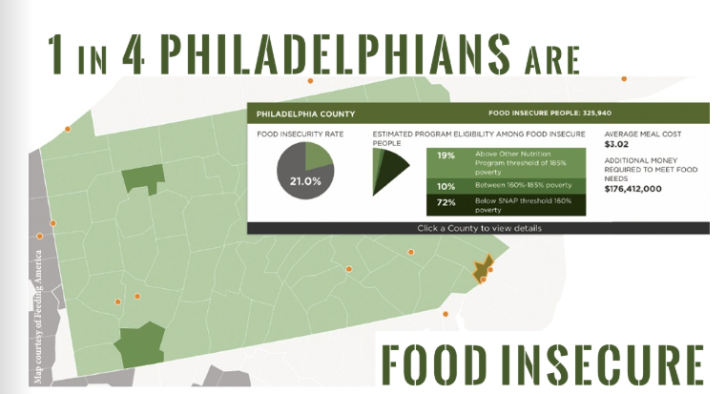
Food Insecurity in Philadelphia
Notes:
EG
According to a study by Hunger Free America, the number of people living in hunger in Philadelphia increased by 22% as national numbers decreased
Philadelphia ranked 10th on Feeding America’s top 10 hungriest counties
About 1 in 4 Philadelphians are food insecure (according to Feeding America’s “Map the Meal Gap” project)
Graphic is from a November 2017 article by One Step Away
PHS estimates that “City Harvest gardeners grow and donate more than 55,000 pounds of produce each year, helping to feed over 1,200 families per week during the growing season

Slide 17
Garden Justice Legal Initiative (GJLI)
400 city gardens, on average
Most growers are not land secure
Gentrification and Development Pressure
Political Pressure
Notes:
EG
Data: 400 plus gardens in the city. This number fluctuates due to both increased popularity in urban growing in the city and the loss of gardens in response to development pressure and gentrification.
Gentrification: We are seeing a large uptick in gardens with unsecure land tenure and access. The main reason for this is because of the increase in development pressure due to gentrification. Land prices are skyrocketing as are property taxes. More garden plots are at risk of sheriff sale and growers run the risk of being undercut by greedy developers. Another reason for this uptick is the city’s failed 1997 tax lien securitization. US Bank, sheriff sale, loss of negotiating power, etc.
The Garden Justice Legal Initiative (GJLI) is a Public Interest Law Center project focusing on providing pro bono legal support, policy research, advocacy, and community education to urban growers in the Philadelphia Region. Community gardening has substantial and immediate benefits for Philadelphia, where a quarter of all people live in poverty, more than 40,000 plots of land lie vacant, and over 300,000 people face hunger and malnutrition.

Slide 18
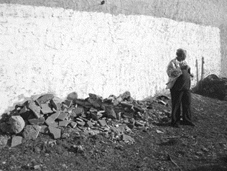
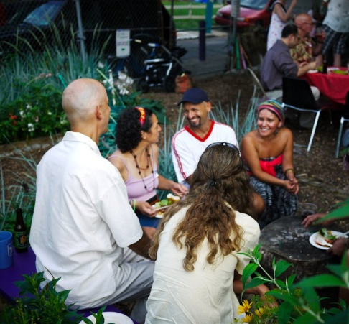
GJLI Components

Slide 19
Two Critical Questions
How long has the potential client been gardening on the vacant land?
> or < than 21 years
Who is the record owner of the vacant land?
Privately Owned and Tax Delinquent
City Owned
Notes:
MM

Slide 20
Elements of Adverse Possession
Hostile/adverse
Actual
Exclusive/distinct
Visible/open/notorious
Continuous
Notes:
MM
1. Hostile/adverse – does not mean ill will but does mean against the right of the true owner and without permission. If given permission, not adverse possession. If
2. Actual - exercising control over the property i.e. acts signifying permanent occupation/dominion over the land. Sporadic, temporary, or repeated acts do not constitute actual possession, but also depends on the nature of the property
3. Exclusive/distinct - within the possession of the adverse possessor alone; but claimant's possession need not be absolutely exclusive; rather, it need only be type of possession which would characterize owner's use
4. Visible/open/notorious - using the property as the real owner would, without hiding his or her occupancy; sufficient to place a reasonable person on notice
5. Continuous for the statutory period (which is 21 years in PA 10 years for side yards). Uninterrupted. Tacking – must be in privity (i.e. lease, descent, or outright sale);

Slide 21
Case Study: La Finquita

Slide 22
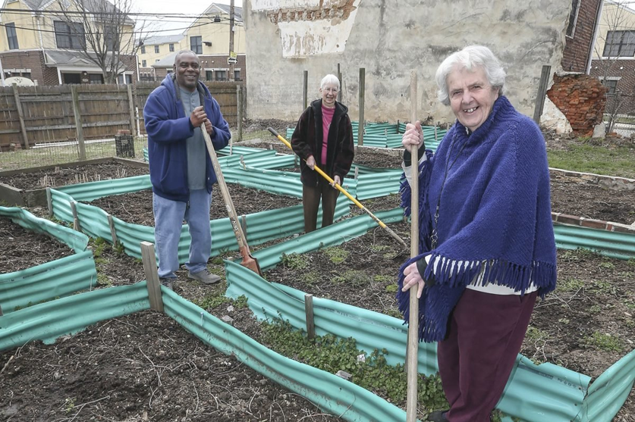
New Jerusalem: A Comparison
Notes:
New Jerusalem: Located in one of Philly’s poorest communities, used to feed residents at drug treatment and recovery center run by nuns

Slide 23
What was different?
No adversarial process
Proactive
Media Influence

Slide 24
Advocacy Strategies
Notes:
Ebony Griffin
Explain Land Bank-
City created Land Bank as a repository for city owned land. Their goal is to take land and put it back into productive use.

Slide 25
Know Your Council Person
Notes:
EG

Slide 26
Privately Owned Tax Delinquent
The Land Bank
In December 2013, City Council unanimously passed legislation to create a land bank
Purpose: to return vacant and tax-delinquent properties to productive use
Land Bank Acquisition Policy
The Land Bank uses the Sheriff Sale process to acquire privately owned tax delinquent land for several uses, including the following:
Side Yards
Community amenities
Notes:
EG
Everything is competitive bid: exceptions: affordable housing or a community asset, development business expansion owner occupied business, or have assembled a super majority of the land there, side yards and rear yards, garden and open space
Noncompetitive then fill out application and disposition process but starts with a conversation

Slide 27
Side Yards¹
Median Sales price of homes in census block <$75,000
Unless has owned adjacent property for > 7 continuous years, has improved the parcel, and is currently maintaining it
Client owns and lives in adjacent property
Property sought does not abut a city owned parcel or other parcel that contributes to an assemblage for development
Property is tax delinquent for >3 years or has public liens totaling more than $800.00
¹ Philadelphia Land Bank, 2017 Strategic Plan and Performance Report, 38.
Notes:
EHG next slide is nominal value

Slide 28
Side Yards Contd.
The Philadelphia Land Bank’s disposition policy permits it to direct, for nominal value, the transfer of property to a household that is eligible to purchase land under the side or rear yard program.¹
¹ Philadelphia Land Bank, 2017 Strategic Plan and Performance Report, 62.

Slide 29
Community Gardens
Title Transfer¹
Nonprofit Organizations
Qualifying Community Development Projects
Deed restriction
¹ Philadelphia Land Bank, 2017 Strategic Plan and Performance Report, 62-63.
Notes:
The Philadelphia Land Bank’s disposition policy permits it to direct, for nominal value, the transfer of property to a specific nonprofit entity for the establishment of an eligible community development project, including community gardens.¹
Do not mention Johnson

Slide 30
Community Gardens¹
Individual Garden Agreement
Individuals or Households
Personal Use
Ownership not required
Within 500 ft of property or up to 1500 ft with approval
One year
Lease
Community Gardens or community managed open space
No residency requirements
More stringent requirements for use
¹ Philadelphia Land Bank, 2017 Strategic Plan and Performance Report, 65-68.
Notes:
The Philadelphia Land Bank’s disposition policy permits it to direct, for nominal value, the transfer of property to a specific nonprofit entity for the establishment of an eligible community development project, including community gardens.¹

Slide 31
CONTACT US
PUBLIC INTEREST LAW CENTER
www.pubintlaw.org 215-627-7100 Facebook.com/PublicInterestLawCenter @PubIntLawCtr

Slide 32
THANK YOU!

Slide 33
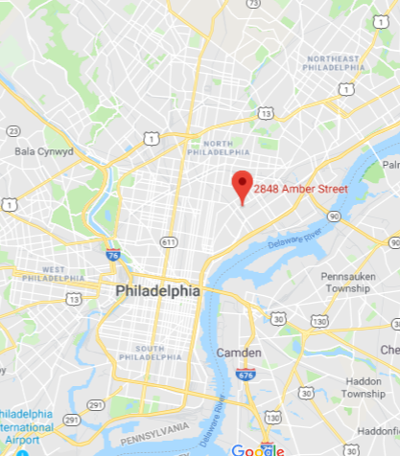
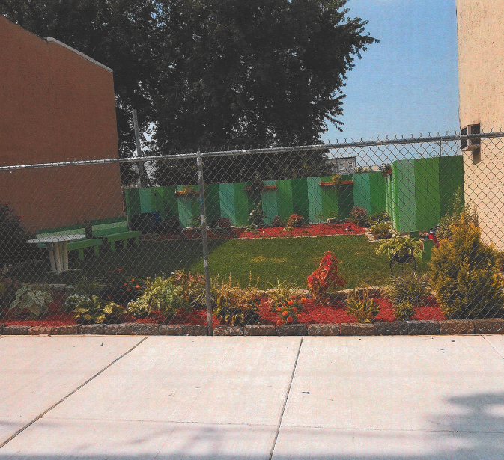
Amber Street Community Garden

Slide 34
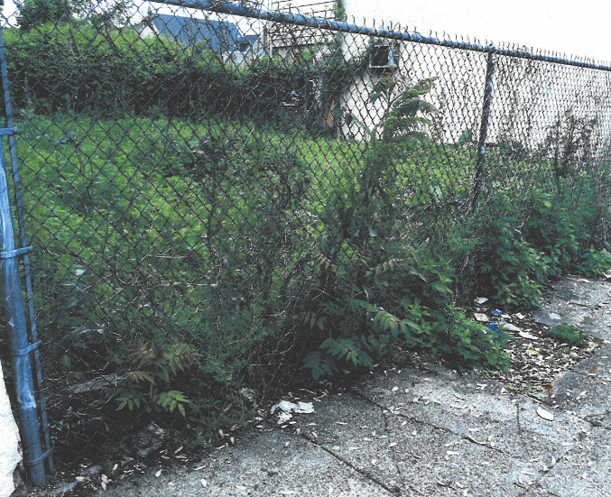
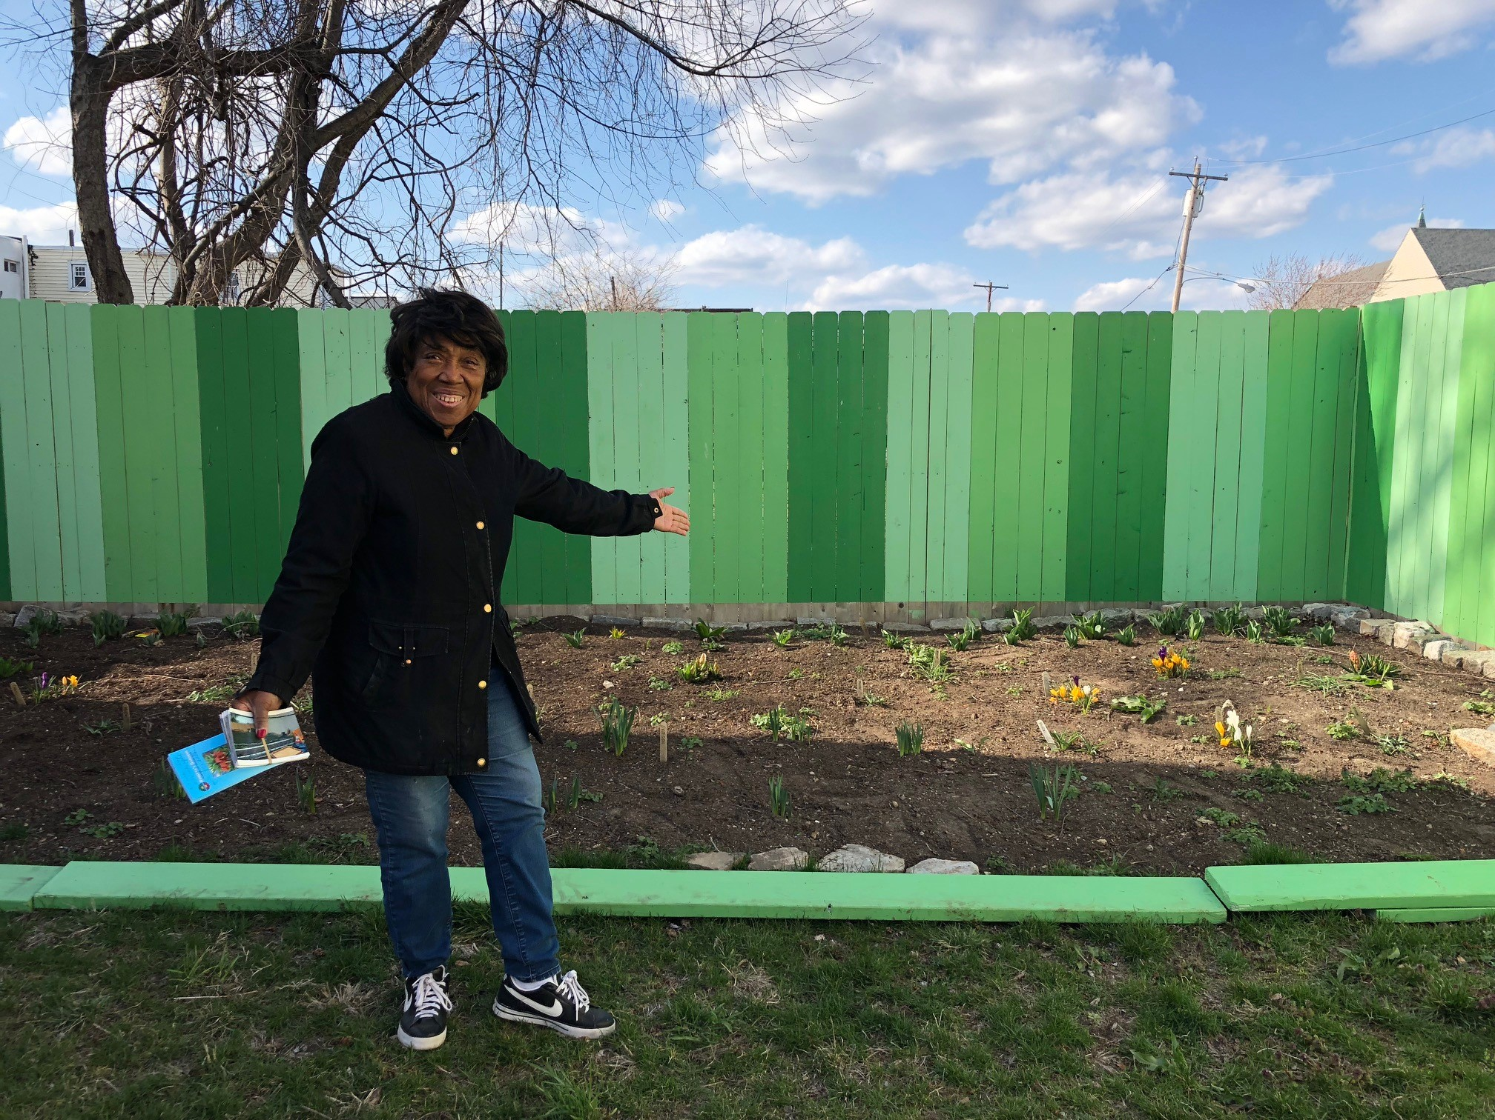
Amber St Community Garden - Before & After

Slide 35
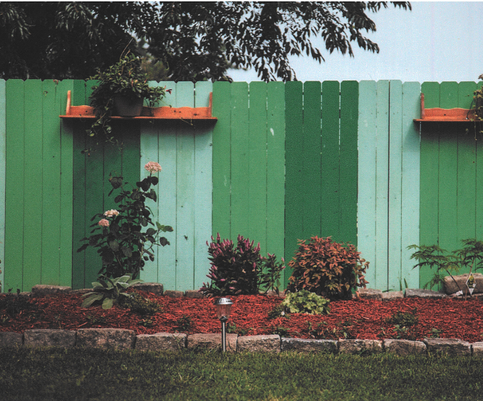
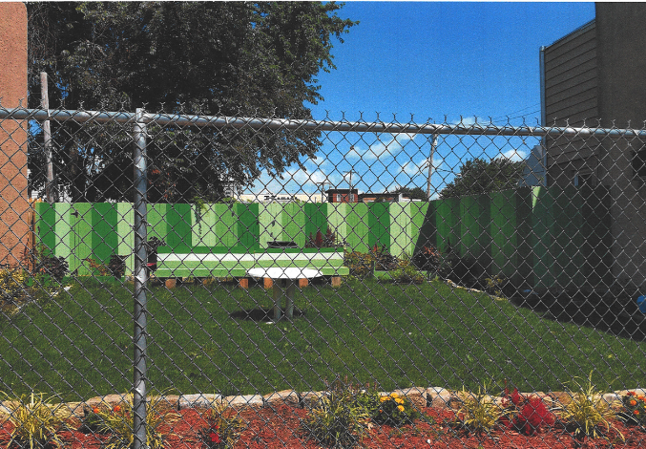
Amber Street Community Garden

Slide 36
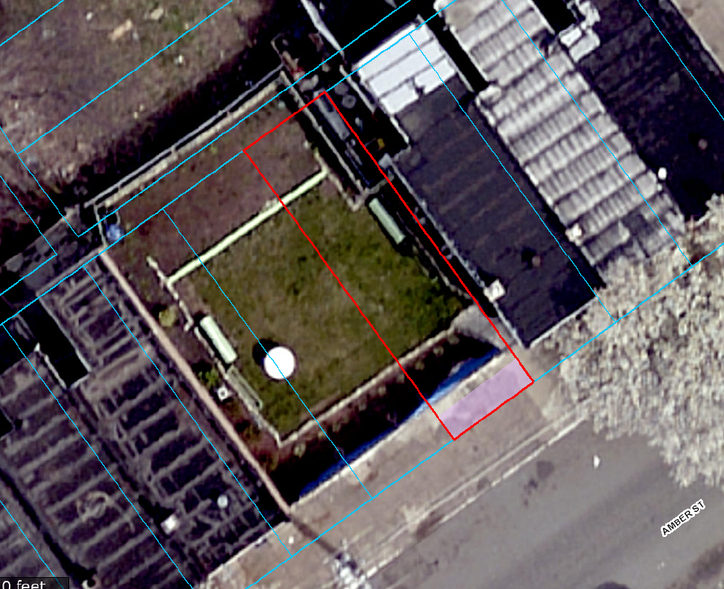
Amber Street Community Garden
Property | Owner | Tax Lien Amt
2848 Amber St | B B Enterprises | $2,793.30
2850 Amber St | City of Philadelphia | N/A
1705 N 55th St | Elihun Crump | $2,904.62
2852
KEY
Owned by the City or City agency
2850
Privately owned, tax delinquent
2848
Permanently preserved by NGT

Slide 37
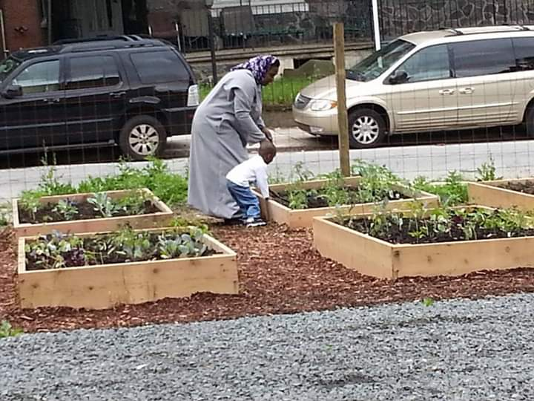
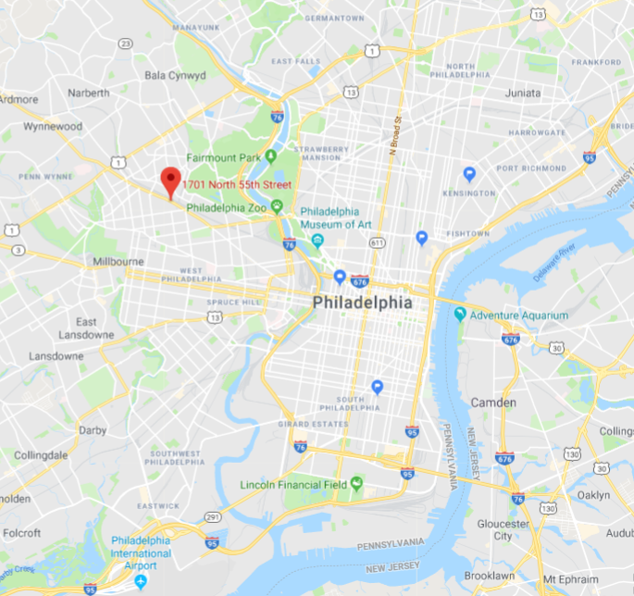
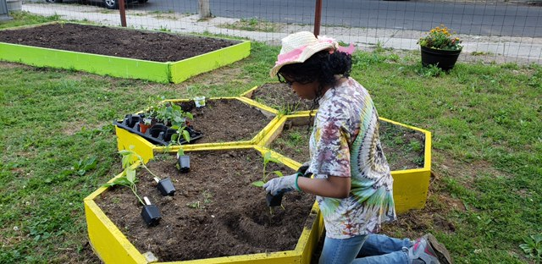
Five Loaves Two Fish Community Garden

Slide 38
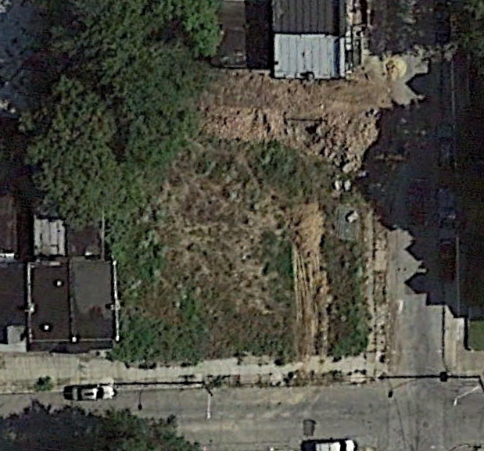
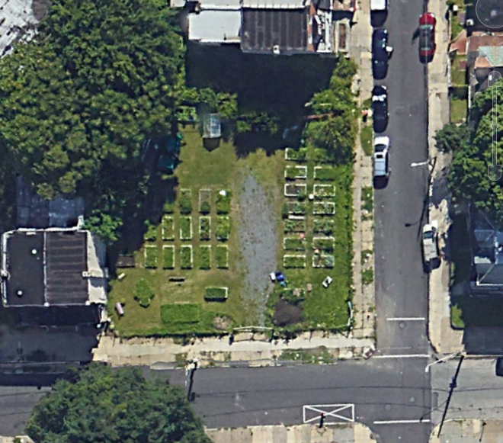
Five Loaves Two Fish Community Garden – Before & After
Before
After
Vacant lot to vibrant garden!

Slide 39
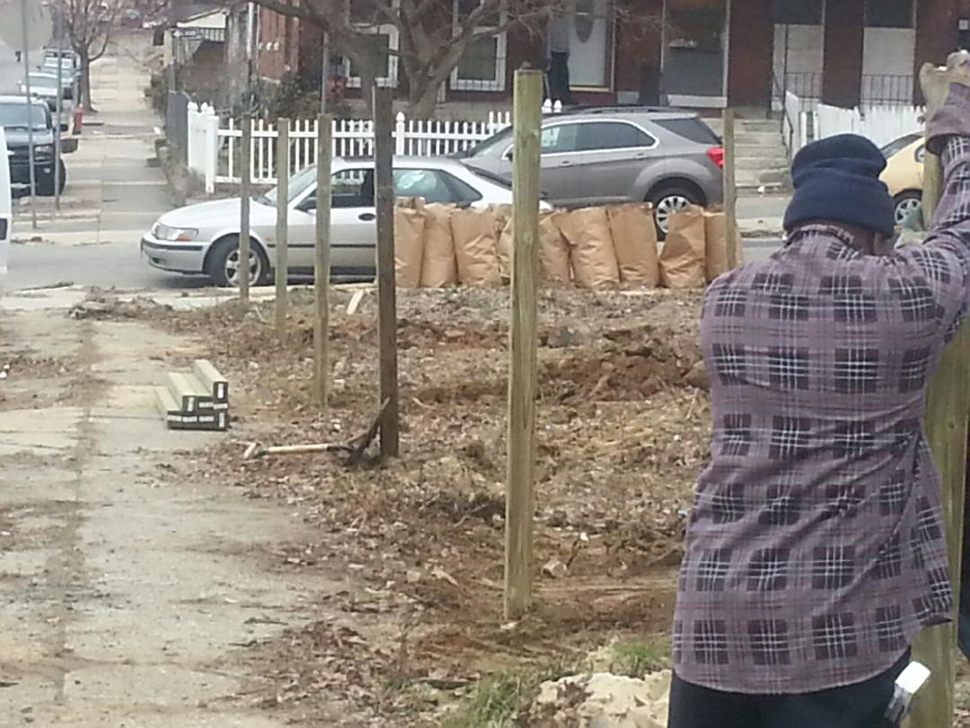
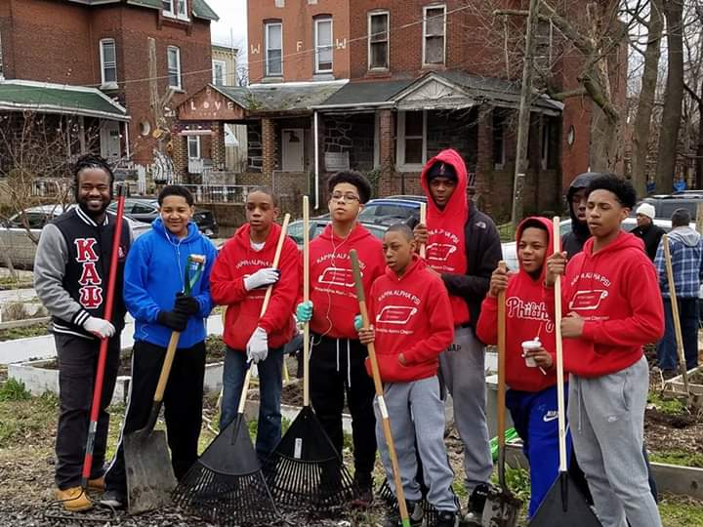
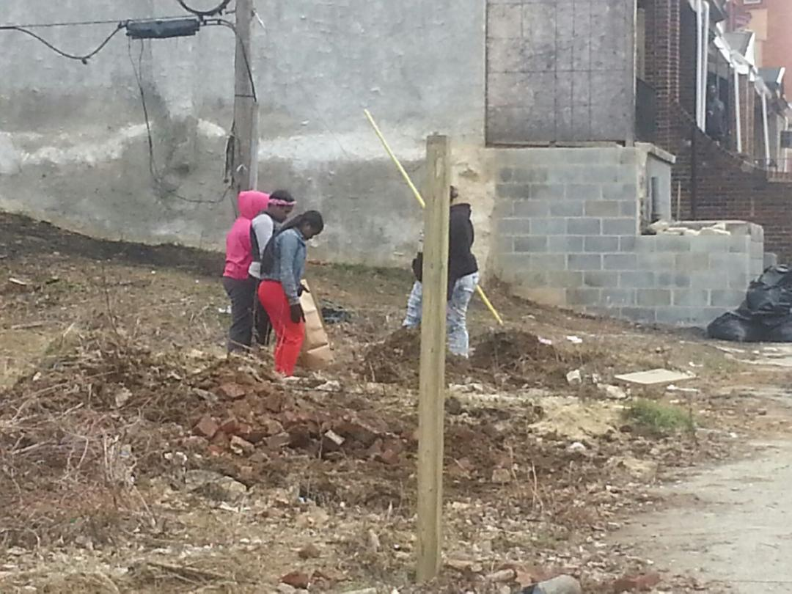
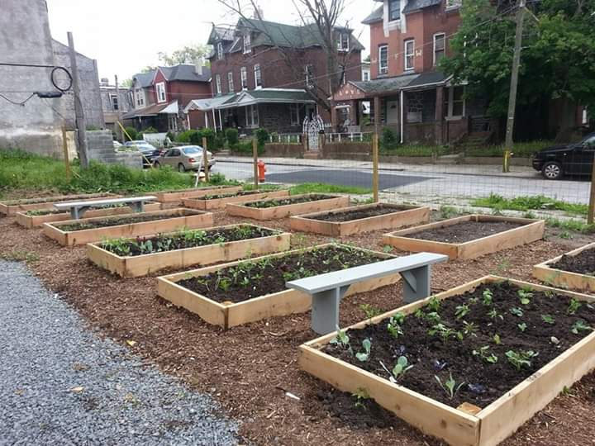

Slide 40
Breakdown of property ownership
2017 & before
Property | Owner | Tax Lien Amt
1701 N 55th St | City of Philadelphia | N/A
1703 N 55th St | Ophir Coan | $10,090.69
1705 N 55th St | City of Philadelphia | N/A
1707 N 55th St | Annie Lee Parker | $6,263.12
1709 N 55th St | Paul F Knaus | $6,635.10
1711 N 55th St | Cecil Gray | $23,353.08
1711
1709
1707
1705
1703
1701
Jefferson St
KEY
Owned by the City or City agency
N 55th St
Privately owned, tax delinquent
Permanently preserved by NGT

Slide 41
Breakdown of property ownership
12/31/2018
Property | Owner | Tax Lien Amt
1701 N 55th St | NGT | $0
1703 N 55th St | Land Bank | $0
1705 N 55th St | NGT | $0
1707 N 55th St | Land Bank | $0
1709 N 55th St | Paul F Knaus | $8,218.31
1711 N 55th St | Land Bank | $0
1711
1709
1707
1705
1703
1701
Jefferson St
KEY
Owned by the City or City agency
N 55th St
Privately owned, tax delinquent
Permanently preserved by NGT

Slide 42
Breakdown of property ownership
10/31/19 - expected
Property | Owner | Tax Lien Amt
1701 N 55th St | NGT | $0
1703 N 55th St | NGT | $0
1705 N 55th St | NGT | $0
1707 N 55th St | NGT | $0
1709 N 55th St | Paul F Knaus | $8,218.31
1711 N 55th St | NGT | $0
1711
1709
1707
1705
1703
1701
Jefferson St
KEY
Owned by the City or City agency
N 55th St
Privately owned, tax delinquent
Permanently preserved by NGT

Slide 43
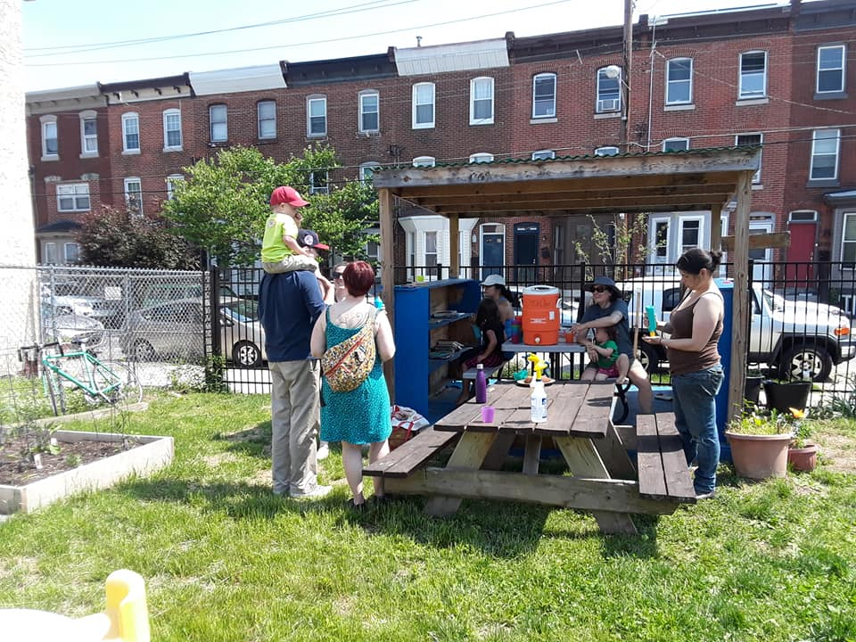
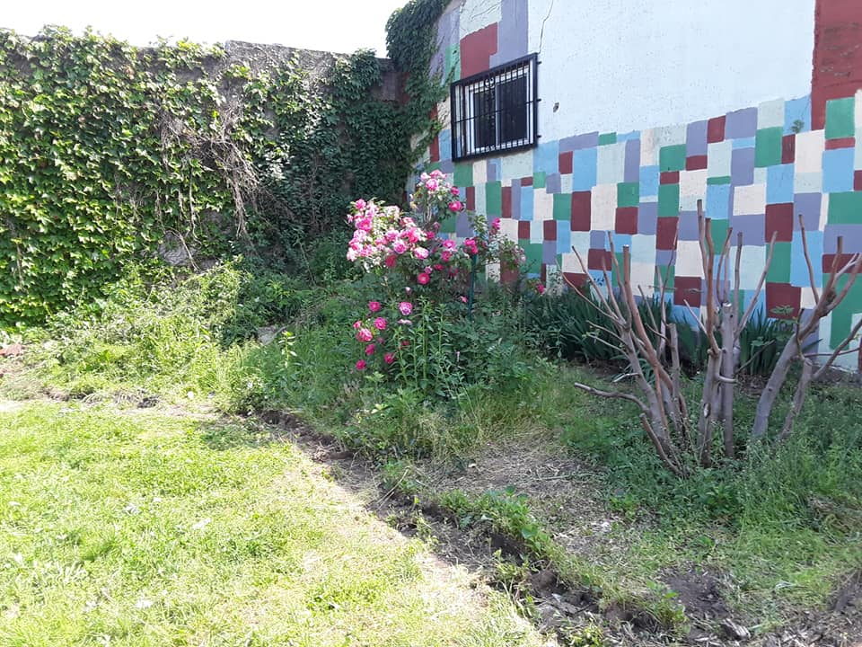
Collins Smith Barrick Playgarden

Slide 44
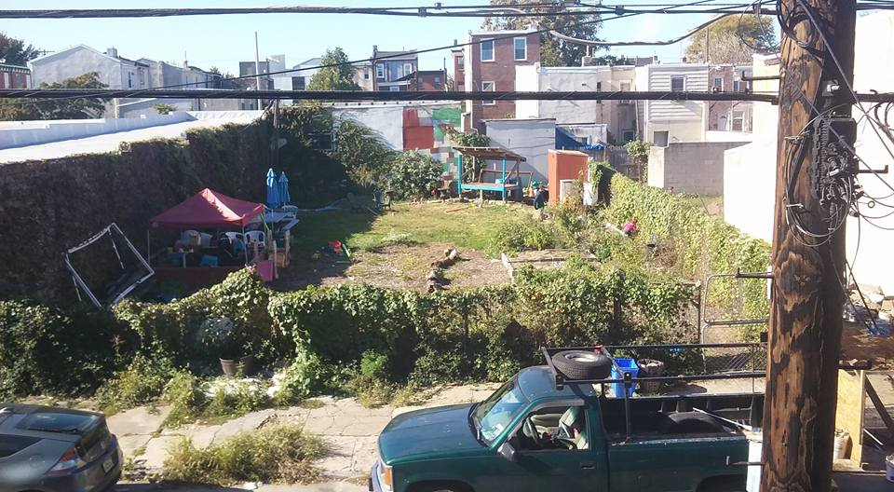
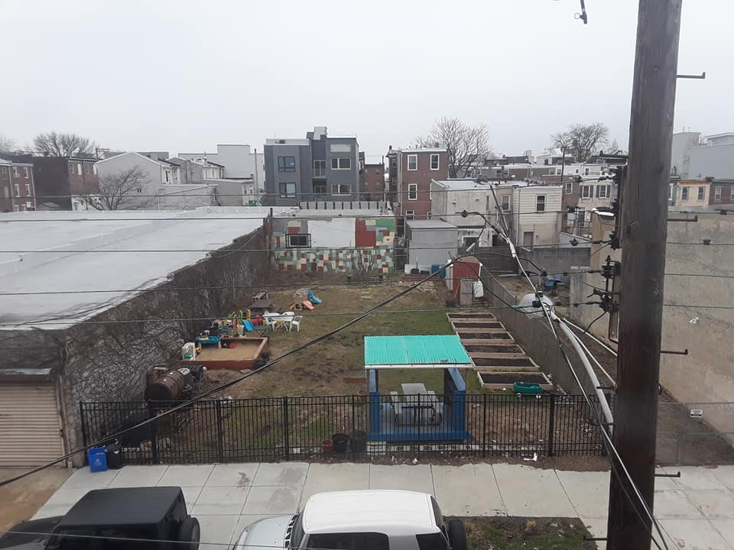
Collins Smith Barrick Playgarden Work in Progress

Slide 45
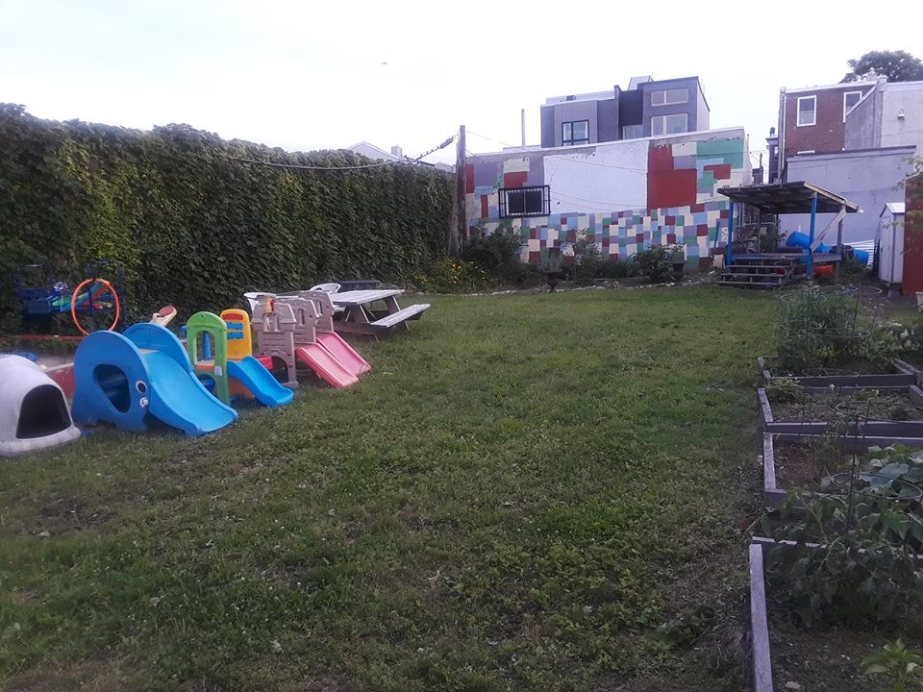
Collins Smith Barrick Playgarden

Slide 46
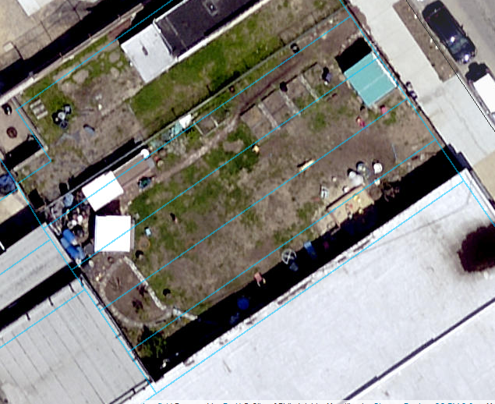
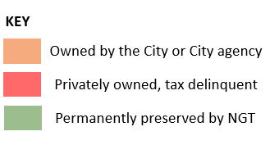
Collins Smith Barrick Playgarden
Address is 2846-52 East Hagert St
Four parcels formerly owned by Philadelphia Redevelopment Authority
Permanently protected by NGT in 2018
2846-52

Slide 47
Q&A

