Slide 1
Healthy Housing Interventions for Renters

Slide 2
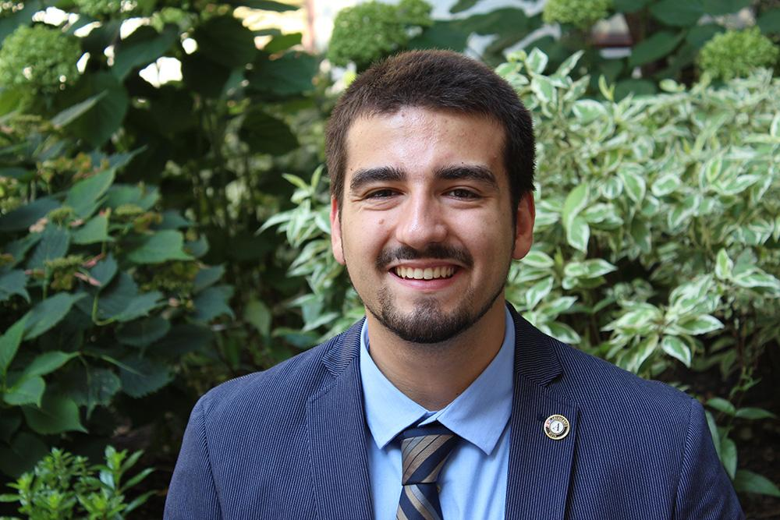
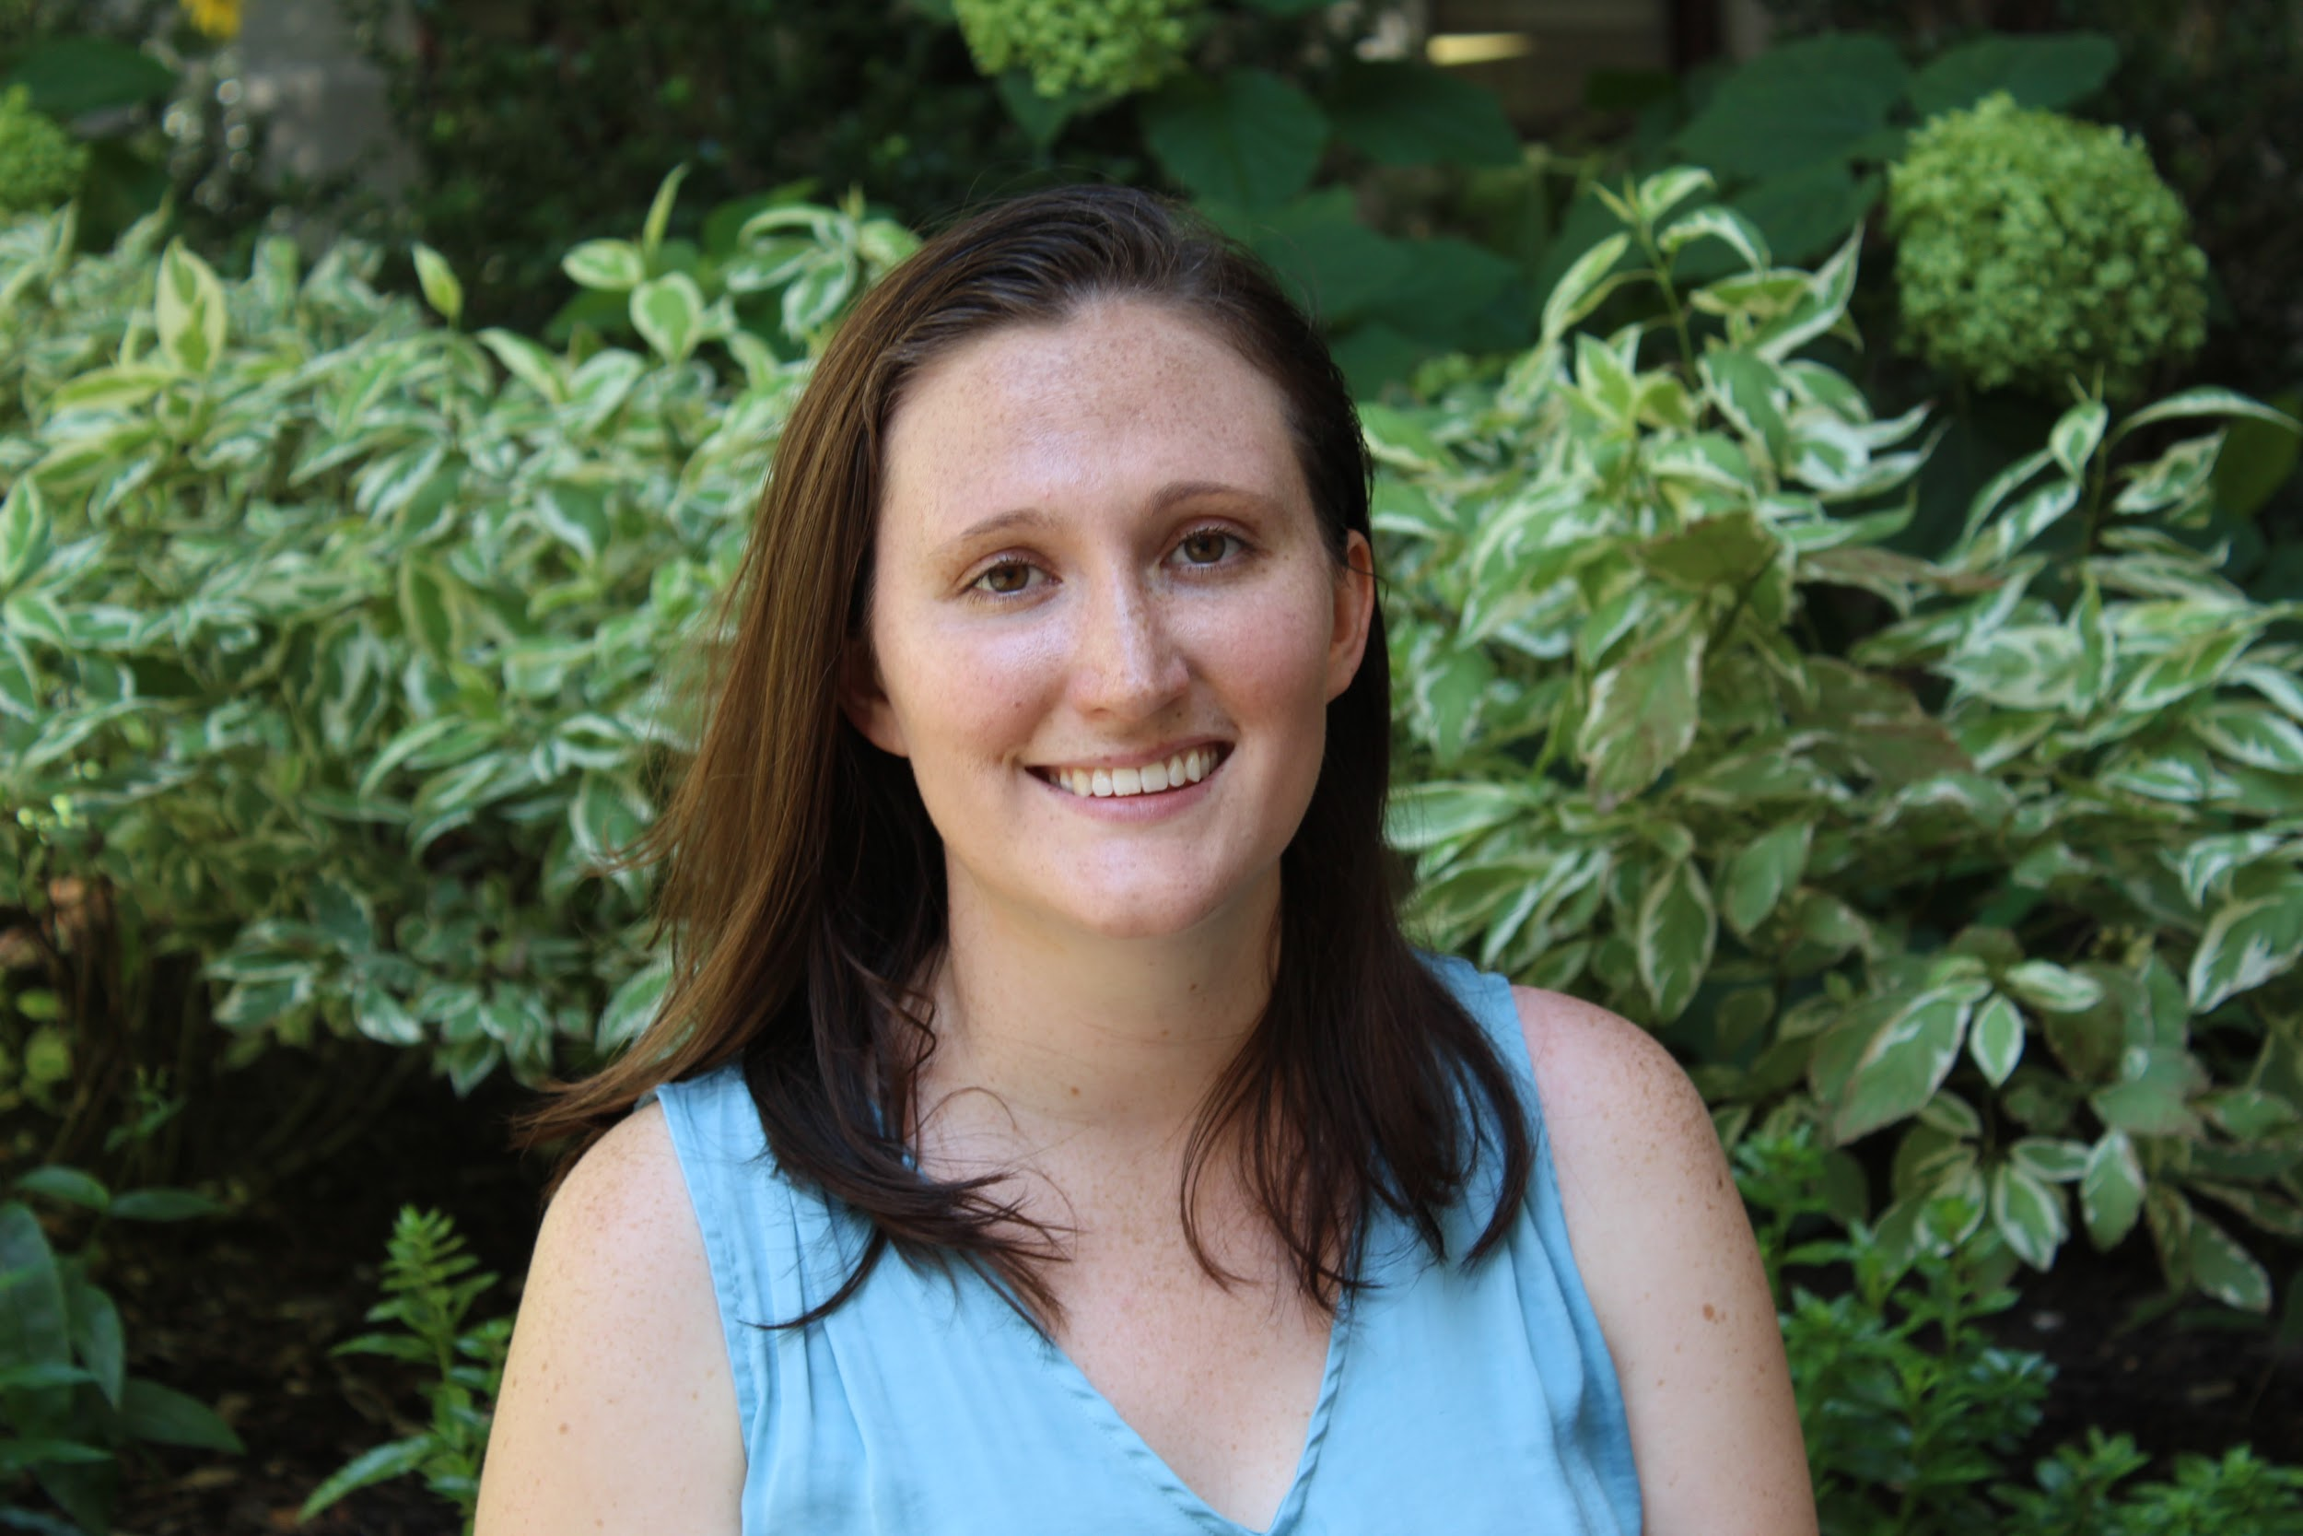
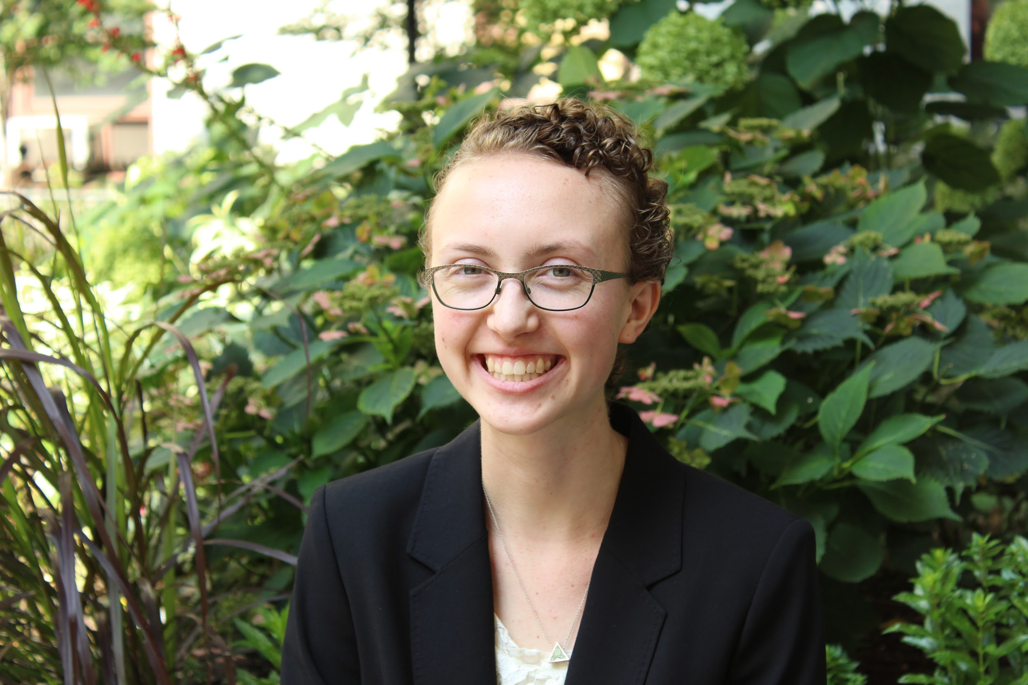
Who We Are
John McLaughlin
Riley Griffin
Sonja Dahl
Notes:
We’re AmeriCorps VISTAs with the WPPZ -- collective impact + federal resources

Slide 3
How Did We Arrive at This Topic?
Promise Zone Background
PACDC Health and Housing Summit, Dr. Kelly Kelleher Keynote
Mayor’s Task Force on Eviction, Housing Security Working Group, and Housing Action Plan
Notes:
With PZ Background I mean our work on our committees, Sonja’s work at CHOP with the CHNA, and the several hospitals and housing issues (quality, affordability/gentrification) in and around the PZ. See this in civics, committees
Impressed by conference
Nationwide Treating neighborhoods as patients
We’ve been researching what’s going on in the city around this -- ex. landlord-tenant court
PACDC -- opp to share with a wider audience, connect to equitable dev convo, and see what you all think. Thank for opportunity

Slide 4
Outline of Presentation
Introduction
Housing Quality and the Case for Renter-Focused Healthy Housing Interventions in Philadelphia
Code Enforcement Expansion and Small Landlord Subsidy
Legal Representation for Low-income Tenants
Community Health Assets
Discussion

Slide 5
Poor Housing Quality in Philadelphia
Notes:
Over 60% of Philadelphia homes were built before 1940, relative to 20% of all homes in the United States

Slide 6
Why Healthcare Organizations Should Invest in Housing Quality
Poor housing quality can lead to asthma, infectious disease, and lead poisoning, among other issues
Healthcare organizations serve to improve health and practitioners wish to reduce harm
Prevention leads to a reduction of hospitalizations, cost savings
Notes:
Researchers have found that Emergency Room visits can cost 2-5x as much as a regular doctor’s visit
Since 2014, CMS ruled that home visits and resulting services are eligible for Medicaid reimbursement, so some of the investments I will discuss have already been reimbursed by Medicaid on top of their ED cost savings. The ACA now penalizes hospitals for repeat admissions due to chronic diseases such as asthma.

Slide 7
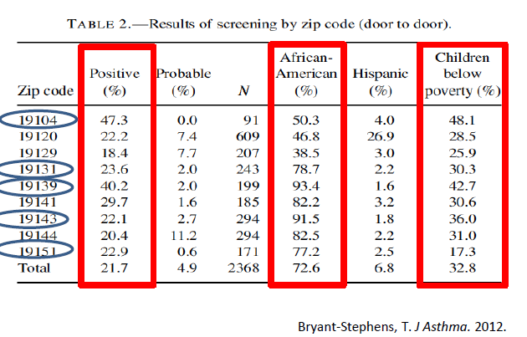
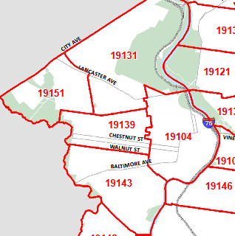
Asthma Prevalence in West Philadelphia
Notes:
Poor-quality housing and its resulting health issues disproportionately impact low-income residents of color in West Philadelphia, perpetuating inequity. Forces such as discrimination and disinvestment leave families with unhealthy housing and limited resources to make repairs.

Slide 8
The Children’s Hospital of Philadelphia’s Expanding Investment in Asthma Remediation
The Community Asthma Prevention Program (CAPP)
Home Preservation Initiative for Healthy Living
Recent CAPP+ expansion, seeking to remediate 100 homes this year
For homeowners
Notes:
I’m going to go through a few ex of successful housing quality interventions in Philly
Since 1997, CHOP, through grants and medicaid managed care reimbursements, offers free in-home asthma education and provides supplies to mitigate environmental triggers for low-income Philadelphia children that have been admitted to CHOP for asthma. Philadelphians have participated in 183 class series about mitigating asthma. CHOP has nearly halved repeat ED visits and readmissions for its highest-risk children, significant cost savings to the hospital.
CHOP partnered with several Promise Zone partners (RTP, Habitat, LISC, PEC, and MVM among others) that had been repairing homes to successfully apply for the BUILD Health Challenge, a philanthropic grant awarded to multi-sector collaborations seeking to improve health disparities caused by social inequities. Representatives from this project also presented at the December Summit. Families in the CAPP program were referred to the BUILD program, and CAPP home health workers were sent to BUILD homes.
In December, CHOP announced that it’s partnering with the Philadelphia Housing Development Corporation to directly remediate homes for asthma triggers.

Slide 9
Philadelphia Department of Public Health Initiatives, Healthy Homes Healthy Kids
Philadelphia Department of Public Health, in partnership with St. Christopher’s Hospital for Children in North Philadelphia
From 2011-13, Healthy Homes Healthy Kids spent, on average, $3,500 per unit in remediating health triggers and reduced child hospitalizations by 70%
For homeowners
Notes:
Remediations include repairing leaks, removing mold and repairing water damage, digging up old carpet and refinishing floors, replacing leaded windows, managing pests, and weatherization

Slide 10
Philadelphia Department of Public Health Initiatives, Room2Breathe
Room2Breathe, in partnership with Education Plus Health, launched in June, modelled after CAPP
Home health visits, asthma reduction education
Environmental assessments and referrals to free pest control vendors to reduce mice and cockroaches (asthma triggers)
Services renters and homeowners
Notes:
Room2Breathe currently has hired two health workers trained in the CAPP program embedded in a North Philadelphia pediatric office
Cutting:
Since 2014, CMS has said that home health visits are eligible for Medicaid reimbursement, so services are 100% free to families and reimbursed by major Medicaid providers

Slide 11
Focus More Attention on Renters’ Housing Quality
Current disparity in home repair services
Disparity in resources to make repairs or seek out counsel
Enforcement challenges

Slide 12
Disparity in Home Repair Services
Few other home repair programs assist renters: Restore, Repair, Renew; Basic Systems Repair Program; and Habitat for Humanity home repair programs do not serve renters

Slide 13
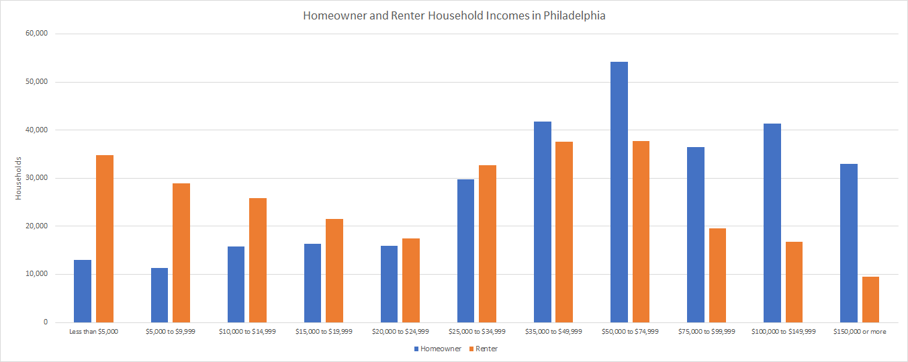
Disparity in Resources
Source: U.S. Census Bureau (2017 ACS 5-year estimates)
Source: U.S. Census Bureau (2017 ACS 5-year estimates)
Notes:
PHA houses ~33,000 families -- but this is inadequate to meet need. Many people on waiting list who are spending lots on housing (waiting list closed 6 years ago!!!)
On avg, monthly housing and utility costs consume 41.9% of Philadelphia renters’ household income

Slide 14
Enforcement Challenges
“The City of Philadelphia has a pretty robust housing code. However, if you lived here… you would not believe this to be true” - Tenant Union Representative Network
“If I was unscrupulous, I could get away with a lot more, cut corners, provide terrible housing and not be reported to L&I”
1 in 10 renters have received the required Certificate of Rental Suitability or Partners for Good Housing brochure - PCPC 2014
Notes:
All landlords must obtain and provide a Certificate of Rental Suitability to new tenants. If a landlord fails to comply, then the landlord is unable to collect rent or seize the property. However, landlords are failing to comply with Philadelphia’s housing code, which is in place to protect renters.

Slide 15
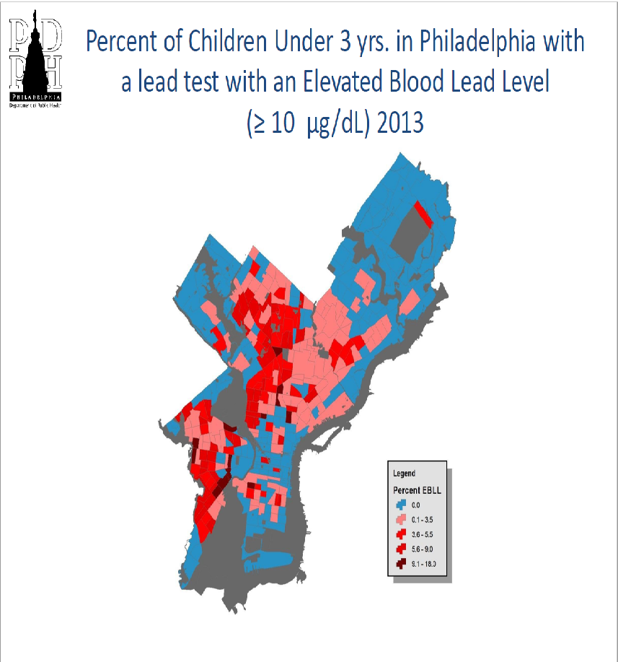
Notes:
As an ex, lead regulations are not followed. Philadelphia landlords are required to hire a certified lead inspector to state that a property built before 1978 is lead safe when renting to families with children age six or younger. If followed, we wouldn’t see the lead levels on this map.

Slide 16
Breathe Easy at Home (BEAH) in Boston
Boston Inspectional Services Department and Boston Public Health Commission
Online referral-based system initiated by health clinician
Home inspection landlord must make repairs in 30-60 days
85% compliance rate, <1% of cases resulting in landlord retaliation
Partnerships central to success
Notes:
BEAH is a 15-year partnership between the Boston Inspectional Services Department (L&I) and the Boston Public Health Commission. It is a referral-based system where clinicians, with consent, sends an electronic referral to L&I to conduct a home inspection of the patient’s home. If identified, violations are documented in a report sent to the landlord with a list of grants and loans available. The landlord makes the repairs in 30-60 days, and the program has an 85% compliance rate. There are very few cases of landlords retaliating against tenants because the clinician asks for the home inspection.

Slide 17
Code Enforcement Expansion and Small Landlord Subsidy
Small Landlord Loan Program Philadelphia Redevelopment Authority
Currently Request for Proposals (RFP), not available now
Means-tested funding for landlord repairs - hospital funds patients’ repairs for landlords
Notes:
This program would require Philadelphia to improve and expand its code enforcement in order to achieve results similar to that of BEAH. Some small landlords need funding to make adequate repairs. In light of this, SLLP provides subsidized, favorable repair loans to landowners of ten units or less that house middle-income and low-income tenants. Perhaps code violations could be paired with means-tested repair funding. If the landlord will not engage, then perhaps his/her license is revoked.

Slide 18
Eviction and the Right to Counsel

Slide 19
National Affordable Housing Crisis
The U.S. lost 60% of its very low-income (< 50% AMI) affordable housing stock from 2010-2016 (Freddie Mac 2017).
Over 1 in 4 of all renters in US spend more than half of their income on rent and utilities.
Nationally, there are 11.4 million extremely low-income renters and 7.5 million rental homes that are affordable to them.
Notes:
<50% AMI is roughly $30,000/hh in philly
The difference is 3.9 million - this creates a power imbalance where the landlord has the ability to no make repairs/evict people because demand for housing is so high, that there is always somebody willing to move in

Slide 20
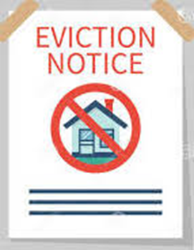
Philly Facts
Between 2000 and 2014, Philadelphia lost 20% of rental units with the gross monthly rent of $750 or less.
In 2016 the eviction rate in Philadelphia was 150% the national rate.
Eviction rates in predominantly African American neighborhoods were on average three times higher than those in in predominantly white areas.
Notes:
26% of Philadelphians - over 400,000 people - live below the federal poverty level.

Slide 21
Outcomes of Eviction: What is at Stake?
Eviction is a leading cause of homelessness.
Evicted workers were approximately 20% more likely to subsequently lose their jobs.
Frequent moves increase the likelihood of a child dropping out of school by up to 30%.
Low-income families who experience eviction are four times as likely to have a child involved in the child welfare system.
Notes:
Home, Job, Education, Family
Homelessness and ability to re-rent and Impact on Credit Score go together - not immediate, sometimes it comes later

Slide 22
Health Effects
“Toxic stress” affects many critical organ systems leading to increased behavioral issues, diabetes, weight issues, and cardiovascular disease.
Children four and under with unstable housing have almost 20% increased risk of hospitalization, and over 25% risk of developmental delays.
Evicted families searching for housing often accept properties with substandard living conditions.

Slide 23
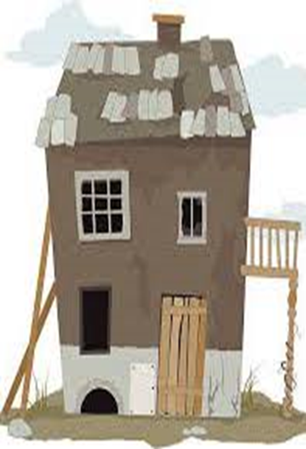
Evictions and Housing Quality
Poor housing quality leads to bad health outcomes.
High demand and low supply lead to power imbalance.
Tenants may withhold rent if properties are not up to code.
Tenants rarely file complaints about code violations for fear of retaliatory evictions or “lock-outs.”
Notes:
this creates a power imbalance where the landlord has the ability to no make repairs/evict people because demand for housing is so high, that there is always somebody willing to move in

Slide 24
Landlord/Tenant Court: No Representation
From 2007-2016 landlords were represented 80% of the time while tenants were represented 7% of the time.
Tenants are reluctant to go to court due to distrust in the legal system, lack of information, an intimidating and unfamiliar court experience.
Tenants have various goals for case outcomes.
Notes:
not guaranteed right to counsel in civil court, as in criminal court = people have to pay for lawyers, and many cannot

Slide 25
With Representation
Represented tenants were 90% less likely to lose by default than unrepresented tenants.
They were given approximately 50 days to find a new residents in comparison to the approximately 35 days that unrepresented tenants are allowed.
They are twice as likely to satisfy the judgements of their agreements.
In New York, representation prevented loss of housing for 91% of clients.
Notes:
fewer evictions served? would make sense that it would reduce negative health effects
last bullet point: NY provides counsel for all low-income residents in certain zip codes, not just the ones with the best case

Slide 26
City Initiatives: National
Passed Right to Counsel legislation - New York City, San Francisco, and Newark
Launched pilot projects for Right to Counsel - Boston, Los Angeles, San Diego, and Kern, Northern Santa Barbara, and Yolo Counties in CA
Created fund for eviction defense - Minneapolis
Introduced bill to establish Right to Counsel - Baltimore, Washington D.C., and Boston
Notes:
healthcare organizations have not been involved. But there’s an opportunity!!!

Slide 27
Philadelphia Initiatives
Philadelphia Bar Association’s Civil Gideon and Access to Justice Task Force gives testimony advocating for legal representation for low-income tenants.
City Council creates pilot project to increase legal aid to tenants: Philadelphia Eviction Prevention Project (PEPP).
Councilwoman Helen Gym introduces bill to guarantee Right to Counsel for low-income tenant facing eviction.
Notes:
Explain what PEPP does and does not do.
https://whyy.org/articles/philly-renters-guaranteed-lawyers-in-eviction-court-under-new-city-council-bill/
However, not in next year’s council budget: https://whyy.org/articles/philly-city-council-passed-a-5-billion-budget-heres-whats-in-it/
“City Council members secured a variety of other smaller wins. Councilwoman Helen Gym successfully sought an increase in funding for anti-eviction programs. Last year, the city gave $850,000 to such efforts, but this year the number will go up to $1.5 million.
Gym introduced legislation earlier this year to establish a right to counsel, which would guarantee low income tenants a lawyer in eviction court. It would require about $5 million annually to fully fund such a program.
“Right to counsel is not just about all the money coming in at once,” said Gym. “This is going to evolve in a very purposeful and steady way to match the funds. We don’t need all of this on the front end because we need a lot more time to plan this out.””

Slide 28
Philly’s Right to Counsel to Bill
The bill allocates $5 million to fund counsel for low-income (below $43,000 for a family of three) tenants facing eviction
The Philadelphia Bar Association asked Stout to quantify City savings for funding $3.5 million towards right to counsel, and the City would save $13 for every $1 invested in the program
Approximately $4.64 in direct healthcare costs avoided per 1$ invested

Slide 29
Example Proposal
Philadelphia hospitals pool funds to supplement the City’s funding in order to fully represent all low-income tenants (less than 200% of poverty level), preventing harm and saving both the City and hospitals resources.
Notes:
$3.5 million gap between fully funding 200% poverty level ($5 million) & allocation in this year’s budget
maybe cost savings will allow City to pay for this entirely later on -- timeline for $1 million less each year?

Slide 30
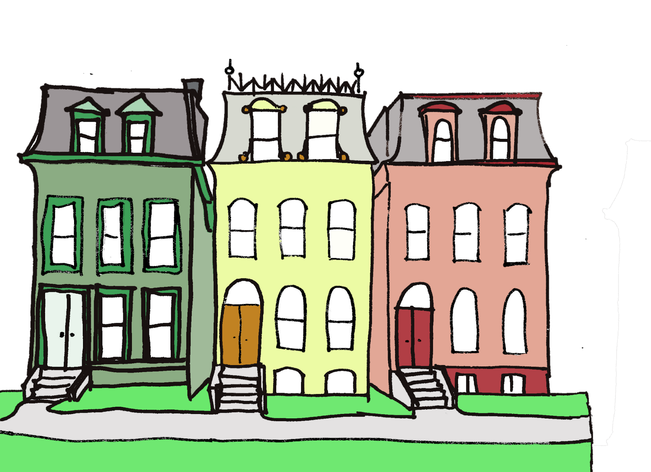
Creation of Community Health Assets
Notes:
Healthcare organizations also work on preventing health issues through creating what might be called “community health assets” – amenities that provide quality affordable housing and fresh food.

Slide 31
Housing Costs and Health
Stress
Forgoing Care: “Low-income families with difficulty paying their rent or mortgage or their utility bills are less likely to have a usual source of medical care and more likely to postpone needed treatment than those who enjoy more-affordable housing.” (Health Affairs)
Notes:
As we know, cost burdens (& prob fear of displacement) lead to stress & foregoing care, poor housing quality leads to health conditions (John will have talked about), lack of healthy food options enables chronic diseases. So actively providing amenities that provide people with quality housing they can afford, and increasing access to fresh food, promotes better health.
Health Affairs lit review of housing & health: “Low-income families with difficulty paying their rent or mortgage or their utility bills are less likely to have a usual source of medical care and more likely to postpone needed treatment than those who enjoy more-affordable housing. Severely cost-burdened renters are 23 percent more likely than those with less severe burdens to face difficulty purchasing food.” https://www.healthaffairs.org/do/10.1377/hpb20180313.396577/full/
An Australian review of housing costs ~ stress: both major life event stressors (like payment problems) and chronic stress, and potentially the stress of frequent moves
https://aifs.gov.au/cfca/sites/default/files/publication-documents/b12.pdf
A few others I was trying to look at:
https://link.springer.com/article/10.1207/S15324796ABM2303_5
https://adc.bmj.com/content/91/11/942.full
https://journals.sagepub.com/doi/abs/10.1177/0885412207299653
https://www.tandfonline.com/doi/pdf/10.1080/02673030120105857?needAccess=true
some mixed results re: whether people will consume more healthy foods once food desert eliminated (but providing is a necessary first step)
https://www.sciencedirect.com/science/article/pii/S0749379714003705
These interventions are either directly for low-income renters, or isn’t restricted to just homeowners. not policy like Riley’s, so not a city-wide impact, but meaningful to those who get to use the amenity.

Slide 32
Carefully Considered Equitable Development
Affordability and displacement
Community involvement and ownership
Notes:
REWORK BASED ON THIS:https://www.citylab.com/equity/2018/09/when-a-hospital-plays-housing-developer/569800/
A lot of what this looks like is a health system taking some role in a development project. As we’ve been talking about this entire conference, to be truly equitable, development needs to be carefully considered (non-displacement, legacy of urban renewal) with meaningful community engagement, and ideally some degree of community control!!! I can’t speak to that for these projects because I wasn’t part of the process, but I’m presenting them because I see in them a huge potential for community benefit -- if community identifies these needs, healthcare orgs have a stake in filling them

Slide 33
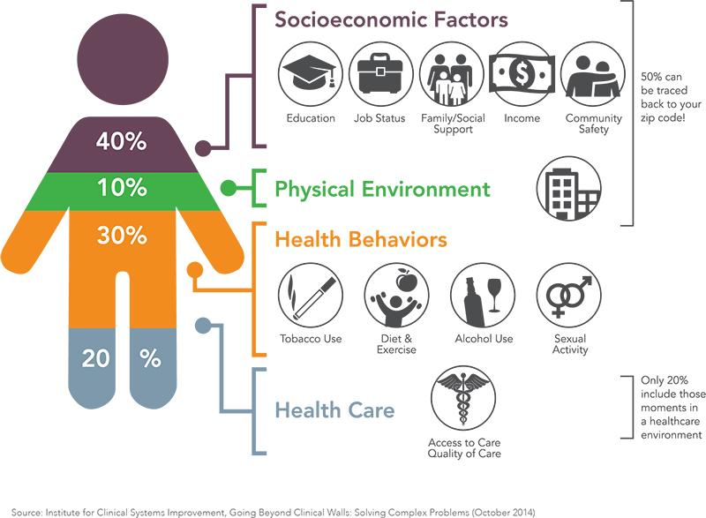
ProMedica & Social Determinants of Health
Screening for food insecurity
Food reclamation
Food clinic
Grocery store
Notes:
an ex of a community health asset
ProMedica, a health system based in Toledo, OH, is among the health systems beginning to recognize that most of the factors that influence health and wellbeing are outside of the healthcare system (graphic – from ProMedica’s website).
2009 CHNA started the process (10 years ago)
Obesity, hunger, food insecurity, chronic illness --> screening for food insecurity (give 1-day food supply + referrals), food reclamation (repackage unserved food from large food service providers), food clinic (Rx for 1/month for 6 months), grocery store
(ProMedica has done other SDOH initiatives, but this is one “thread”)
Be sure to mention that CHOP has a food pharmacy

Slide 34
The Grocery Store Model
Full-service grocery store est. 2015
Established in a food desert
Workforce pipeline
Notes:
Uptown Neighborhood -- chosen for high poverty and poor health outcomes as well as food desert
Groceries: Fresh, reasonably priced and available to people who otherwise would not have been able to access
Job training program is a workforce pipeline where residents living w/in 1 mi of store get 12 months of retail experience w/ time to pursue GED, etc. Can set up for a job at the health system.
Later added a “mobile market” to go to senior housing --- accessibility

Slide 35
Beyond Groceries
Financial Opportunity Center
Free GED and STNA classes
Computer lab
Teaching kitchen
Mixed income multifamily development to be built across the street
Notes:
Other programming on upper floors, including financial opportunity center, classes & programming. Again, an amenity that broadly provides for the community’s health by addressing SDOH.
“The best way to describe is that we are investing in a mixed-income, mixed-use multifamily development across the street from the Ebeid Center, which houses the grocery store, our financial opportunity center and GED & STNA (state tested nursing assistant) training programs and is about 4 blocks from our Job Training Center that we operate in partnership with Goodwill of Northwest Ohio. We do have a development partner, the project is in an opportunity zone and will use no government subsidy on the affordable units. The below 80% AMI units will be subsidized through our Ebeid Neighborhood Promise initiative.”
breakdown of housing units: 50% market rate, 30% workforce (80-120% AMI -- in Toledo this is about $40-80k for a family of 4), 20% below 80% AMI (below $40k for a family of 4)
In Philly, we really need lower AMI
ProMedica thinks of these kinds of investments as investing in business market -- when the local economy succeeds, the hospital succeeds
Notably, the grocery store and associated programs are not restricted to ProMedica patients! They’re community assets with a broad goal of improving community health – again, the kind of project that health systems could spearhead

Slide 36
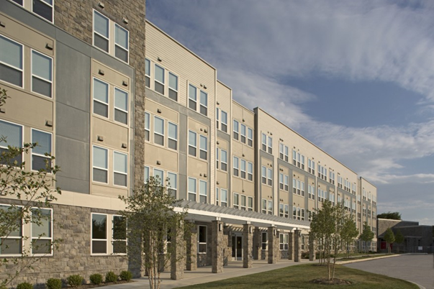
Other Community Health Assets
Bons Secours
Housing First pilots
Notes:
Gibbons Apartments, built by Bons Secours in Baltimore. Includes housing affordable at 30-60% AMI, green space, rec, community services
https://bonsecours.com/baltimore/find-a-facility/bon-secours-gibbons-apartments
Several Housing First pilot programs across the country have found cost savings of tens of thousands per person annually in healthcare costs by housing the homeless
A Los Angeles program housing 1,000 individuals experiencing homelessness saved $14,000 per person, and Orlando Hospital saved over $160,000 by housing six frequent visitors to its Emergency Room
A 2015 Camden City Housing First pilot saw a 60% reduction in ER and inpatient costs for 52 housed residents
Orlando Hospital invested $1.5 million in housing for six frequent users and saved $2.5 million
Probably don’t include, but just in case:
Changes in Medicaid reimbursement from the Affordable Care Act have made it easier for states to incentivize health systems to prevent costs through alternative means. For example, the ACA now penalizes health systems for frequent readmissions of patients for chronic diseases such as asthma. This is outside of our scope, but I have a reading on these changes available to everyone as you leave this talk. Managed Care Organizations (MCOs), or insurance providers, should also invest in healthy housing. During the Dec Summit, representatives from Amerihealth Caritas in DC discussed investments they made in transitional housing and their cost savings.

Slide 37
Example Proposal
Hospitals can work with low food access communities to add a grocery store and low-income housing units.

Slide 38
Resources
“Housing and Health: an Overview of the Literature,” Health Affairs Health Policy Brief, https://www.healthaffairs.org/do/10.1377/hpb20180313.396577/full/
“The Impact of Housing Quality on Children’s Health,” Philadelphia Department of Public Health, http://healthyrowhouse.org/wp-content/uploads/2015/03/The-Impact-of-Housing-Quality-on-Children-Health-Phila-nfeyler-feb-2015.pdf
“Renting in Philadelphia: A Survey of Tenants and Landlords,” Philadelphia City Planning Commission, https://www.phila.gov/CityPlanning/resources/Publications/RentingInPhiladelephia_FINAL_web.pdf
“Economic Return...for Providing Counsel… for Low-Income Tenants,” Philadelphia Bar Association, https://www.philadelphiabar.org/WebObjects/PBA.woa/Contents/WebServerResources/CMSResources/PhiladelphiaEvictionsReport.pdf
“Housing and Health: An Overview of the Literature,” Health Affairs, https://www.healthaffairs.org/do/10.1377/hpb20180313.396577/full/
“When a Hospital Plays Housing Developer,” CityLab, https://www.citylab.com/equity/2018/09/when-a-hospital-plays-housing-developer/569800/
“Embracing an Anchor Mission: ProMedica’s All-In Strategy,” ProMedica and The Democracy Collaborative, https://democracycollaborative.org/sites/clone.community-wealth.org/files/downloads/Promedica-web.pdf

Slide 39
Discussion
1. What are some connections between our presentation and others you have seen today?
2. What do you see as the biggest obstacles to implementing one of these proposals?
3. Can you give an example about how one of these proposals might be implemented in the community where you live or work?
4. What makes these proposals examples of equitable development?

Slide 40
Discussion
5. Can you think of ways these proposals could be implemented that could hurt certain communities and drive inequity?
6. What policy changes and/or incentives would it take for these types of interventions to become widespread?
7. Can you think of another example of a community health asset besides affordable housing and a grocery store?
8. How could that asset be developed in an equitable way?

