Slide 1
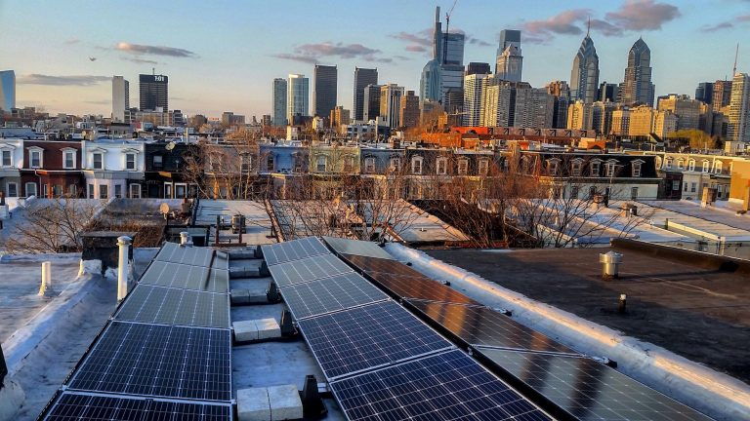
Solar Energy as a Pathway to Community Development
Philadelphia Association of Community Development Corporations
2019 Forward Equitable Development Conference

Slide 2
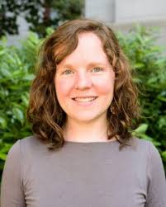
Today’s Presenters
Laura Rigell
Philadelphia Energy Authority
Ky Sanders
Solar States
Chris Spahr
Centennial Parkside CDC
Russell Hicks
Ebony Suns Enterprises, LLC

Slide 3
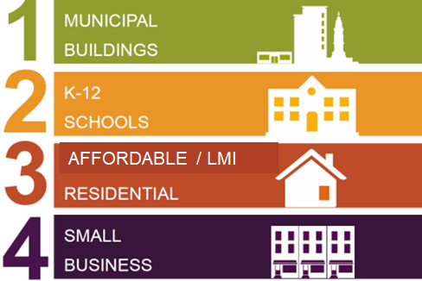
Philadelphia Energy Campaign
$1 billion investment over 10 years in energy efficiency and clean energy projects, leveraging public and private dollars
10,000 jobs
25,000 households
2,500 small businesses
First 2 years:
$130+ million active
Nearly 1,000 jobs
$750M+ pipeline
Self-funding projects
www.solarizephilly.org

Slide 4
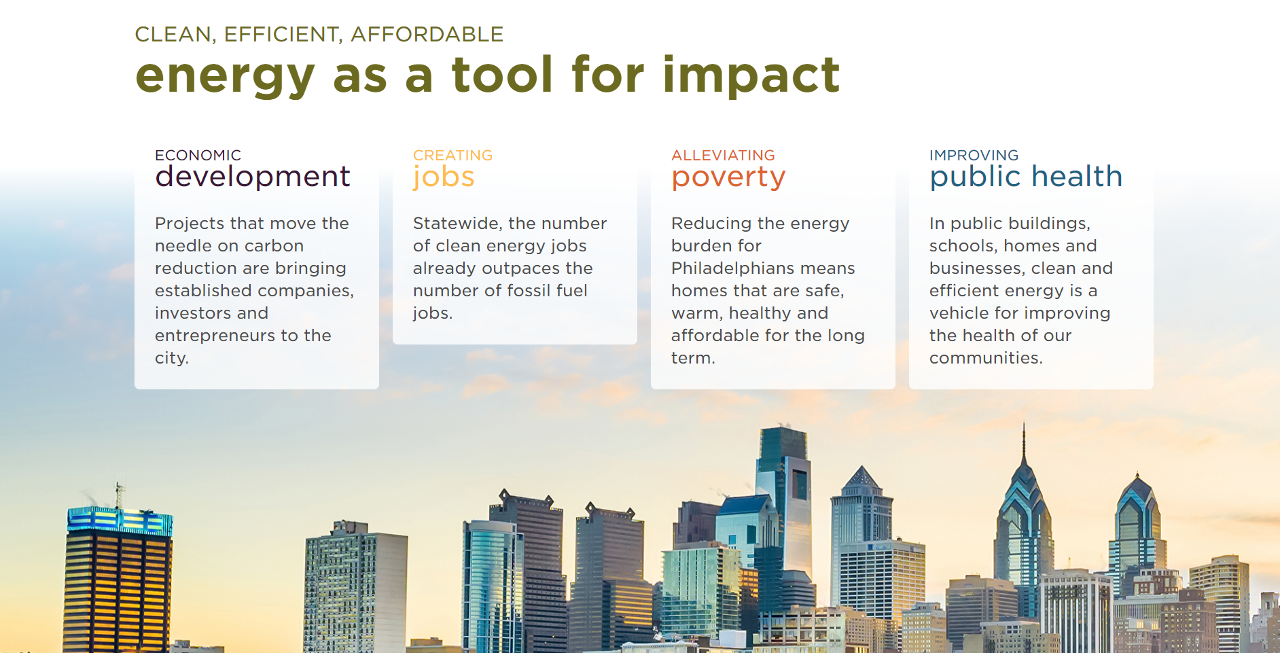

Slide 5
Notes:
Goal of growing solar market, given PECO and L+I improvements
Largest campaign in country
4th fastest growing solar market in US in 2017 (46%)
Ran 2 phases 2017-2018, launching phase 3
DOE Solar In Your Community Challenge

Slide 6
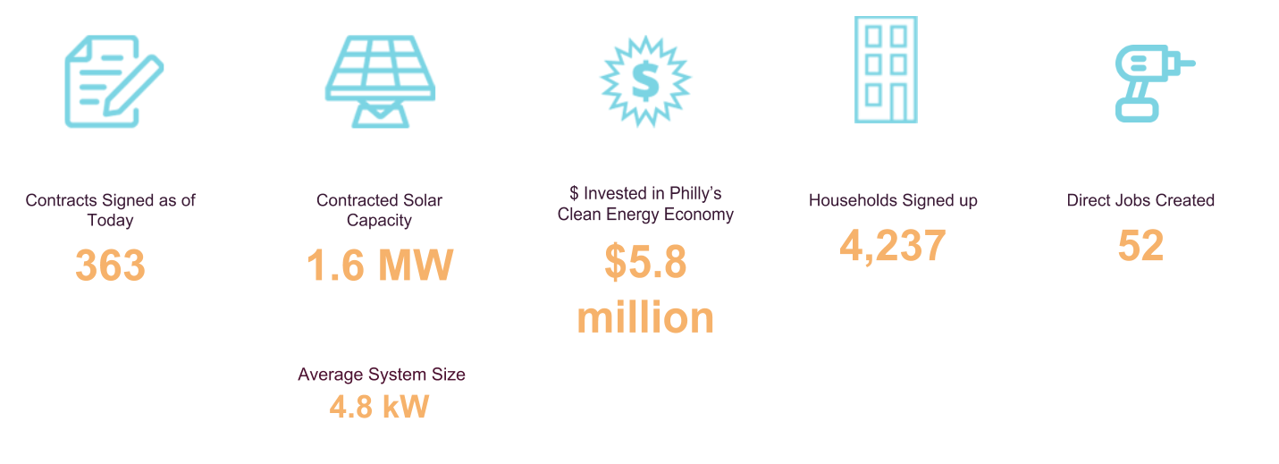
Largest Solarize in U.S.
www.solarizephilly.org
Notes:
Driving the residential solar market
Philadelphia 4th in country for solar growth last year

Slide 7
Solar as a solution to address energy insecurity
Energy insecurity disproportionately impacts low-income and minority households.
40% of households earning less than $60,000
> 50% of all minority households of all income levels ²
Solar installed disproportionately by high-income and white households.
15% of solar adopters are below 200% of FPL, though 28% of U.S. population is below 200% of FPL
Black-majority census tracts have installed 61% less rooftop solar compared with no majority tracts and Hispanic-majority census tracts have installed 45% less. White-majority census tracts have installed 37% more.”
Solar as a solution.
predictable energy costs
potential for long-term savings
Notes:
Sources:
http://www.philaenergy.org/residential-energy-consumption-survey-implications-for-philadelphia/
https://www.nature.com/articles/s41893-018-0204-z
http://eta-publications.lbl.gov/sites/default/files/income_trends_of_residential_pv_adopters_final_0.pdf
https://www.kff.org/other/state-indicator/population-up-to-200-fpl/?currentTimeframe=0&sortModel=%7B%22colId%22:%22Location%22,%22sort%22:%22asc%22%7D

Slide 8
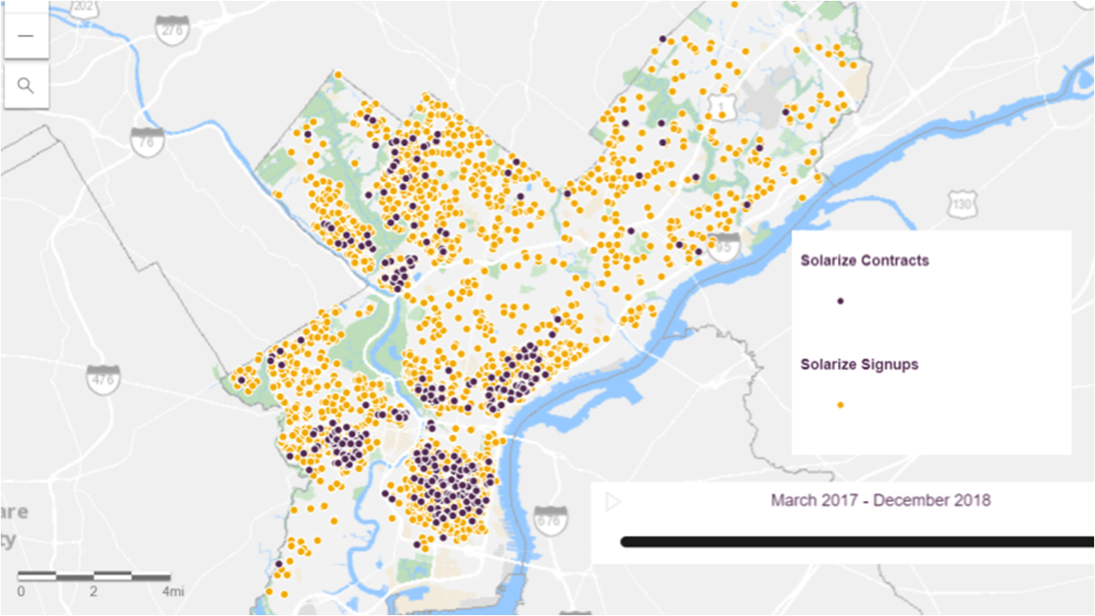
www.solarizephilly.org

Slide 9
Key Goals
Grow an inclusive, equitable solar market in Philadelphia that allows all residents to participate in the clean energy economy
Create a scalable financial vehicle to access private investment in LMI solar
20% LMI participation in Solarize Philly
1,000 LMI solar households by 2026

Slide 10
Special Financing Pilot
Program design
Available for up to 45 LMI households
$0 down
15-year lease
20% savings in Year 1
Anticipated Partners
Sunwealth
PA Treasury
PEA
PHFA

Slide 11
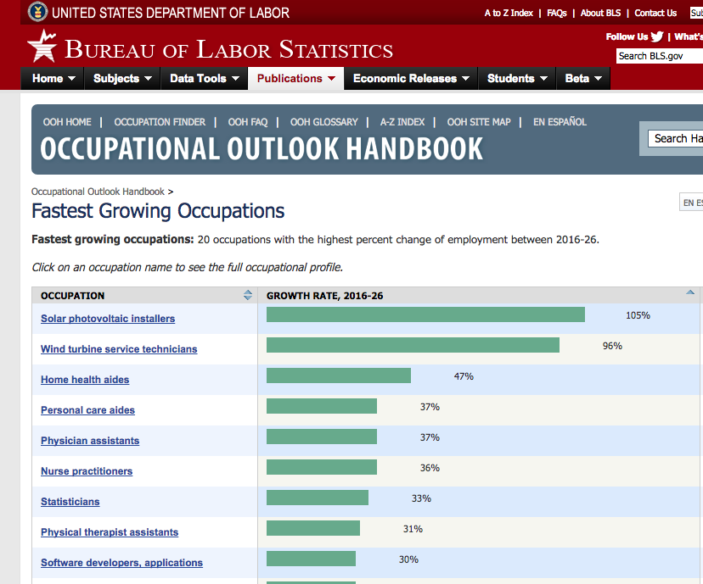

Slide 12
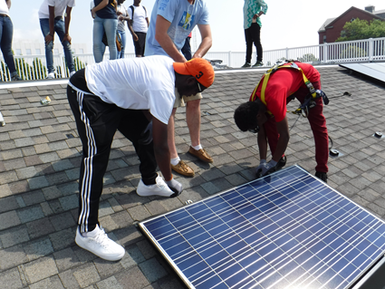
Bright Solar Futures
Establishing the nation’s first Solar Energy Program of Study for Career and Technical Education students
Trained 52 students in 2017-2018
100+ more students reached through 2021
Funded by PECO and $1.25 M award from U.S. Department of Energy
Solar States 2017

Slide 13
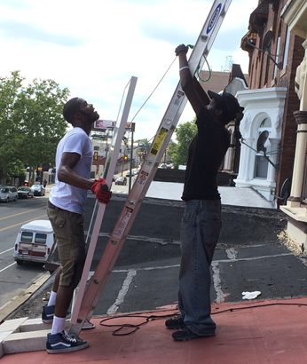
Serenity Soular
Grassroots initiative connecting North Philadelphia residents to solar energy and jobs
Supported 6 young people to attend solar training
Partnership with RE-volv
Serenity House
Village of Arts and Humanities
Installs in urban gardens
People’s Garden
Philly Urban Creators
Solar States 2016

Slide 14
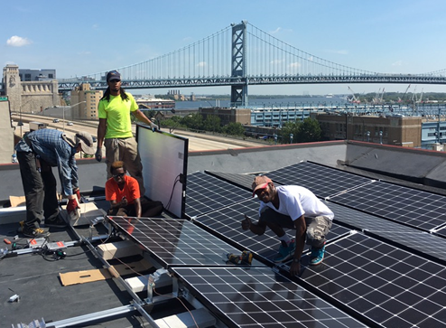
Solar States
Solar installation company based in Philadelphia and founded in 2008, with a dual mission to install solar and educate the next generation.
Locally owned and operated B-corps
Pre-approved Solarize Philly installer
Solar States 2016

Slide 15
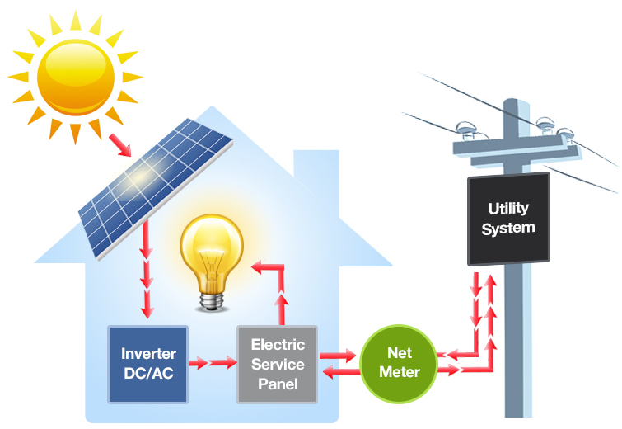
How Does Solar Works?

Slide 16
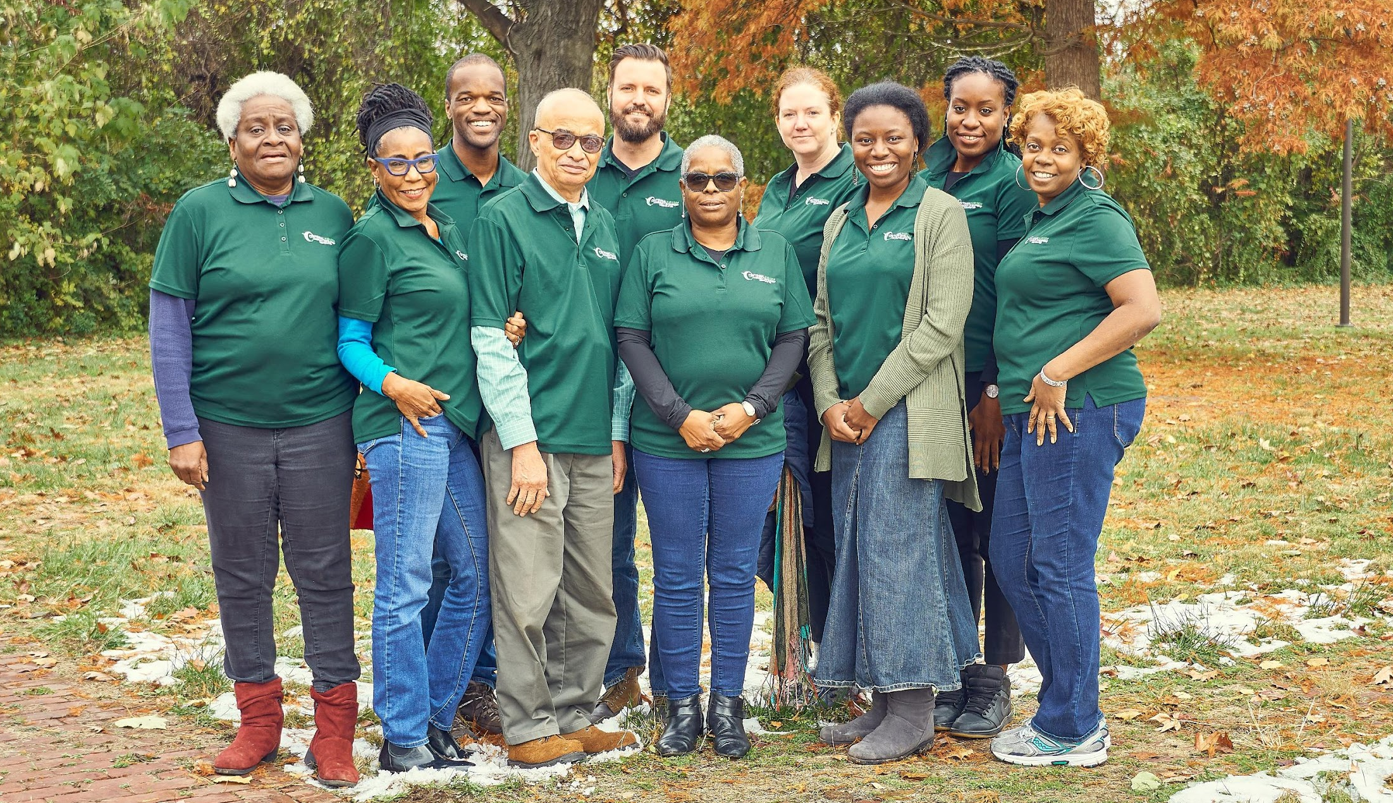
Notes:
Executive Director of the Centennial Parkside CDC in the East Parkside neighborhood of West Philadelphia.
working with a very innovative team of individuals
promoting a powerful idea around local ownership of resources in the interest of creating organizational sustainability for a community development corporation.
Solar energy
I wanted to explore this to learn:
How CBOs could create revenue generating models to sustain themselves
Create revenue to be reinvested into community development programming
The Centennial Parkside CDC has become a thought leader within the community development environment
using new ideas for business models to sustain organizations,
its influence on public policy as it relates to community based solar energy production,
and its leadership in the community when thinking about organizational sustainability and community development in new ways.
Recognition
•October 2017 Drexel University Lindy Institute for Urban Innovation awarded me an Urban Innovation Fellowship
•Extraordinary work to solve critical urban challenges

Slide 17
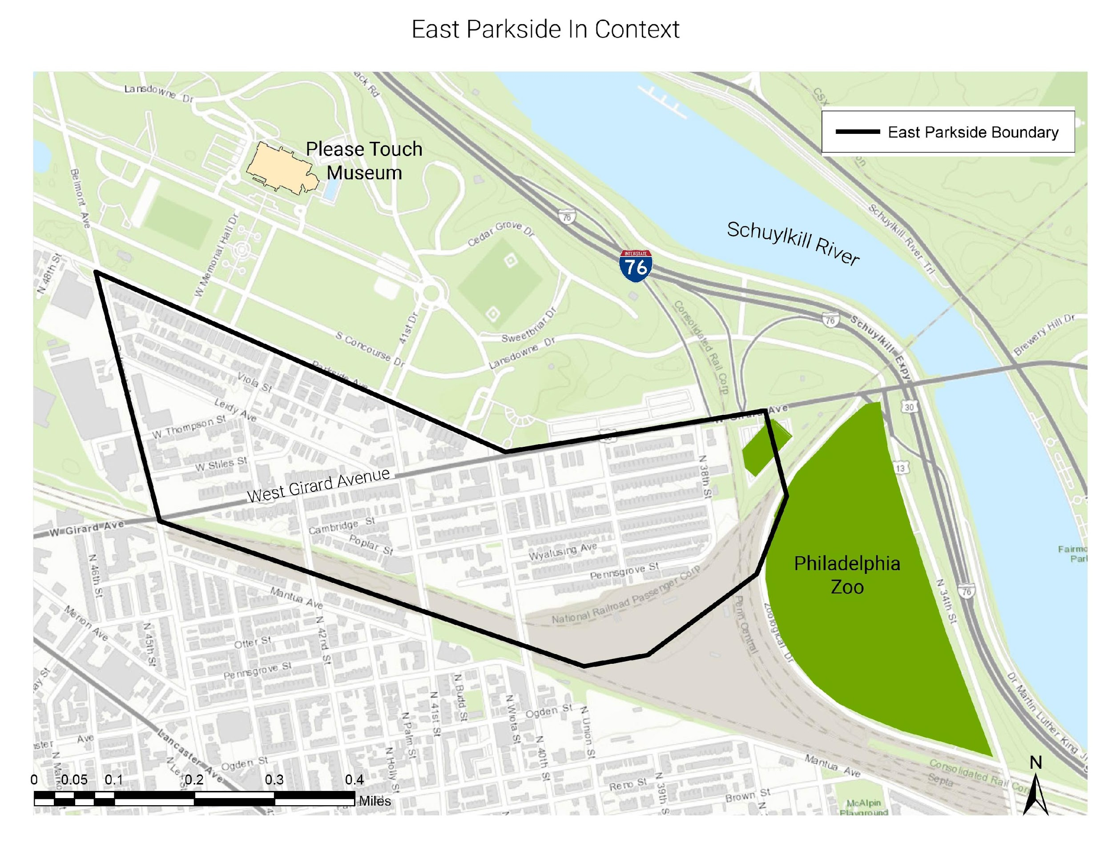
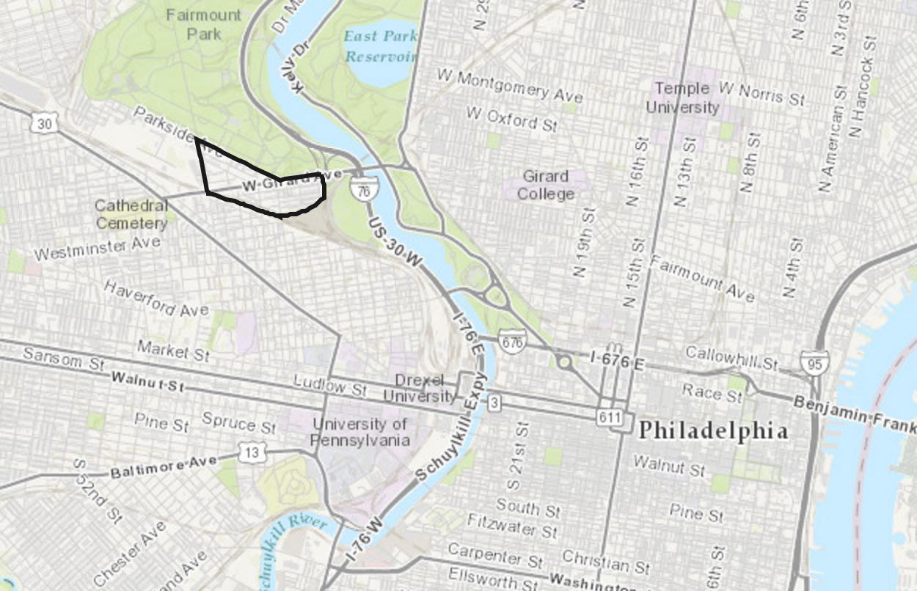
A governing body made up of residents and existing organizations to progress community development goals.
Mission: Work to preserve, promote and revitalize East Parkside through partnerships with businesses and institutions and programs that engage residents, increase opportunity, and grow a diverse, thriving community
Date Organized:
March 1, 2015
Non Profit Status:
August 18, 2015
Notes:
What is the Centennial Parkside CDC?
Stress its strategic location

Slide 18
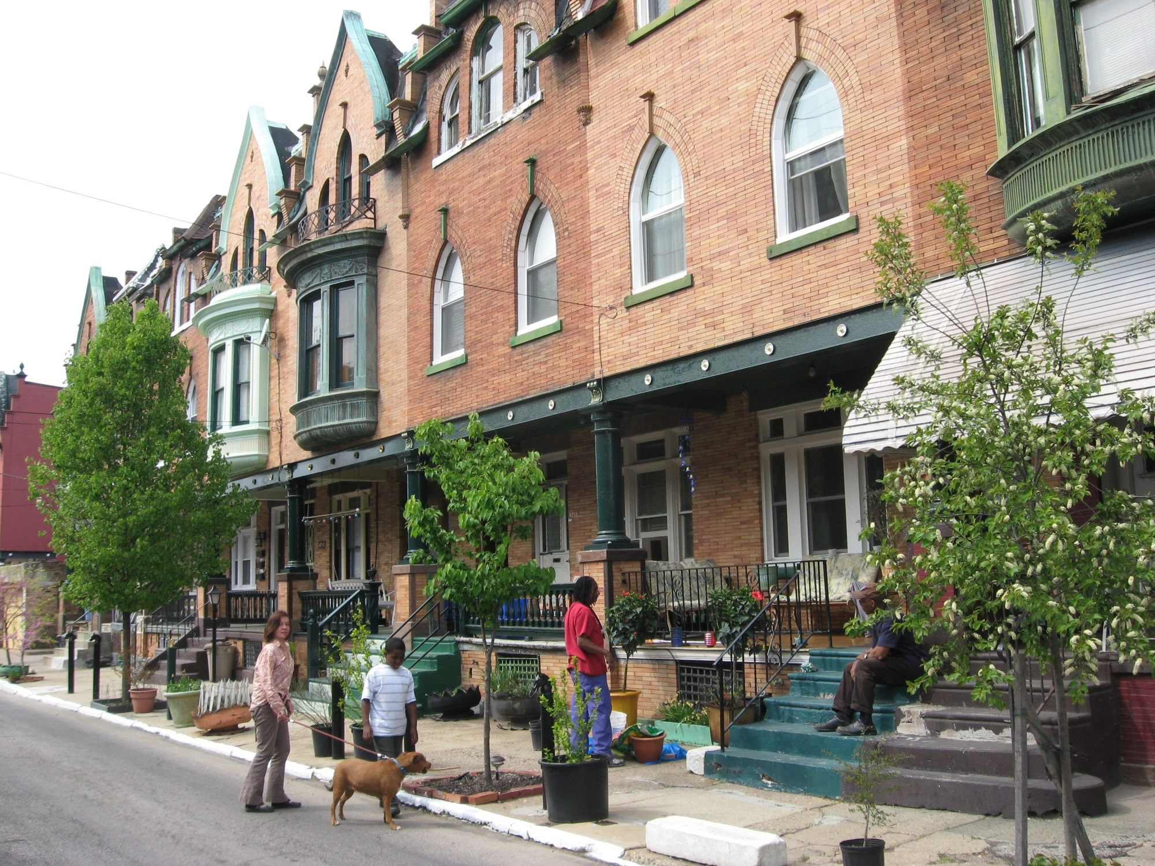
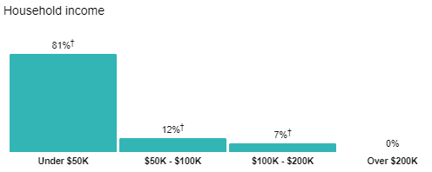
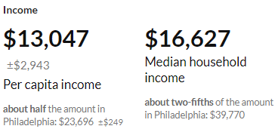
Notes:
Despite its strategic location, the service area has seen many years of disinvestment. The population has dwindled, there is a lot of joblessness, and incomes are low.
Our work at the CDC is important to spur and sustain economic development in the neighborhood while creating new opportunities for residents to build wealth and be a part of a thriving neighborhood.

Slide 19
Solar Energy
Locally produced solar energy can serve as a community development strategy
Regulations
Regulatory barriers make “community renewable energy” difficult.
Trust
Inter-organizational trust is needed for community based organizations to implement local solar energy production.
Notes:
One identified area of cost savings and revenue generation within communities is in local renewable energy, specifically solar energy. What is “Community Solar”?
In Pennsylvania, true community solar is prohibited as multiple meters cannot be tied into one solar array. While community solar is prohibited in Pennsylvania (and 34 other states), community based organizations can work within the obstructive regulations to implement local forms of energy production that can save residents money and create revenue for community development projects.
For community based organizations to implement local energy production in Pennsylvania they need to engage the local community and create inter-organizational trust. Through information and revenue sharing a sense of ownership can be created.

Slide 20
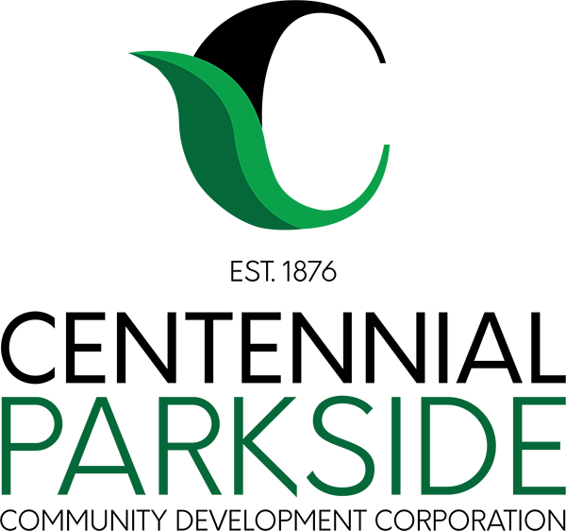
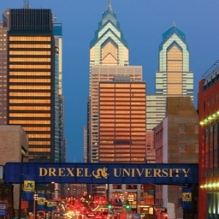
$
$
Notes:
The Centennial Parkside CDC is proposing to be the owner and operator of solar facilities that would provide energy to local businesses and institutions and generate revenue for the community. This is how it would work
System would be owned by community residents and the CDC to operate solar systems on strategically selected vacant land within the districts boundaries
Long term contracts to sell the solar energy to the institutions and businesses within the district
Revenues go back to community through the Centennial Parkside Community Development Corporation and take on energy improvements that address energy insecurity, create investment in public spaces, wealth generation and structural solutions without displacement.

Slide 21
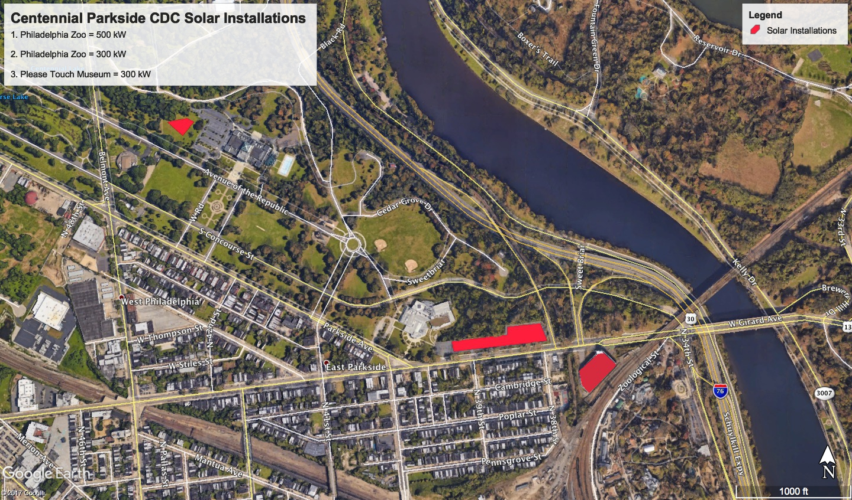
3
1
2
Notes:
Three sites that were initially identified in East Parkside include
A parking lot for the Philadlephia Zoo. In this situation, solar panels would be canopied over the parking lot so that cars could park underneath the solar array.
A parking structure for the Philadlphia Zoo. In this situation, solar panels would be canopied over the top level of the parking structure much like in the parking lot.
On a side lawn at the Please Touch Museum
Additional sites are currently being identified to serve Brandywine Realty Trust and Drexel University.

Slide 22
Community Solar LLC
Philadelphia Zoo & Please Touch Museum
Business or Institution
Centennial Parkside CDC
Foundation X
The Reinvestment Fund
Foundation X
PPA
Energy Pmts
Grant
Cash
Cash
Tax Equity Investor X
Centennial Parkside CDC
Community Solar LLC
Tax Credit
Energy Pmts
Debt Service
Loan
Affinity Investor X
Notes:
From a financing standpoint, this is how the solar model works.
A Solar Energy LLC is formed, which serves as a for-profit arm of the CDC and involves an agreement between the CDC and a for-profit developer.
A Tax Equity Investor invests in this LLC and receives all solar tax credits
An affinity or social interest investor invests in the CDC to advance this model
A philanthropic partner invests in the CDC to advance this model
Through the CDC funders, the CDC can provide cash to the community solar LLC
The LLC builds, owns, and operates solar arrays on underutilized land and sells that energy to local businesses and institutions through 20 year Power Purchase Agreements.
Revenue is used to pay off debt and is split between the CDC and the for-profit partner.
Net revenue then going to the CDC supports the CDC operations and is reinvested into the community

Slide 23
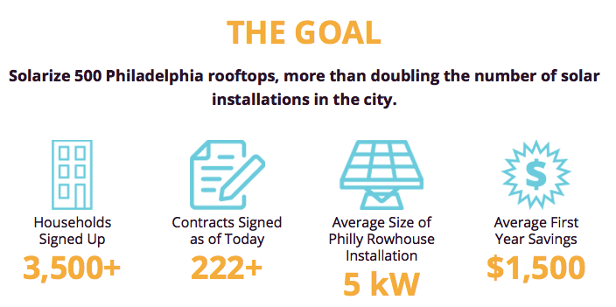
Notes:
What is SolarizePhilly?
•Group buying program to bring down the cost or residential solar
•Pay in cash or through financing
•Equity Gap
•The CDC is working with the program to create opportunities for low income families to participate
•Loan program that offers low interest financing to solar developers to lease panels to low-income families and create a small rate of return for the CDC

Slide 24
Long-term Discussions
Long-term Discussions
Verbal Agreement
Preliminary Discussions
Preliminary Discussions
Teaming Agreement
Notes:
Current Status of our Projects
We have a preliminary agreement from Solarize Philly for our residential line of work and have raised the philanthropic funds from Spark Therapeutics and the William Penn Foundation to support a loan to to the Solarize Philly fund.
We’ve been in discussions with and are developing initial agreements with the initial energy offtakers being Brandywine Realty Trust and Drexel University
We have a teaming agreement with a codeveloper who is providing design support and financing support.
We have funding from the U.S. Department of Energy, the Drexel University Lindy Institute for Urban Innovation, and a community organizing group called Pennsylvanians Organized to Witness, Empower, and Rebuild. Most of this funding is to study the model and perform community engagement.
And finally, we are nurturing long term relationships with the Please Touch Museum and the Philadelphia Zoo who at one time we thought were the low hanging fruit but have since proven to be rather risk averse when it comes to innovative thinking.

Slide 25
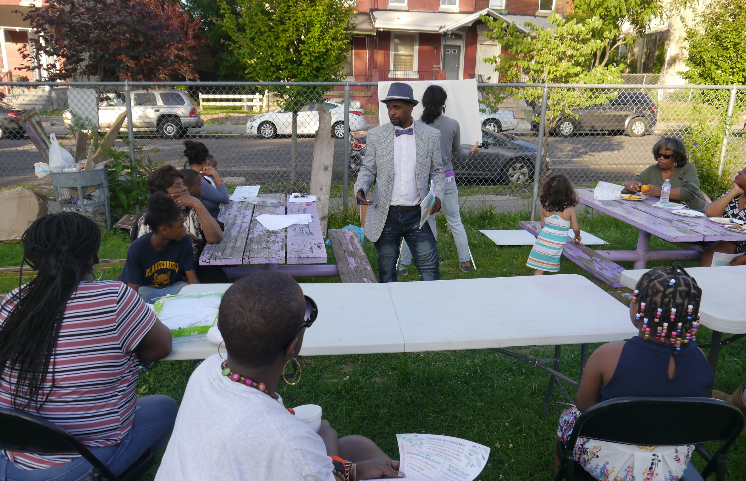

Slide 26
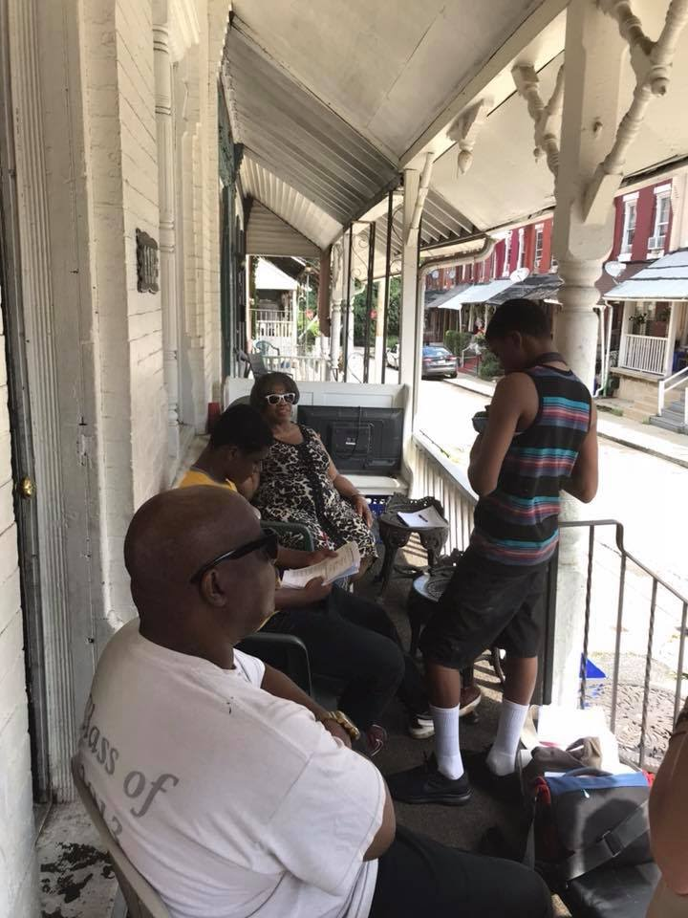
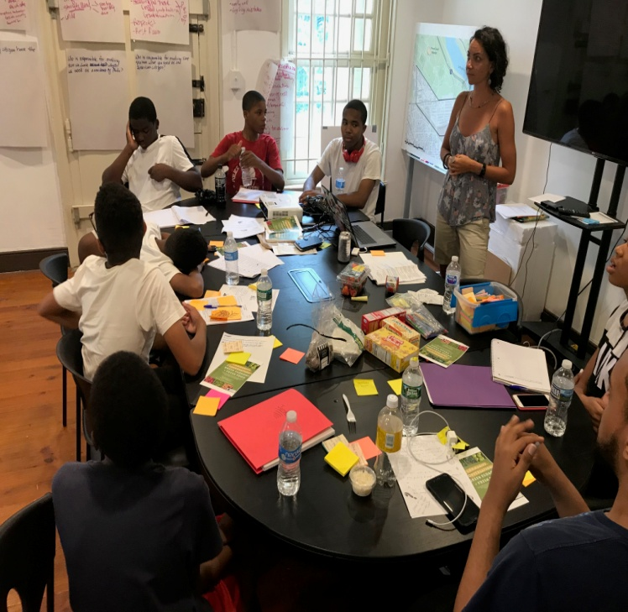
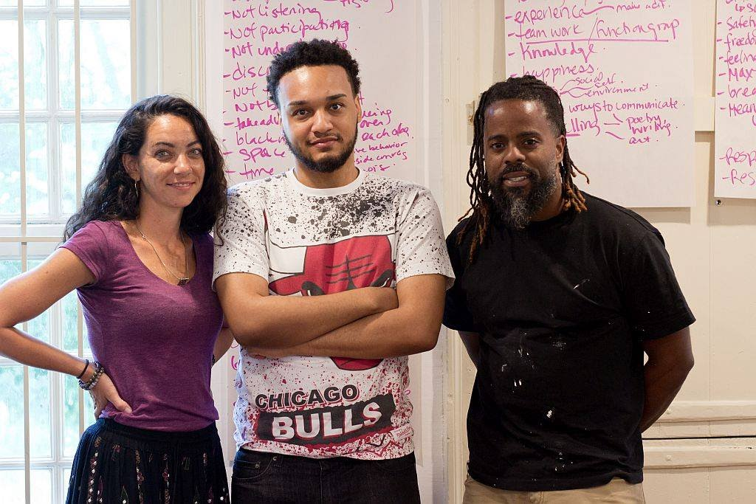
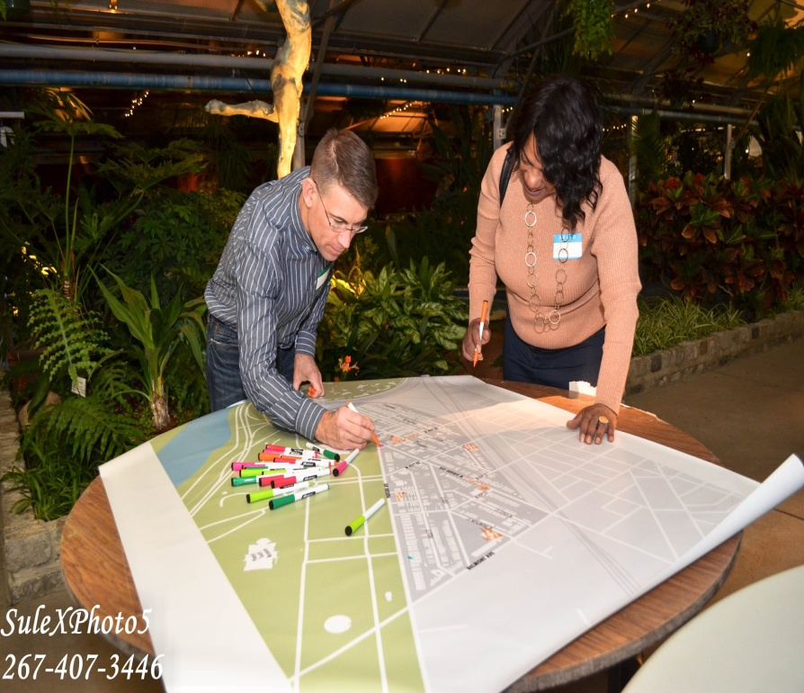
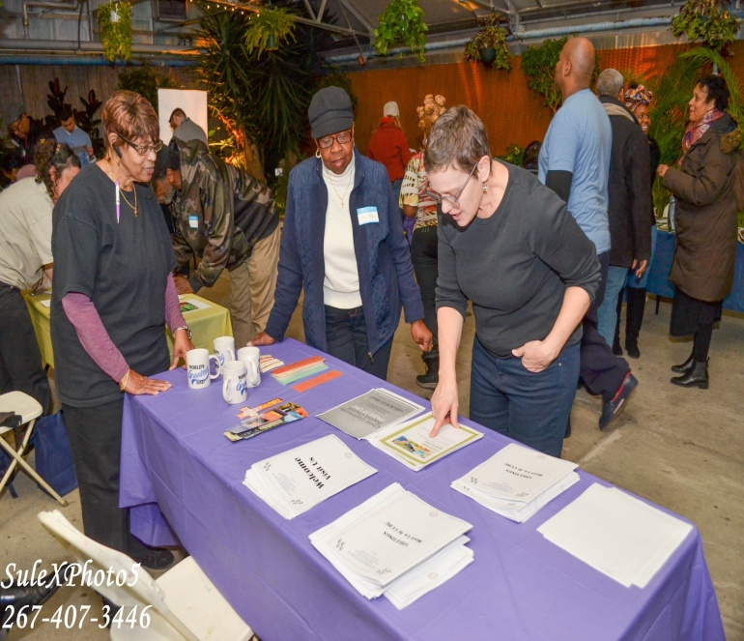
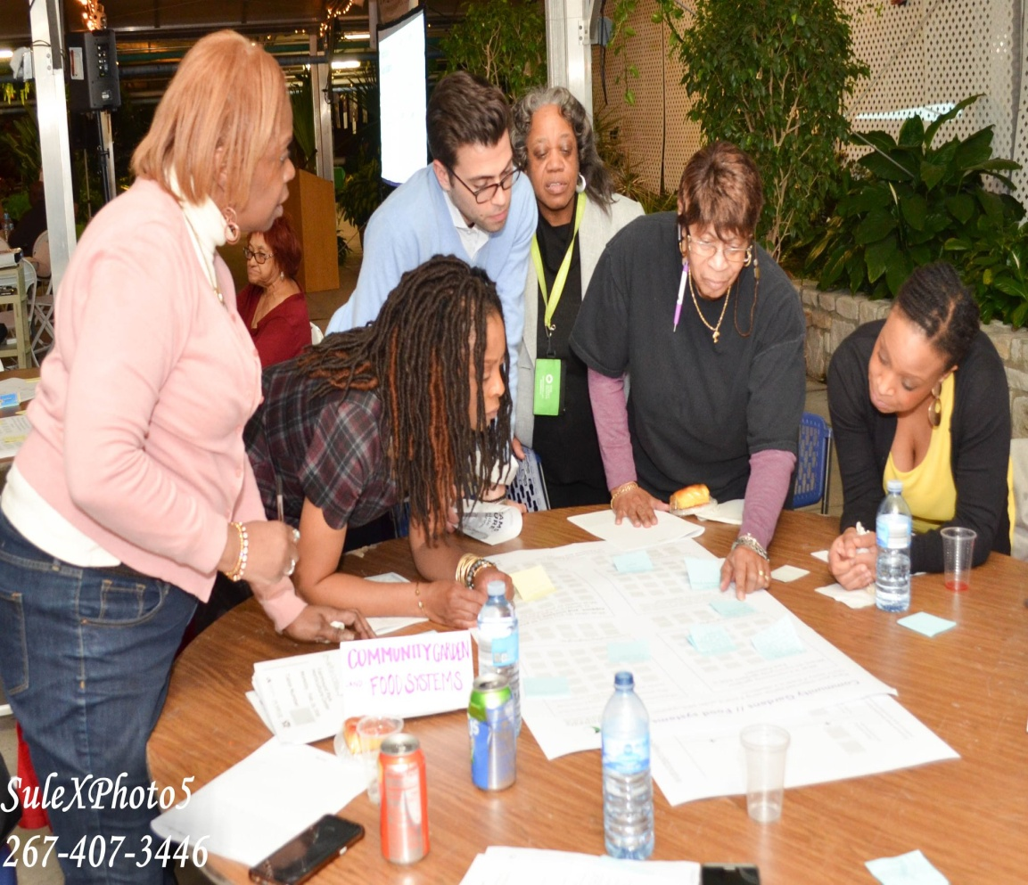
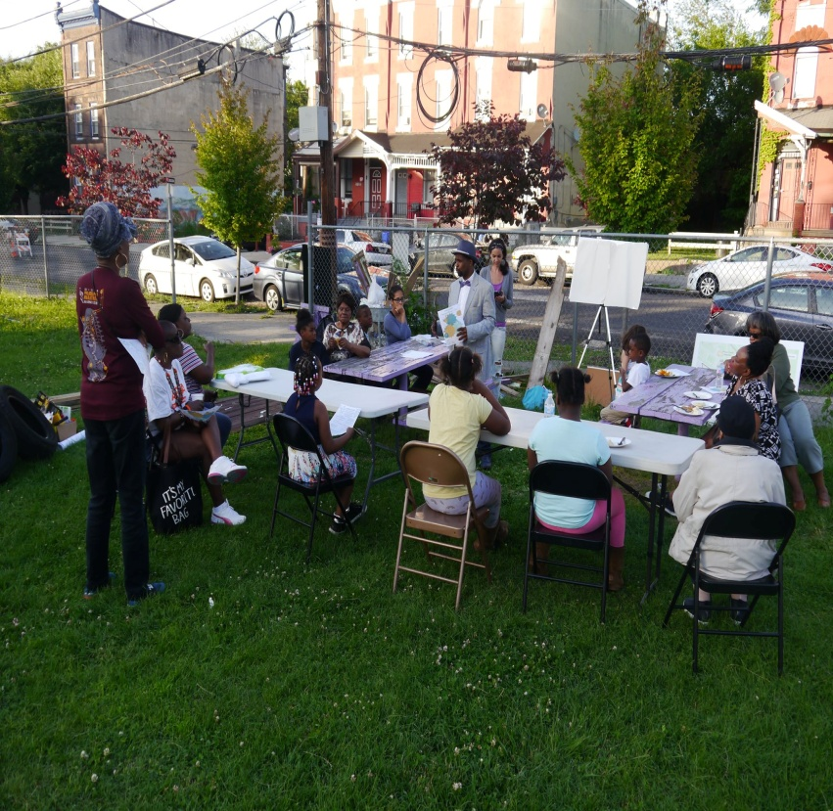
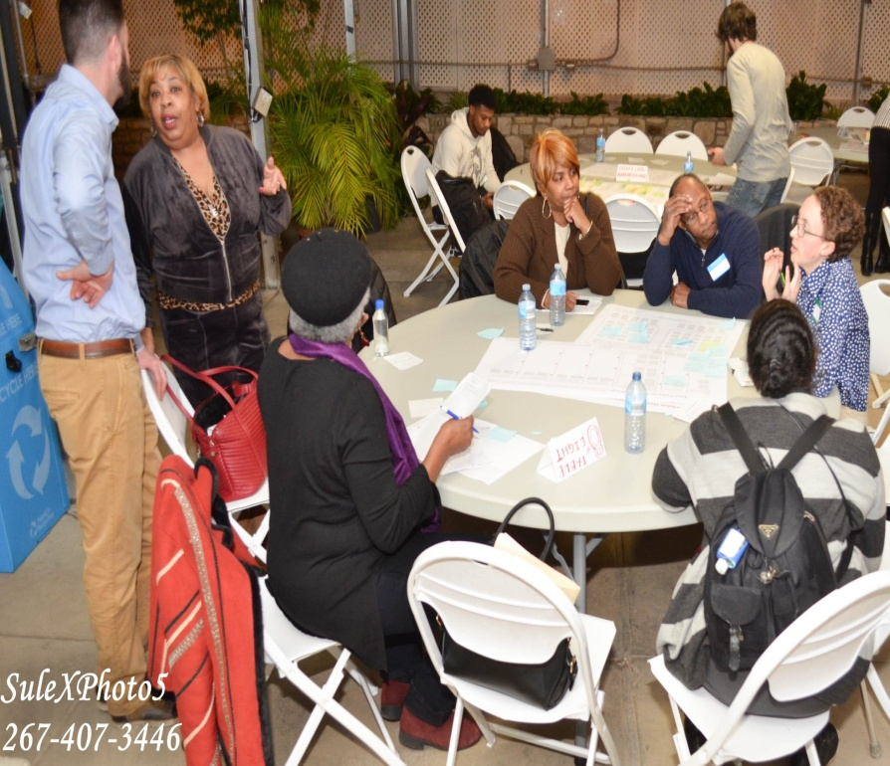
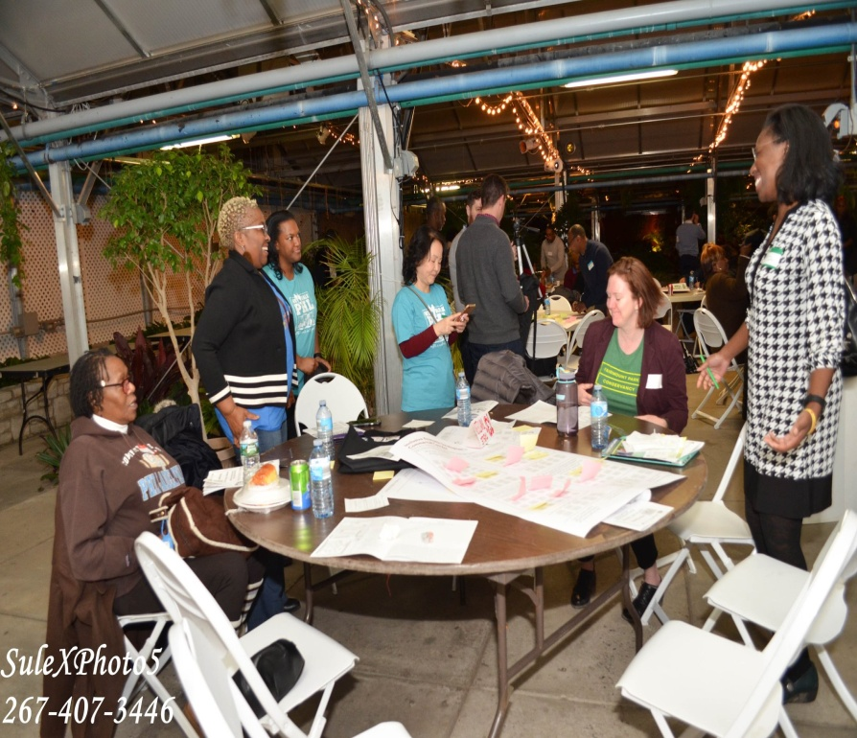
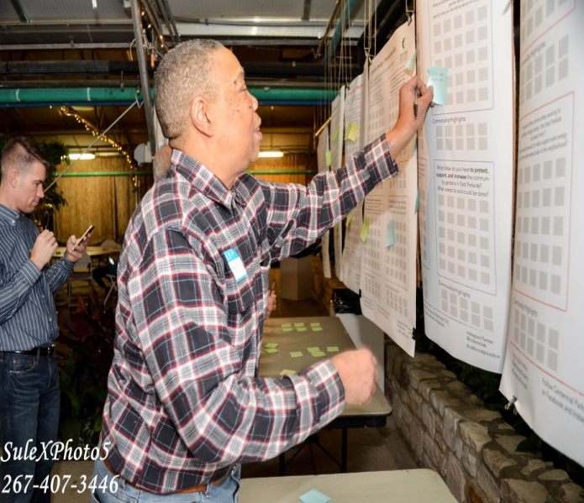
Community Engagement
Notes:
The community engagement process was conceived out of the idea that while the solar energy idea was generated from community members, namely my board chair and the other board members, it wasn’t well vetted in the community. And since it was gaining traction, it was, in my personal opinion necessary to engage the community around this to 1) Build an understanding of it 2) Develop a level of community buy-in and 3) Develop a level of emotional ownership for it.
To do this, the CDC put together a community engagement team which consists of a community engagement consultant who lives in the neighborhood and works for an international collective of women designers and researchers called In•site collaborative. She then put together a small team of subconsultants (Ebony Suns) who have either a level of expertise in the green economy or a strong understanding of the community itself.
And as the engagement process started, important observations arose.
it’s hard to build understanding and trust in a community based revenue model when there still isn’t a good understanding or level of trust in the organization who is developing it, in this case the CDC
Talking about solar energy development in a community where many people are jobless and just getting by, if not done in the right way, shows a strong disconnect. In other words, if you just talk about building solar arrays to sell energy to the businesses and institutions to raise revenue to the CDC, nobody will care. But if you explain that a strong CDC can lead to a thriving community and that solar energy production can create jobs and cost savings for residents and ultimately build wealth, then a connection can be made
Finally, and connected to the second point, for people to understand the benefits of locally produced solar energy, they must first understand how a green economy works.
Methods for Engagement consist of several different activities
Green Economy Chat ‘n Chews– These occur once a month. They are small and intimate dinners and take place in locations where the community feels comfortable (playgrounds, vacant lots, front porches) and involve several standard elements
An introduction to the CDC
An introduction and discussion around the green economy
A conversation about a specific green economic development activity (green stormwater infrastructure, tree planting, reuse of materials to develop community assets, community agriculture)
An introduction to and discussion about the Centennial Parkside CDC’s solar energy model
Training of youth around methods of community based participatory research through a program entitled My Future, My City. This program employs methods of “dream catching”, which are front porch conversations with residents to collect their stories and their dreams for the future.
An annual large community dinner that accomplishes the following:
Showcases the work of the Centennial Parkside CDC in order to share information and build continued trust in the work of the organization
Creates an opportunity for the entire community to come together and see each other and share ideas with each other
Shares back information gathered through all of the other community engagement activities including the monthly Chat ‘n Chews, the youth CPBR program, and the dream catching work
Provides an opportunity for residents to build upon project ideas generated throughout the ongoing engagement process, design projects, and prioritize these projects for funding through a participatory budgeting process.
All of the information gathered from the above activities is transcribed and documented in an organized fashion so that it can be referred to for future feedback sessions with the community as well as a way to identify themes and document lessons learned.

Slide 27
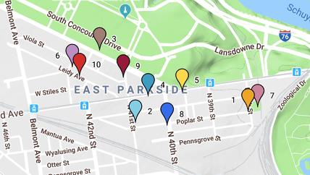

Slide 28
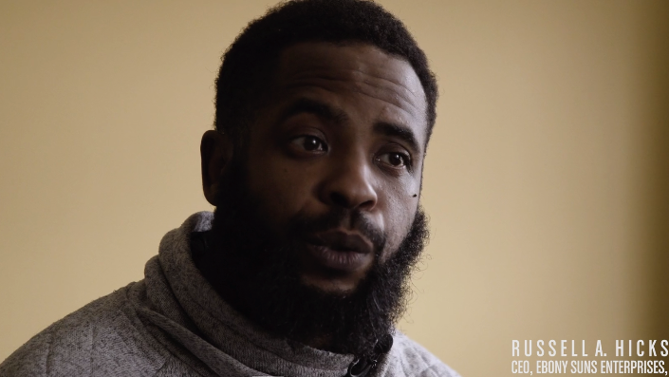

Slide 29
Key Takeaways
Solar energy has the potential to provide cost savings, create jobs, and help Philadelphia to meet its renewable energy goals.
CDCs can leverage solar energy to advance community development goals and serve as the leaders in narrowing the equity gap related to solar energy.
Effective community engagement is critical to implementing solar energy projects in Philadelphia neighborhoods.

Slide 30
Q&A
Laura Rigell
Solar Manager
Philadelphia Energy Authority
lrigell@philaenergy.org
(215) 686-4483
Ky Sanders
Installer and trainer
Solar States, Serenity Soular
kydread@gmail.com
(267) 591-6921 (texts preferred)
Russell Hicks
C.E.O./Owner
Ebony Suns Enterprises, LLC
(267) 872-6636
www.ebonysuns.com
Chris Spahr
Executive Director
Centennial Parkside CDC
cspahr@centennialparkside.org
(267) 225-8356

