Slide 1
Supportive Housing
101
Forward Equitable Development Conference
June 26, 2019

Slide 2
Today’s Agenda
Introductions
What is Quality Supportive Housing?
Supportive Service Overview
Supportive Housing Development & Financing
Q&A
Coordinating Roles

Slide 3
Who is in the Room?
Developers
Service Providers
Finance
Consultants
Legal
Other
Coordinating Roles

Slide 4
Notes:
So exactly how does CSH further supportive housing as a platform for services and healthier communities
Via our 4 lines of business depicted here, CSH offers capital, expertise, information and innovation that allow our partners to use supportive housing to achieve stability, strength and success for the people in most need. ​
Many people know us for our Policy Reform and Training/Education Work but we have expanded to include Lending and Consulting
Lending – ME
Consulting
Federal HUD TA Consultant
City, State and Municipality Consultant
​

Slide 5
CSH Community Investment – Predevelopment & Acquisition Financing
CSH is a source of early-stage financing, taken out at construction
Project Initiation Loans | Acquisition | Predevelopment
Interest: 0% for 24 mos. | Interest: 6% fixed | Interest: 6% fixed
Typical Term: 3 years | Typical Term: 3 years | Typical Term: 3 years
Typical Range: Up to $50k | Typical Range: $150k - $5 million | Typical Range: $150k - $2 million (Up to $500k unsecured)
No Collateral | 130% LTV (not including interest holdback) | 130% LTV (not including interest holdback)
Learn more at https://www.csh.org/csh-solutions/lending-community-investment/
Notes:
- The community investment team has community investment officers across the country
- The CI team provides early stage financing – including funds for pre-development costs and acquisition. CI Officers also work closely with public funding partners to align resources to support development of supportive housing.
- We have a national loan fund as well as multiple local loan funds to help support production in key markets across the country.

Slide 6
CSH Community Investment – New Markets Tax Credits
CSH Recently received an additional $55 million allocation from U.S. Treasury Dept.’s CDFI Fund
CSH uses our New Markets Tax Credit (NMTC) allocations to support the innovative financing of:
  Mixed use projects that include supportive housing
  Non-residential projects like community health facilities that are either co-located with supportive housing or in the community, providing critical services to both our target populations and residents of supportive housing.
Notes:
- The community investment team has community investment officers across the country
- The CI team provides early stage financing – including funds for pre-development costs and acquisition. CI Officers also work closely with public funding partners to align resources to support development of supportive housing.
- We have a national loan fund as well as multiple local loan funds to help support production in key markets across the country.

Slide 7
What Is Quality Supportive Housing?

Slide 8
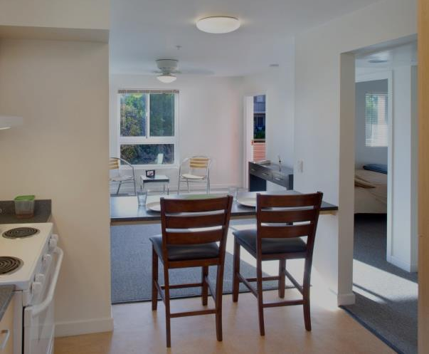
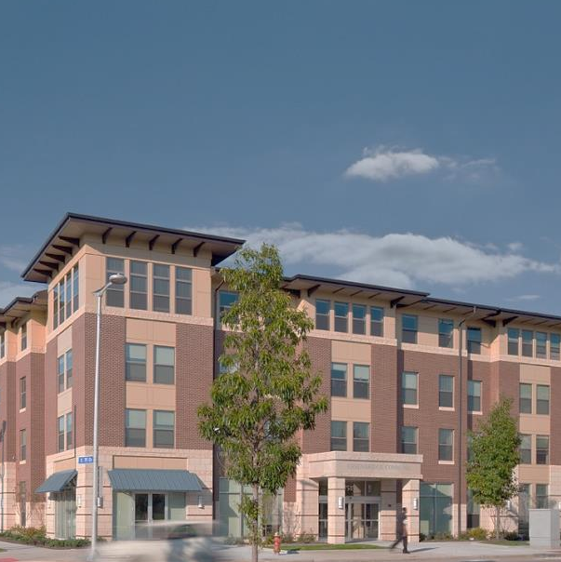
What is Supportive Housing?
Permanent
Affordable
Independent
Tenant-Centered
Flexible
Voluntary
Notes:
SH is a combination of affordable housing and supportive services designed to help vulnerable individuals and families use stable housing as a platform for health, recovery and personal growth. SH is designed for people who, at the time that they’re moving into housing, cannot access housing without the help of services, and can’t participate in services, including health services, without the stability provided by permanent housing.
Is permanent, affordable, independent, tenant-centered, flexible, and voluntary.
SHcombines affordable housing with services that help people who face the most complex challenges to live with stability, autonomy, and dignity.
In SH, supportive services providers actively engage tenants in flexible, voluntary and comprehensive services, work with property and housing management to support tenant stability, and ensure that the housing remains a positive community asset for the long-term.

Slide 9
Why
Supportive Housing?
Cost-Effective
Beneficial
Successful
Notes:
It’s Successful: SH improves housing stability, employment, mental and physical health, and school attendance; and reduces active substance use. People in SH live more stable and productive lives.
It’s Cost-Effective: SH costs essentially the same amount as keeping people homeless and stuck in the revolving door of high-cost crisis care and emergency housing.
It’s Beneficial: SH helps build strong, healthy communities by improving the safety of neighborhoods, beautifying city blocks with new or rehabilitated properties, and increasing or stabilizing property values over time.

Slide 10
Key Components of Supportive Housing
Provides unit with lease
Housing is affordable
Engages tenants in flexible, voluntary services
Coordinates among key partners
Supports connecting with community
Targets households with multiple barriers
Notes:
Although there are many models of SH in a wide range of geographic locations, all quality SH includes these key components, and we’ll go through each component now so you an become familiar with it.

Slide 11
Key Components of Supportive Housing
Targets Households
with Multiple Barriers
Notes:
Because we know that Supportive housing combines affordable housing with services, we want to make sure that it is targeted effectively to the people who are most in need.

Slide 12
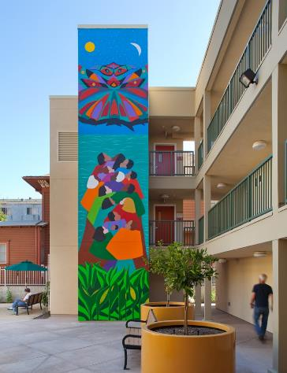





Who is supportive housing for?
Chronically homeless
Cycling through systems
At risk of homelessness
Exiting institutions
Notes:
People who go into SH at this point of their life, need more than the affordability. SH is for people who need services + housing
SH is for people who are highly vulnerable, like those that are chronically homeless. Someone experiencing chronic homelessness has lived on the streets, in his or her car, in a shelter or somewhere not meant to be lived in for an extended period of time.
SH is also an effective intervention for those who cycle through institutions, such as emergency rooms, psychiatric facilities, jails, and hospitals, for example. In fact, we know that some people who are chronically homeless are those that are cycling through institutions.
It’s really for people who without housing, are not able to secure the treatment and supportive services available to them. Because SH provides the stability that we hope everyone can have, somewhere where they can call home, it allows people to start to access non-emergency services like primary health care, mental health care, public benefits and others.

Slide 13
Key Components of Supportive Housing
Provides unit with a lease
Notes:
Next, let’s discuss a second component. Supportive Housing provides a unit with a lease.

Slide 14
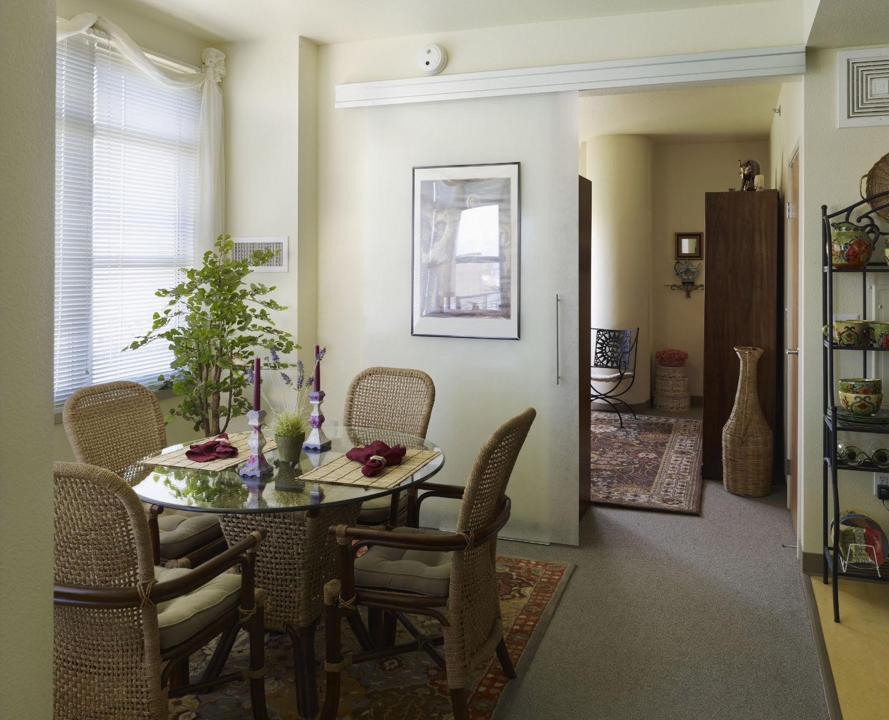
Key Components:Leases in Supportive Housing
Identical to tenants in non-supportive housing.
Tenants have a clear understanding of their rights and responsibilities.
No service participation agreements.
Notes:
Identical to tenants in non-supportive housing - All tenants have a lease or sublease identical to those of tenants who are not in supportive housing. Ideally the term of the lease should be one year.
Tenants have a clear understanding of their rights and responsibilities – Staff walk through the lease agreement with the tenant, clearly explaining their rights and responsibilities. The tenant is given a copy of their lease and they are notified of the process for lease violations and the grievance or appeals procedure. Tenants should also be supported in requesting and obtaining any reasonable accommodations in order to successfully continue their tenancy.
No service participation agreements - Like tenants in other non-supportive housing buildings, tenants should not be evicted for choosing not to participate in services, for not taking medication, or for not being sober. SH strives to prevent eviction, but when it is necessary to evict a tenant, it should only be for a lease violation, such as failure to pay rent. Staff will not remove a tenant from housing without going through the legal eviction process.

Slide 15
Key Components of Supportive Housing
Housing is affordable
Notes:
Next, let’s take a closer look at a 3rd component of supportive housing – housing is affordable.

Slide 16

Key Components of Supportive Housing
Access through Affordability
Whenever possible, adequate financing is secured to allow tenant’s payment for rent and utilities to be no more than 30% of tenant income.
Notes:
Whenever possible, adequate financing is secured to allow tenant’s payment for rent and utilities to be no more than 30% of tenant income. This means that if we’re serving highly vulnerable people who may not have an income, we need to be prepared to cover the full cost of rent. If the tenant does have income and can contribute toward rent, then we need to find funding sources to help make up the difference between what the tenant can pay and what the housing costs.

Slide 17
Key Components of Supportive Housing
Engages tenant in flexible, voluntary services.
Notes:
A 4th component is – supportive housing engages a tenant in flexible, voluntary services.

Slide 18



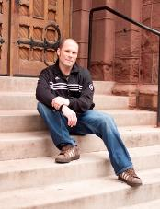
Key Components of Supportive Housing
Why are Services Important?
Services make the difference in helping vulnerable persons obtain and sustain housing.
Services help tenants quickly access housing (first) so that they can use it as a platform for health, recovery, and personal growth.
Notes:
Why are Services Important?
Services make the difference in helping vulnerable persons obtain and sustain housing.
Services help tenants quickly access housing (first) so that they can use it as a platform for health, recovery, and personal growth.

Slide 19







Key Components of Supportive Housing
Supportive Services
Health/Mental Health Services
Child Care
Community Building Activities
Independent Living Skills
Employment Services and Support
Substance Use Recovery and Support
Budgeting and Financial Management Support
Notes:
Here are some examples of services that make the difference in a person being housed versus homeless:
Counseling
Health and mental health services
Child care
Employment services and support
Substance use recovery and support
Independent living skills
Budgeting and financial management support
Community building activities
Services such as these, in combination with a decent place to live, provide the support system people need to break out of the cycle of long-term homelessness.

Slide 20
Key Components of Supportive Housing
The Low Demand Model
Low Demand
High Rate of Housing Stability
Notes:
The key components of a low demand model include:
(1) a simple application process that does not require numerous site visits and excessive documentation
(2) a housing-first approach that does not require sobriety or adherence to a medication regime in order to be housed, and
(3) no conditions of tenancy that exceed the normal conditions under which any leaseholder would be subject, including participation in treatment and other services, abstinence, or money management.
Like any tenant, however, residents of SH are required to pay their rent and can be evicted for destroying property or engaging in activities that would harm other tenants, just like any other tenant.
And what’s most exciting about services in SH is that Medicaid understands the value of services now too, that they are the platform for stable healthy lives for people.

Slide 21
Key Components of Supportive Housing
Coordinates among key partners
Notes:
Next, let’s talk about the 5th component- coordinating among key partners.

Slide 22

Key Components of Supportive Housing
Coordinated Roles
Property/ Housing Management Staff
Supportive Services Providers
Tenants sustain stable housing
Notes:
Coordinated means Property or Housing Management staff work closely with service providers and landlords to ensure tenants sustain stable housing. This sounds kind of obvious but most of the trainings we do are specific to helping property managers work with service providers and tenants, and for service providers to learn how to work with property managers. People are coming with different backgrounds, perspectives and experiences and it requires special skill-sets, dedication, training and documentation to make this relationship successful.

Slide 23
Key Components of Supportive Housing
Supports connecting with community
Notes:
Finally, let’s take a closer look at the 6th and final component – supportive housing supports connecting with the community.

Slide 24








Key Components of Supportive Housing
Community Integration
Notes:
Units are located in within safe neighborhoods with close proximity to:
Transportation
Employment opportunities
Services
Shopping, recreation and socialization.
The housing and its tenants are good neighbors, contributing to meeting community needs and goals whenever possible.

Slide 25
Core Outcomes
A strategy that works for people.
43% Reduction in Number of Nights in Shelter
46% Savings in ER
50% Reduction in Number of Days in County Jail
51% Savings in Ambulance Transportation
Notes:
SH reduced costs:
A 43% reduction in the number of nights spent in shelter by participants in Hennepin County over the course of 22 months.
46% Savings in ER Costs – source for this is an average of over 10 studies that looked at this.
A 50% reduction in the number of days in jail for participants in the New York FUSE program, compared to a comparison group.
51% Savings in Ambulance Transportation - source for this is an average of over 10 studies that looked at this.

Slide 26

Core Outcomes
More than 80% of tenants stay housed for at least one year.
Even when services are voluntary:
81% health care utilization
80% mental health treatment
56% substance abuse services
A strategy that works for people.
Notes:
These figures are from evaluations and studies undertaken in places such as Baltimore, Boston, San Diego, San Francisco, and Hennepin County, Minnesota.
More than 80% of tenants stay housed for at least one year.
Even when services are voluntary: 81% health care utilization, 80% mental health treatment, and 56% substance abuse services.
1 Supportive Housing and Its Impact on the Public Health Crisis of Homelessness, CSH, May 2000
2 Analysis of the Anishinabe Wakaigun, September 1996-March 1998
3 Making a Difference: Interim Status Report of the McKinney Research Demonstration Program for Homeless Mentally Ill Adults, 1994
Closer to Home Initiative
HUD/CDC Housing & Health Study

Slide 27
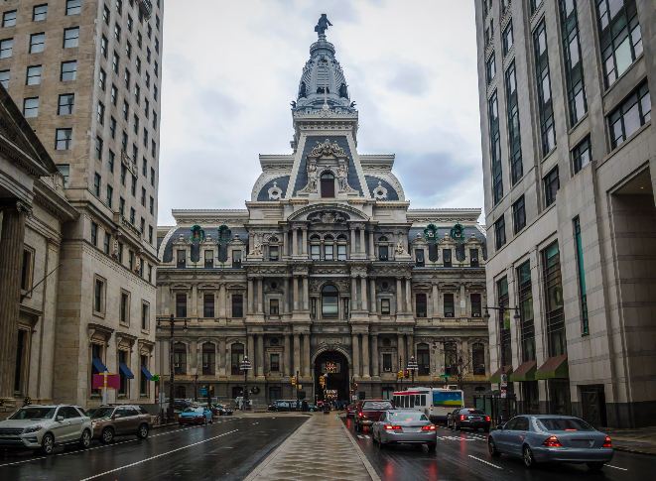



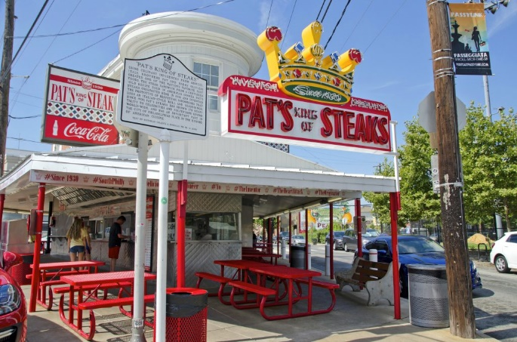
CSH in Philadelphia
Hi-Five
Training and assessment
Investment
CSH
OHS Strategic Plan
Notes:
HI – Five: A Frequent Utilizer Systems Engagement Program
Office of Homeless Services Strategic Plan including needs assessment and focus on data.
Work coming soon: Trainings and Systems Change work to try to de-silo and promote cross systems work. We value the importance of data
Training Center including Property Management Certification

Slide 28
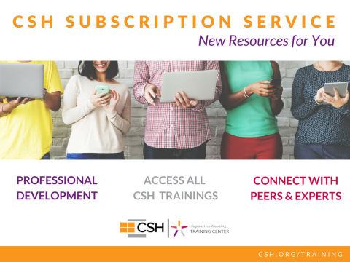
Notes:
The new CSH Subscription Services is complete portal to interaction and knowledge designed to advance professional development
It replaces and upgrades everything covered in the All Access Pass
In addition to extensive and comprehensive trainings on quality supportive housing -- including creation, financing, Medicaid billing and other health and human services partnerships
Our Voluntary Services Track for case managers
Meaningful and timely trainings added throughout the year, including new courses this fall for supportive housing supervisors to improve program operations and support staff management
Access to national learning communities fostering peer exchanges on best practices for bed bug control, addressing hoarding and cluttering, and other challenges faced by property managers
National learning communities for supervisors focused on balancing administrative and clinical responsibilities, creating training plans, and many more important topics
Peer sharing for case managers on engagement content, home visits and advances in the profession
Direct interaction with experts at CSH to support your specific work. (Coordinated Entry experts are on tap for February)
Exclusive previews of CSH reports and other materials

Slide 29
Resources
CSH Supportive Housing Dimensions of Quality
http://www.csh.org/quality
Not a Solo Act
http://www.csh.org/resources/not-a-solo-act/
Integrating Property Management & Supportive Services:
www.csh.org/wp-content/uploads/2011/12/Tool_PropertyMgmtManual.pdf
CSH PHA Toolkit: An online technical assistance resource for Public Housing Authorities and their partners who want to end homelessness.
www.csh.org/phatoolkit

Slide 30


Slide 31

Permanent Supportive Housing (PSH)
Service
Overview
Lisa Quintana MS CPRP
PSH Program Director

Slide 32





PROVIDERS
House Horizon
Merakey
Project HOME
RHD
JEVS ( in development)

Slide 33

INCEPTION
PSH started in 2012 with Mobile Psychiatric services and CPS services
Closing of Residential Services (CRRs, CLAs, etc)
Three pilot agencies (HH, Merakey (Formally NHS), and RHD)
Two additional Residential agencies (Project HOME and JEVS) were added
PSH agencies were charged with supporting individuals with developing their skill set

Slide 34

MISSION
  To help persons with long-term psychiatric disabilities increase their functioning so that they are successful and satisfied in the environments of their choice, with the least amount of ongoing professional intervention.

Slide 35
  Elements of the Mission
Skill Based: Teaching a skill
Increase independence/functioning
Chosen environment: Living, Learning, Working, Socializing
Supports and Resources
Least amount of professional intervention needed

Slide 36




DOMAINS of Psychiatric Rehabilitation
Living
Learning
Working
Socializing

Slide 37
Roles and Responsibilities
Mobile Psychiatric Rehabilitation Worker (MPRW)/Certified Peer Specialist (CPS )
Attend linkage meetings
Active participation in the meetings
Develop MPR/CPS goals that are different and distinct
Coach and/or Train (show, model, teach how to call the Dr, schedule an appt., travel train, self-advocate)

Slide 38
Cont’d Roles and Responsibilities MPRW/CPS
Flexible hours are available to meet the needs of the participants
Visits based on need and recovery plan
Collaborative Efforts with Case Management and any additional supportive services
Community Integration

Slide 39
Stakeholders
Case Managers (CM)/MPRW/CPS should have monthly contacts w/Tenant Services Coordinators to ensure housing issues are being addressed
MPRW/CPS should be in contact with housing team consistently

Slide 40

COLLABORATIVE EFFORTS
MPRW & CM STAFF
CSS (Community Support Service) Involvement
Weekly Reporting to CSS team with CBH
Initial Authorizations
Monthly Provider Meetings w/ CSS

Slide 41
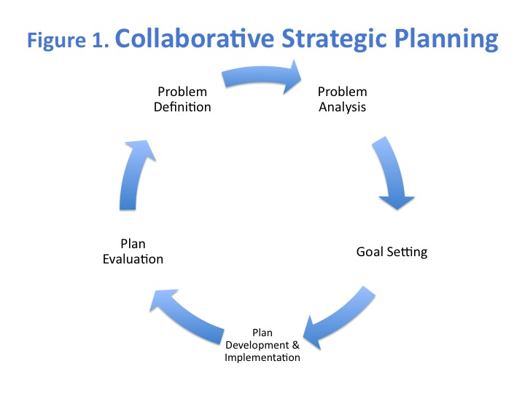

Slide 42

Q & A

Slide 43


Slide 44



MISSION FIRST HOUSING GROUP
Supportive Housing 101
Philadelphia Association of CDCs
2019 Forward Equitable Development Conference
June 2019
missionfirsthousing.org

Slide 45
OUR VISION AND MISSION
Mission First Housing Group’s mission is to develop and manage affordable, safe and sustainable homes for people in need, with a focus on the vulnerable. We ensure our residents have access to resources to help them live independently. We deliver housing that provides long-term benefits to residents and neighborhoods alike.
Based in Philadelphia for nearly 30 years.
PORTFOLIO
Over 3,700 Affordable Housing Units
422 Affordable Housing Units Preserved Since 2012 (326 in Pennsylvania)
3,000 Affordable Housing Unit Pipeline
PEOPLE
Over 5,000 People Housed
Over 1,000 Homeless People Housed
More than 200 Veterans Housed
Over 1,000 Seniors Housed
MISSION FIRST HOUSING GROUP
1260 Housing Development Corporation
Columbus Property Management & Development, Inc.
Mission First Housing Development Corporation
Dover Housing Development Corporation
ACHIEVEability
Making It Possible to End Homelessness
Philadelphia Council for Community Advancement
A full service nonprofit organization that develops and manages multi-family, affordable rental housing for more than 5,000 individuals and families in need in nealy 3,700 units throughout the Mid-Atlantic region from Central New Jersey to Washington, DC.
missionfirsthousing.org
1

Slide 46
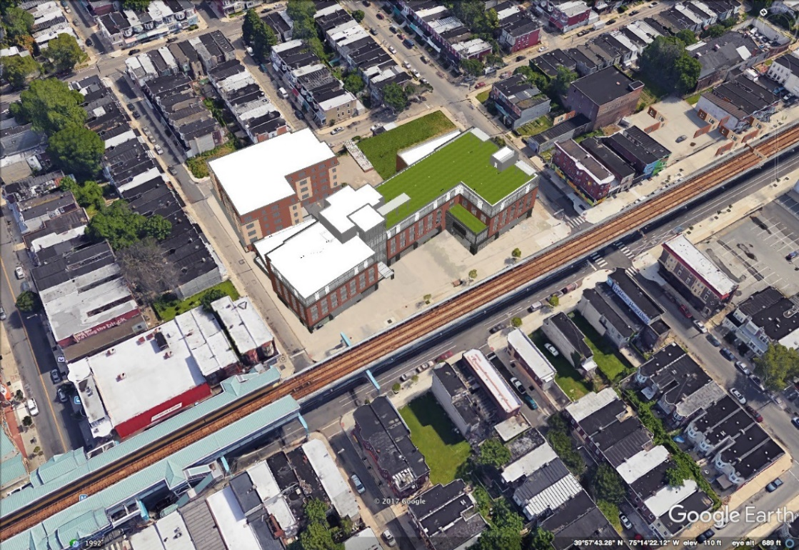
MISSION FIRST’S SUPPORTIVE HOUSING
Contracts with Philadelphia’s Office of Homeless Services and Department of Behavioral Health to provide housing to:
  Previously homeless individuals and families
  Individuals with serious mental illness
Montgomery County of Pennsylvania’s Department of Behavioral Health and Developmental Disabilities
State of Delaware Health and Social Services’ Division of Substance Abuse and Mental Health
The Whitehall, Spring City, Chester County—supportive housing for previously homeless veterans
1700 total supportive housing units
missionfirsthousing.org
2

Slide 47
TYPES OF FUNDING
There are three key types of funding
Capital
Operating
Services
Developers are mainly concerned with capital and operating.
missionfirsthousing.org
3

Slide 48
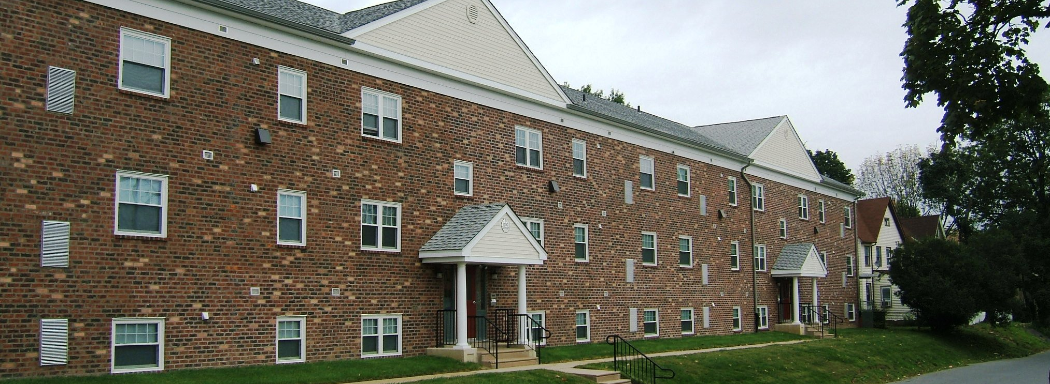
CAPITAL
$$ to buy/build/renovate
Mostly from same sources as “conventional” affordable housing
  Low income housing tax credit equity: set-asides and points for supportive housing
  HOME/CDBG (via municipality): sometimes a special needs “pot” of funds (i.e., health reinvestment $$, SHP)
  State funds: PHARE, PennHOMES
  Federal Home Loan Bank Affordable Housing Program grants: easier to get for supportive housing projects
missionfirsthousing.org
4

Slide 49
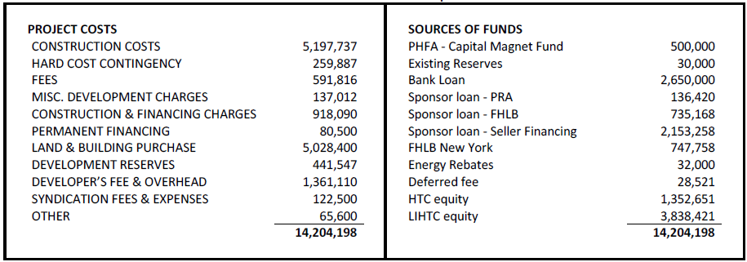
CAPITAL
missionfirsthousing.org
5

Slide 50
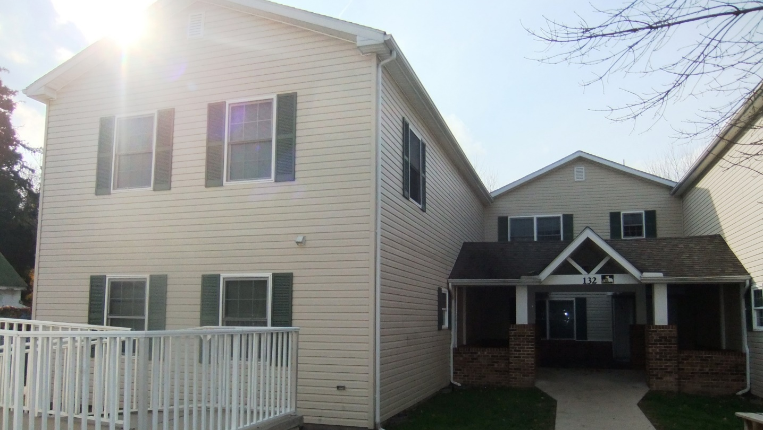
OPERATING
Often supportive housing clients are not able to pay full rent, even if it’s “affordable”
        Philly rent at 50% of area median income:
        one-bedroom $845 two-bedroom $1013
Sources include: Section 8, ACCs, state source of rent subsidy (not PA)
DBH and OHS contract with providers to house people
Older HUD contracts (e.g. Shelter + Care)
missionfirsthousing.org
6

Slide 51
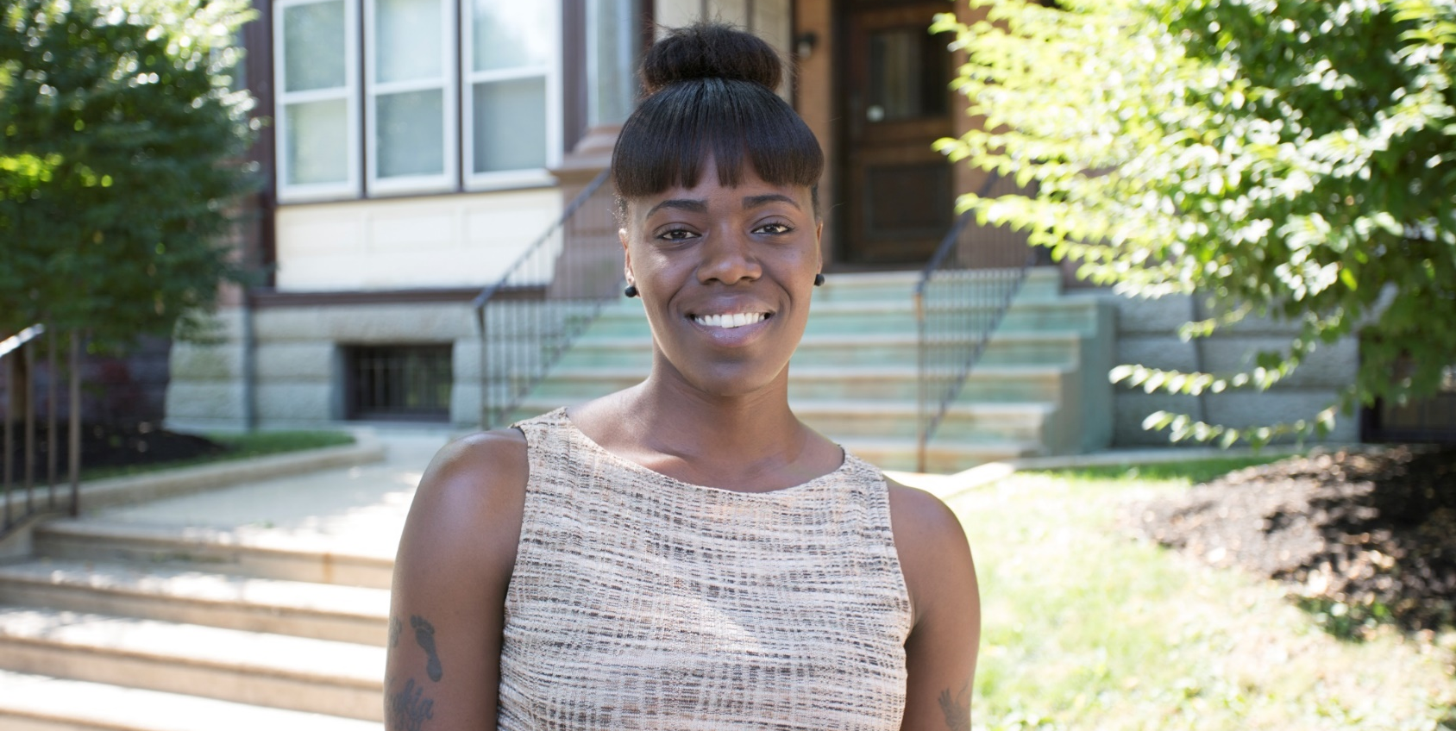
SERVICES
Money is outside the project—three primary types:
  HUD/other contracts to pay for project-based staff (shrinking)
  Funding to service provider who has a relationship with the resident, not the project
  Supportive service escrow for resident services coordination
    In an LIHTC project, take additional developer fee>>generates cash equity>>cash is put into an escrow account and pays the cost of services over 15 years.
missionfirsthousing.org
7

Slide 52
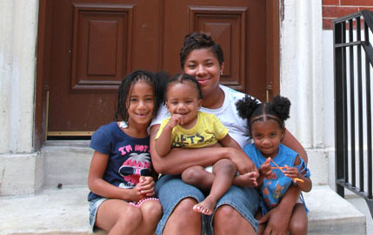
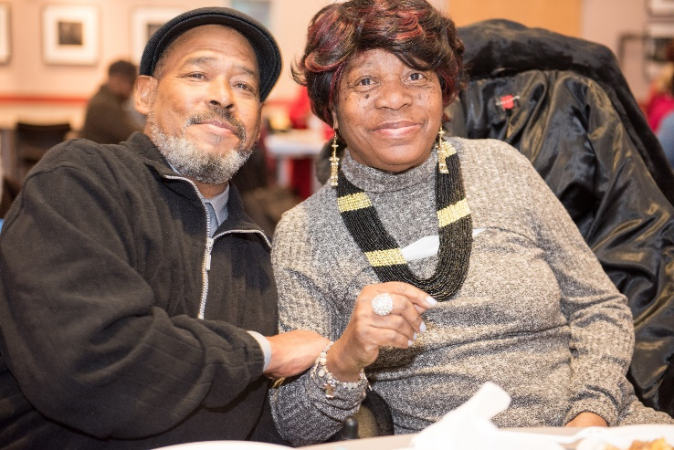

SERVICES
Resident services coordination
  In “conventional” affordable housing
      focus on social activities, workshops, connecting with residents with services like tax prep, utility support, financial counseling
  In supportive housing
      also includes liaison with residents’ case managers
missionfirsthousing.org
8

Slide 53
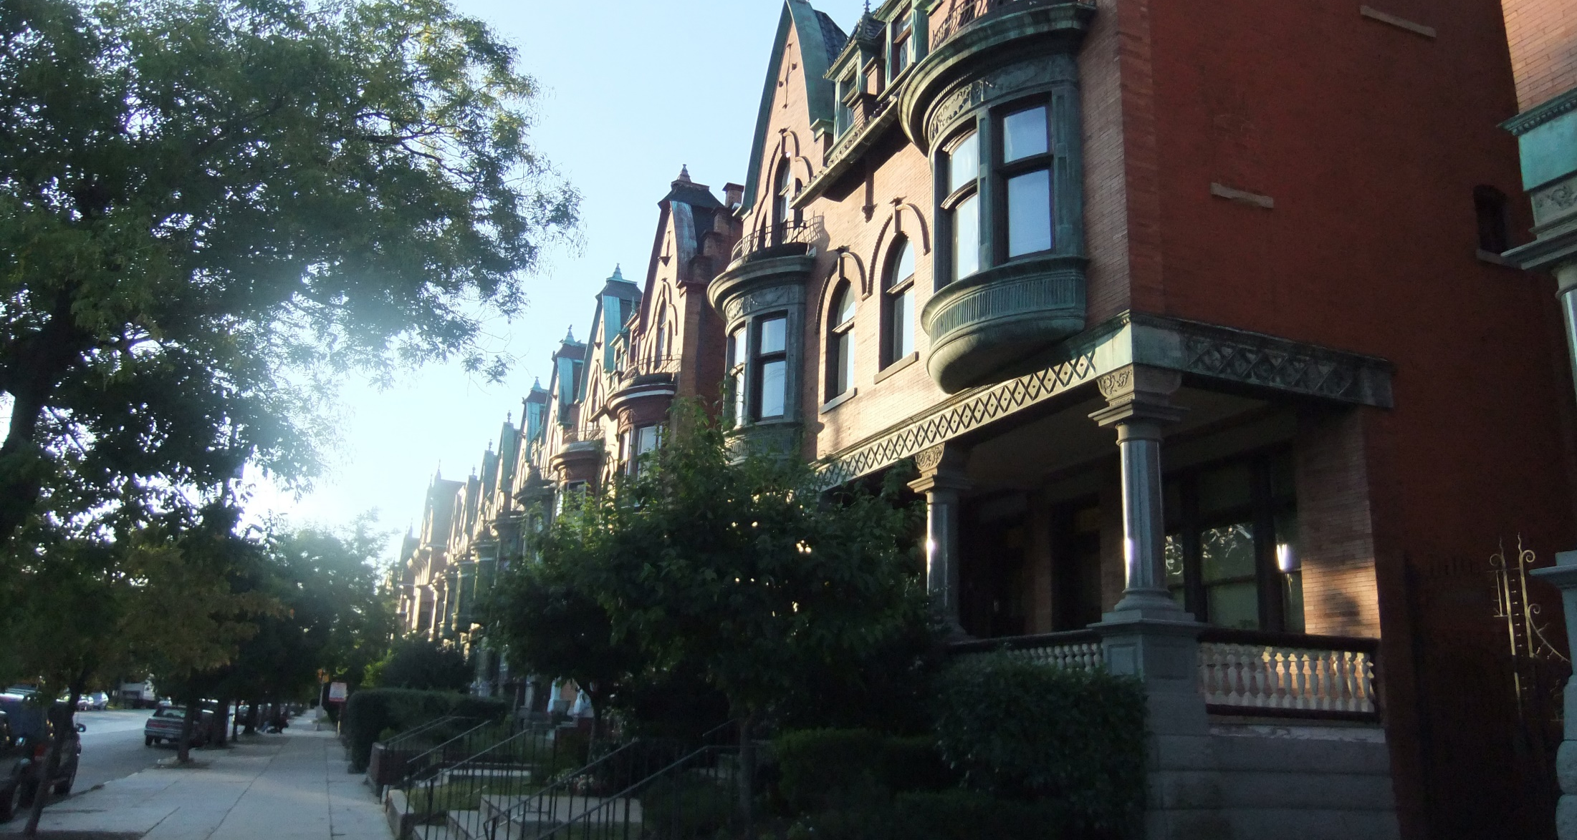
PARKSIDE PRESERVATION
82 apartments in 13 buildings in Philadelphia’s Parkside neighborhood
Mix of mainstream and supportive housing residents
Clients served by various providers
Rent support includes both Section 8 and DBH contracts
missionfirsthousing.org
9

Slide 54
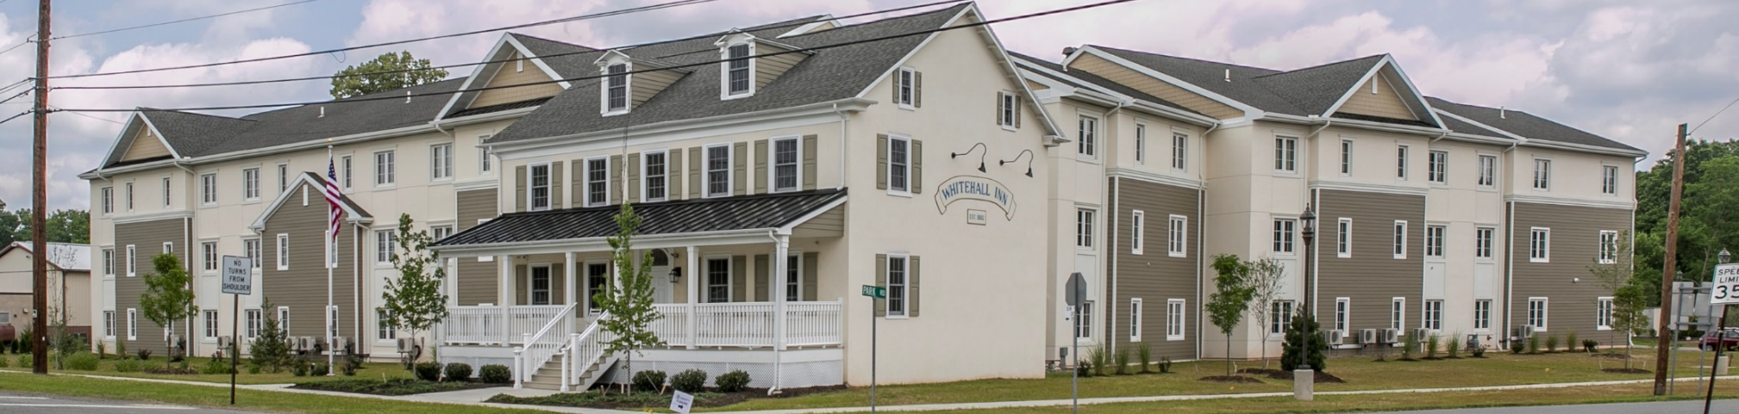
THE WHITEHALL APARTMENTS
Integrated Supportive Housing: Mission First’s partnership with the Housing Authority and Coatesville VA Medical Center integrates supportive housing for veterans into the local community.
New Construction: 49 units of affordable housing
    40 1-bedroom units
    3 2-bedroom units
    5 3-bedroom “suite” units
    1 on-site manager unit
Awarded 35 HUD-VASH Vouchers; preference for Veterans in all units
Building amenities: community room, computer room, laundry room, on-site support service, fitness room and management office
missionfirsthousing.org
10

Slide 55
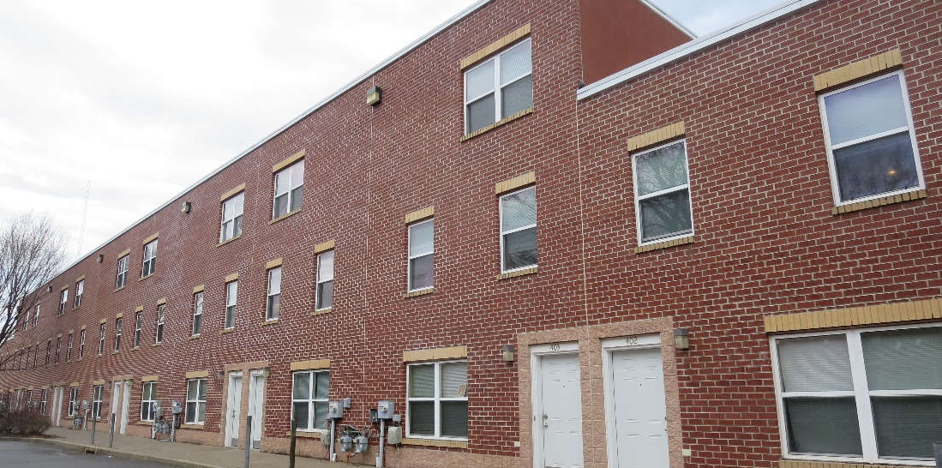
MONUMENT MEWS
60 apartments
Partnership with Methodist Services
Located on Methodist Services’ campus in West Philadelphia
30 mental health clients (services via various providers)
30 homeless families (services from Methodist Services)
missionfirsthousing.org
11

